Slide 1
Predicting Bluefin Tuna Spawning in the Gulf of Mexico using Polar Orbiter Imagery
Alexandra Ender
Sarah Privoznik
Estrella Malca
13 February 2015

Slide 2
Atlantic Bluefin Tuna Ecology
Native range
Spawning migration
  Gulf of Mexico
  Ideal conditions
    Temperature: 24-27°C (297-300K)
    Low chlorophyll (<0.16mg/m³)
    Shelf break & edge of ocean features

Slide 3
Objective & Data
To predict favorable habitat regions for bluefin tuna spawning in the Gulf of Mexico
VIIRS satellite imagery
  Sea surface temperature
    Bands 15 (10.7µm) and 16 (12µm)
    Band math equation: M15 + (M15 – M16)
  Ocean color
    Bands M5 (0.67µm), M4 (0.55µm), and M3 (0.48µm)
    True color imagery
    RGB Composite

Slide 4
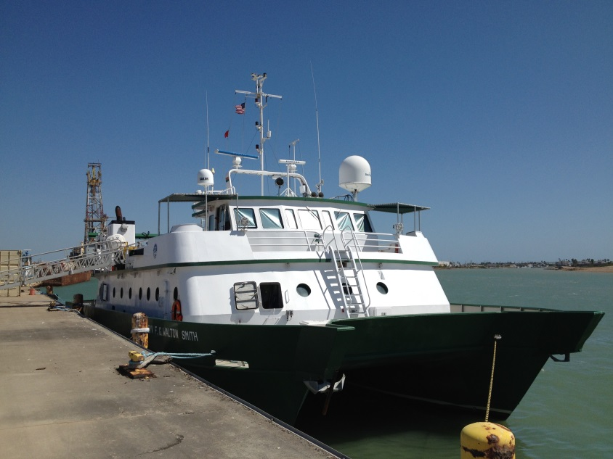
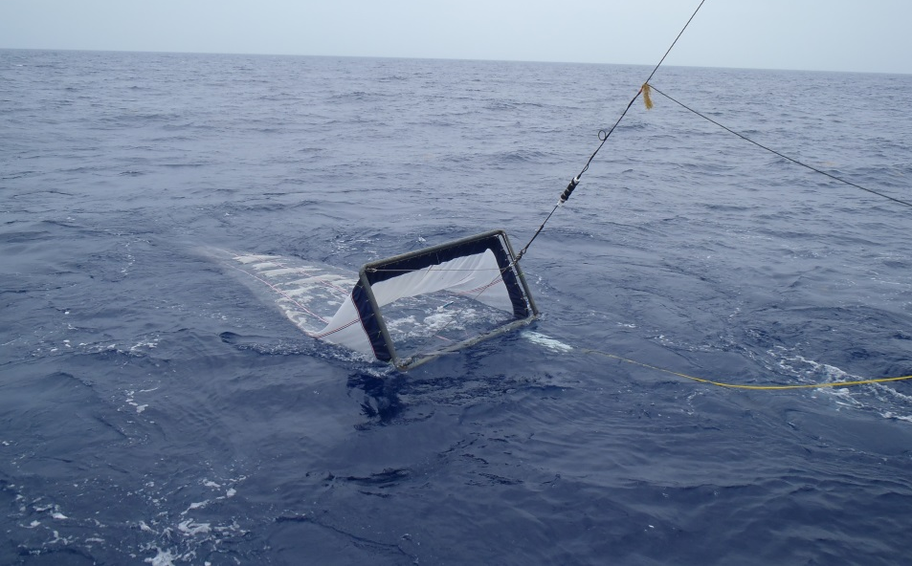
Larval sampling

Slide 5
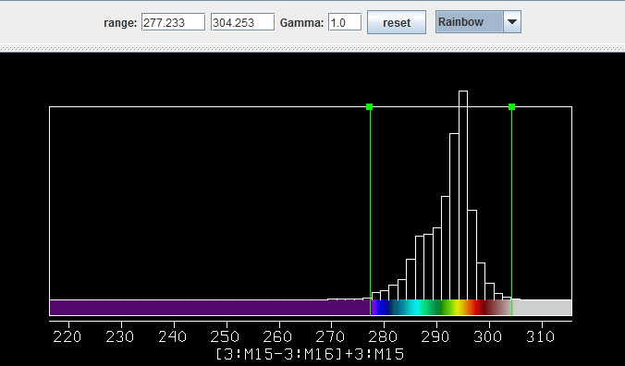
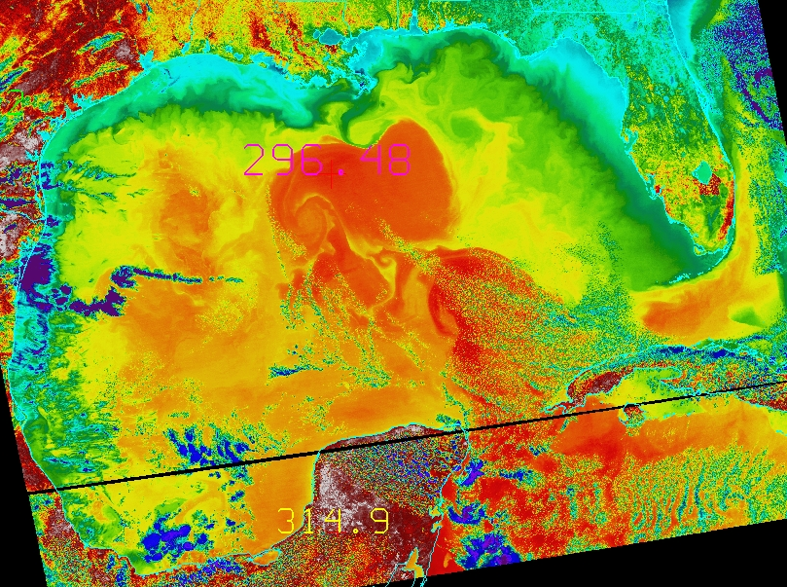
Maximum observed temperature = 296.48K (23.3°C)

Slide 6
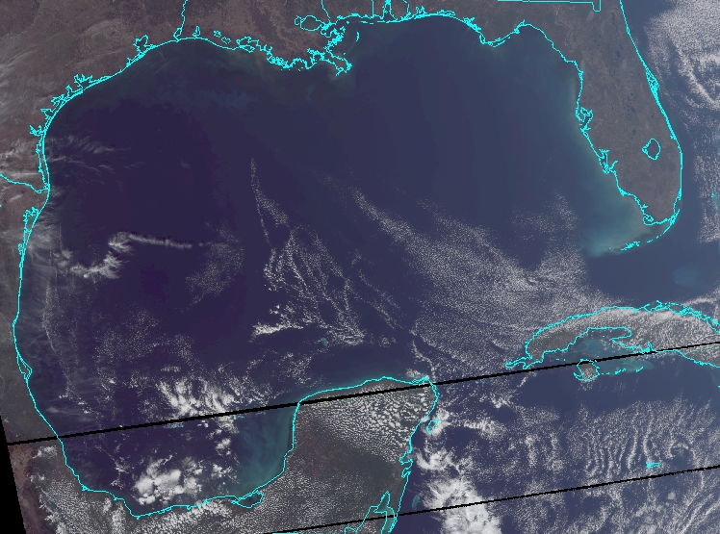

Slide 7
Conclusions
Conditions as of 28 January 2015 are not ideal for spawning
  Temperature not warm enough
  Chlorophyll levels would not inhibit spawning
Adult fish are probably starting to arrive to region
Spawning likely to begin in 2-3 months

Slide 8
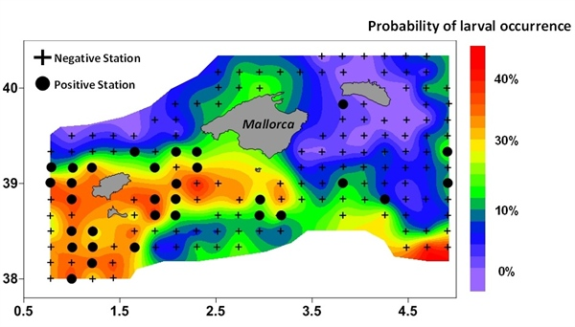
Habitat Model
Mediterranean Bluefin spawning Grounds
Muhling and Nero, in prep
Gulf of Mexico Bluefin spawning Grounds

