Slide 1
Polar Orbiter Product Environmental Applications: Part 3
Kathleen Strabala
Miami Direct Broadcast Polar Orbiter Workshop
Atlantic Oceanographic and Meteorological Laboratory (AOML) of NOAA
11 February 2015

Slide 2
VIIRS
Day/Night Band
Visible wavelength available at night!
  735 m spatial resolution centered at about .7 microns
What can now be seen at night?
  Cities
  Smoke, Dust, Ash
  Low Clouds/Fog
  Fires, Volcanoes (Lava)
  Auroras
  Lightning
How much can be seen depends heavily on lunar illumination – Phase of moon, and rising setting times

Slide 3
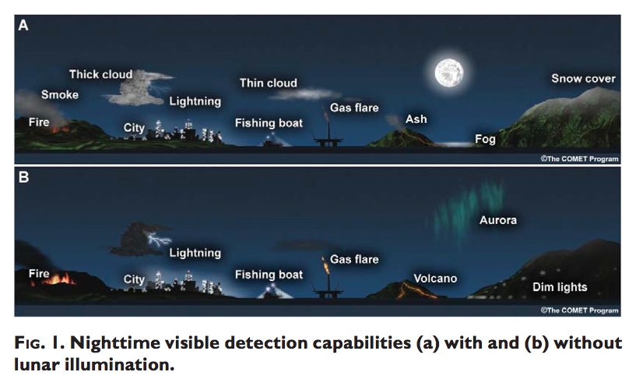
VIIRS Day/Night Band
Taken from: T., Miller, S. D., Turk, F. J., Schueler, C., Jullian, R., Deyo, S., Dills, P., and Wang, S., 2006: The NPOESS VIIRS Day/Night Visible Sensor, Bulletin Am. Met. Society, DOI:10.1175/BAMS-87-2-191, p. 191-199.

Slide 4
Currently Displaying Radiances
Data spans 7 orders of magnitude
We display it in terms of radiance units
  Difficult to model the top of atmosphere incoming radiation from the moon, so no reflectance units as of yet. In progress.

Slide 5
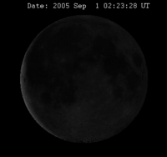
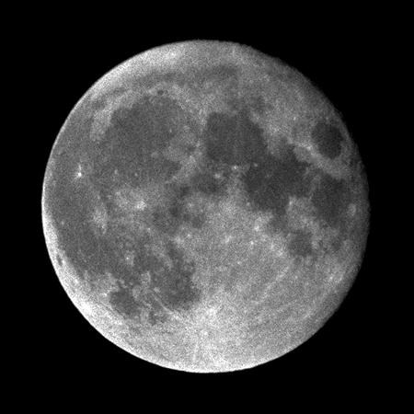
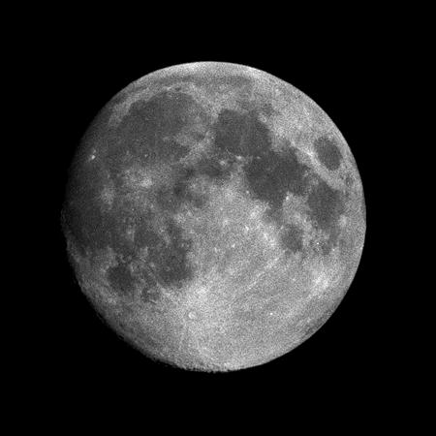
Lunar Reflectance Model
9 Aug 1987 1900 UTC
2 Feb 1988 1600 UTC
Perigee: 357,643 km
Apogee: 406,395 km
Mean Distance = 384,401 km
Notes:
Information from: http://www.fourmilab.ch/earthview/moon_ap_per.html
Moon Radius = 1738 km
Earth Radius 6378.14 km
The Moon's orbit is inclined 5.145396° with regard to the ecliptic (the plane in which the Earth's orbit around the Sun lies or, more precisely, the plane in which the centre of gravity of the Earth-Moon system [its barycentre] orbits the Sun), so as seen from the centre of the Earth the Moon drifts up and down slightly more than five degrees in the course of each orbit.
The Moon's orbital inclination, combined with the inclination of the Earth's axis of rotation, causes the Moon's declination, as observed from the Earth, to vary between ±28.5° when the Moon's inclination adds to that of the Earth, and ±18° when the two inclinations oppose one another; the maxima and minima of declination repeat every 18.6 years, the period in which the ascending node of the Moon's orbit precesses through a full circle. (Recall Earth’s own declination is about 23.5 degrees)
The combination of the eccentricity and inclination of the Moon's orbit causes the Moon, as seen from the Earth, to nod up and down and left and right. These apparent motions, the lunar librations, allow us to observe, over a period of time, more than 59% of the Moon's surface from the Earth, albeit with the terrain in the libration zones near the edge of the visible disc, only very obliquely.
The intensity of light varies as the inverse square of the distance between a light source and the observer, so taking the ratio between the perigee and apogee distances in the photographs above as typical, the distance at apogee was 1.1363 times the perigee distance, and hence the Moon's intensity at perigee was the square of this quantity, 1.2912 times brighter—about 30%.

Slide 6
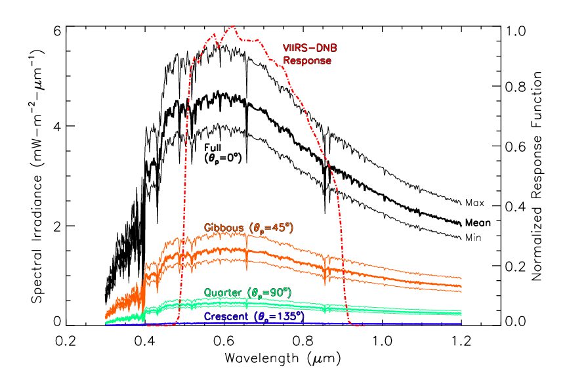
Lunar Reflectance Model
9 Aug 1987 1900 UTC
2 Feb 1988 1600 UTC
Perigee: 357,643 km
Apogee: 406,395 km
Mean Distance = 384,401 km
Notes:
Information from: http://www.fourmilab.ch/earthview/moon_ap_per.html
Moon Radius = 1738 km
Earth Radius 6378.14 km
The Moon's orbit is inclined 5.145396° with regard to the ecliptic (the plane in which the Earth's orbit around the Sun lies or, more precisely, the plane in which the centre of gravity of the Earth-Moon system [its barycentre] orbits the Sun), so as seen from the centre of the Earth the Moon drifts up and down slightly more than five degrees in the course of each orbit.
The Moon's orbital inclination, combined with the inclination of the Earth's axis of rotation, causes the Moon's declination, as observed from the Earth, to vary between ±28.5° when the Moon's inclination adds to that of the Earth, and ±18° when the two inclinations oppose one another; the maxima and minima of declination repeat every 18.6 years, the period in which the ascending node of the Moon's orbit precesses through a full circle. (Recall Earth’s own declination is about 23.5 degrees)
The combination of the eccentricity and inclination of the Moon's orbit causes the Moon, as seen from the Earth, to nod up and down and left and right. These apparent motions, the lunar librations, allow us to observe, over a period of time, more than 59% of the Moon's surface from the Earth, albeit with the terrain in the libration zones near the edge of the visible disc, only very obliquely.
The intensity of light varies as the inverse square of the distance between a light source and the observer, so taking the ratio between the perigee and apogee distances in the photographs above as typical, the distance at apogee was 1.1363 times the perigee distance, and hence the Moon's intensity at perigee was the square of this quantity, 1.2912 times brighter—about 30%.

Slide 7
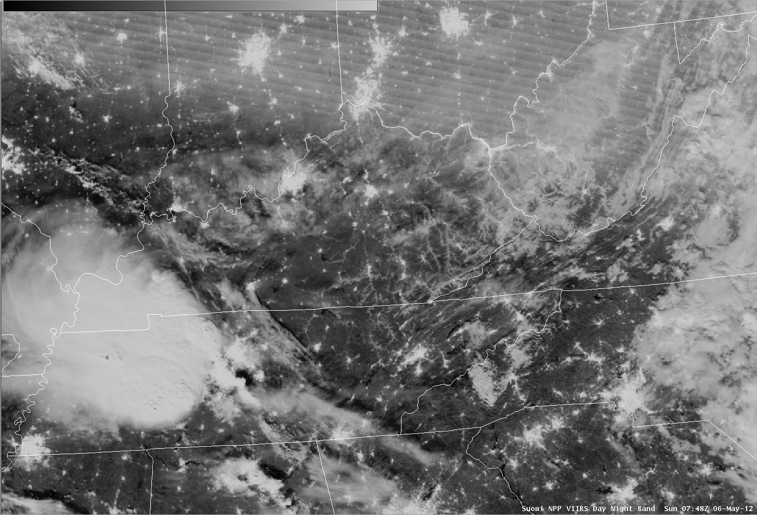
VIIRS Fog Detection Capability
Day/Night Band 6 May 2012

Slide 8
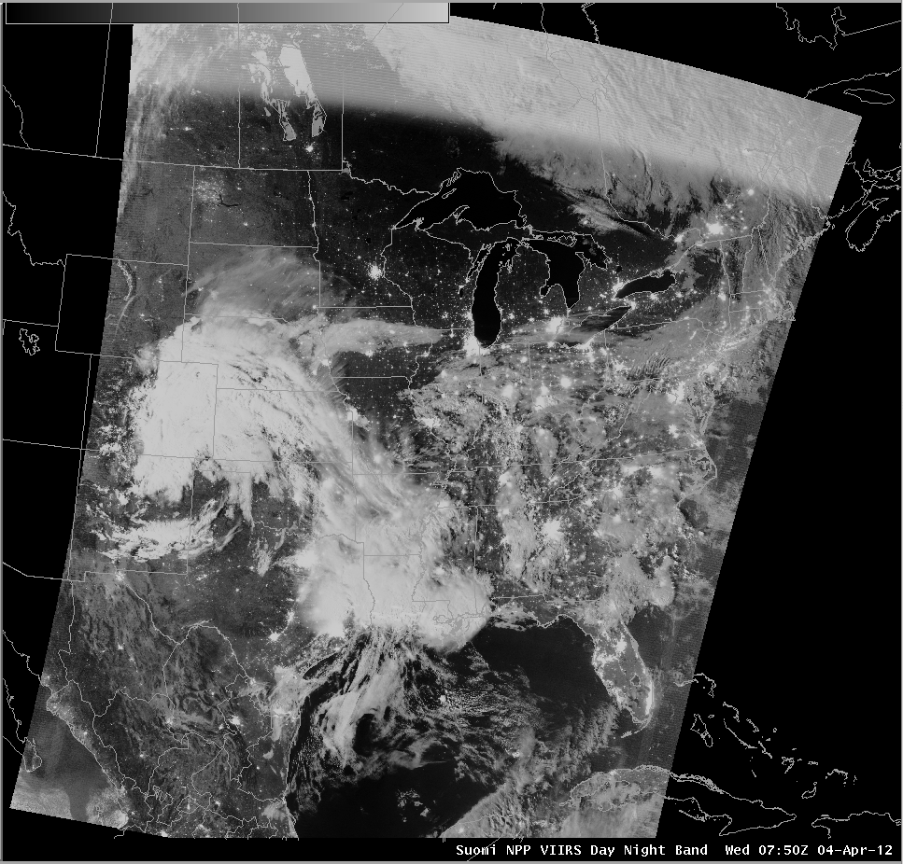
VIIRS in AWIPS Day/Night Band
Lightning Detection 4 April 2012
Lightning streaks
SSEC/CIMSS

Slide 9
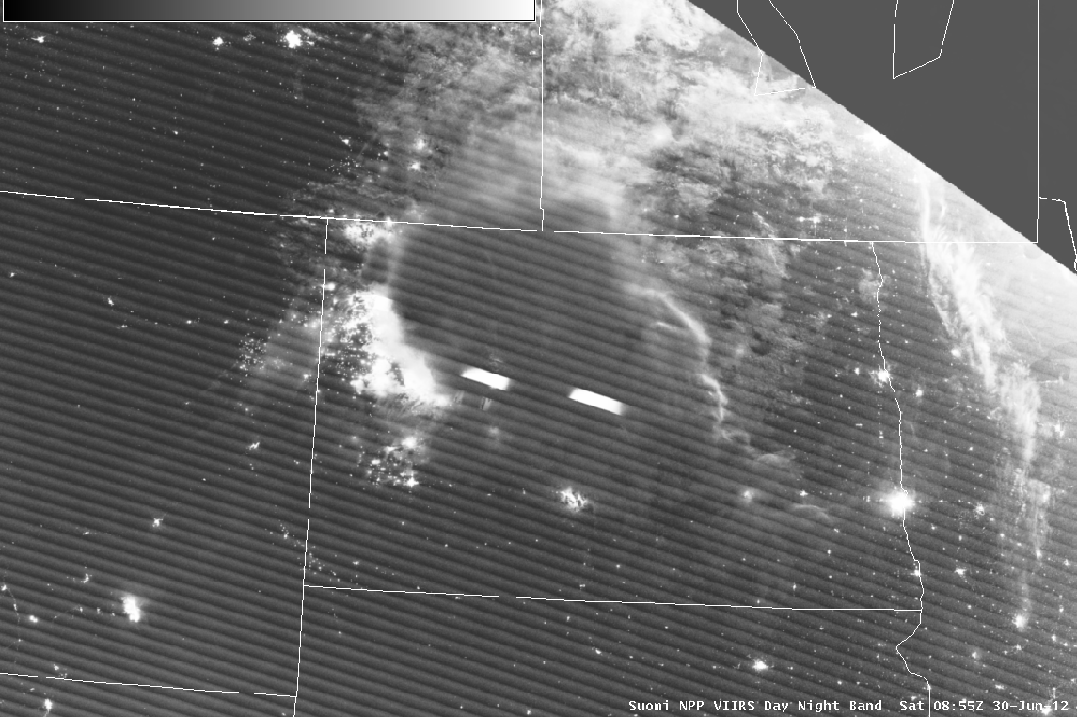
VIIRS in AWIPS Day/Night Band
Lightning Detection 30 June 2012
Side lighting from Sun
Illumination from oil fields
Lightning

Slide 10
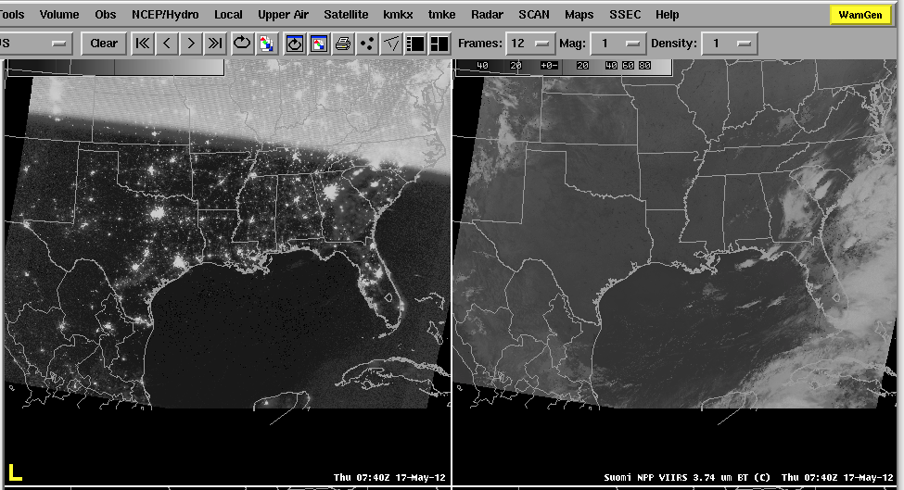
Moon Phase Affects
How Much Can be Seen
Stray light region
Thick Cloud
Thick Cloud
Crescent moon means less illumination making it difficult to identify clouds

Slide 11
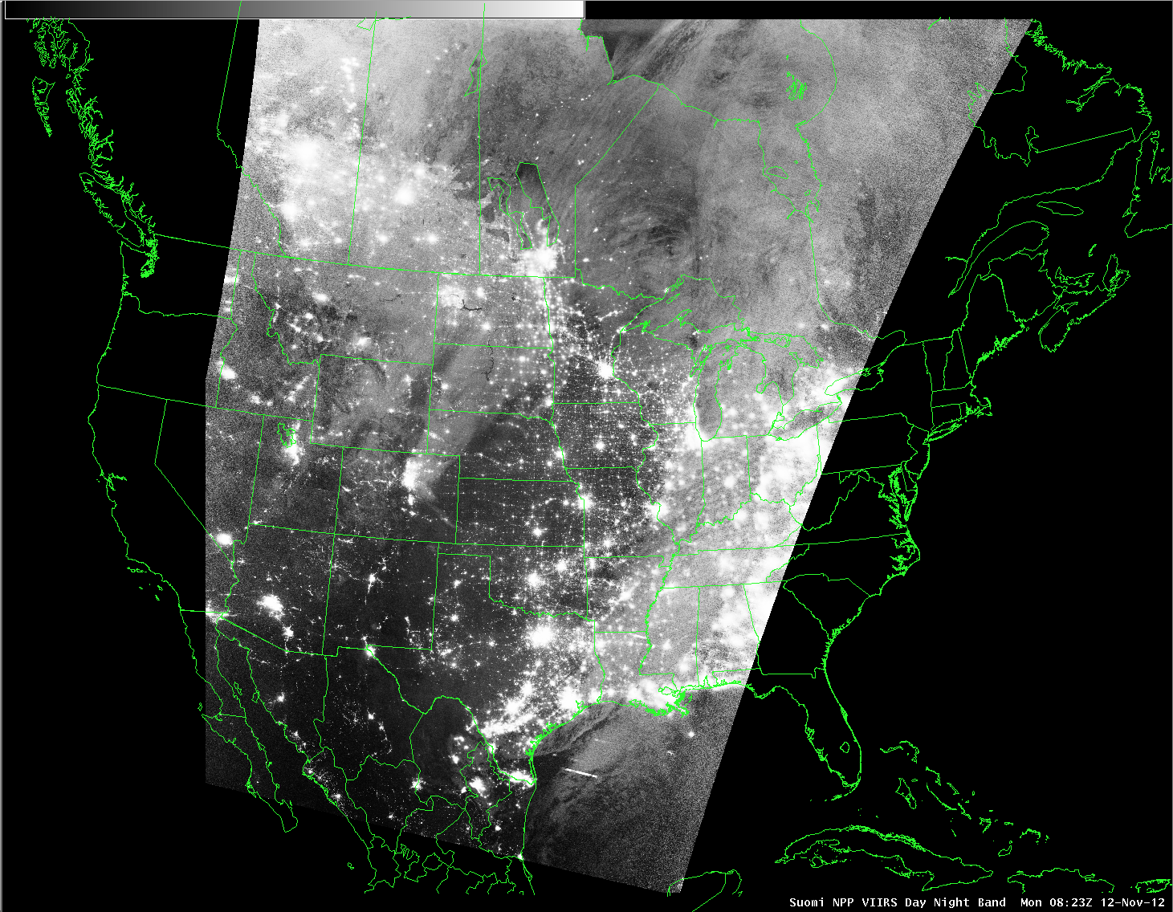
VIIRS Day/Night Band
New Moon

Slide 12
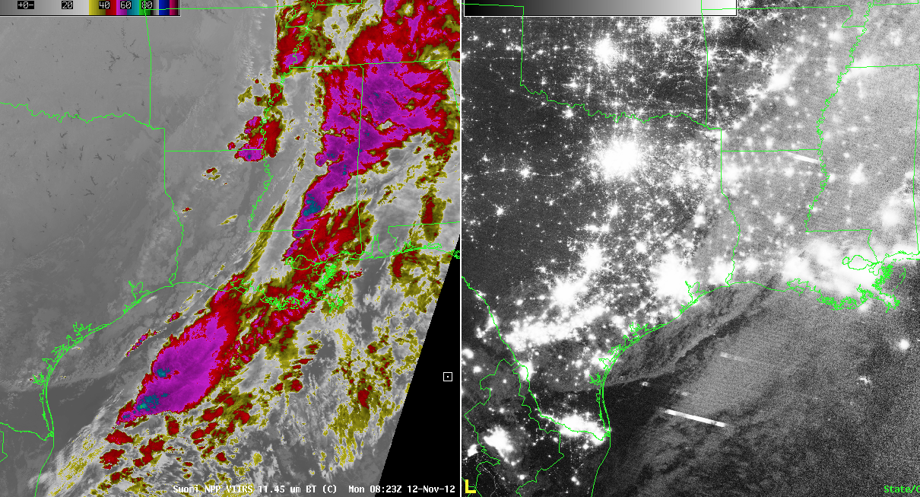
VIIRS Day/Night Band
New Moon

Slide 13
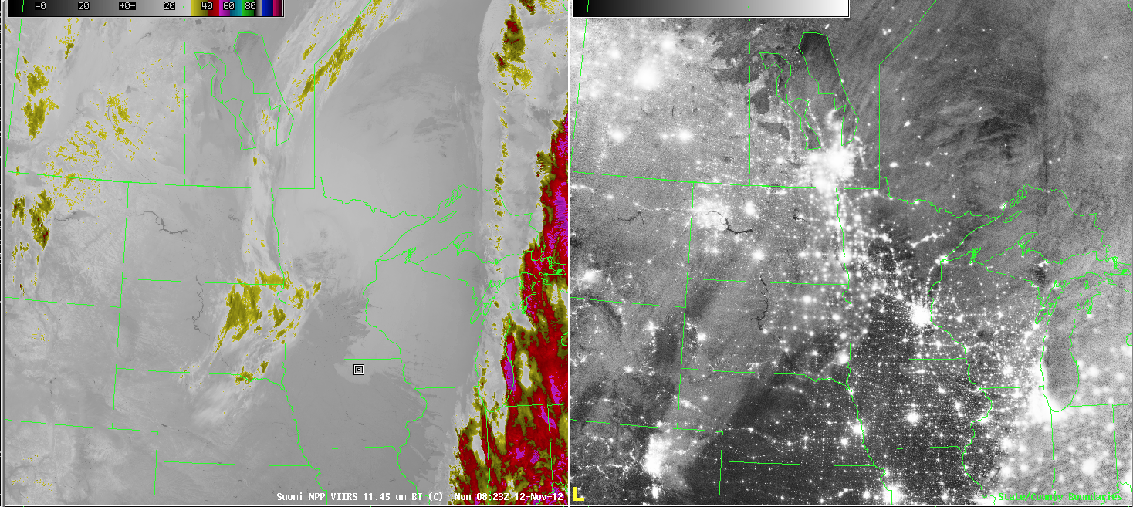
VIIRS Day/Night Band
New Moon

Slide 14
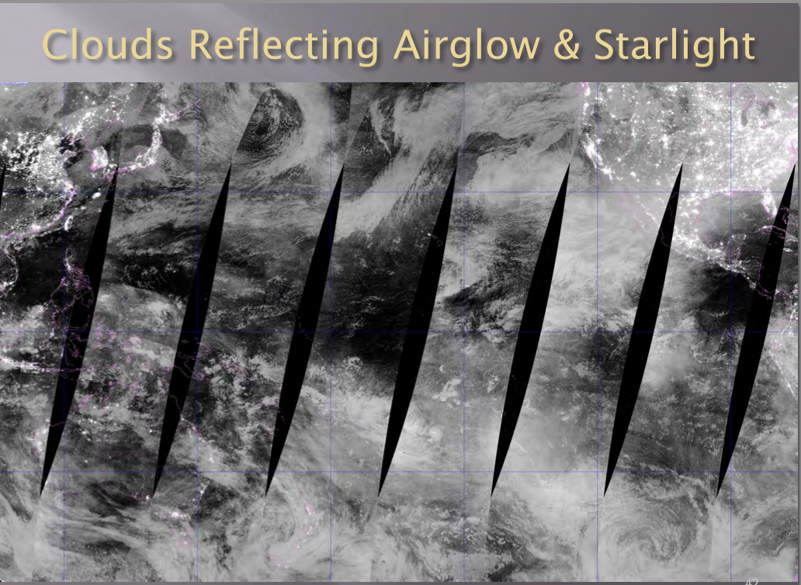

Slide 15
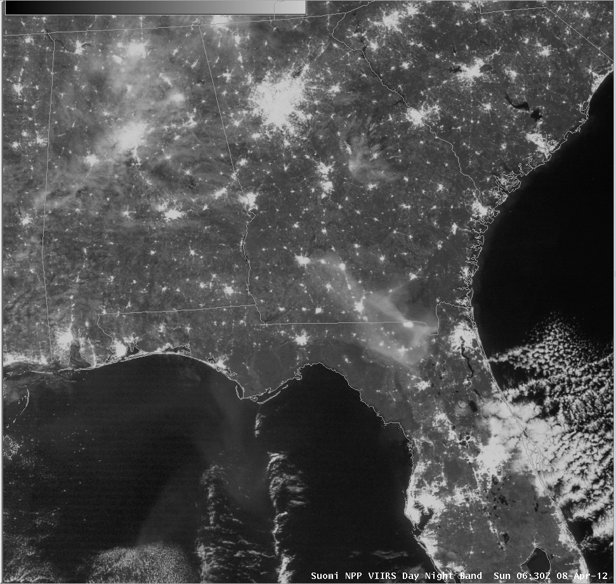
VIIRS in AWIPS Day/Night Band
Smoke Detection 8 April 2012
Smoke from County Line Fire in northern Florida
SSEC/CIMSS

Slide 16
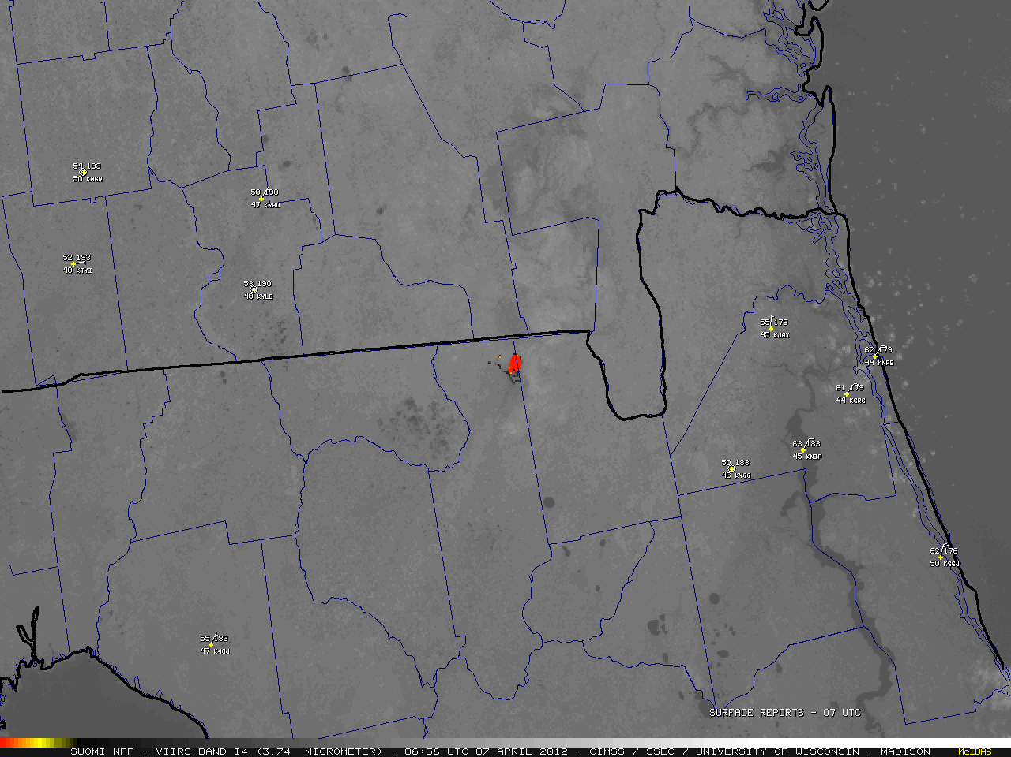

Hot Spot from Florida County Line Fire
7 April 2012 06:58 UTC
Suomi NPP Data VIIRS I4 (4 μm) and IR Window (11 μm)

Slide 17
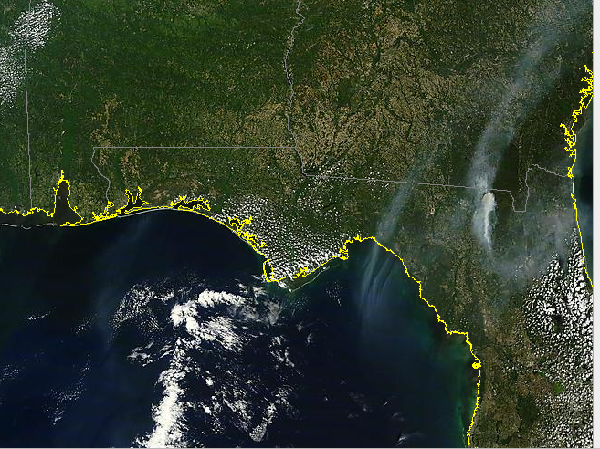
Terra MODIS 8 April 2012 16:15 UTC

Slide 18
Wildfires
VIIRS in AWIPS Fires

Slide 19
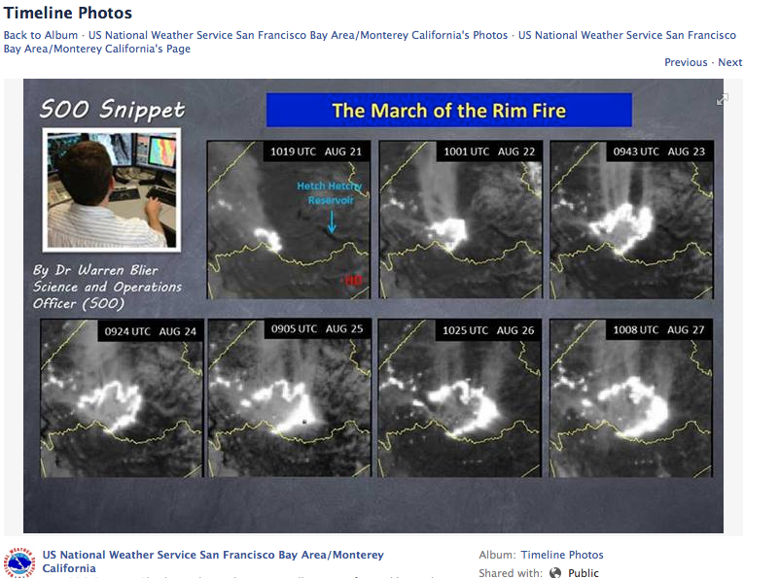

Slide 20
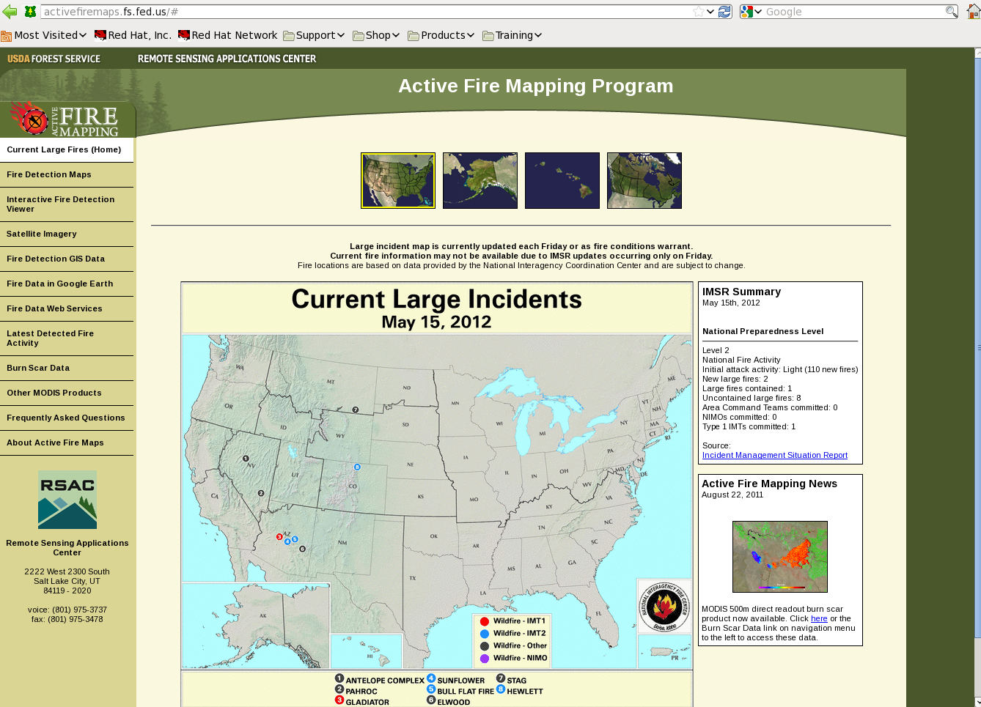
VIIRS in AWIPS Fire Detection Capability 15 May 2012
SSEC/CIMSS

Slide 21
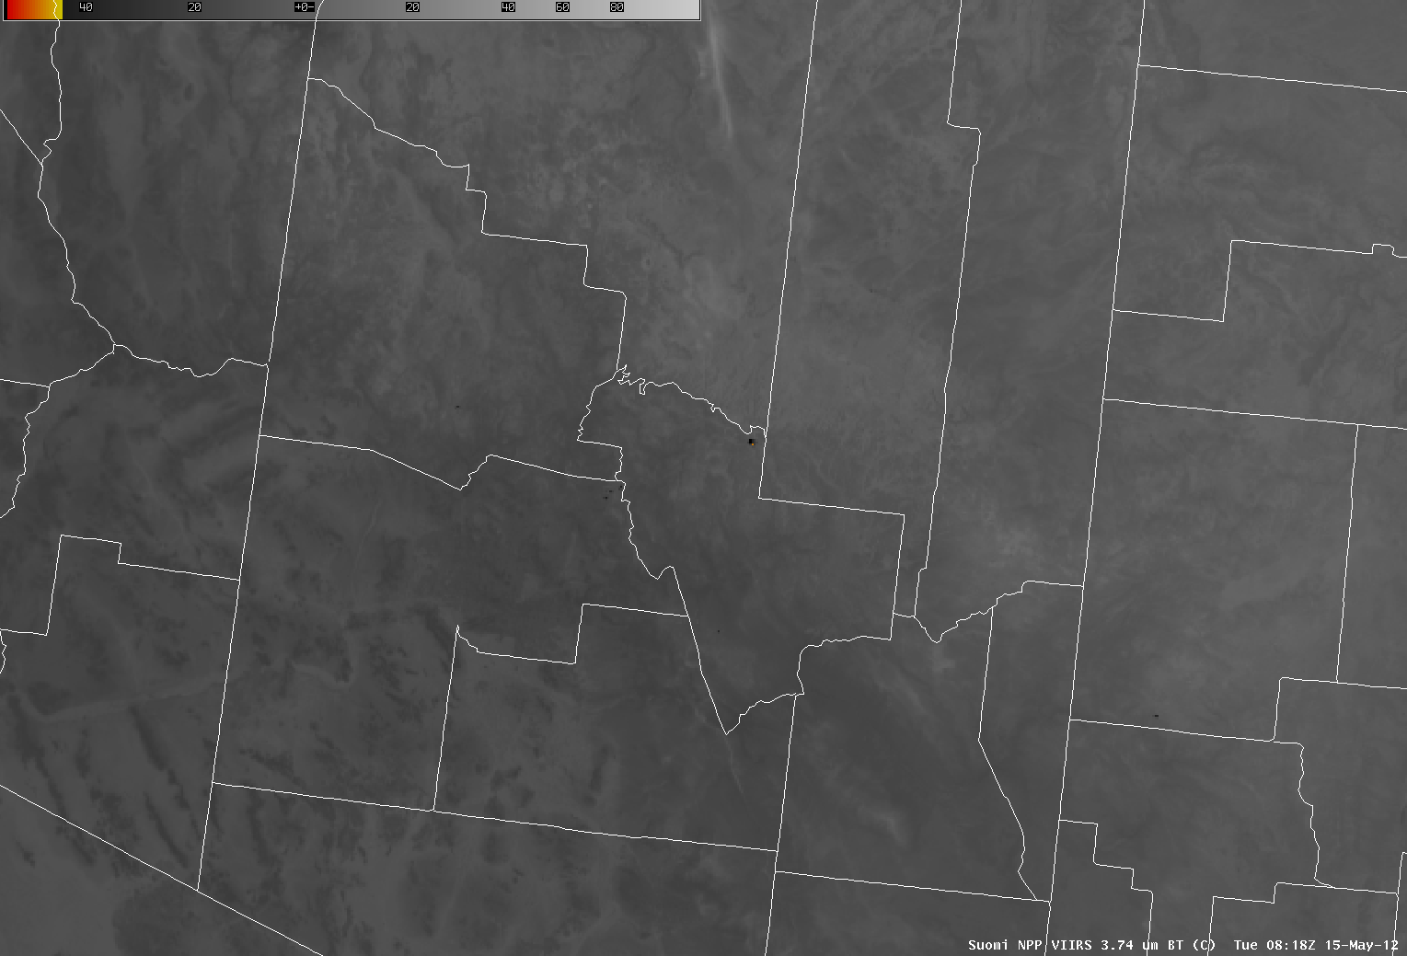
VIIRS in AWIPS Fire Detection Capability 15 May 2012
Bull Flat Fire
Sunflower Fire
SSEC/CIMSS
Notes:
Bull Flat = 48.1C, Sunflower = 44.5

Slide 22
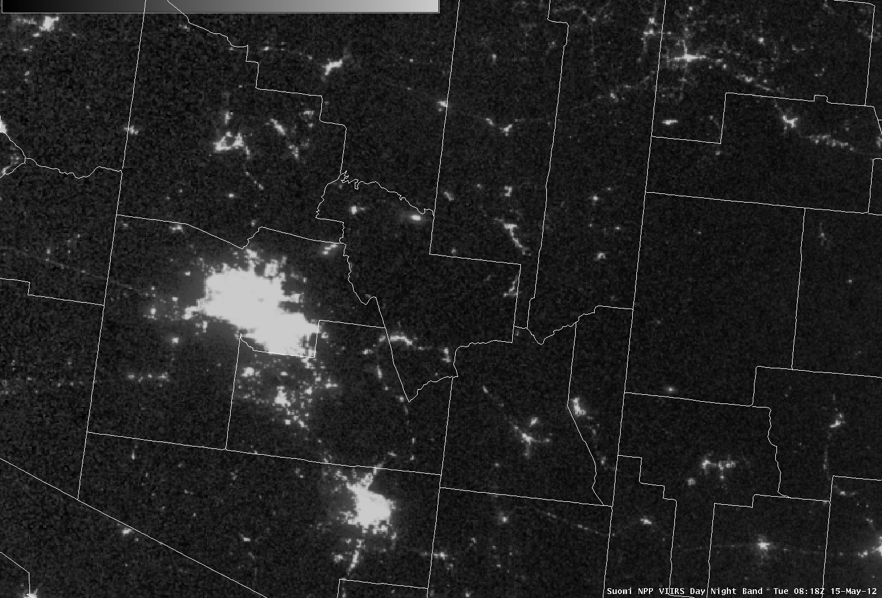
VIIRS in AWIPS Fire Detection Capability 15 May 2012
Bull Flat Fire
Sunflower Fire
Phoenix
SSEC/CIMSS

Slide 23
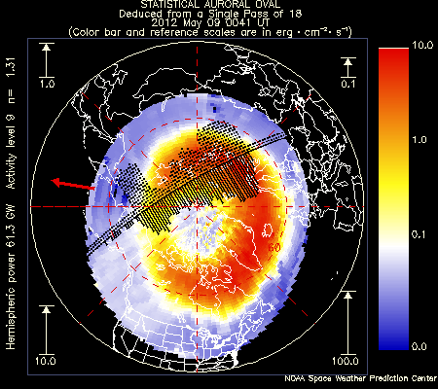
Auroral Oval
9 May 2012

Slide 24
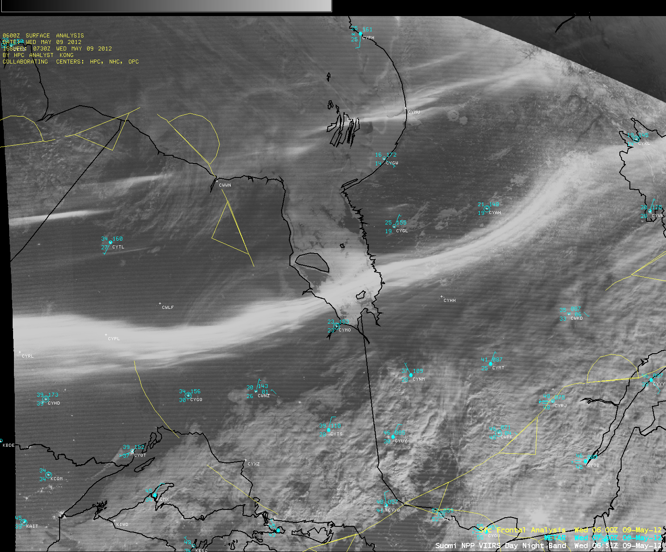

VIIRS in AWIPS Observing
Auroras 9 May 2012

Slide 25
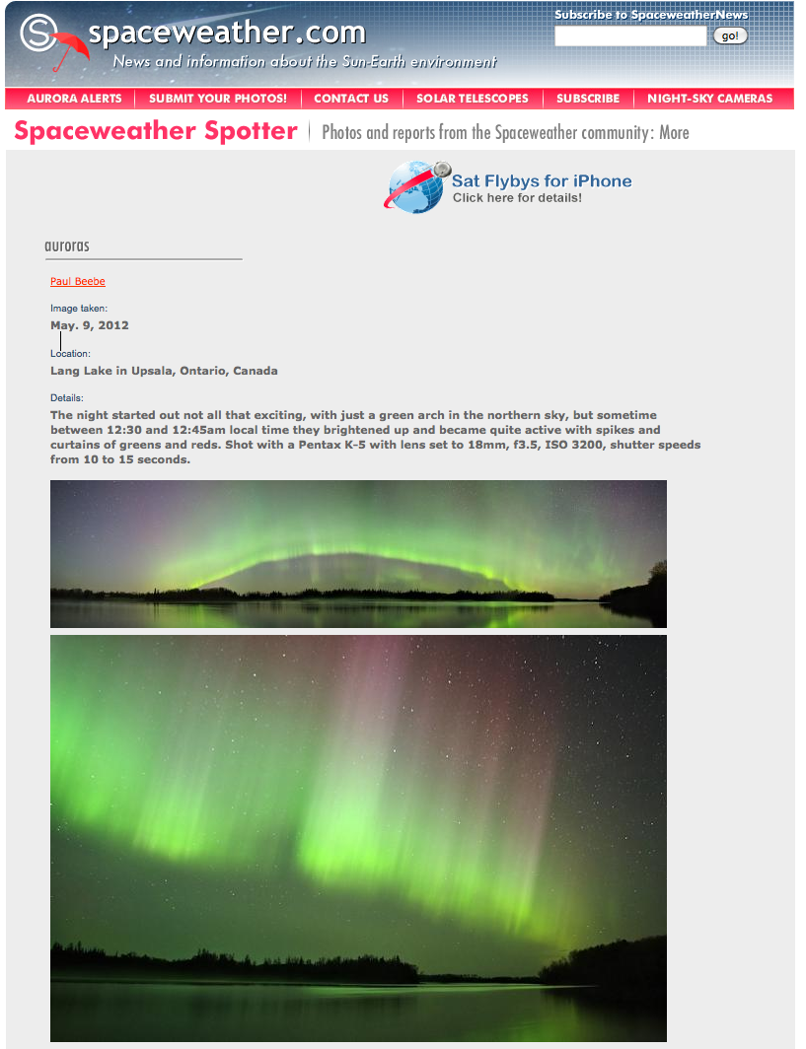

Slide 26
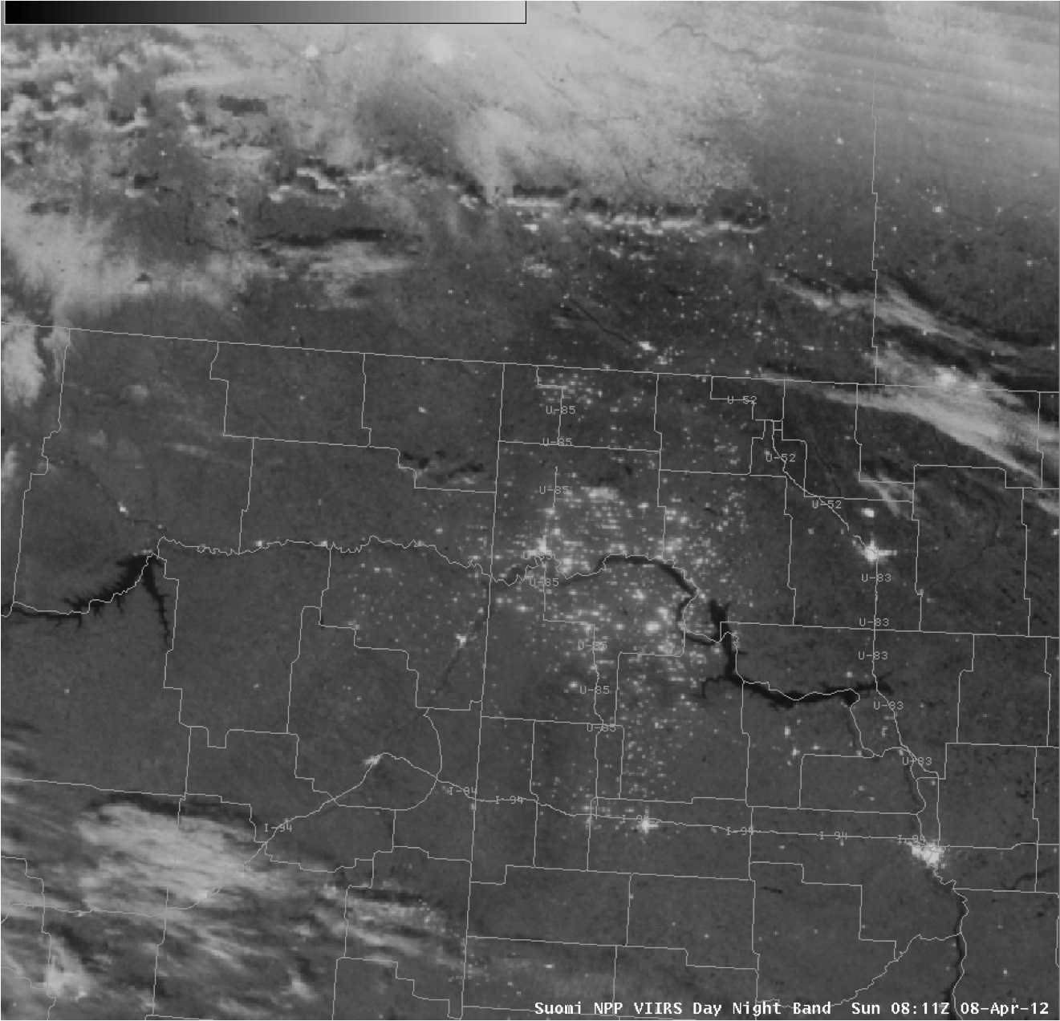
VIIRS in AWIPS Day/Night Band
Mining Operations 8 April 2012
Another example of a Day/Night Band image from 08 April 2012 revealed a large number of natural gas flares and illuminated “man camps” associated with extensive drilling operations in the Bakken Shale Oil Field area of eastern Montana and western North Dakota.

Slide 27
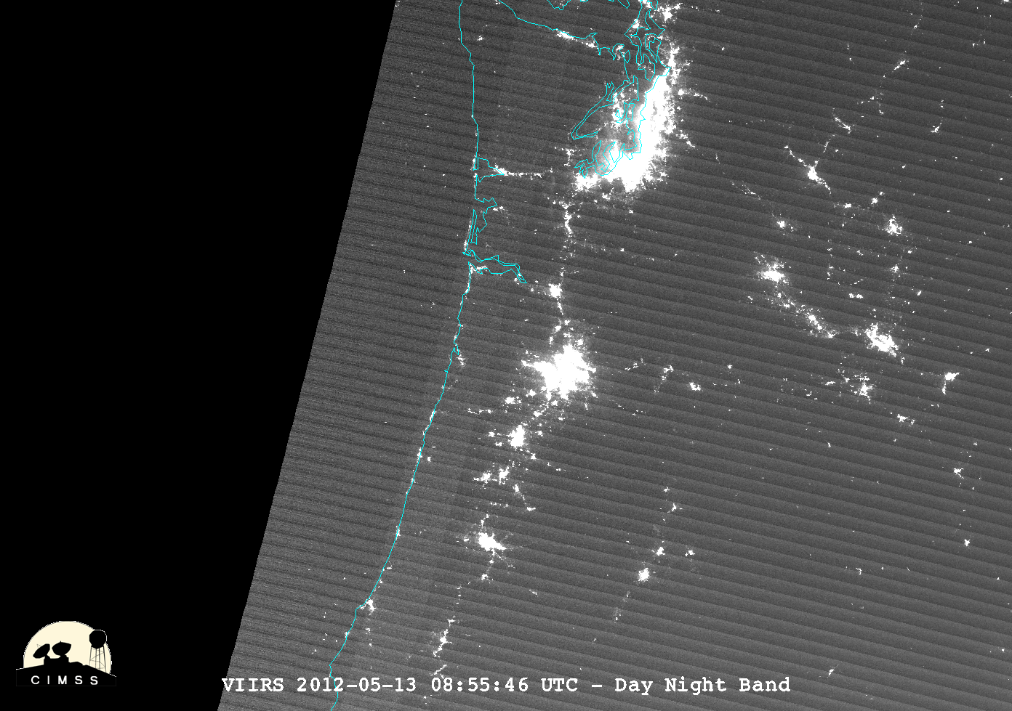
Examples Ships
Seattle
Ships

Slide 28
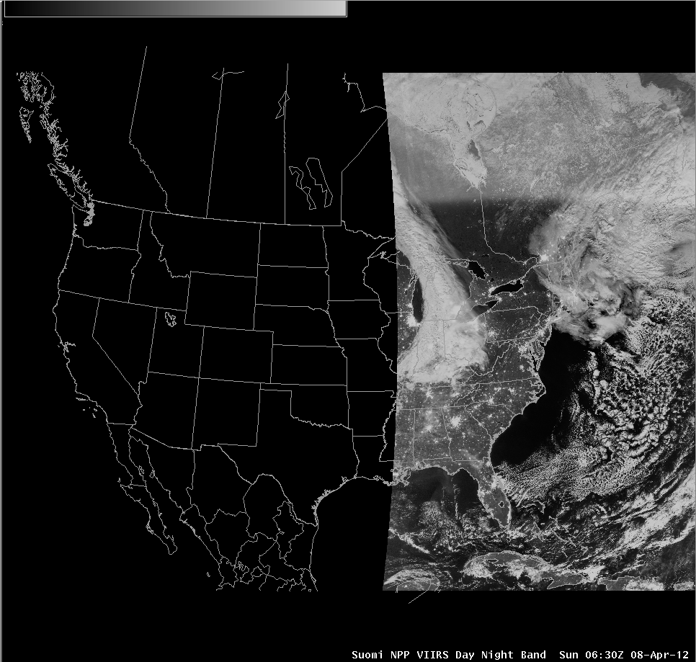
Examples- Sea ice
Ice covered
Hudson Bay

Slide 29
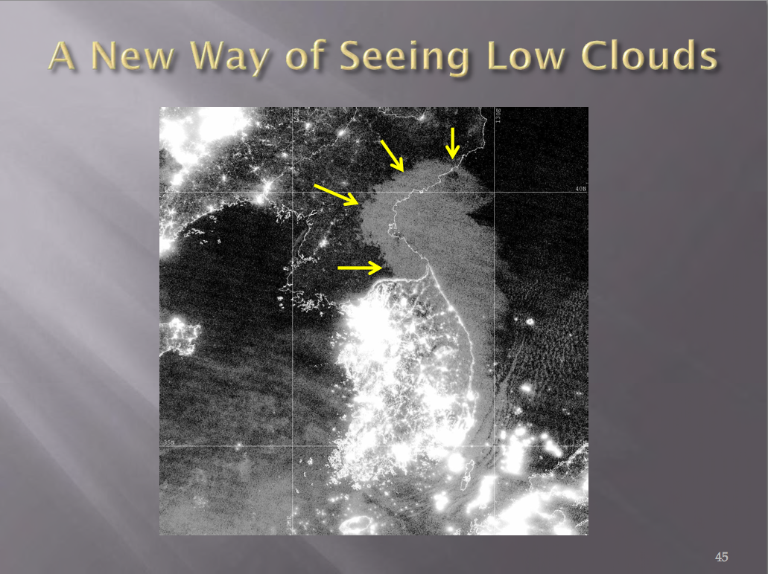

Slide 30
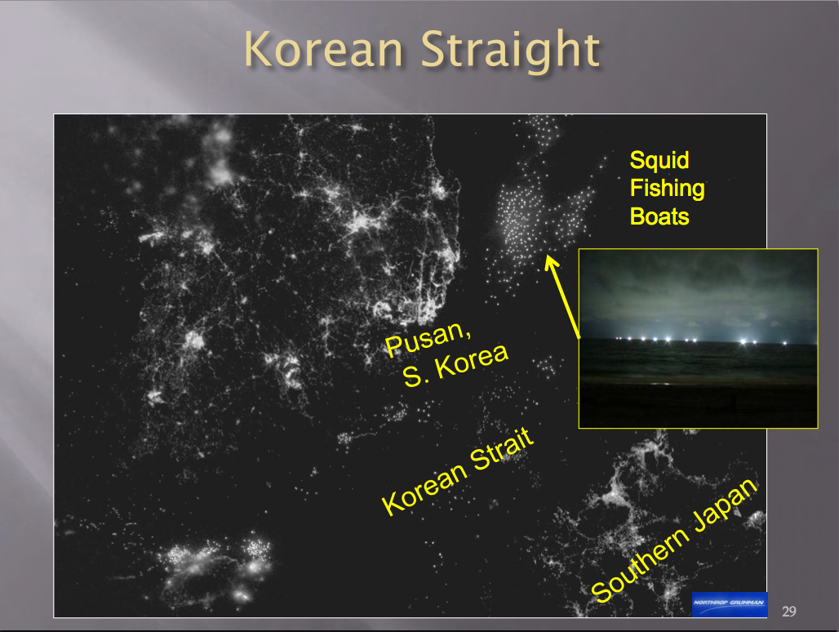

Slide 31
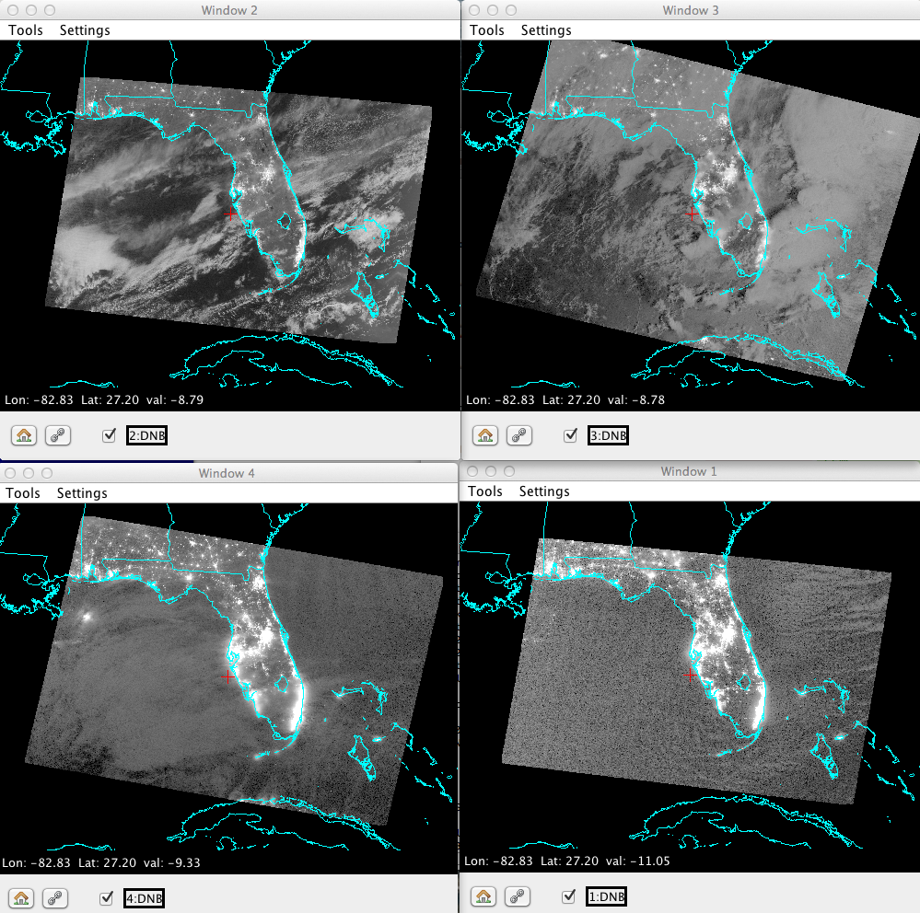




Four Lunar Illumination Regimes

Slide 32
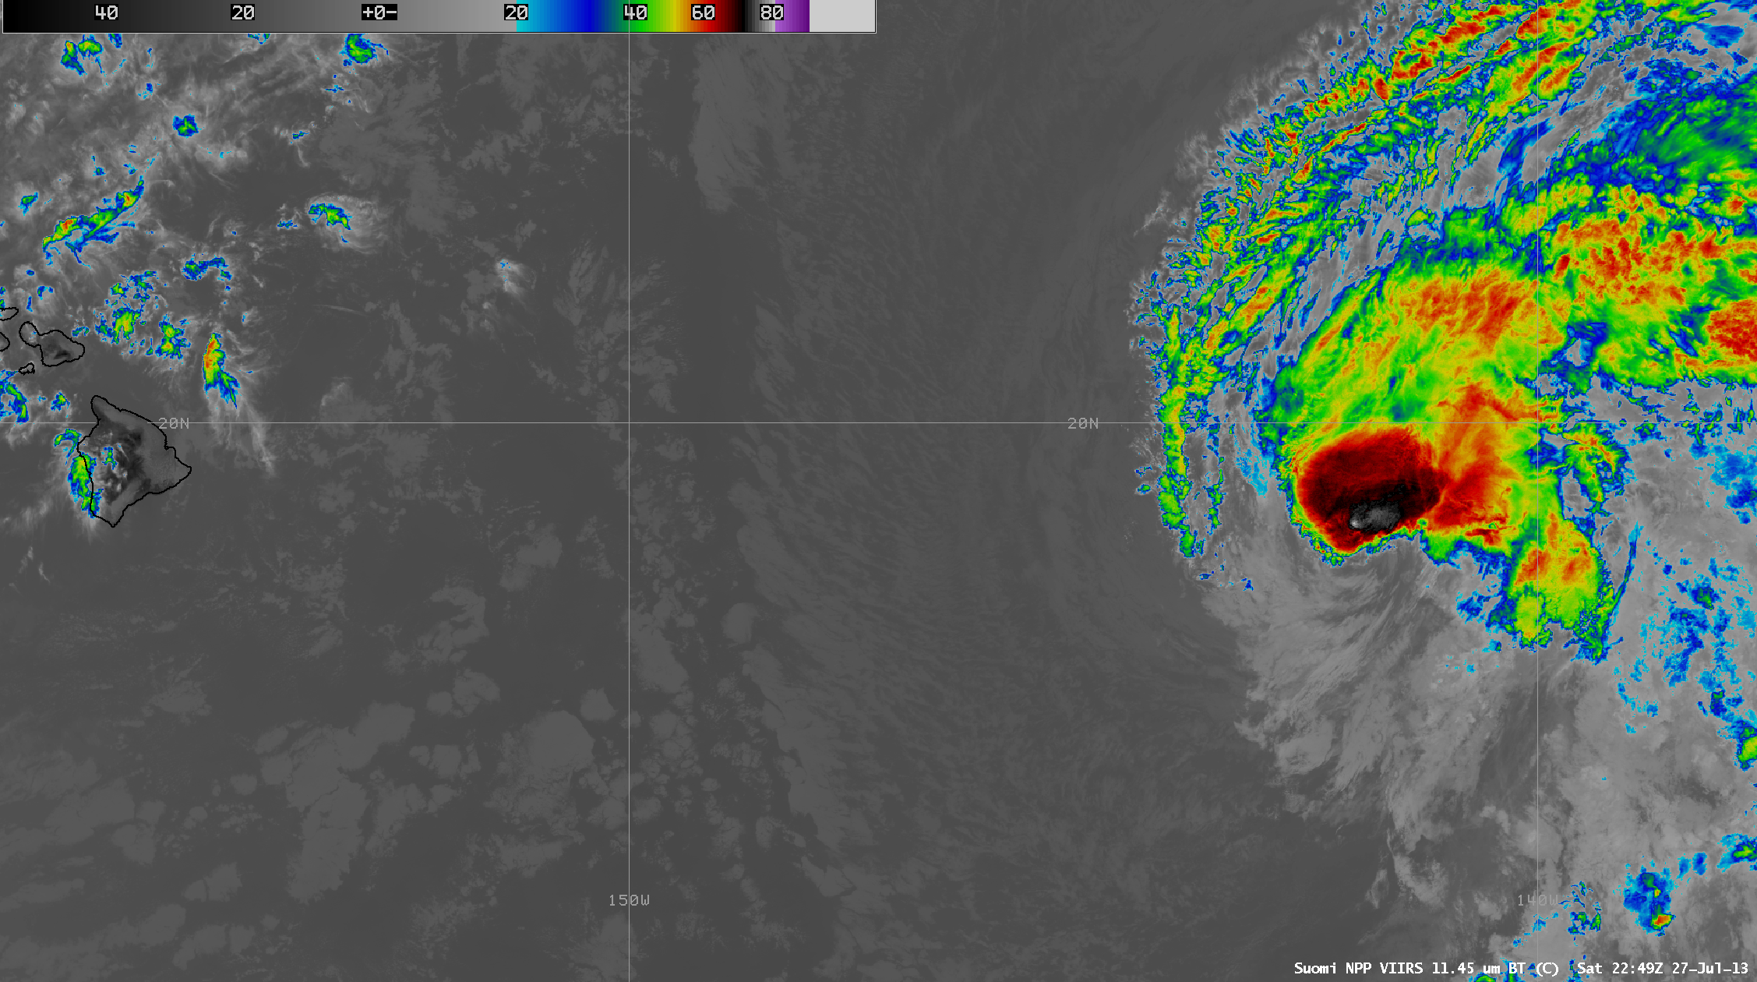

Tropical Storm Flossie Approaching Hawaii
S-NPP VIIRS IR Window Loop
27-28 July 2013
Data acquired by Honolulu Direct Broadcast Antenna
processed using CSPP software and displayed in AWIPS-I

Slide 33
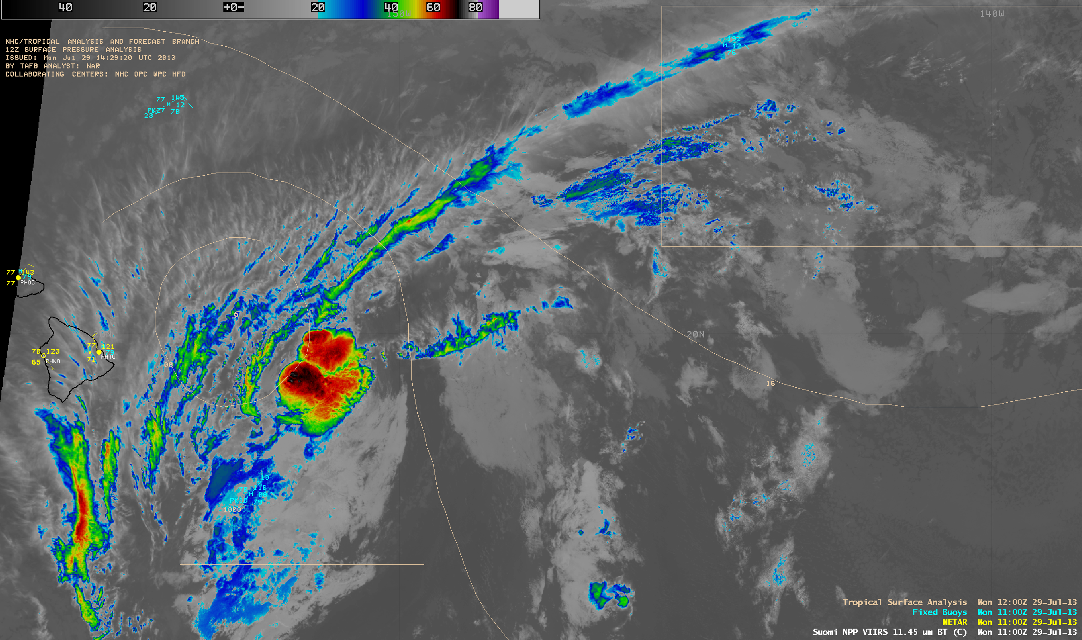
Tropical Storm Flossie
VIIRS IR Window 29 July 2013

Slide 34
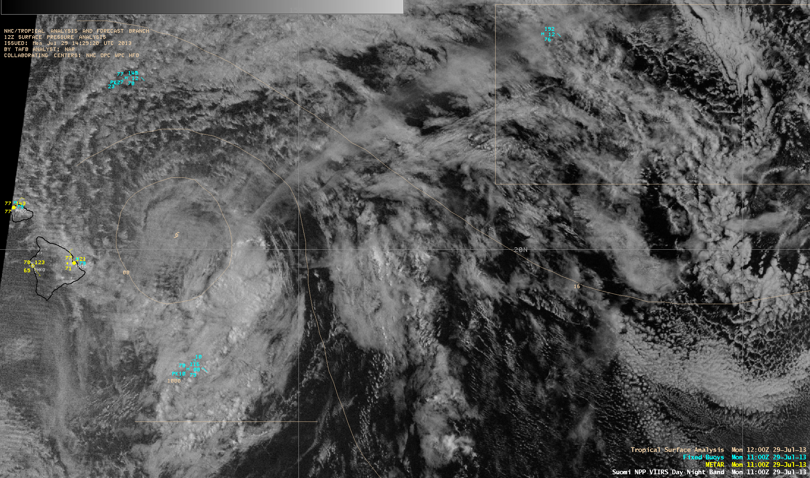
Tropical Storm Flossie VIIRS
Day/Night Band 29 July 2013

Slide 35


S-NPP DB Data Used by NWS Central Pacific Hurricane Center
TROPICAL STORM FLOSSIE DISCUSSION NUMBER 19
NWS CENTRAL PACIFIC HURRICANE CENTER HONOLULU HI EP062013
500 AM HST MON JUL 29 2013
THE CENTER OF FLOSSIE WAS HIDDEN BY HIGH CLOUDS MOST OF THE NIGHT BEFORE VIRS NIGHTTIME VISUAL SATELLITE IMAGERY REVEALED AN EXPOSED LOW LEVEL CIRCULATION CENTER FARTHER NORTH THAN EXPECTED. WE RE-BESTED THE 0600 UTC POSITION BASED ON THE VISIBLE DATA. SUBJECTIVE DVORAK ANALYSES CONTINUED SHOW CURRENT INTENSITIES OF 3.0 BUT SATELLITE LOOPS SUGGEST A RAPID WEAKENING TREND WITH THE LOW LEVEL CENTER PULLING AWAY FROM A SMALL AREA OF CONVECTION SOUTHEAST OF THE CENTER. IT IS LIKELY THAT CONTINUED NORTHWEST SHEAR WILL MAINTAIN THIS WEAKENING TREND.
THE TRACK HAS BEEN SHIFTED NORTH TO REFLECT THE RE-LOCATED CENTER. THE TRACK GUIDANCE SHIFTED FOLLOWING THE TRACK CHANGE AND WAS CONSISTENT WITH A NEW TRACK FARTHER TO THE NORTH. THE TRACK NOW SHOWS FLOSSIE PASSING OVER MAUI TODAY...OVER OAHU TONIGHT...THEN PASSING SOUTH OF KAUAI EARLY TUESDAY MORNING. WE EXPECT FLOSSIE TO WEAKEN STEADILY AS IT TRACKS WEST NORTHWEST AND DISSPATE WITHIN 96 HOURS.

Slide 36
VIIRS data used by CONUS forecasters
AREA FORECAST DISCUSSION
NATIONAL WEATHER SERVICE MILWAUKEE/SULLIVAN WI
309 AM CST MON NOV 26 2012
.TODAY AND TONIGHT...FORECAST CONFIDENCE...MEDIUM TO HIGH
WEAK LOW LEVEL COLD AIR ADVECTION EXPECTED TO CAUSE AREAS OF LOWER CLOUDS OVER SRN WI FOR A TIME THIS MRNG. TIMELY VIIRS DAY/NIGHT BAND IMAGE FROM 0721Z SHOWED THICKER CLOUDS OVER NORTHWEST CWA EXTENDING ACROSS CENTRAL INTO NRN WI. A FEW FLURRIES GETTING SHAKEN FROM THESE CLOUDS FARTHER NORTH IN VICINITY OF WEAK LOW LEVEL CONVERGENCE. AS UPPER JET FINALLY SLIDES OFF TO THE EAST...LOW CLOUDS WILL INCREASE FOR A TIME EARLY THIS MRNG ACROSS SRN WI. HOWEVER INCREASING SUBSIDENCE FROM LEFT ENTRANCE REGION AND DRYING SHOULD RESULT IN CLOUDS DECREASING LATER THIS MRNG AND AFTN. DAYTIME TEMPS NOT EXPCD TO RISE MUCH DUE TO NORTHWEST WINDS CARRYING EVEN COLDER AIR OVER THE REGION. NORTHWEST WINDS AND APPROACHING HIGH PRESSURE ALSO PROTECTING SRN WI FROM THE ISENTROPIC LIGHT PRECIP EVENT GOING ON TO THE SOUTHWEST OF WI.

Slide 37
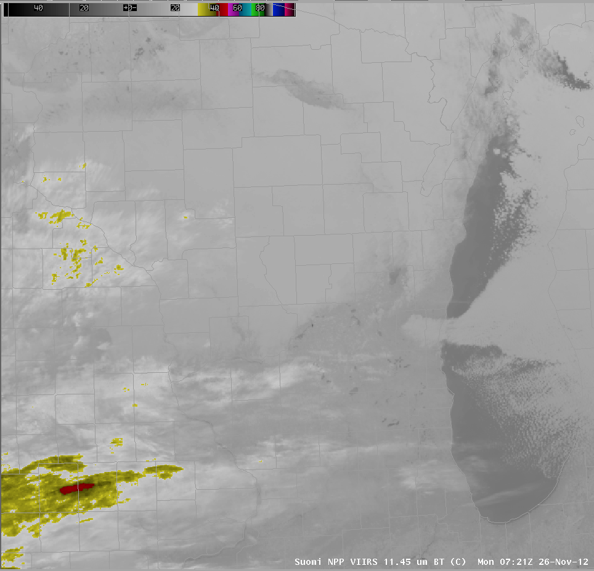
VIIRS data used by CONUS forecasters

Slide 38
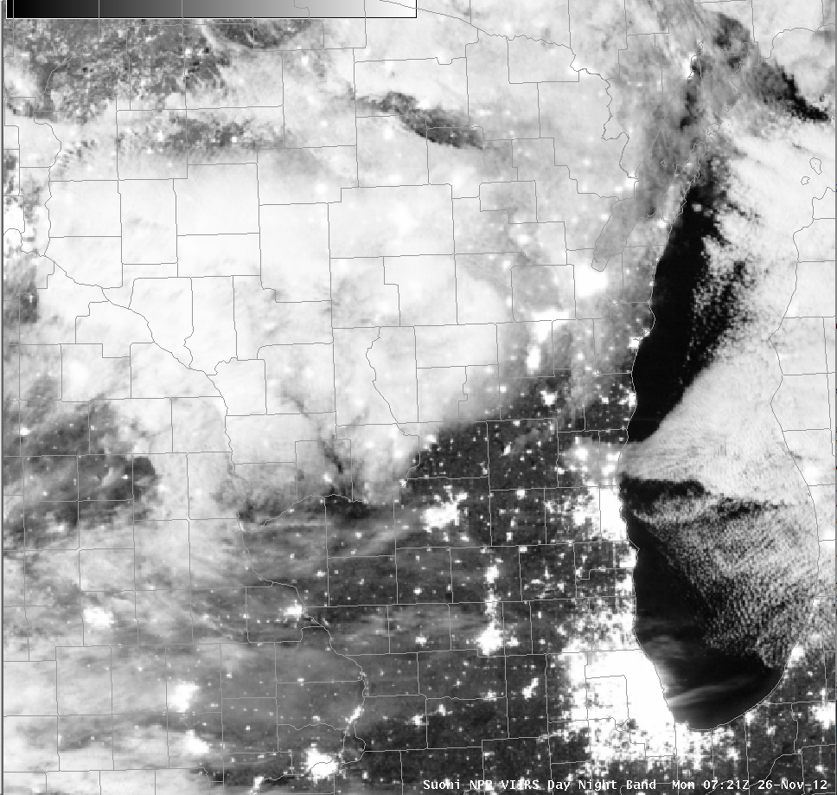
VIIRS data used by CONUS forecasters

Slide 39
VIIRS Data used by CONUS Forecasters
From: Chad Gravelle <chad.gravelle@noaa.gov>
Subject: DNB in NWS MTR Operations
Date: November 6, 2012 1:26:40 PM CST
To: Kathy Strabala <kathys@ssec.wisc.edu>
Hi Kathy...
...I've asked NWS Monterey to provide me with some informal feedback when they find the DNB useful and how their meteorologists were using the imagery. I did this so that we can begin to develop a database of potential uses. The following was sent to me by one of their lead forecasters.
Chad,
Last week on our mids we issued some Dense Fog Advisories and Nowcasts. The fog was very shallow upon its return after an offshore wind event. We had numerous surface obs (ASOS sites, etc) reporting the fog. However, for us the night time pass usually comes at a good time (say between 8-10z). The resolution gave us the confidence upon actually seeing where the fog was to issue (and not issue) for certain zones. It also gave us increased confidence to issue a Marine Dense Fog Advisory for San Francisco Bay, a spot where we don't have real obs over the water in general. So, as is often the case its just another tool to help increase or decrease confidence. In situations where the skies are clear and the fog/cloud deck is shallow it can really pinpoint things for us along the coast where the marine layer intrusions can vary depending on exact location, valley and layer depth. Ryan

Slide 40
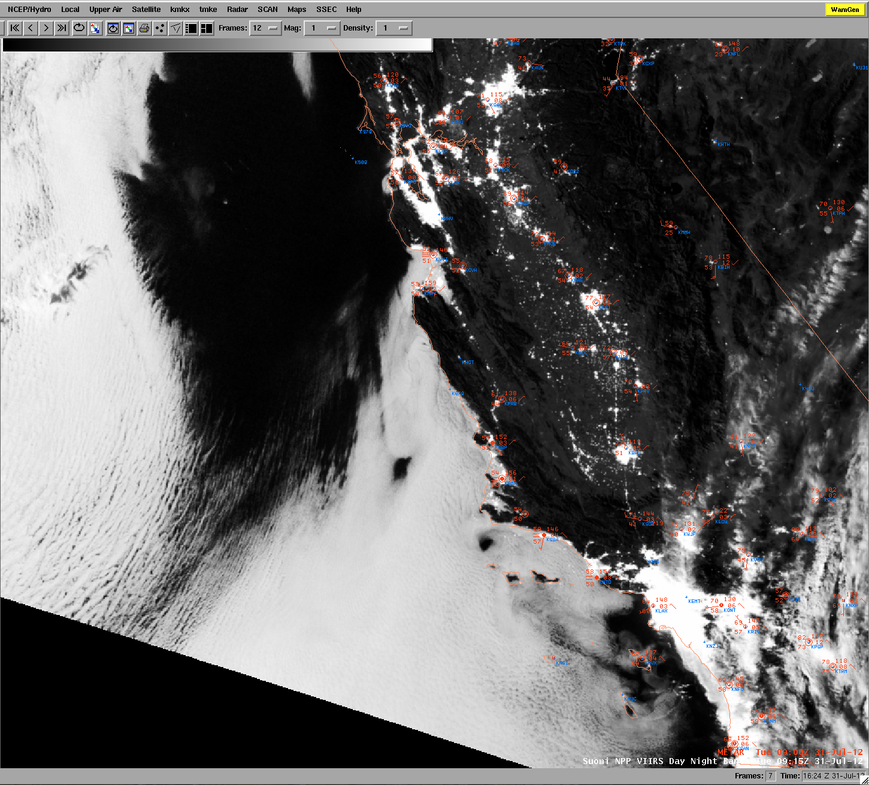
Identifying Maritime Stratus
Intrusion at Night 31 July 2012

Slide 41
Hot Spot Detection

Slide 42
Hot Spot Detection
(Fire Product, Thermal anomolies)
Based upon the difference in Temperature Sensitivity between 4 and 11 microns
Contextual Fire Detection Algorithm
  Infrared static Brightness Temperature thresholds
  Dynamic thresholds compare pixel to surrounding background

Slide 43
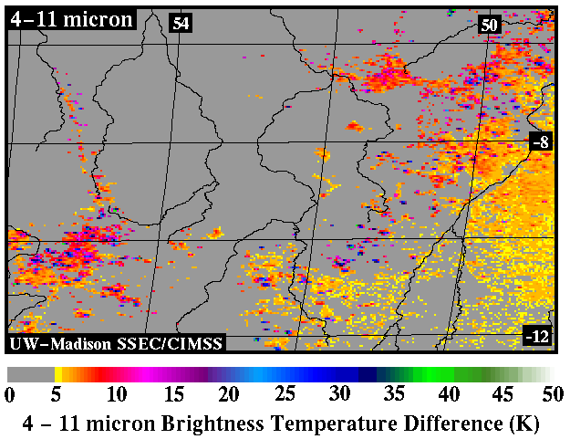
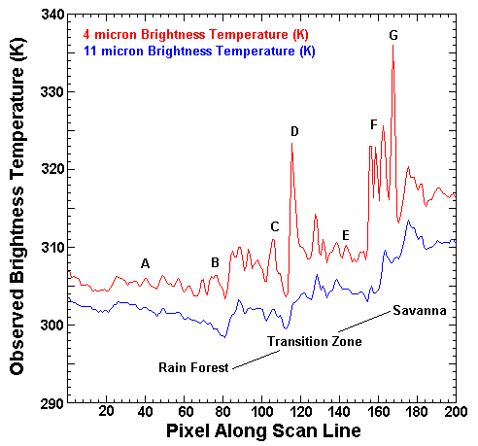
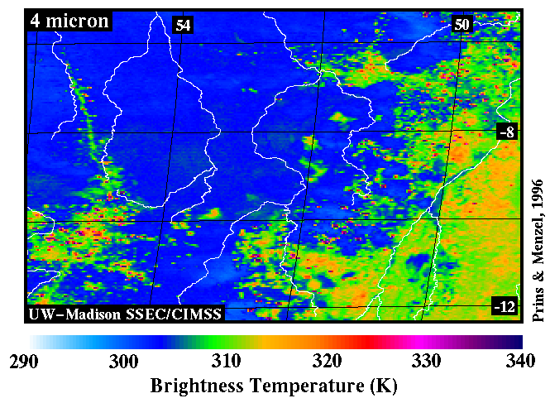
How are Meteorological Satellites Used to Monitor Fires?
Pixel
p
1-p

Slide 44
Fire Output Parameters
1km resolution
fire_mask 8 bit unsigned integer
  0 missing input data
  3 water
  4 cloud
  5 non-fire
  6 unknown
  7 fire (low confidence)
  8 fire (nominal confidence)
  9 fire (high confidence)
Line and element of fire pixel
Latitude and longitude of fire pixel
Fire pixel confidence (one value for each fire detected per scene)

Slide 45
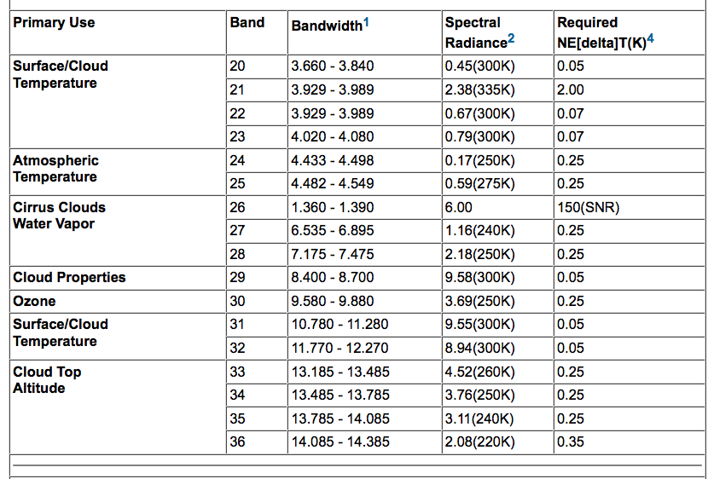
MODIS Emissive Bands

Slide 46
Algorithm Description
MODIS bands 21 and 22 (3.99 micron)
  Band 22 saturates at 331 K
  Band 21 “fire channel” saturates at ~ 500 K
    12 bit range broader – less sensitive
    The calibration of B21 uses fixed calibration coefficients and not using the scan-by-scan onboard black body (more noise)
    So use Band 22 unless it is saturated
MODIS band 31 (11 micron)
  Saturates at ~ 400 K for Terra
  Saturates at ~ 340 K for Aqua

Slide 47
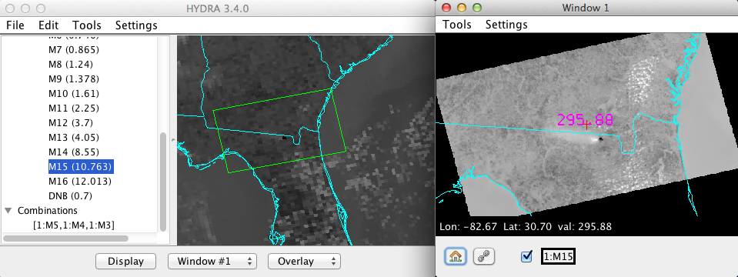
S-NPP Band 13
4.05 microns

Slide 48
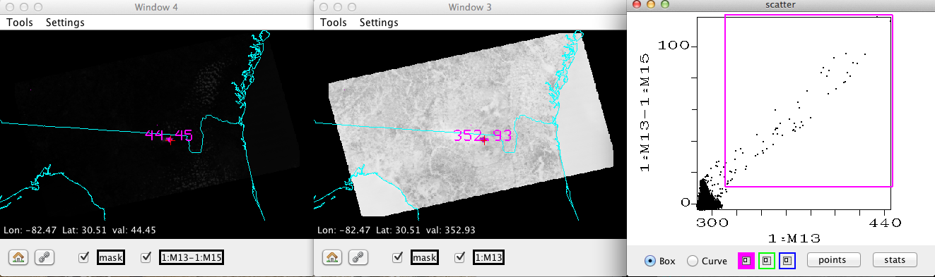
S-NPP IR Bands
11 August 2013

Slide 49
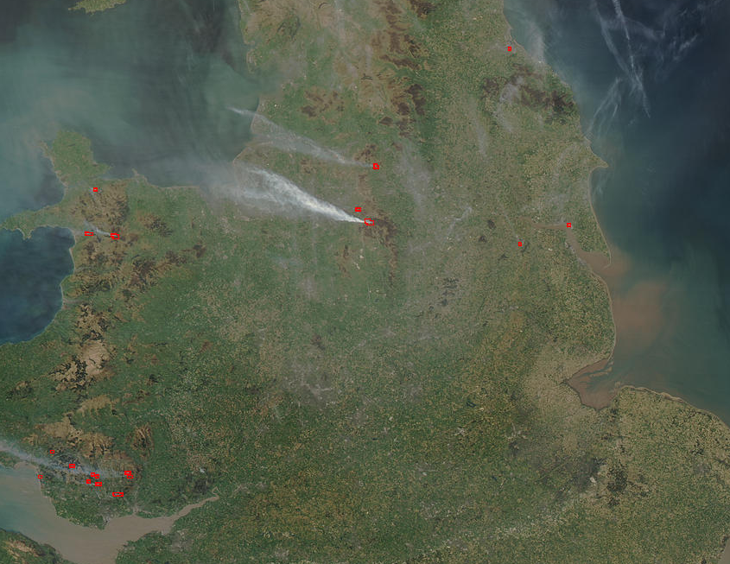
Algorithm Description (cont.)
Aqua MODIS true color image 18 April 2003 12:45 UTC

Slide 50
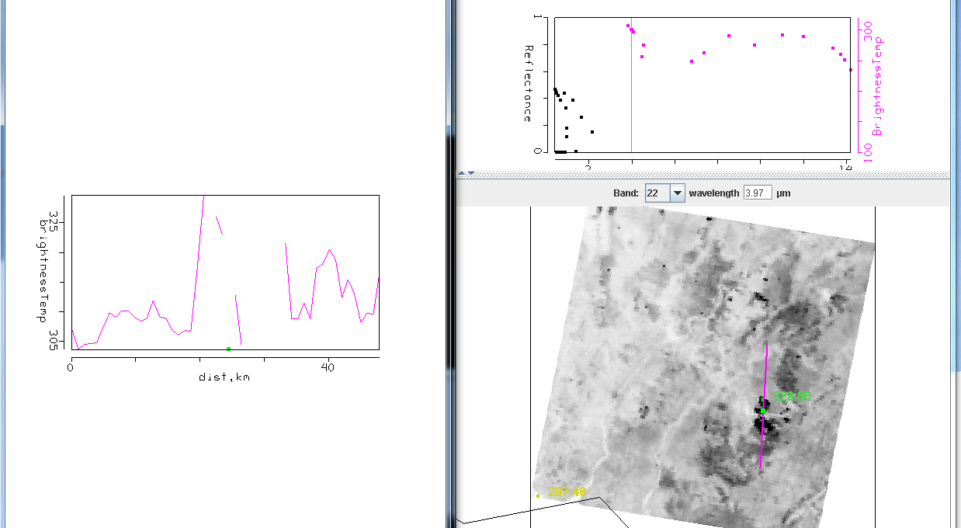
MODIS Terra Band 22
(3.99 micron) transect over fires

Slide 51
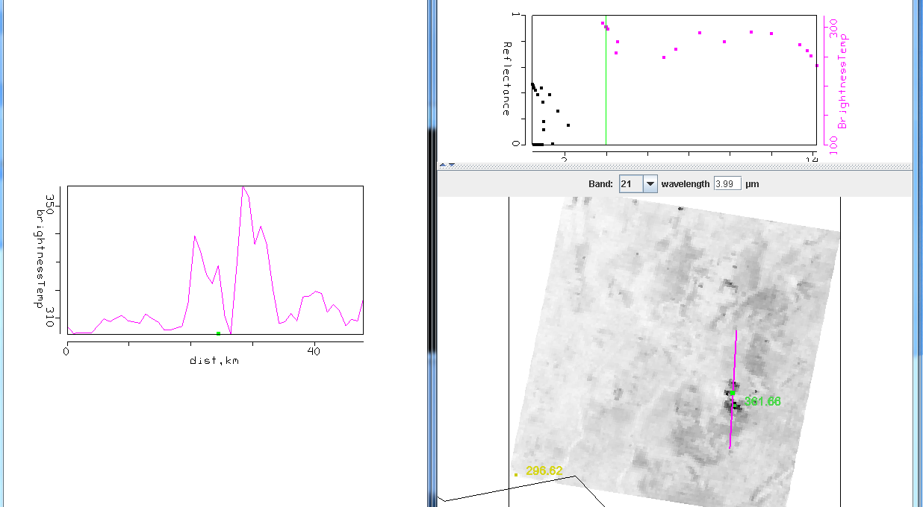
MODIS Terra Band 21 (3.99 μm)
transect over fires

Slide 52
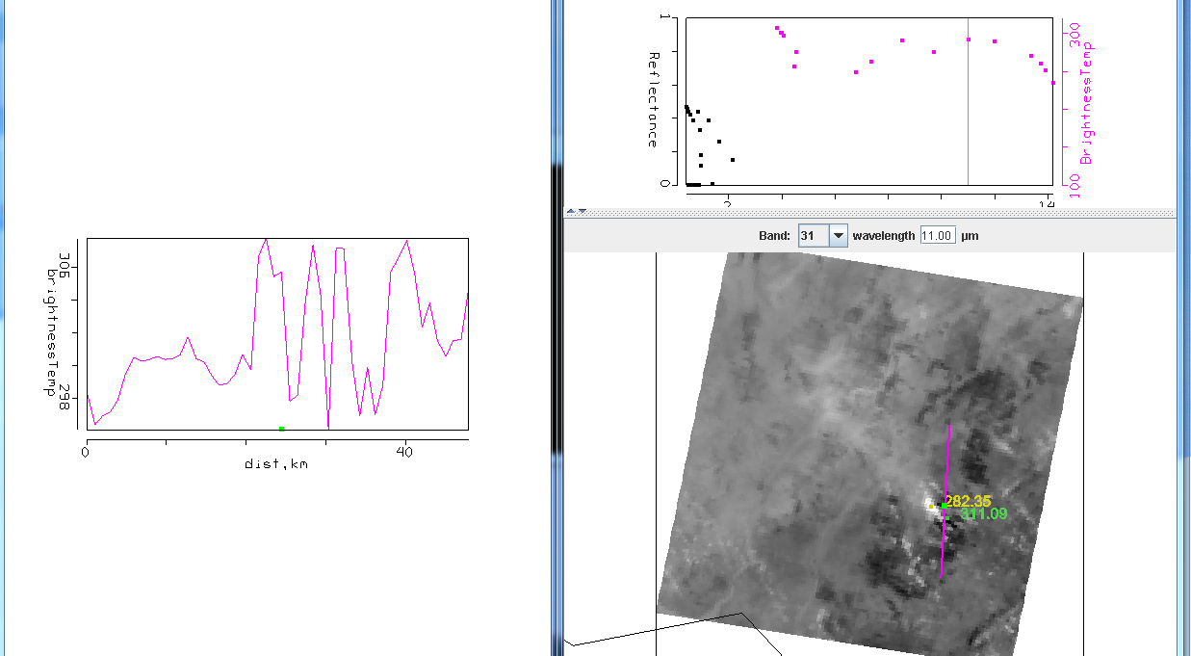
MODIS Terra Band 31 (11 μm)
transect over fires

Slide 53
Algorithm Description (cont.)
Potential Fire Pixel identified
  BT4 > 310 K (~37 C)
  BT4-11 > 10 K
  .86 micron reflectance < .3
Otherwise flagged as non-fire pixel

Slide 54
Screening Potential Fire Pixels
BT4 > 360 K (~87 C)
Contextual Tests: Performed on as many as 21 x 21 box surrounding potential fire pixel to separate out from background
(2)
(3)
(4)
(5)
(6)
Where δ is the Mean Absolute Difference (MAD):
MAD =

Slide 55
Problem Areas
If there are many fires – hard to get representative background temperature in max 21x21 pixel region
Sunglint – Affects 4 micron band radiance
Transition areas – contextual tests pick up boundaries
Coastal areas – need really good geolocation so no mixed pixels are included
Clouds – BT4-11 large over water and thick ice cloud

Slide 56
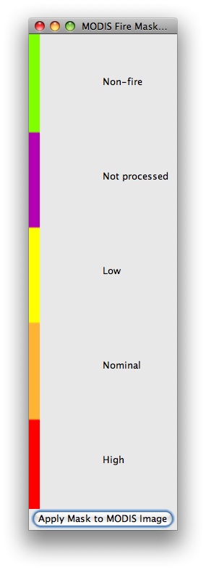
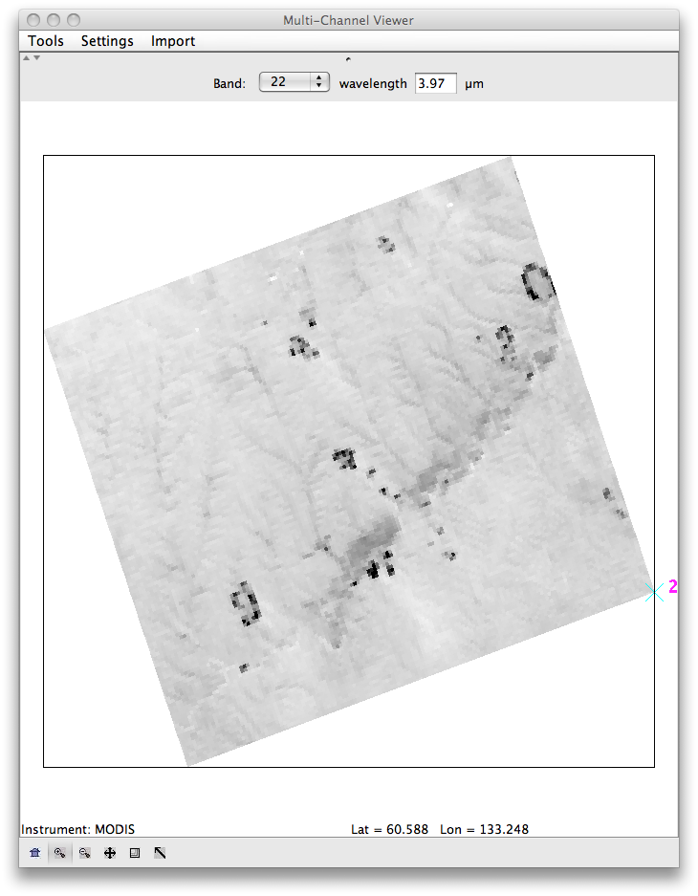
MODIS Fire Product
11 May 2011
03:40 UTC
Aqua MODIS

Slide 57
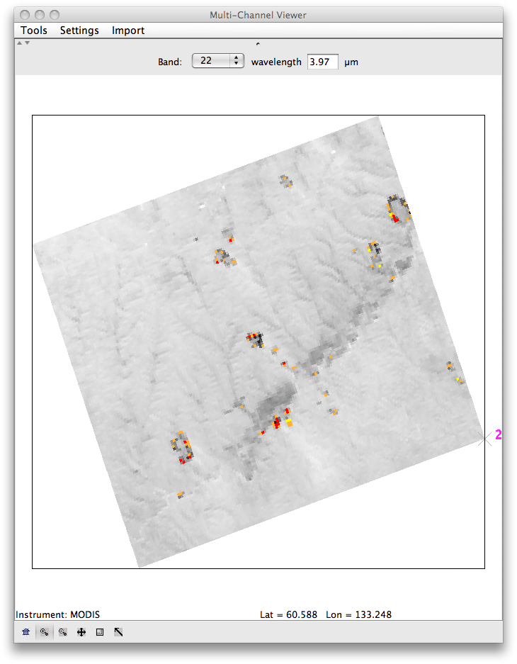
MODIS Fire Product
11 May 2011
03:40 UTC
Aqua MODIS

Slide 58
Fire Detection
AREA FORECAST DISCUSSION
NATIONAL WEATHER SERVICE LUBBOCK TX
315 PM CDT MON APR 11 2011
.FIRE WEATHER...GOES 3.9 MICRON AND MODIS/POES 3.7 MICRON SATELLITE IMAGES SHOW ONLY ONE FIRE START SO FAR THIS AFTERNOON ALONG THE KENT/SCURRY COUNTY LINE. GOOD NEWS IS THAT THEY ARE NOT SHOWING ANY LARGE FLARE-UPS ON THE SWENSON/STONEWALL AND KING COUNTY FIRE. DECREASING WIND SPEEDS WILL ALSO HELP WITH ANY CONTINUED FIREFIGHTING EFFORTS THROUGH TONIGHT. BY LATE TOMORROW MORNING...CONDITIONS CONTINUE TO LOOK MARGINAL TOMORROW FOR MEETING RED FLAG CRITERIA...BUT SOUTH WIND OF 15 TO 25 MPH AND RH VALUES BETWEEN 10 TO 15 PERCENT WILL RESULT IN AT LEAST AN INCREASED FIRE DANGER OVER THE REGION. WILL HOLD ONTO THE FIRE WEATHER WATCH FOR ANOTHER COUPLE OF SHIFTS TO MAKE SURE THE FORECAST REMAINS CONSISTENT IN THE COMPUTER MODELS FOR TOMORROW.
Due to wildfires, the NWS WFO in Lubbock, Texas, is using the AWIPS alerting system, GUARDIAN, to inform forecasters of each new MODIS and AVHRR shortwave IR image that arrives.

Slide 59
Contact Information
Kathy Strabala
  kathys@ssec.wisc.edu

