Slide 1



Polar Orbiter Product Environmental Applications: Part 2
Kathleen Strabala
Miami Direct Broadcast Polar Orbiter Workshop
Atlantic Oceanographic and Meteorological Laboratory (AOML) of NOAA
11 February 2015

Slide 2
Aviation Applications
Turbulence, Clouds

Slide 3
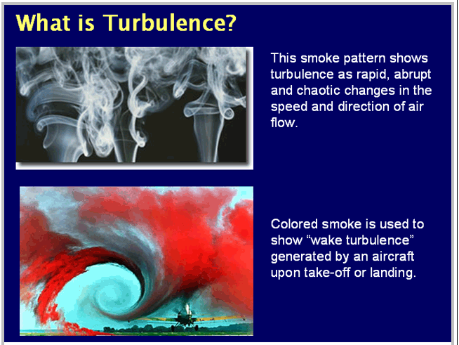
Atmospheric Turbulence

Slide 4
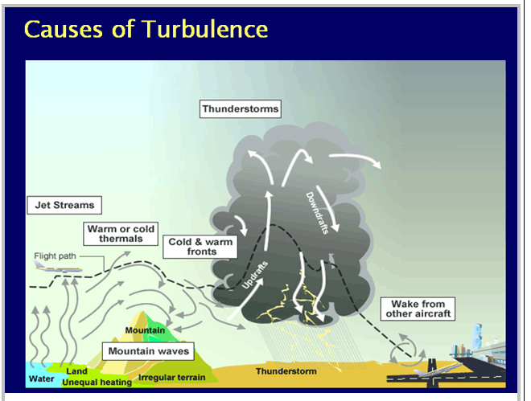
Atmospheric Turbulence

Slide 5
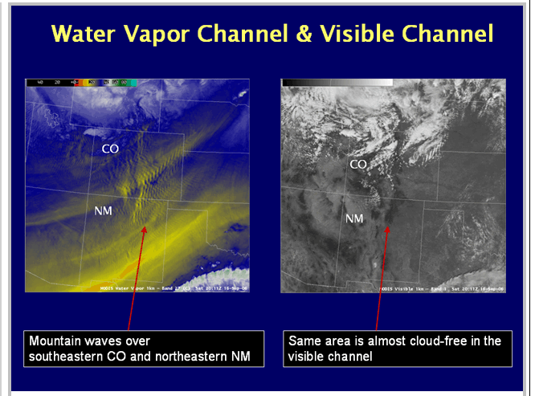
Why is 6.7 μm Important for the Detection of Turbulence?

Slide 6
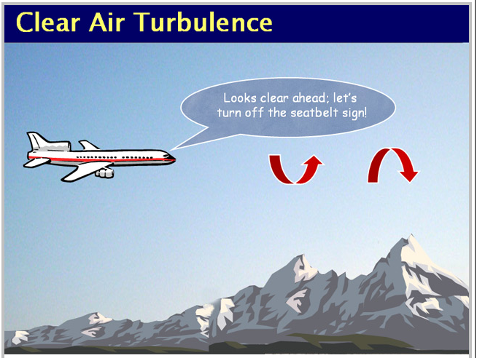
Why is This Important?

Slide 7
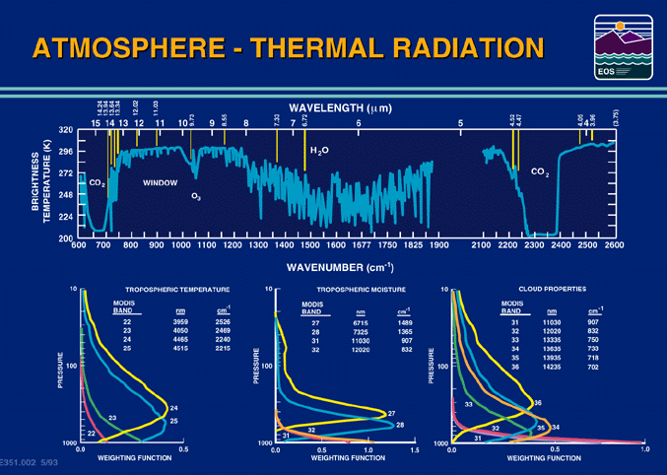
Notes:
The brightness temperatures of the outgoing radiance observed by an airborne interferometer are shown along with the MODIS infrared spectral bands. The brightness temperatures generally decrease as the center of an absorption band is approached. This decrease is associated with the decrease of tropospheric temperature with altitude. Near about 690 cm⁻¹, the temperature shows a minimum which is related to the colder tropopause. On the basis of the sounding principle already discussed, the MODIS team selected a set of sounding wave numbers such that a temperature layers in the troposphere can be described. The arrows indicate the selection. The associated weighting functions are also shown revealing that the radiation is coming from broad overlapping layers, helping to confound the inversion problem from multispectral radiance measurements to temperature profile.

Slide 8
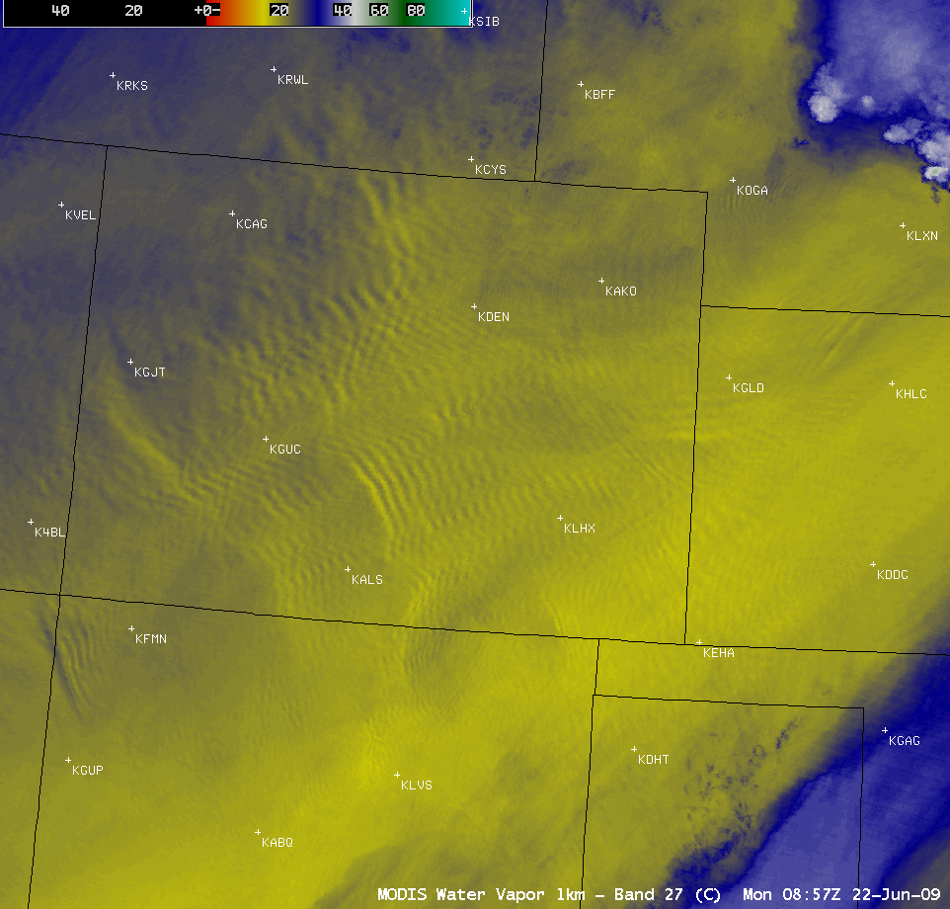

Mountain Wave Clouds in Clear Air
MODIS and
GOES
08:57 UTC
22 June 2009

Slide 9
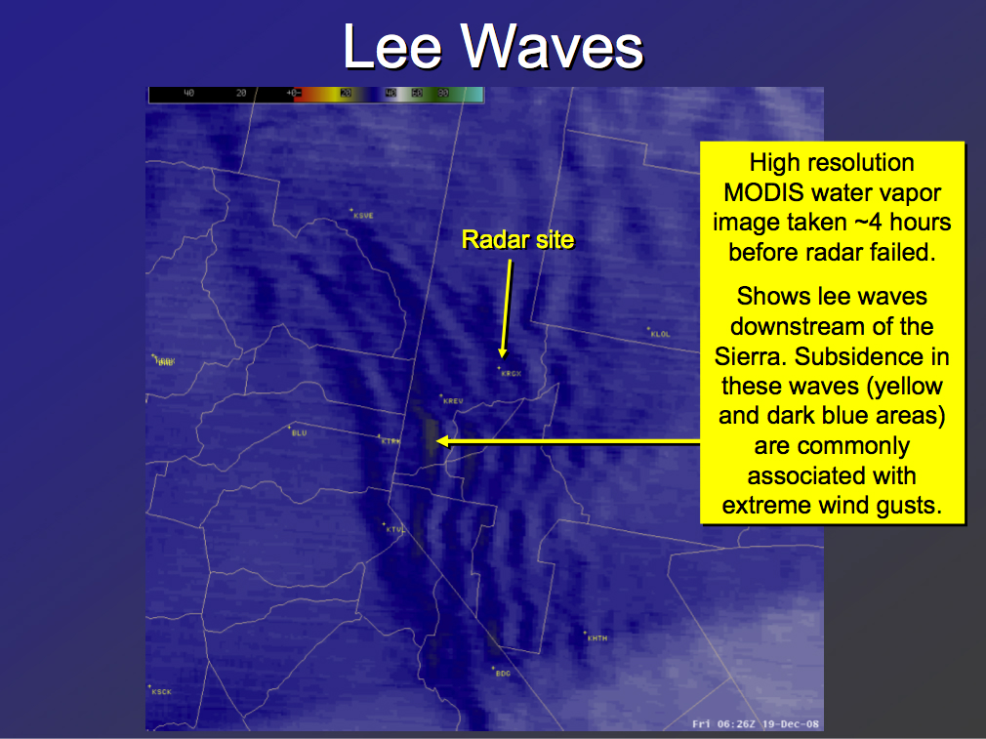
MODIS water vapor
(credit: NWS forecast office, Reno NV)

Slide 10
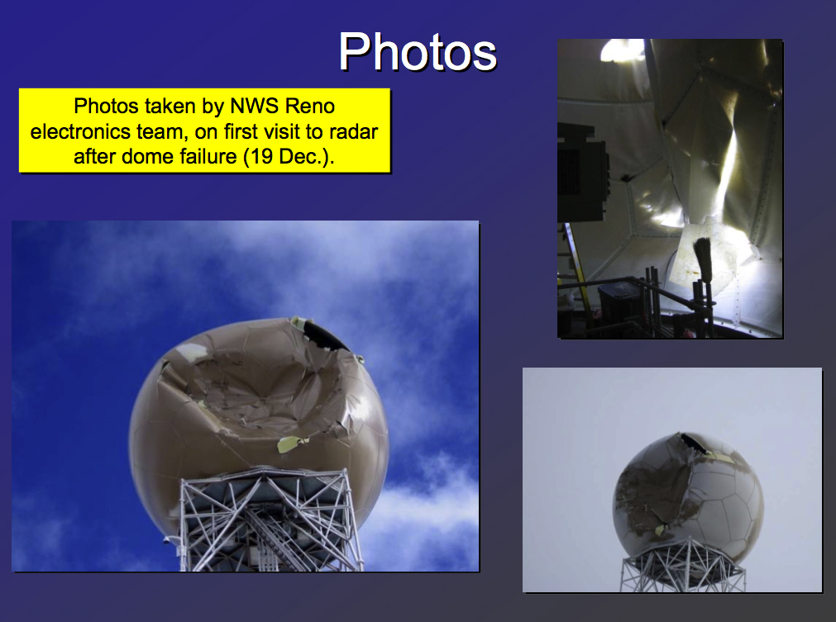
(credit: NWS forecast office, Reno NV)

Slide 11
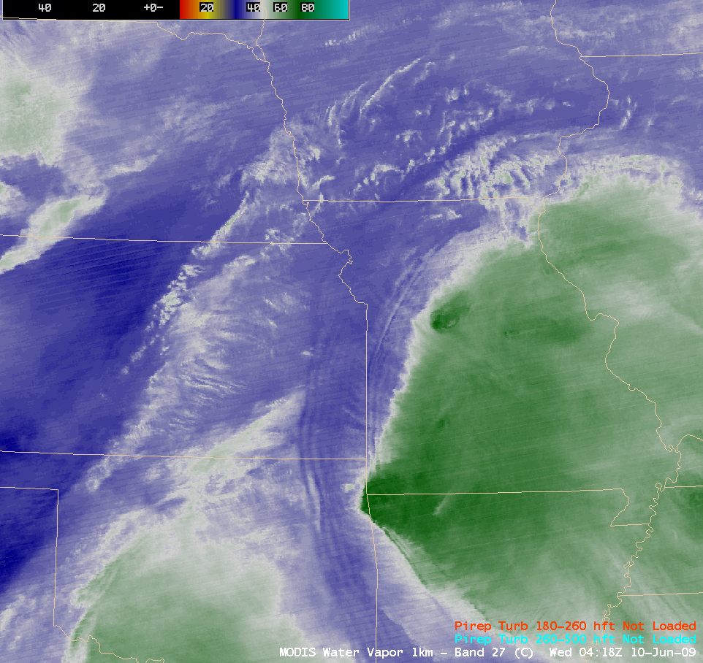

Turbulence Not Just from Orography
MODIS 6.7 μm
Water Vapor
Band
04:18 UTC
10 June 2009

Slide 12
Recent Examples
30 January 2015

Slide 13
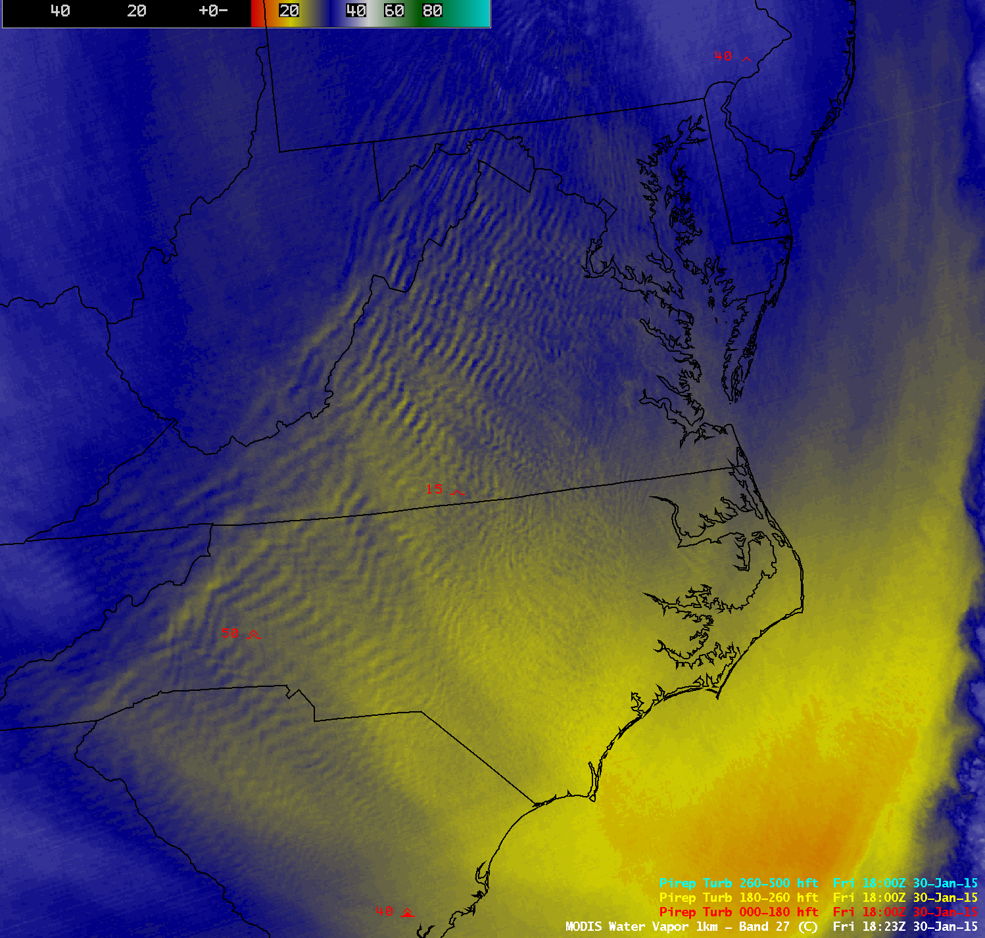


Slide 15
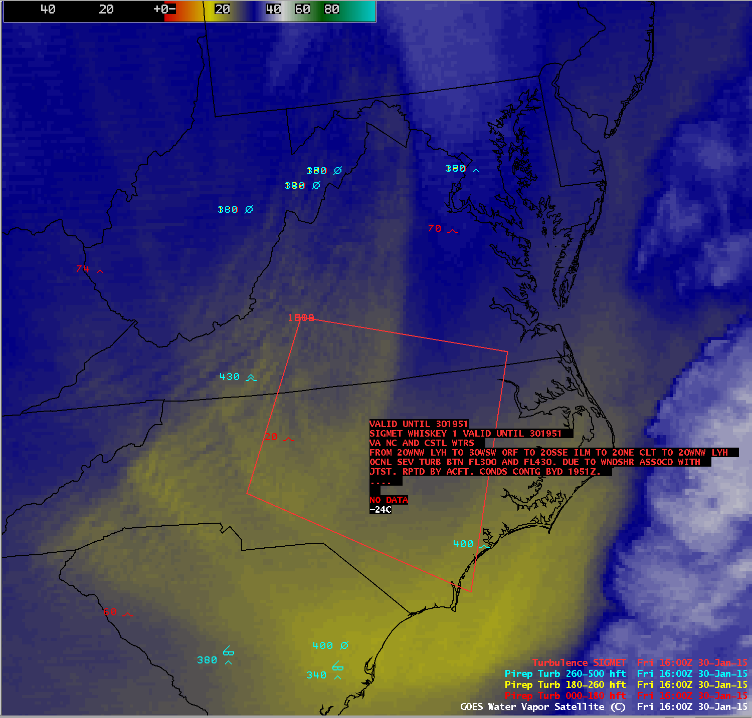

Slide 16
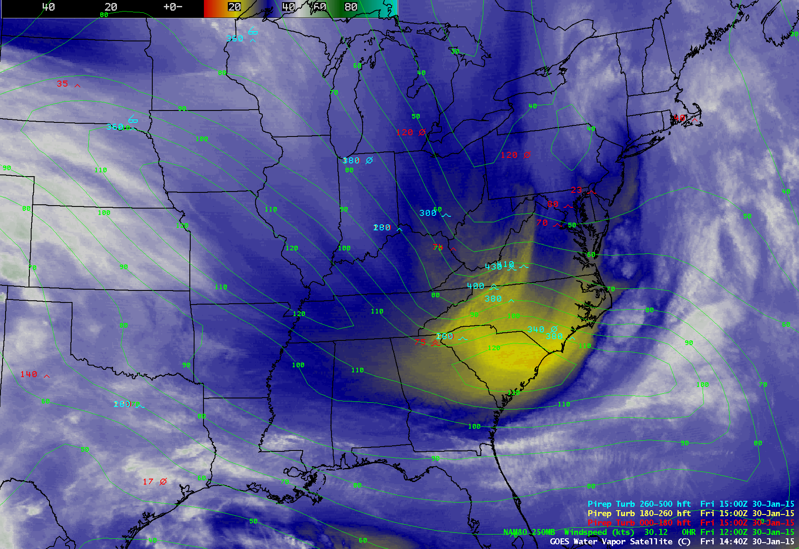

Slide 17
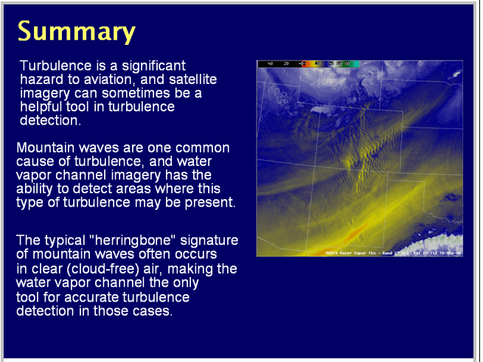
Why is 6.7 μm Important for the Detection of Turbulence?

Slide 18
Cloud Applications Continued
Clouds
  Composition
  Cloud Top Properties
  Cloud Phase

Slide 19
Clouds
MOD06 Cloud Product Example filename: a1.13214.2325.mod06ct.hdf
  Cloud Top Properties at 5km and 1 km
    Cloud Top Pressure, Cloud Top Temperature, Cloud Fraction, Cloud Emissivity
  Cloud Phase at 5 km
  Cloud Optical Properties at 1 km (Daytime only)
    Cloud Effective Radius
    Cloud Optical Thickness

Slide 20
Cloud Top Property Algorithm
Cloud Top Pressure, Temperature, Emissivity derived using CO₂ “slicing”
MODIS product utilizes 4 spectral channels in the 13 – 14 μm region.
5x5 1 km pixel retrievals where at least 5 of the 1 km pixels are cloudy as determined by the cloud mask
Cloud properties retrieved both day and night

Slide 21
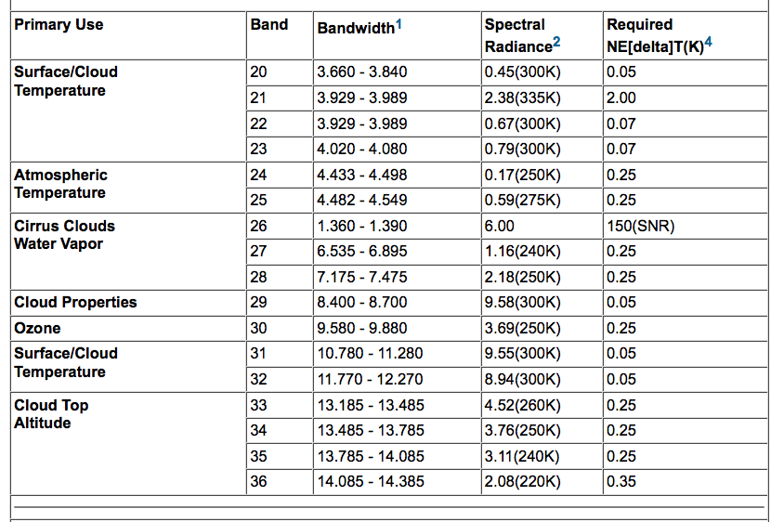
MODIS Emissive Bands

Slide 22
Notes:
The brightness temperatures of the outgoing radiance observed by an airborne interferometer are shown along with the MODIS infrared spectral bands. The brightness temperatures generally decrease as the center of an absorption band is approached. This decrease is associated with the decrease of tropospheric temperature with altitude. Near about 690 cm⁻¹, the temperature shows a minimum which is related to the colder tropopause. On the basis of the sounding principle already discussed, the MODIS team selected a set of sounding wave numbers such that a temperature layers in the troposphere can be described. The arrows indicate the selection. The associated weighting functions are also shown revealing that the radiation is coming from broad overlapping layers, helping to confound the inversion problem from multispectral radiance measurements to temperature profile.

Slide 23
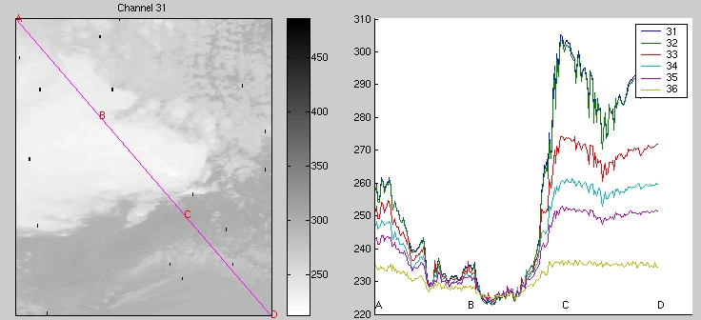
BT in and out of clouds for MODIS CO₂ bands
- demonstrate weighting functions and cloud top algorithm
S. Platnick, ISSAOS ‘02

Slide 24
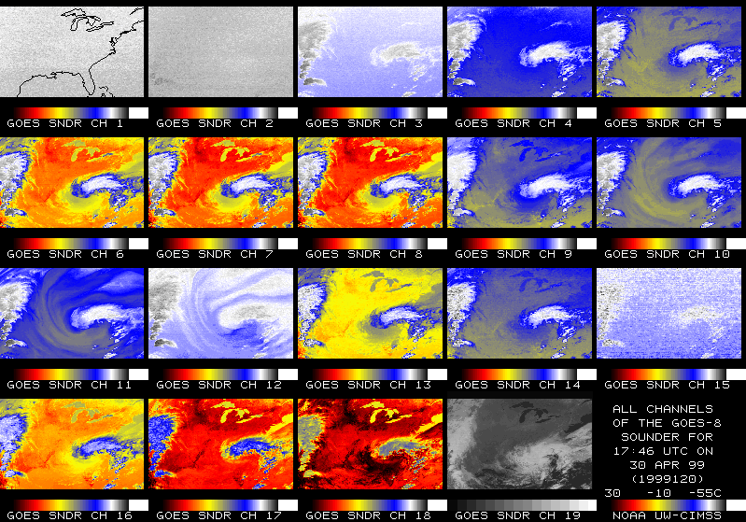
CO2 channels see to different levels in the atmosphere
Band 36 Band 35 Band 34 Band 33
14.2 um 13.9 um 13.6 um 13.3 um

Slide 25
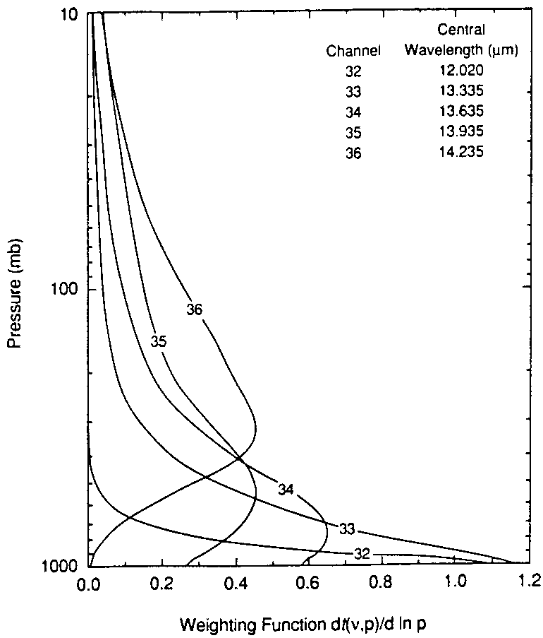
Different ratios
reveal cloud properties
at different levels
hi - 14.2/13.9
mid - 13.9/13.6
low - 13.6/13.3
Meas Calc
p_{c}
(I_{λ1}-I_{λ1}^{clr}) ηε_{λ1} ∫ τ_{λ1} dB_{λ1}
p_{s}
----------- = ----------------
p_{c}
(I_{λ2}-I_{λ2}^{clr}) ηε_{λ2} ∫ τ_{λ2} dB_{λ2}
p_{s}

Slide 26
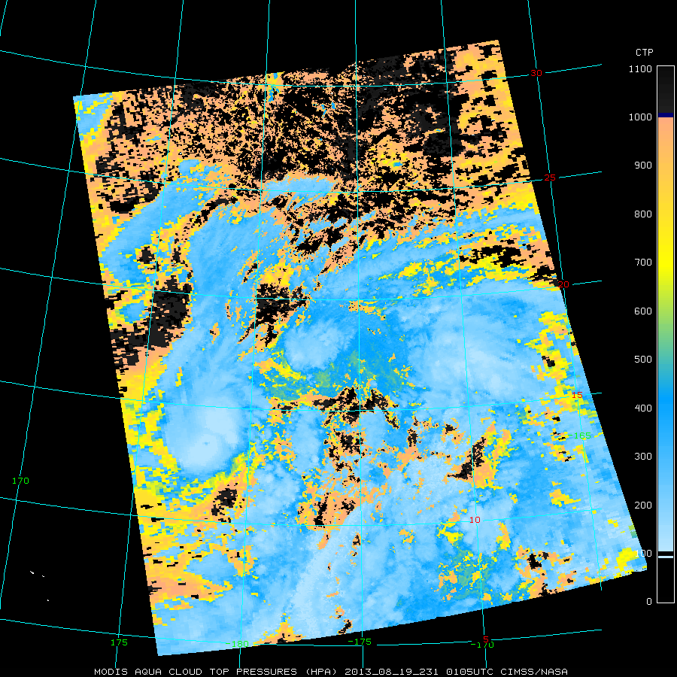
Example Cloud Top Pressure Product

Slide 27
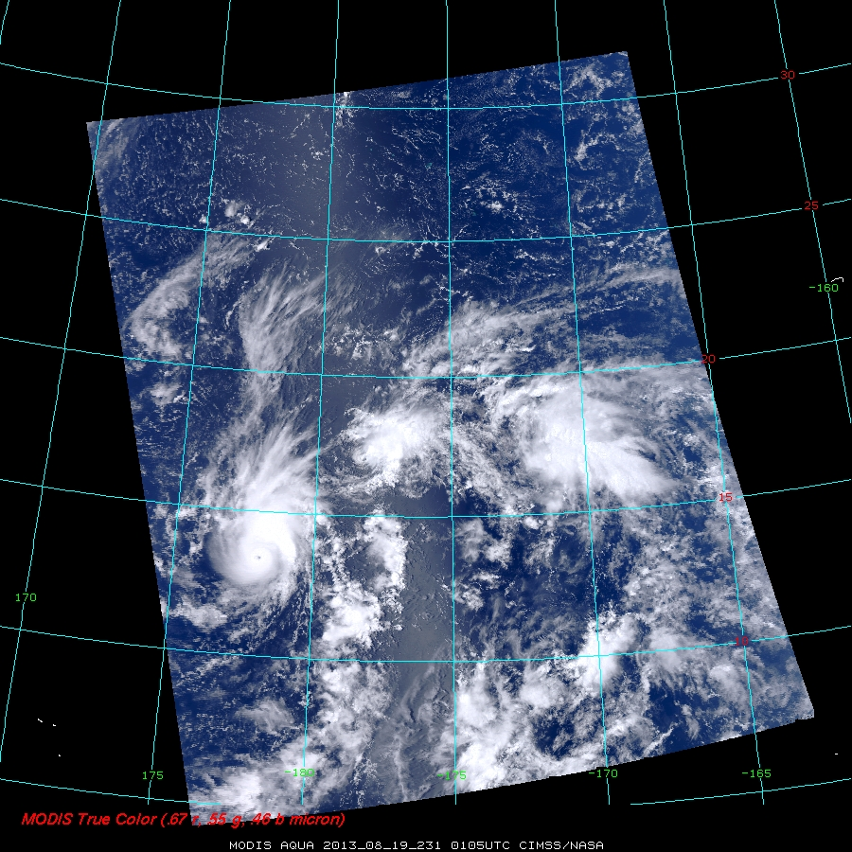
Example Cloud Top Pressure Product

Slide 28
Cloud Phase
IR Brightness Temperature Difference Product
  Band 29 (8.6 μm) – Band 31 (11 μm)
  Takes advantage of difference in water/ice cloud absorption in this spectral region
Near Infrared Bands (1.6 and 2.1 μm)
Short Wave Infrared Bands (4 μm region)

Slide 29
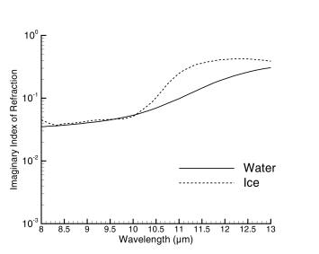
Imaginary Index of Refraction of Ice and Water 8 – 13 microns

Slide 30
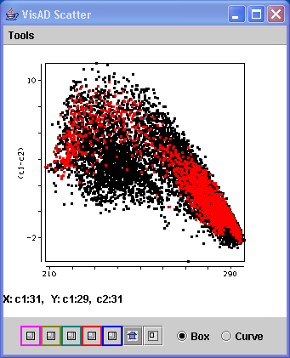
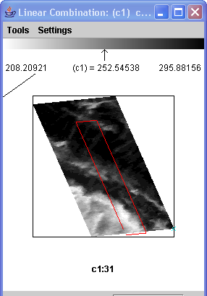
Ice Cloud Example

Slide 31
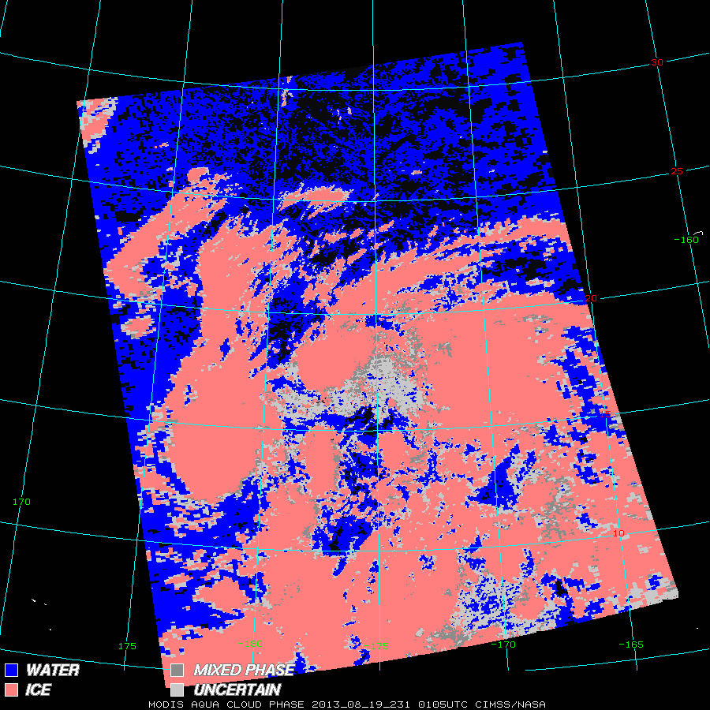
Example Cloud Phase Product

Slide 32
Example Cloud Top Pressure Product

Slide 33
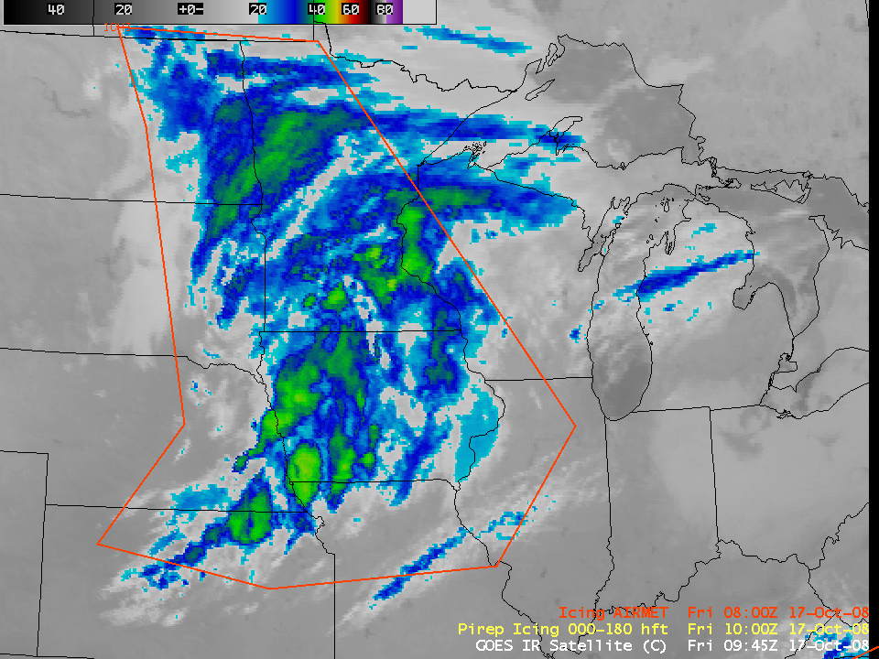

Using Satellite Imagery to Help Diagnose Areas of Aircraft Icing Potential
GOES IR window animation 17 October 2008

Slide 34
Icing
Freezing Level
  Altitude at which the temperature is 0 degrees C
  Above this level the temperature is < 0 C
Water Can Exist at Temperatures Well Below Freezing
  Supercooled Water
An airplane whose temperature is < freezing in this environment can accrue ice

Slide 35
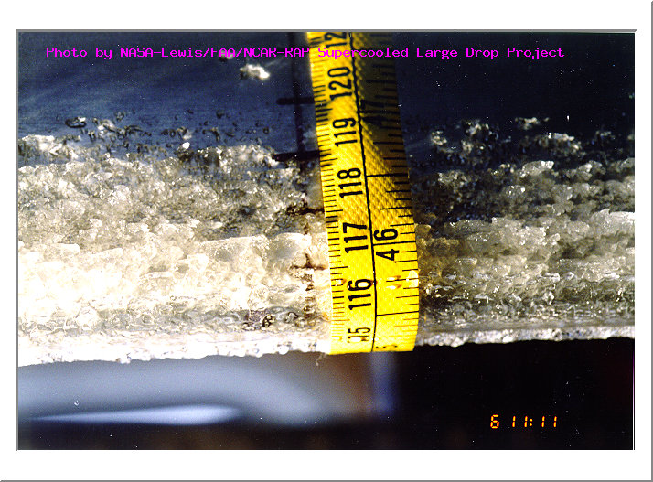
Why is This Important?
We worry about icing because it can adversely affect the flight characteristics of an aircraft. Icing can increase drag, decrease lift, and cause control problems. The added weight of the accreted ice is generally only a factor in light aircraft.
Ice Accumulation On
The Wing of a Small Aircraft
NASA

Slide 36
A closer view using AWIPS images of the MODIS visible channel, 11.0 µm “IR window” channel, Cloud Top Temperature (CTT) product, and Cloud Phase product at 17:29 UTC (below) indicated that much of the cloud shield along the trailing (western) edge of the shortwave over Minnesota and Iowa exhibited cloud top temperatures that were below freezing (generally in the -5 to -12º C range), but the MODIS Cloud Phase product designated those trailing edge clouds as “Water droplet” clouds (blue enhancement). Within this area of supercooled water droplet clouds were several pilot reports of icing at the 8000-foot altitude across southern Minnesota and western/central Iowa.

Slide 37
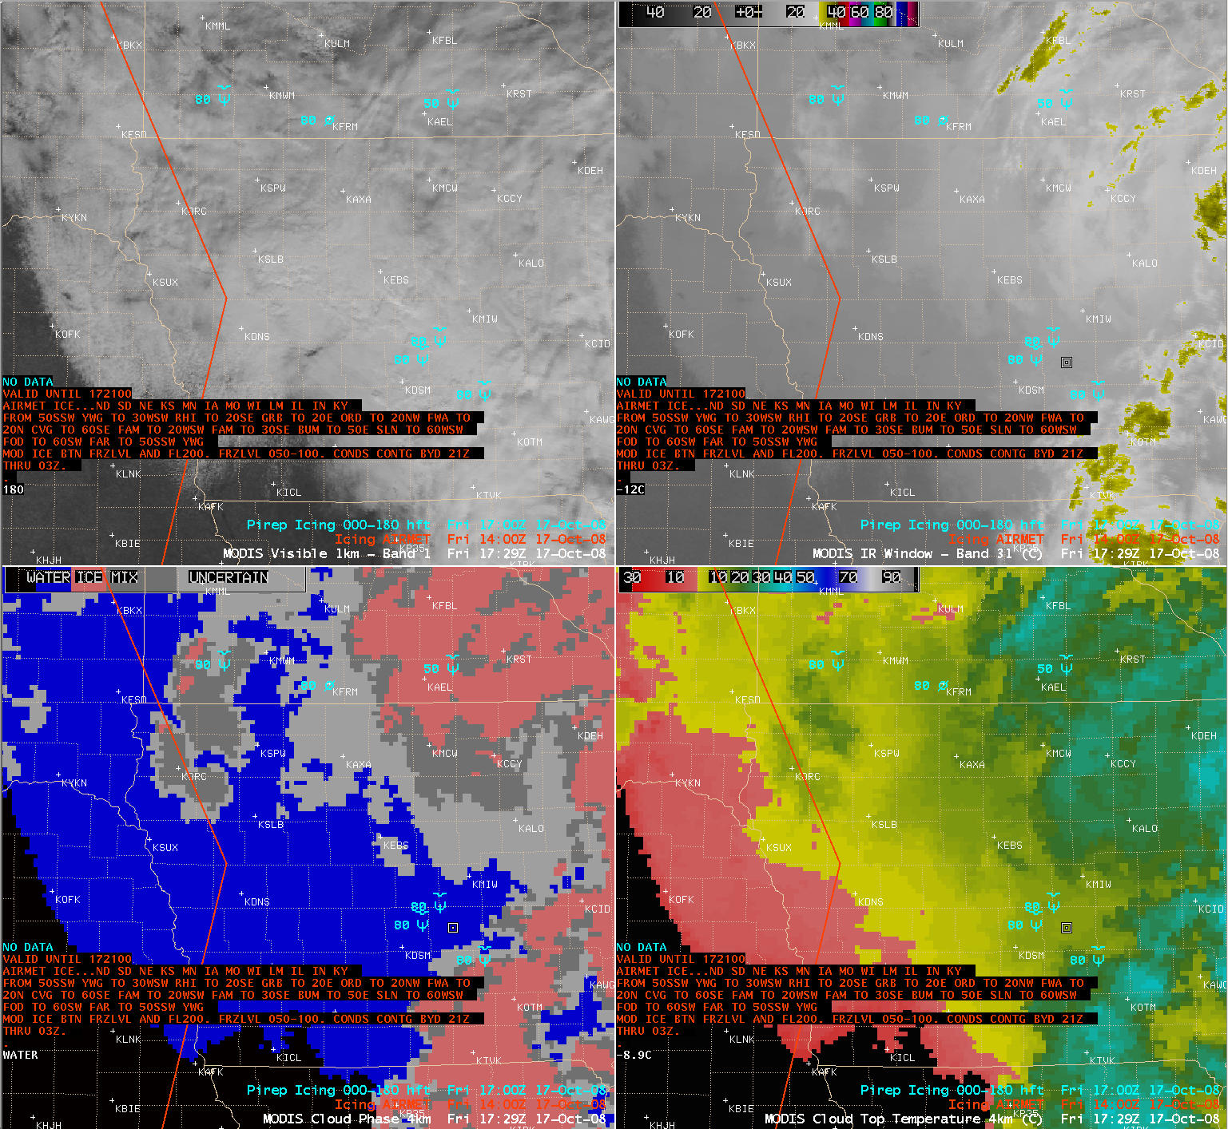

Slide 38
Other Cloud Applications Too
Identification of mature T-storms
  Must glaciate, meaning tops of cell must be ice
Accurate height of “thin” high clouds
  Energy transmitted from below the cloud in the IR window. Can’t get accurate level from window BT.
  Important for pilots. Clouds mean more moisture, dry entrainment and potential for turbulence.

Slide 39
Other Applications

Slide 40
Sea Surface Temperatures
Simple Brightness Temperature Difference Algorithm
“Split Window” technique
Regression between
  11-12 μm BTDIF (MODIS bands 31 and 32)
  4 – 11 μm BTDIF (MODIS bands 22 and 31)
    Must be careful in sunglint regions because of solar contamination
  In essence, you are trying to correct for the lowering of the observed brightness temperatures by water vapor using the BTDIF between these two window channels

Slide 41
Notes:
The brightness temperatures of the outgoing radiance observed by an airborne interferometer are shown along with the MODIS infrared spectral bands. The brightness temperatures generally decrease as the center of an absorption band is approached. This decrease is associated with the decrease of tropospheric temperature with altitude. Near about 690 cm⁻¹, the temperature shows a minimum which is related to the colder tropopause. On the basis of the sounding principle already discussed, the MODIS team selected a set of sounding wave numbers such that a temperature layers in the troposphere can be described. The arrows indicate the selection. The associated weighting functions are also shown revealing that the radiation is coming from broad overlapping layers, helping to confound the inversion problem from multispectral radiance measurements to temperature profile.

Slide 42
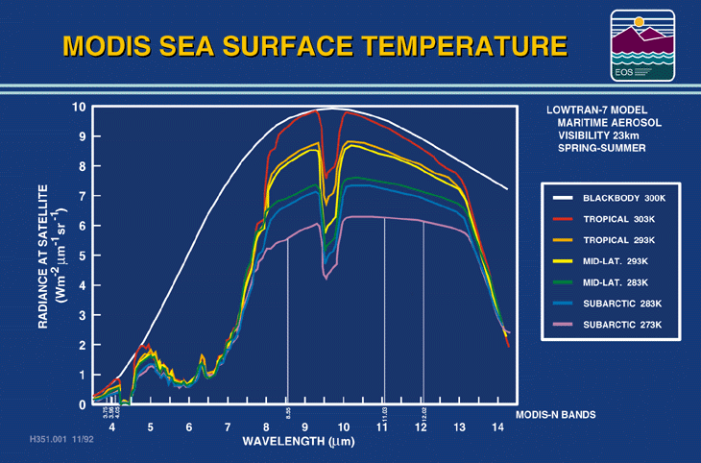
Notes:
The infrared radiance received at the satellite depends of the ocean surface temperature and emissivity, and the amount of water vapor in the atmosphere. The height of the curve indicates the surface temperature, while the difference between the 11 and 12 micron radiances indicates the amount of water vapor absoprtion (more at 12 microns than 11 microns).

Slide 43
MODIS Longwave Infrared Sea Surface Temperature (c5)
dBT <= 0.5
sst = a00 + a01*BT11 + a02*dBT*bsst + a03*dBT*(1.0/mu - 1.0)
dBT >= 0.9
sst = a10 + a11*BT11 + a12*dBT*bsst + a13*dBT*(1.0/mu - 1.0)
0.5 < dBt < 0.9
sstlo = a00 + a01*BT11 + a02*dBT*bsst + a03*dBT*(1.0/mu - 1.0)
ssthi = a10 + a11*BT11 + a12*dBT*bsst + a13*dBT*(1.0/mu - 1.0)
sst = sstlo + (dBT - 0.5)/(0.9 - 0.5)*(ssthi - sstlo)
where:
dBT = BT11 - BT12
BT11 = brightness temperature at 11 um, in deg-C
BT12 = brightness temperature at 12 um, in deg-C
bsst = Either sst4 (if valid) or sstref (from Reynolds OISST)
mu = cosine of sensor zenith angle
a00, a01, a02, a03, a10, a11, a12, a13 derived from match-ups

Slide 44
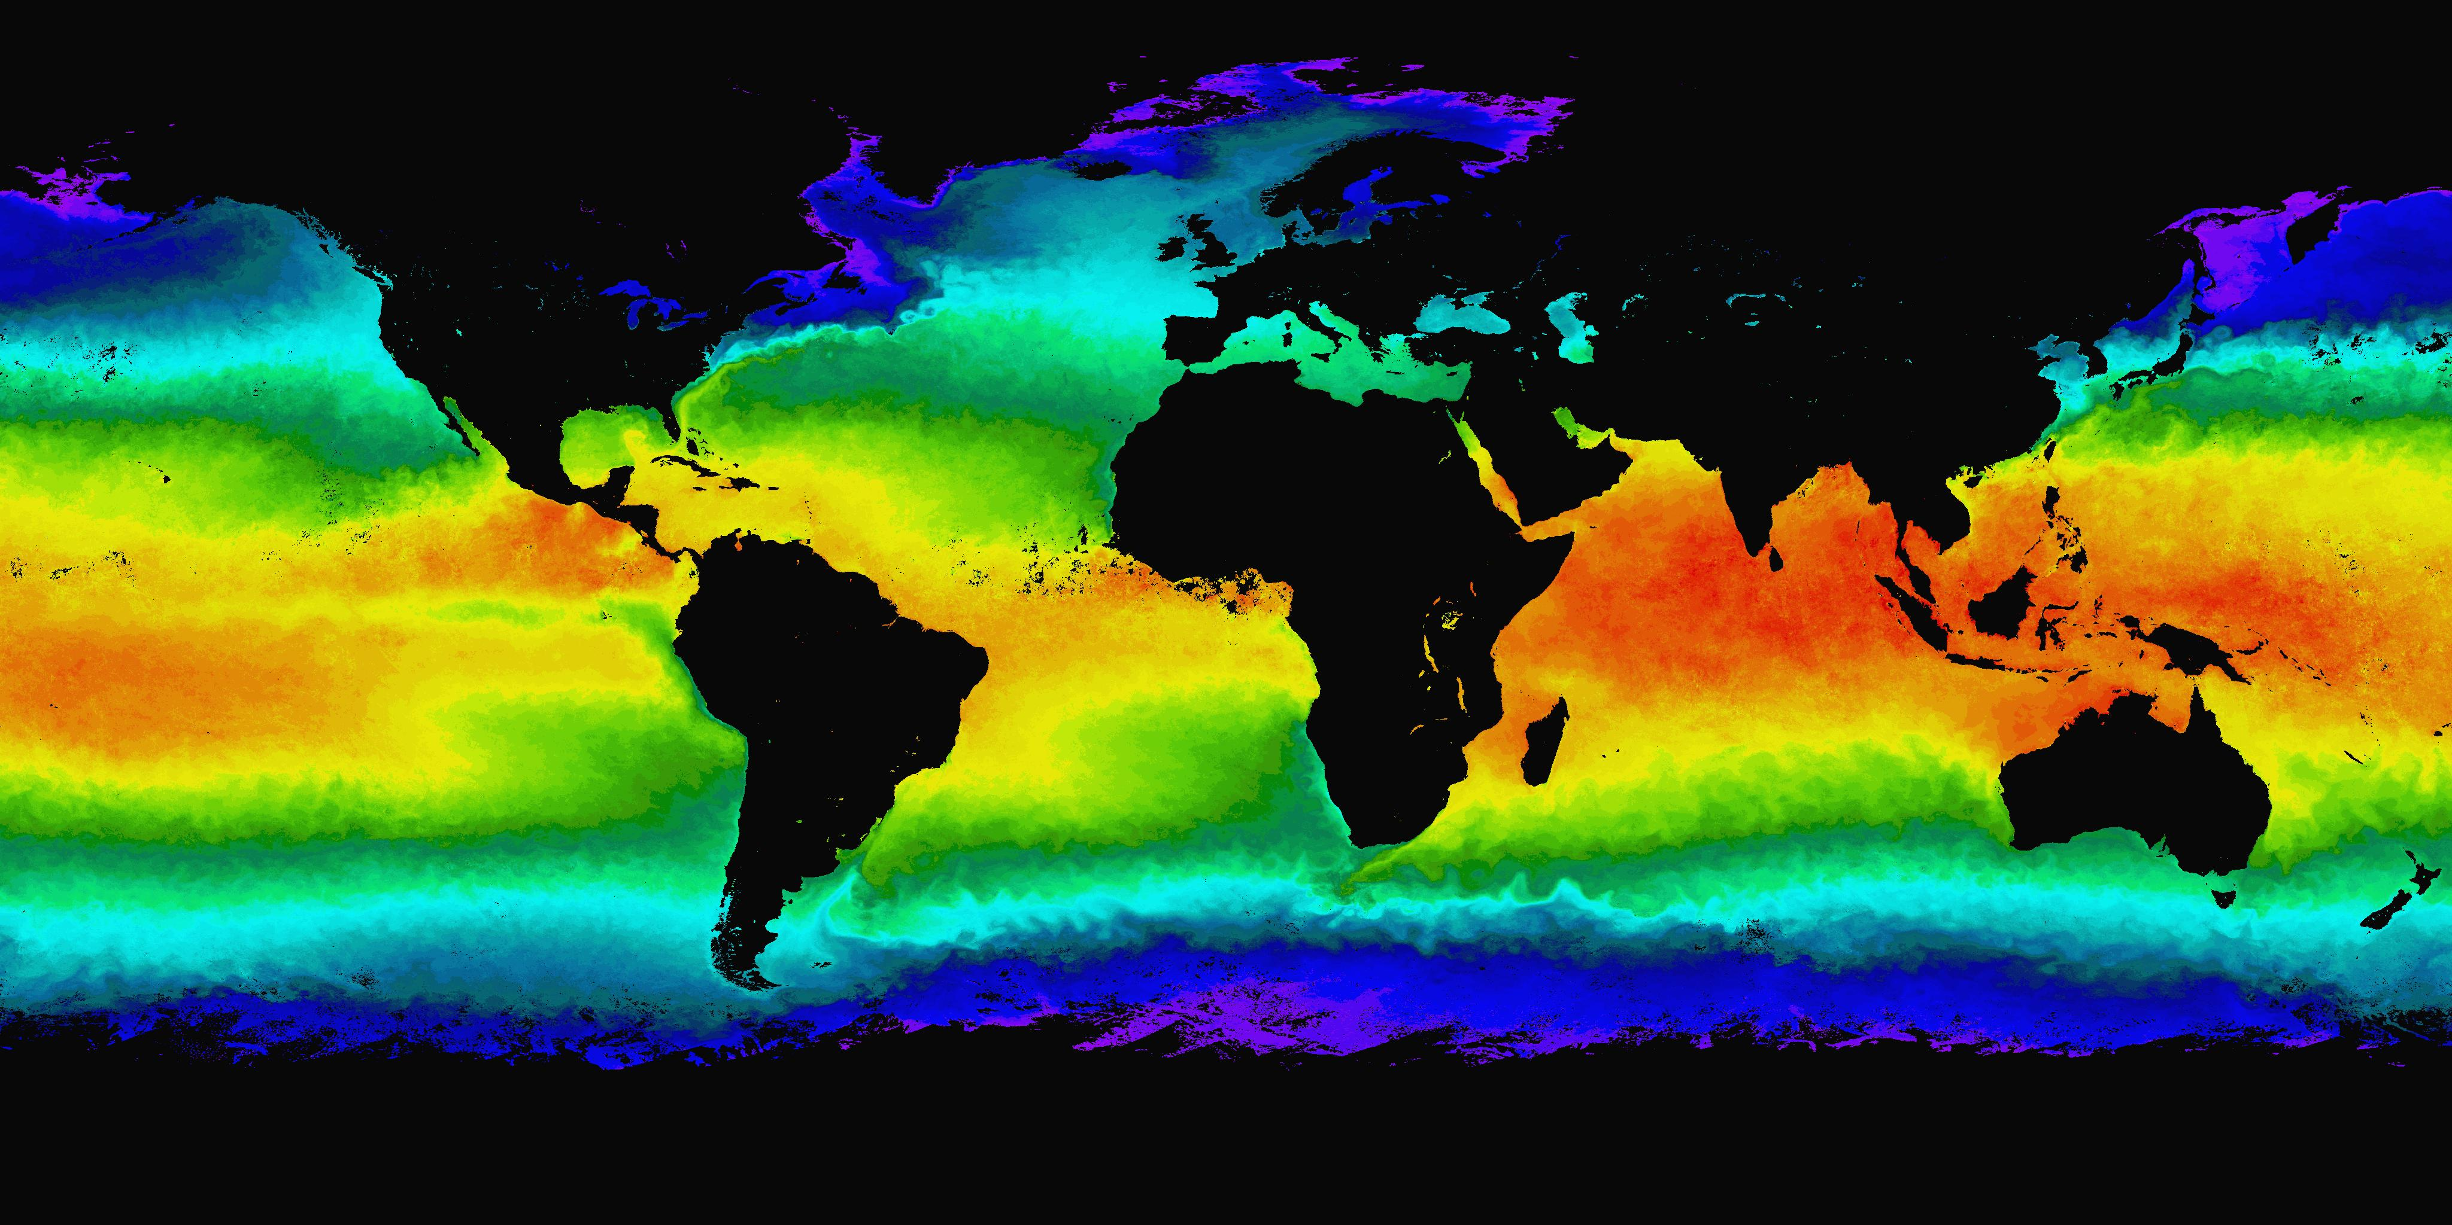

Aqua MODIS Sea Surface Temperature, April 2004
Notes:
Global composites of sea surface temperature and chlorophyll reveal the relationship between temperature and ocean productivity.

Slide 45
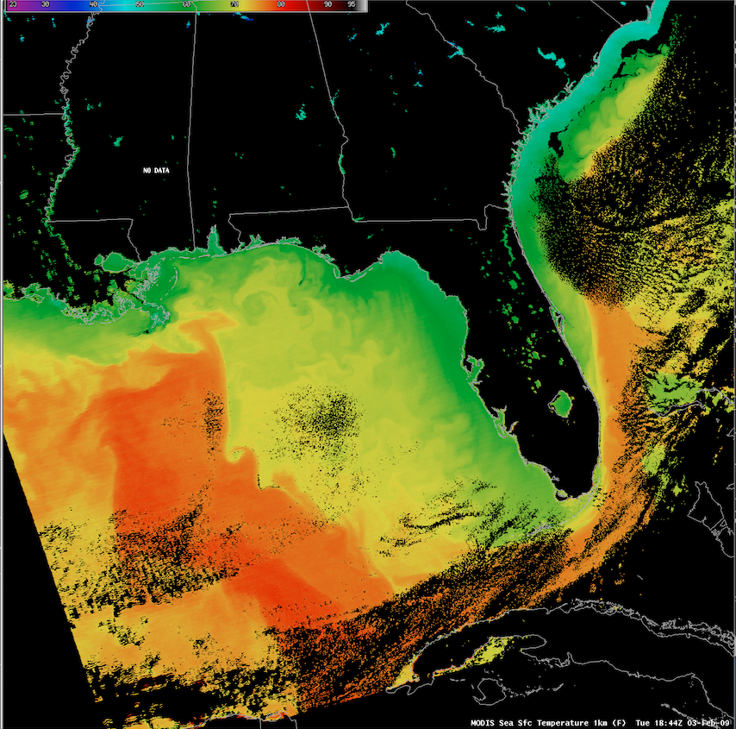

Slide 46
MODIS Sea Surface Temperature used by Forecasters
AREA FORECAST DISCUSSION...UPDATED
NATIONAL WEATHER SERVICE MILWAUKEE/SULLIVAN WI
338 AM CDT TUE MAY 31 2011
UPDATED TO ADD TODAY/TONIGHT AND AVIATION/MARINE SECTIONS
.MARINE...CLEAR MODIS IMAGE FROM MONDAY EARLY AFTN SHOWED SHALLOWER NEAR SHORE WATERS HAD WARMED INTO THE LOWER 50S...WHILE MID LAKE TEMPS REMAINED IN THE MID 40S DUE TO OVERTURNING. TIGHTENING PRESS GRADIENT THIS MORNING AND SUNSHINE WILL RESULT IN STRONG MIXING EARLY THIS MRNG. HENCE WL BUMP UP START OF SMALL CRAFT ADVY SEVERAL HOURS...AND RUN INTO THE EVE. FEW GUSTS NEAR THE SHORE MAY REACH 30-35 KNOTS LATER THIS MRNG/EARLY AFTN.

Slide 47
MODIS Ocean Standard Products
SeaDAS - a1.15039.1951.seadas.hdf for MODIS
Geophysical Parameter Name | Description
nLw_412 | Normalized water-leaving radiance at 412 nm
nLw 443 | Normalized water-leaving radiance at 443 nm
nLw_488 | Normalized water-leaving radiance at 488 nm
nLw_531 | Normalized water-leaving radiance at 531 nm
nLw_551 | Normalized water-leaving radiance at 551 nm
nLw_667 | Normalized water-leaving radiance at 667 nm
Tau_869 | Aerosol optical thickness at 869 nm
Eps_78 | Epsilon of aerosol correction at 748 and 869 nm
Chlor_a | OC3 Chlorophyll a concentration
K490 | Diffuse attenuation coefficient at 490nm
Angstrom_531 | Angstrom coefficient, 531-869 nm
SST | Sea Surface Temperature: 11 micron
SST4 | Sea Surface Temperature: 4 micron (night only)

Slide 48
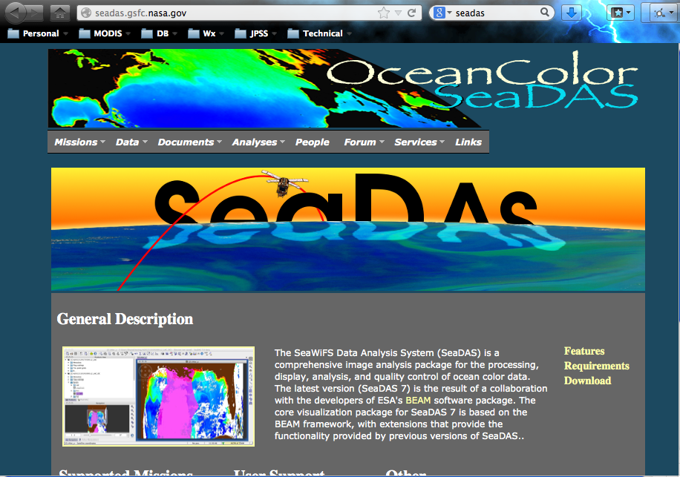
Ocean Color - SeaDAS

Slide 49
MODIS Atmospheric Correction for Ocean Bands
Statement of the problem:
Total radiance observed by the satellite is composed of 5-10% ocean signal and 90-95% atmosphere signal.
The atmospheric and ocean surface scattering effects must be accurately modelled and removed.
Desired parameter is normalized water leaving radiance (nLw) for MODIS bands 8, 9, 10, 11, 12, 13 (0.412, 0.443, 0.488, 0.531, 0.551, 0.667 microns)
Aerosol model selection:
Assume zero (or negligible) water leaving radiance in the NIR bands (15 and 16; 0.750 and 0.865 microns); remainder is from aerosols.
This is extrapolated to visible wavelengths using aerosol models.
For case 1 waters, NIR bands are used to select aerosol model.
Where this assumption is not valid, water-leaving radiance in NIR bands is estimated and removed prior to aerosol model selection.

Slide 50
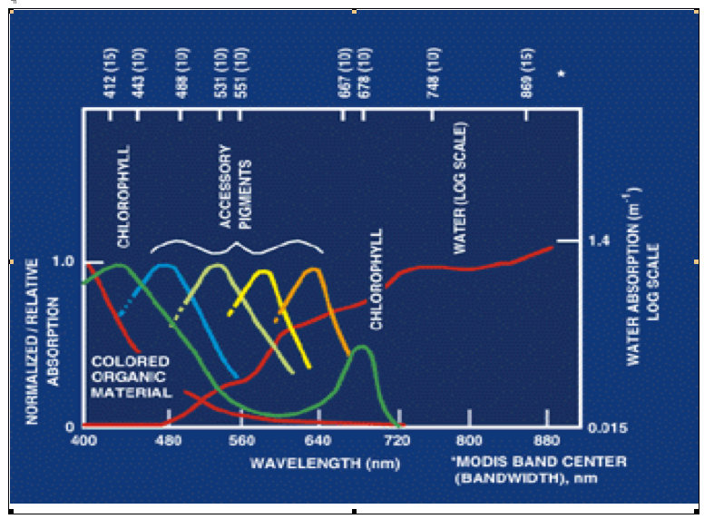
Visible light absorption by water

Slide 51
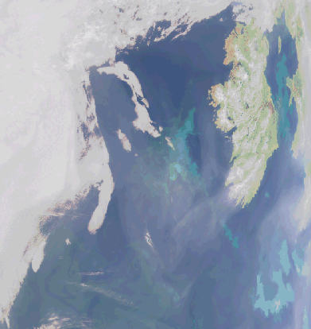
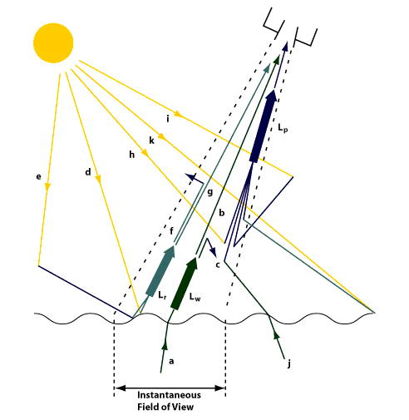
Atmospheric correction is critical for ocean color retrievals
Clouds
Clouds
L_{w} is only 5-10% of signal reaching satellite: rest due to L_{p}
L_{p} components: molecular (Rayleigh) & aerosols

Slide 52
MODIS Chlorophyll Algorithm (OC3)
Semi-analytical algorithm⁽¹⁾
Chl_a = 10**(0.283 - 2.753*R + 1.457*R² + 0.659*R³ - 1.403*R⁴)
where:
R = log10((Rrs443 > Rrs488) / Rrs551)
Rrs = nLw / F0; remote sensing reflectance
F0 = extraterrestrial solar irradiance
nLw = water leaving radiance at 443, 488, 551
⁽¹⁾ Performance of the MODIS Semi-analytical Ocean Color Algorithm for Chlorophyll-a Carder, K.L.; Chen, F.R.; Cannizzaro, J.P.; Campbell, J.W.; Mitchell, B.G. Advances in Space Research. Vol. 33, no. 7, pp. 1152-1159. 2004

Slide 53
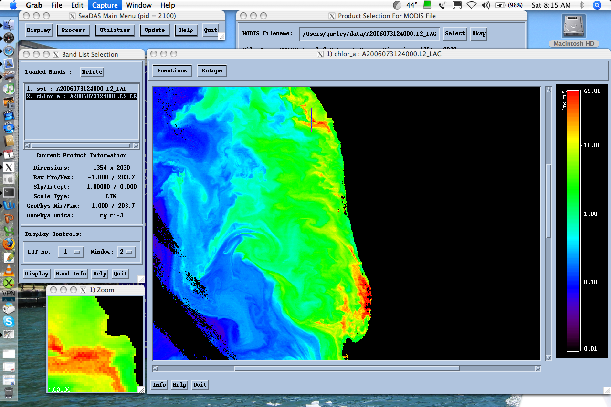

Slide 54
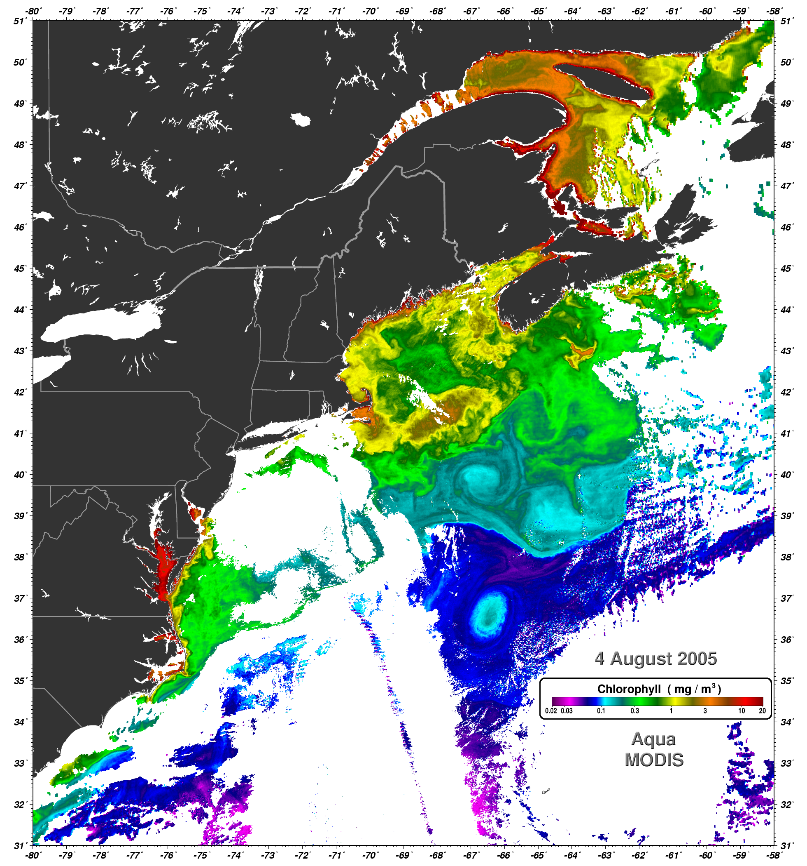
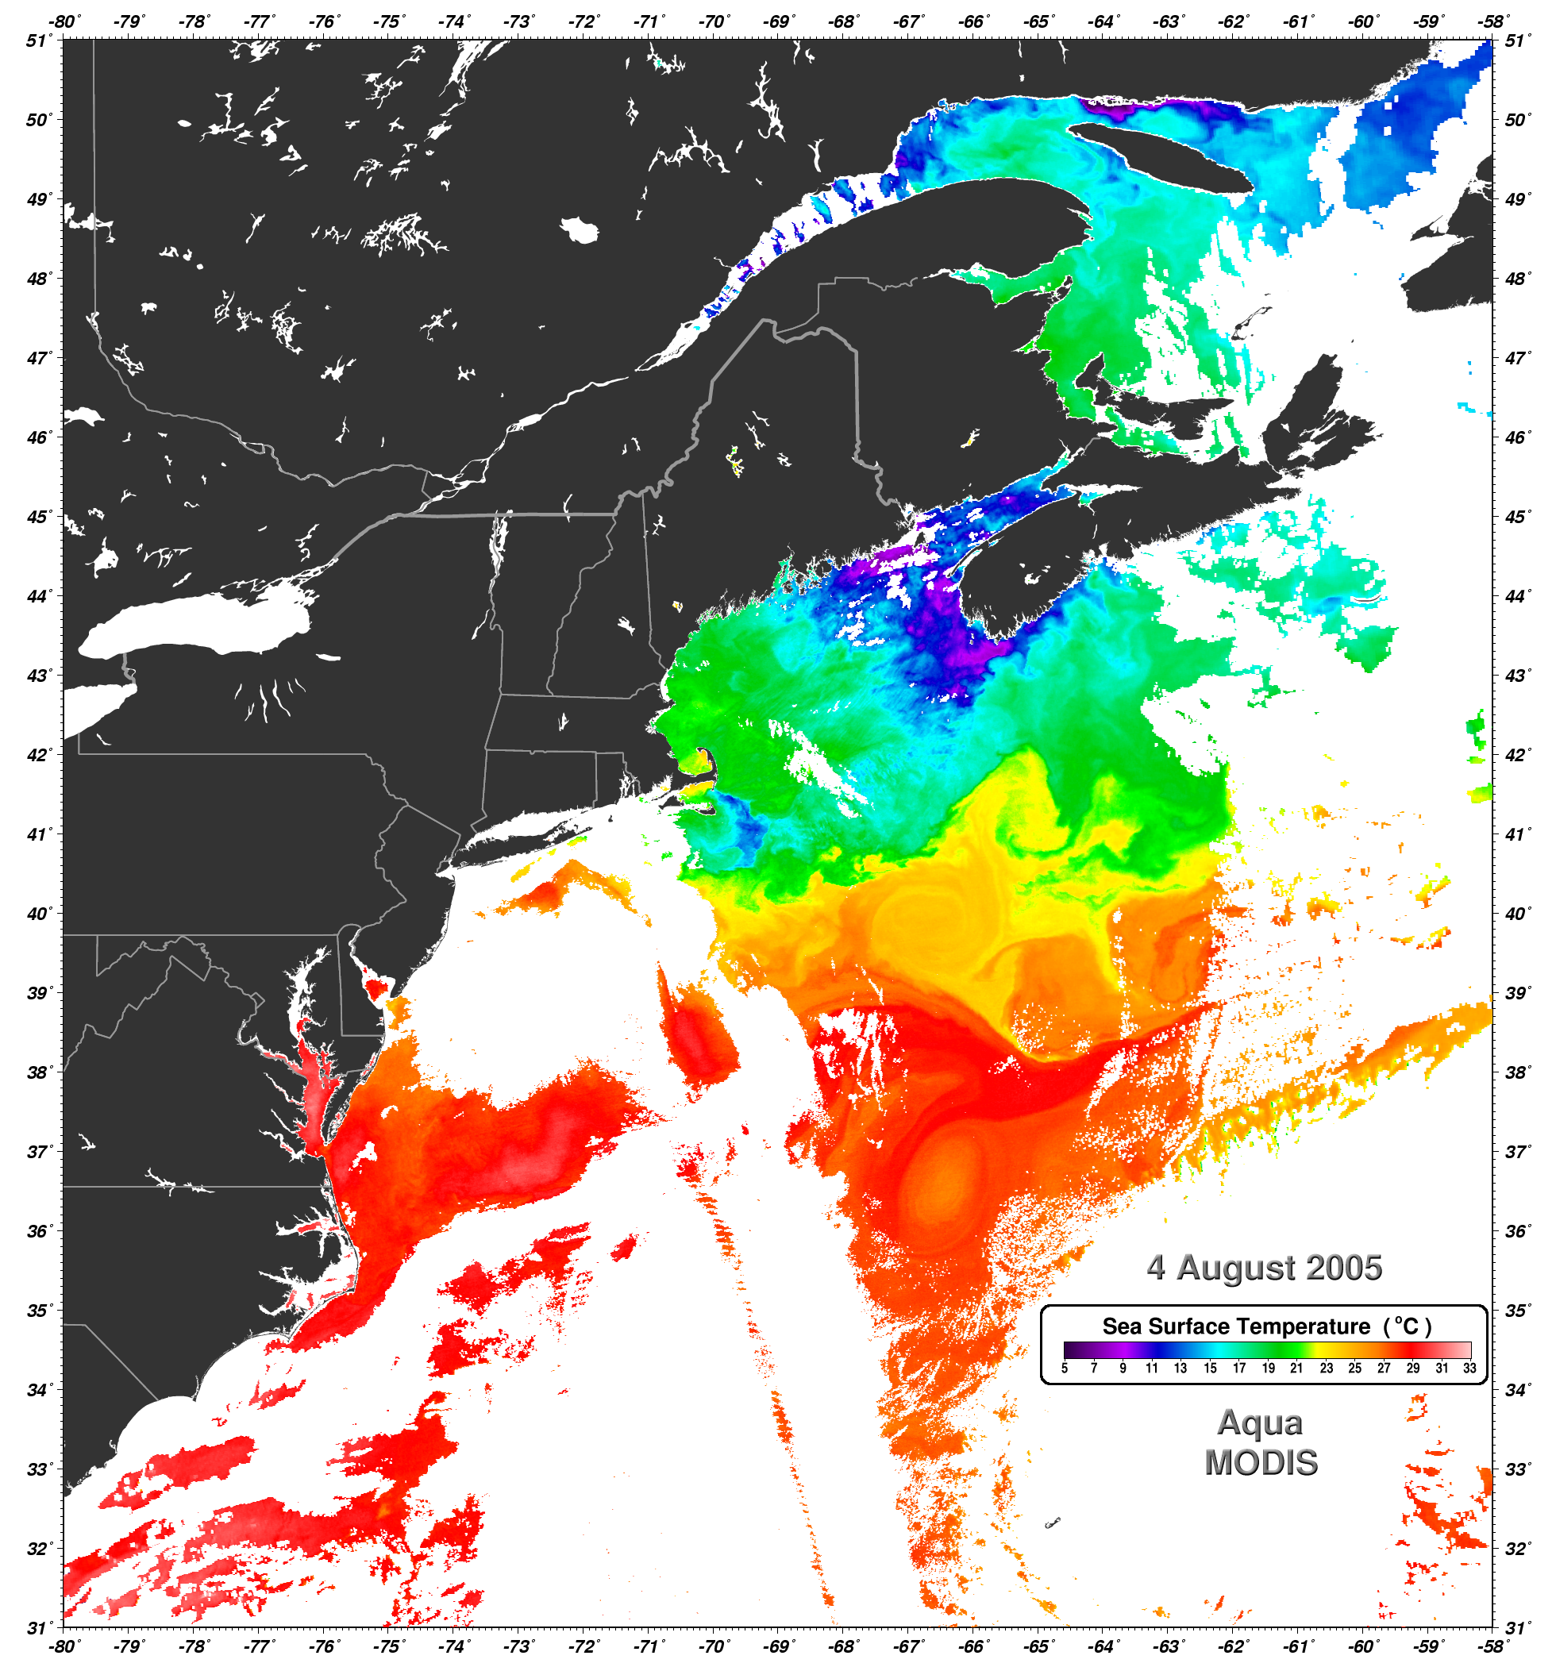

Slide 55
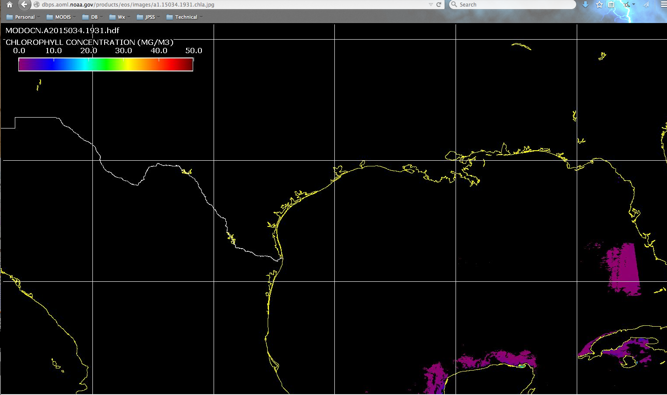

Slide 56
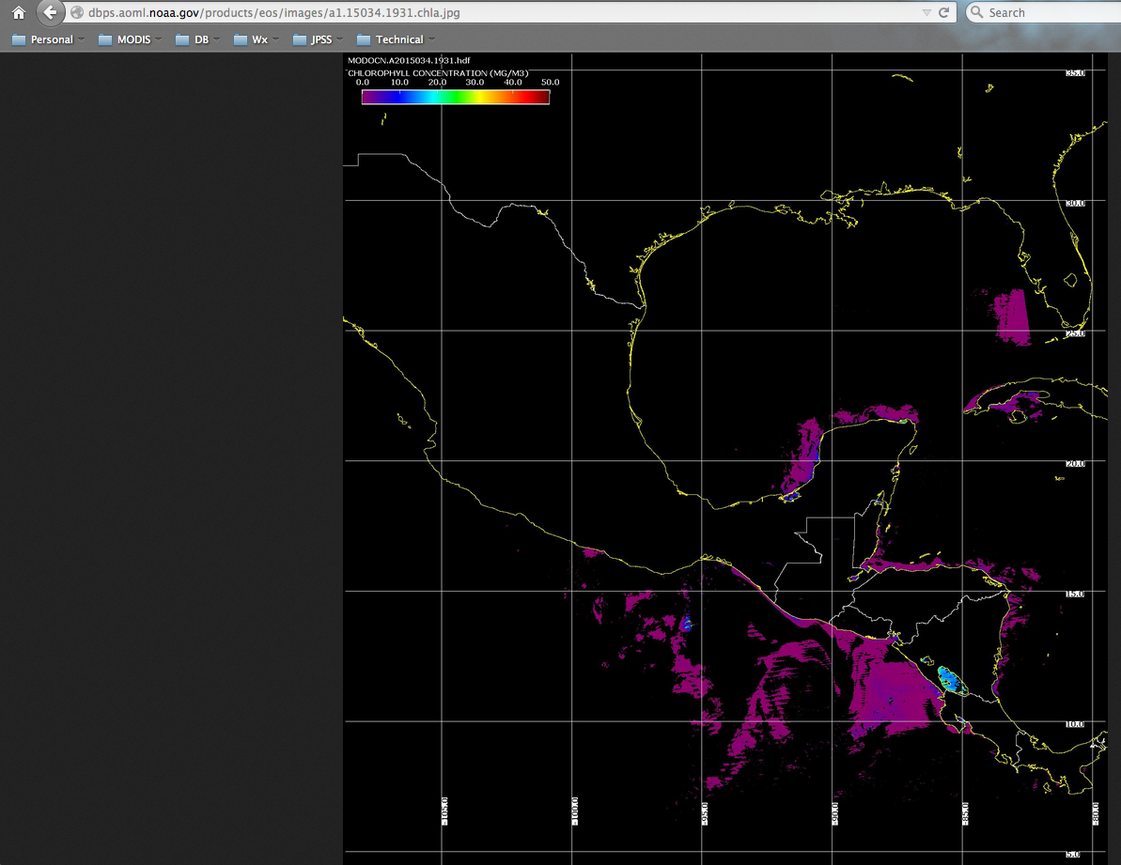

Slide 57
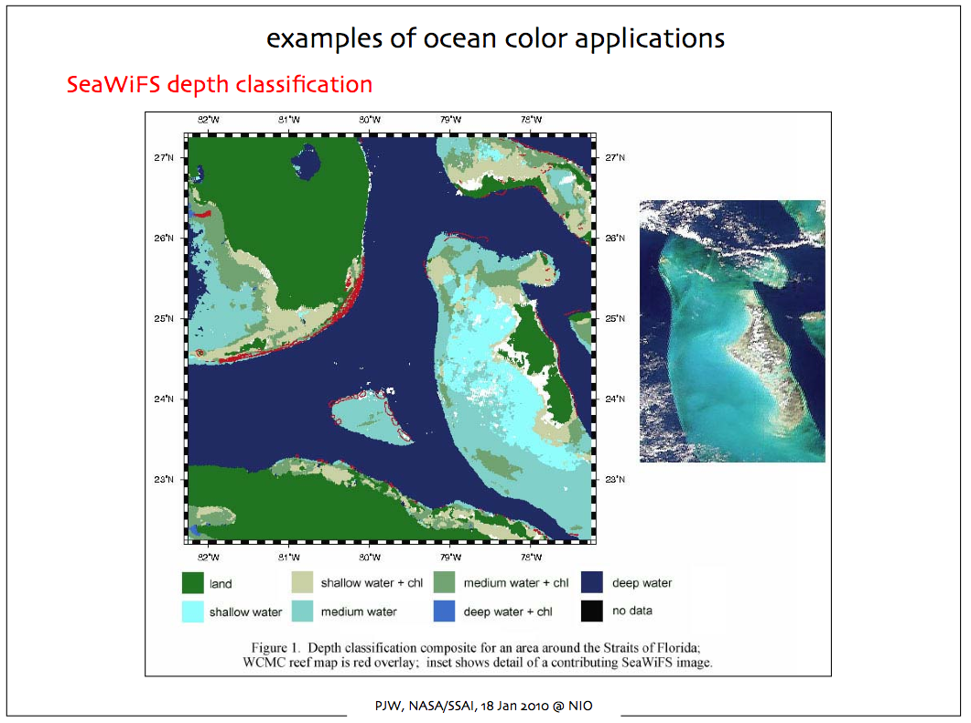

Slide 58
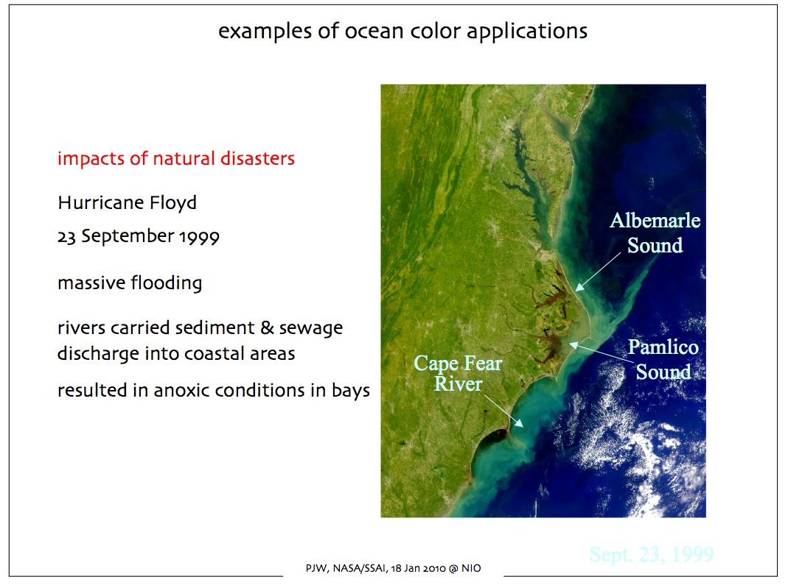

Slide 59
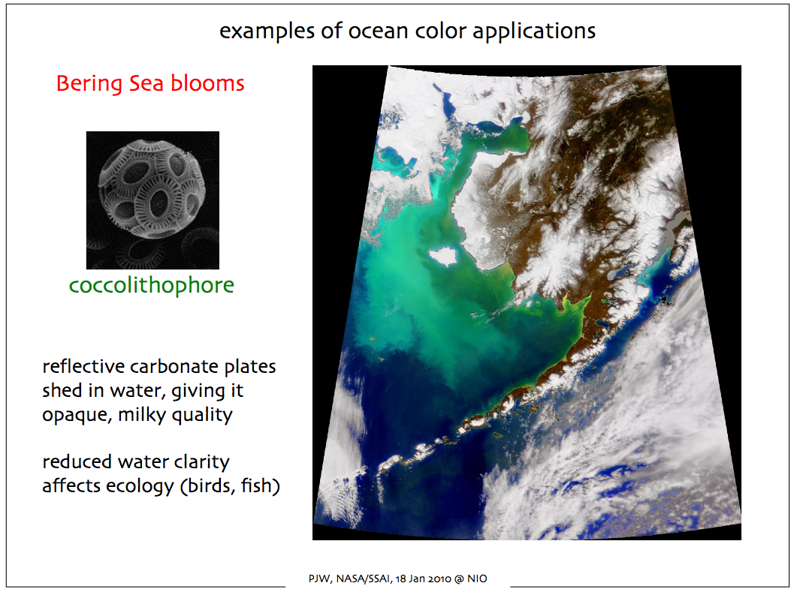

Slide 60
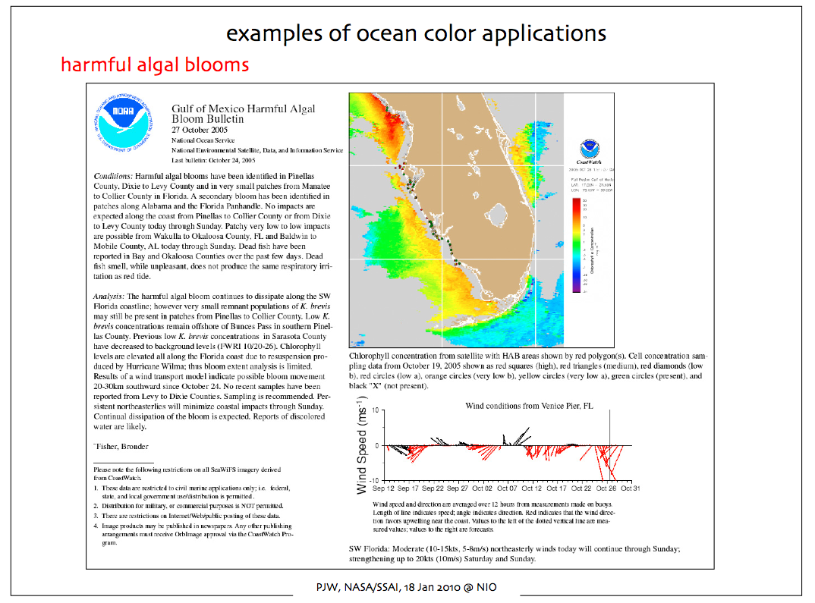

Slide 61
Air Quality Applications
Aerosol Detection

Slide 62
Scattering and Absorption of Light by Aerosols
I=Light
Detector (W/m²)
Io=Light Source (W/m²)
L=Path Length
The quantity L is called the density weighted path length. σ_{ext(λ)} L is a measure of the cumulative depletion that the beam of radiation has experienced as a result of its passage through the layer and is often called the optical depth τ_{λ}.

Slide 63
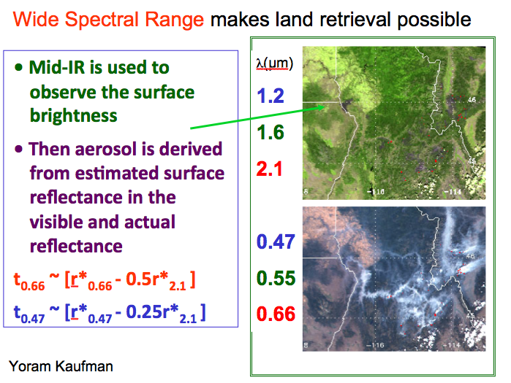

Slide 64
3 non-dust models
plus dust
Set by geography and
season
Models are dynamic f(τ)
Notes:
We have to build a LookUp Table that gives top of atmosphere radiance for a variety of geometries and aerosol amounts. Then we match the observed radiance from MODIS to the calculated radiance in the LUT to get the AOT. But to make the calculation we need to input other information about the aerosol optical properties besides the optical thickness. These assumptions make a big difference in the accuracy of the retireval. Over land we make arbitrary assumptions about the aerosol types depending on season and geography.

Slide 65
The Ocean Algorithm
Choice of 4 fine modes
and 5 coarse modes
And 5 coarse modes
In order to minimize
(ρ_{meas} - ρ_{LUT}) over 6 wavelengths
Notes:
This is the annimation I use to explain the ocean algorithm. Here we don’t worry too much about the ocean surface because it is well-characterized at the wavelengths we use in the retrieval. Because of the constant surface we have more information from the aerosol and can determine both aerosol optical thickness and also aerosol size with good accuracy. The algorithm finds a combination of one fine mode and one coarse mode, and the relative amounts of each that best match the measured reflectances at top of atmosphere in 6 wavelengths. When it makes the match, everybody is happy.

Slide 66
MODIS Over Land Algorithm
20 x 20 pixels at 500 m resolution
(10 km at nadir)
400 total
- 56 water
________
344
- 24 snow
________
320
- 55 cloud
_______
265
-116 “bright”
________
149 “good”
water
snow
cloud
cloud
Discard brightest 50%
and darkest 20% of the
149 good pixels.
10 km
44 pixels
Notes:
Here we show why we retrieve at 10 km resolution even though we use 500 m pixels. We are in the data discarding business! In a 10 km box we have 20 x 20 pixels at 500 m (400 total). In this land scene we eliminate pixels identified as water, snow or cloud and are left with 265 pixels. Then because we are looking for dark vegetated surfaces, we eliminate the pixels determined to be too bright. That brings us down to 149 good pixels. We aren’t done yet! Then we systematically discard the brightest 50% of the pixels to be sure to eliminate residual cloud or bright surfaces, and also the darkest 20% to eliminate cloud shadows. From the original 400 pixels we are left with 44 pixels. We average the measured reflectances of these 44 pixels and do the retrieval from them. All we need in the 10 km box is 12 remaining pixels to do a retrieval.

Slide 67
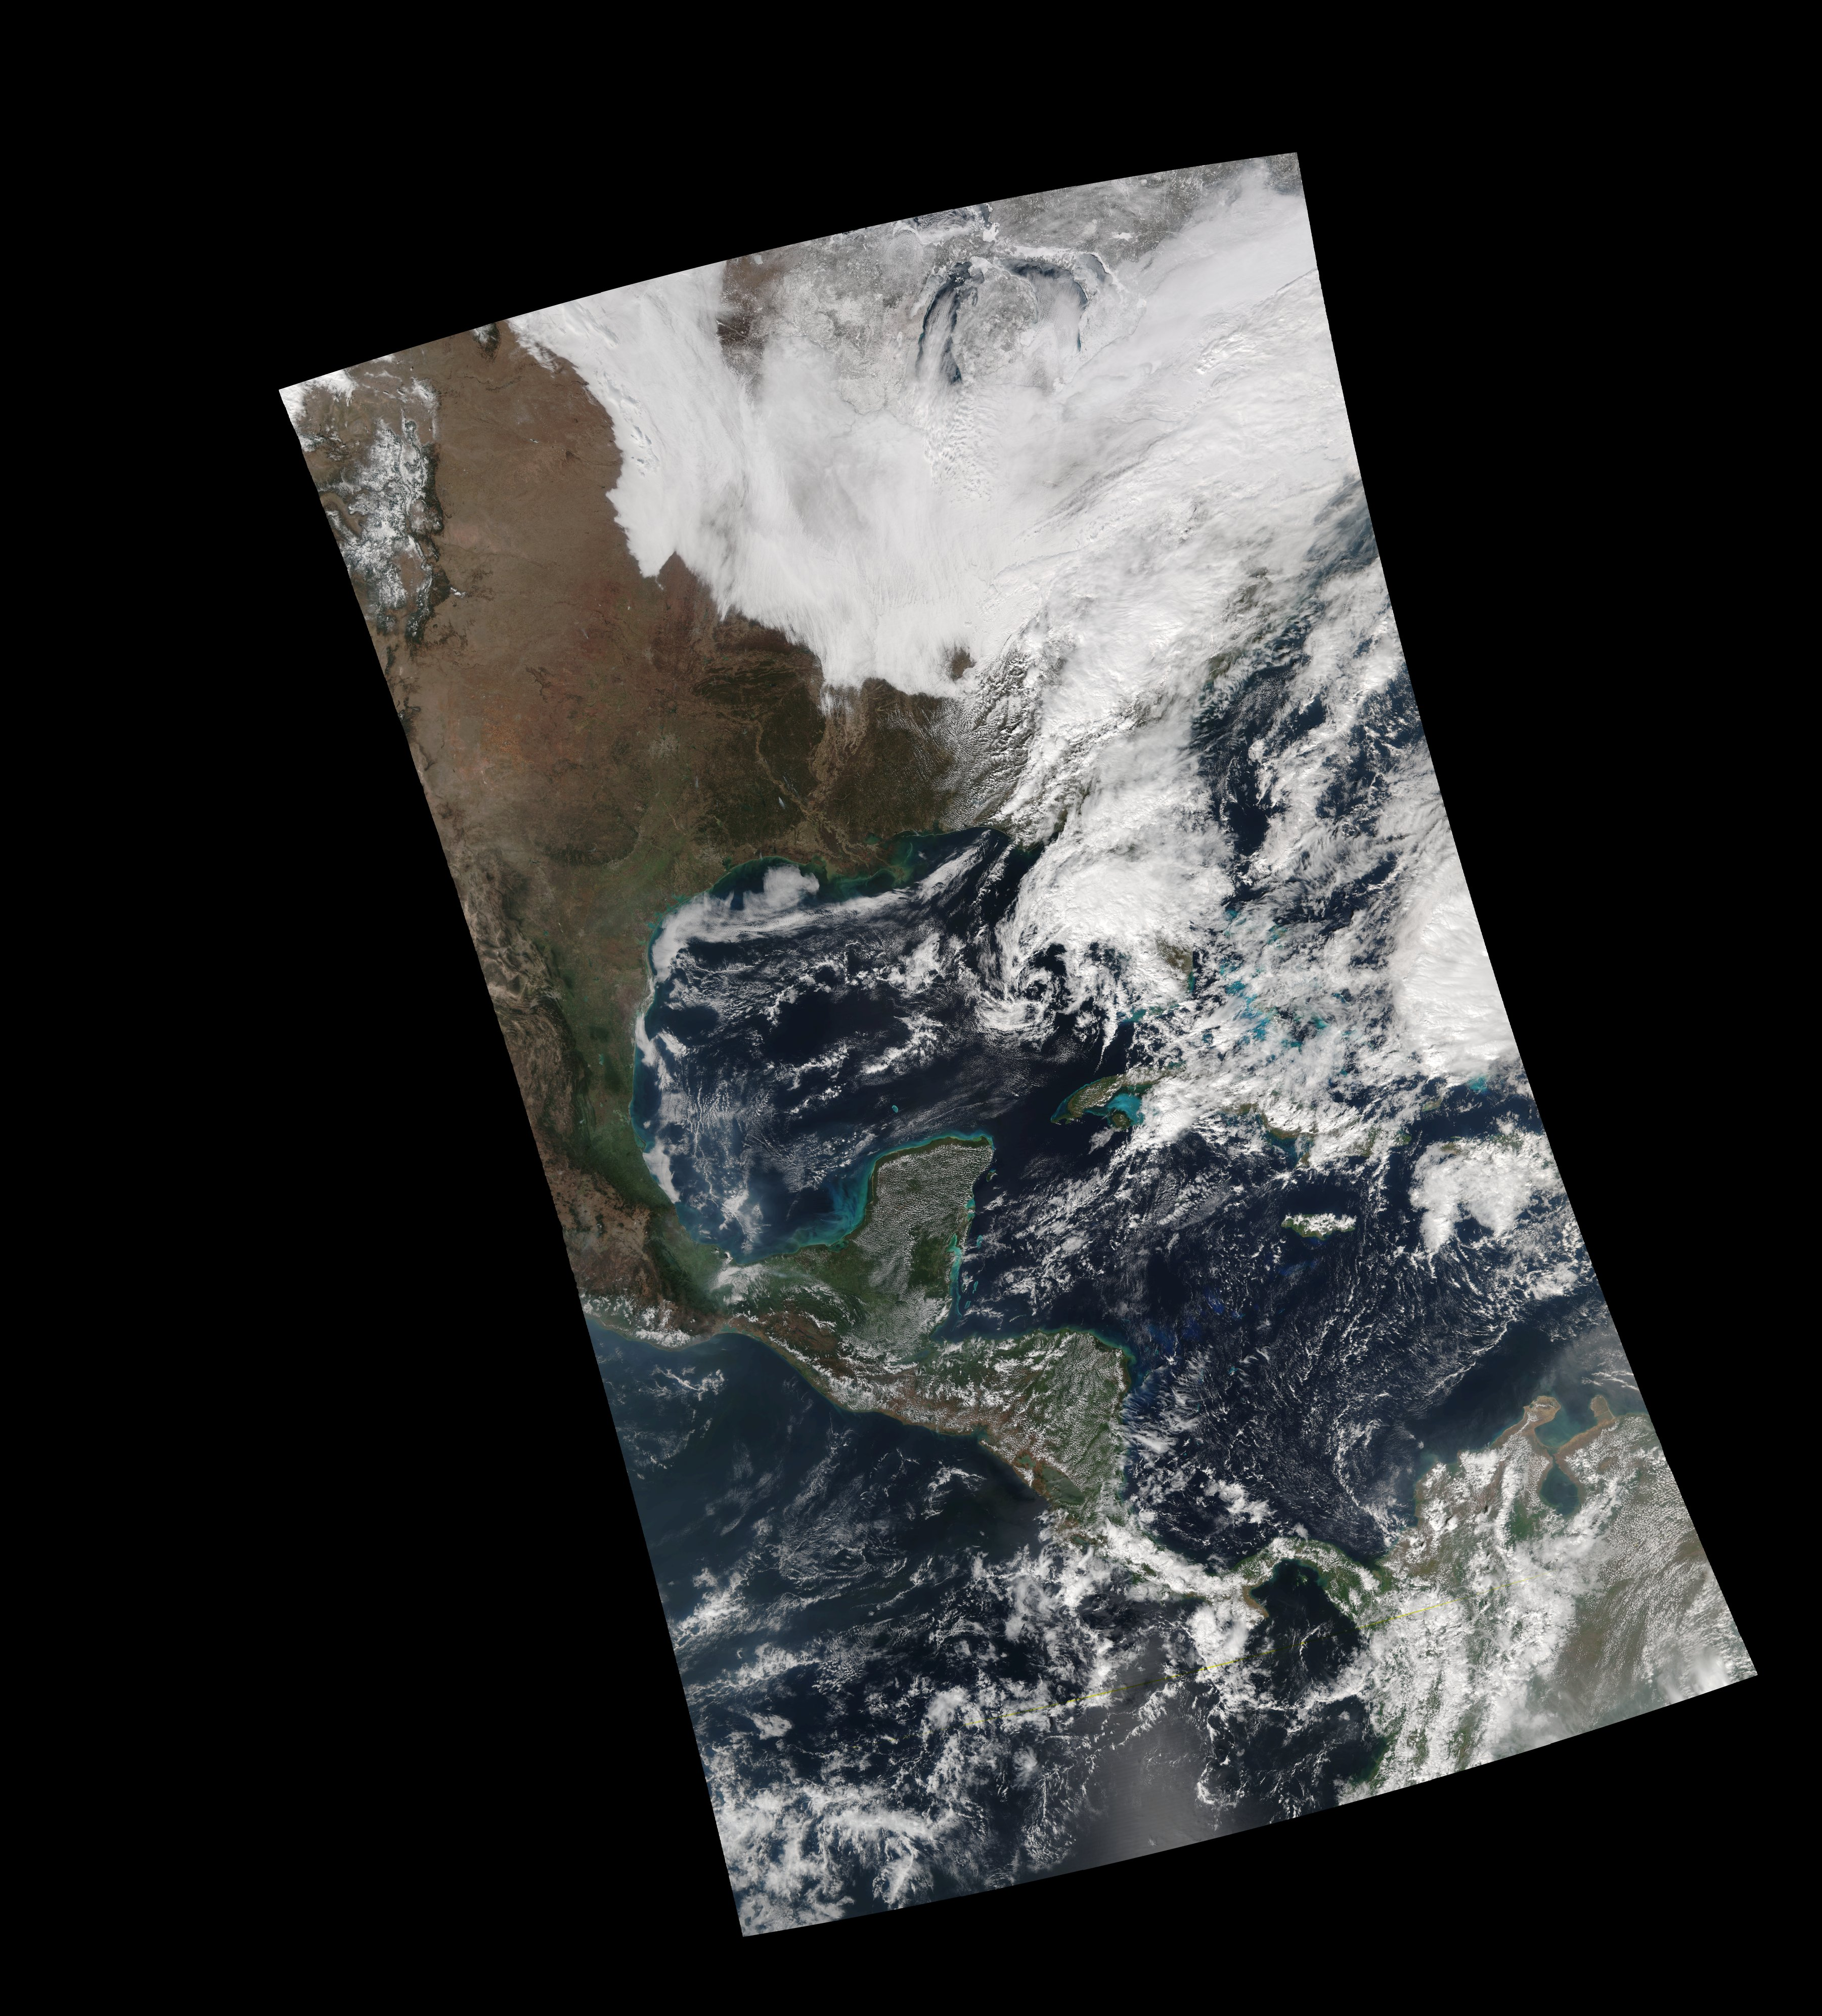
VIIRS True Color Image 9 February 2015 18:53 UTC

Slide 68
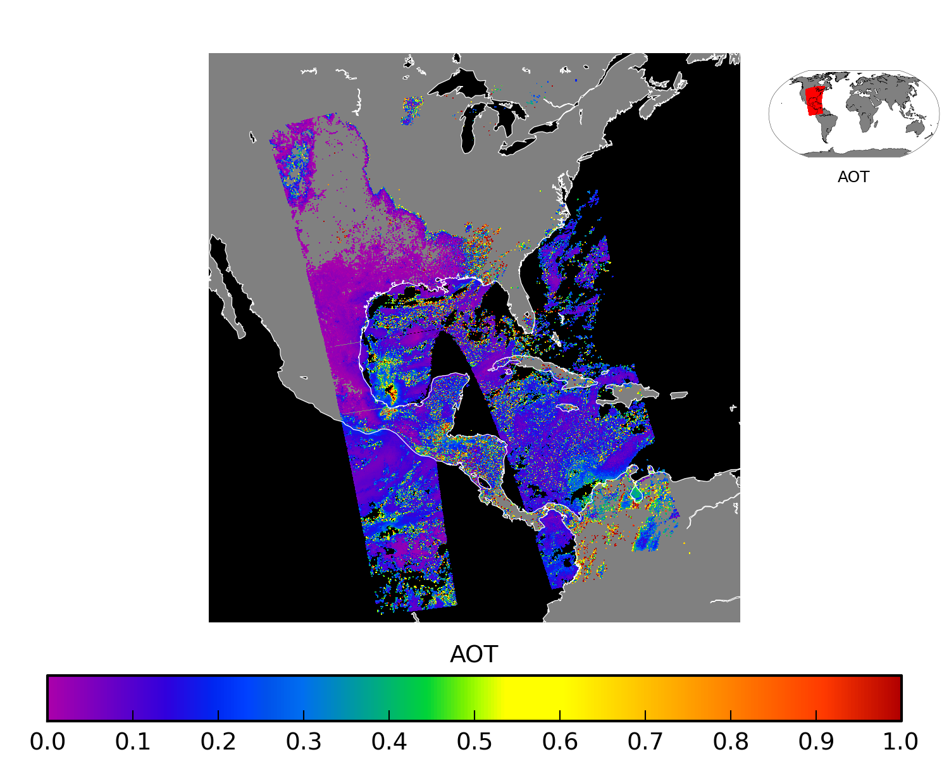
VIIRS Aerosol Optical Thickness 9 February 2015 18:53 UTC

Slide 69
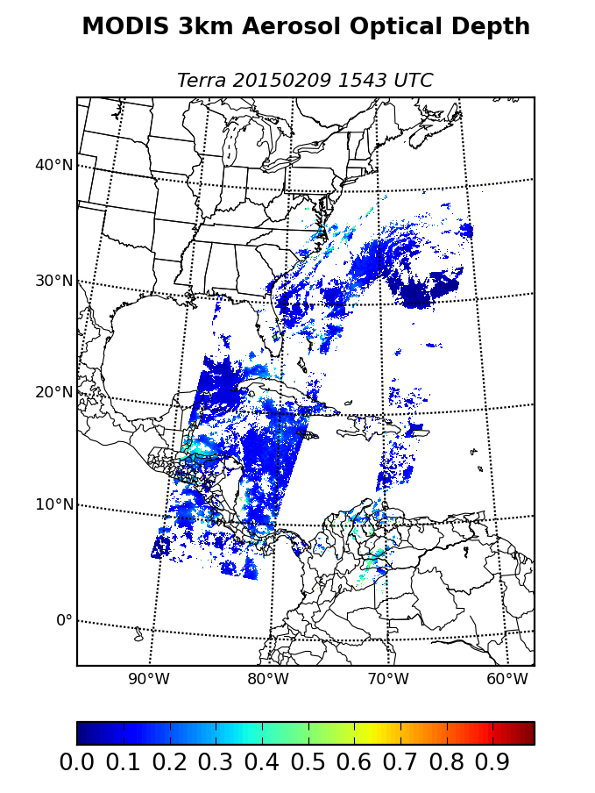

Slide 70
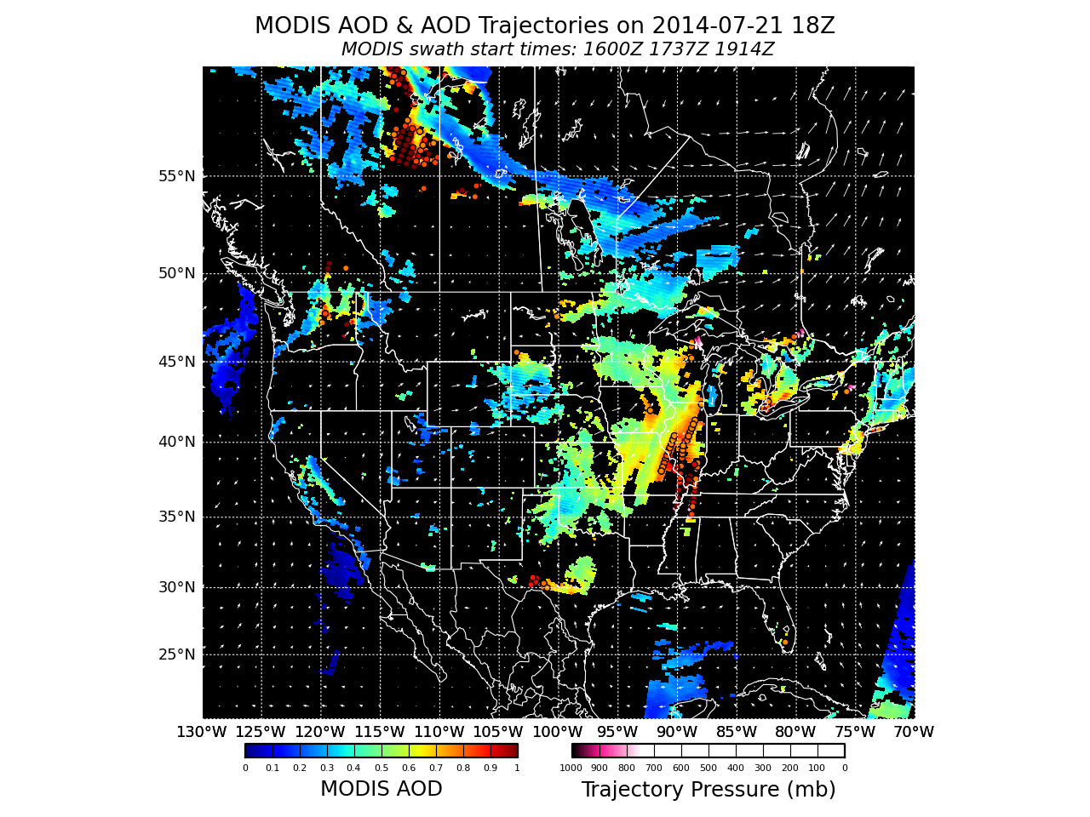

Slide 71
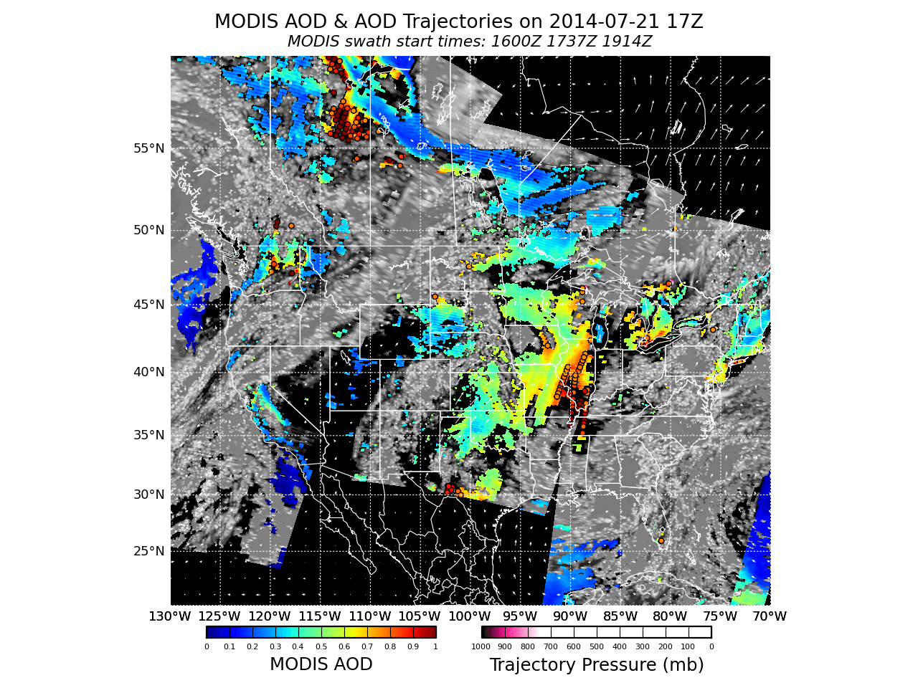

IDEA-I Infusing Satellite Data into Environmental Applications

Slide 72
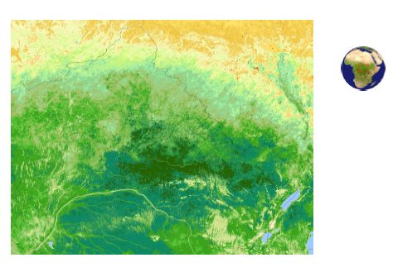
Vegetation Index
Normalized Difference Vegetation Index (NDVI) image of Central Africa
http://rapidfire.sci.gsfc.nasa.gov/

Slide 73
Photo-Chemistry
Light may be absorbed and participate (drive) a chemical reaction. Example: Photosynthesis in plants
Only certain wavelengths are absorbed by some participant(s) in the reaction
Some structure must be present to allow the reaction to occur –Chlorophyll
Combination of chemical and structural properties of plants

Slide 74
Primary and secondary absorbers in plants
Primary
  Chlorophyll-a
  Chlorophyll-b
Secondary
  Carotenoids
  Phycobilins
  Anthocyanins

Slide 75
Absorption of Visible Light by Photo-pigments
Sunlight
Intensity
Chlorophyll b
Phycocyanin
Absorption
B-Carotene
Chlorophyll a
300 400 500 600 700 800
Wavelength [nm]
Lehninger, Nelson and Cox

Slide 76
Theoretical description
VISIBLE radiation is highly absorbed
by vegetation in the red (0.68 micron)
and in the blue (0.47 micron). The
absorption is mainly due to
photosynthetically active pigments
NIR radiation is reflected
and transmitted with very
little absorption by vegetation
Contrast between RED and NIR
responses is correlated to
vegetation amount

Slide 77
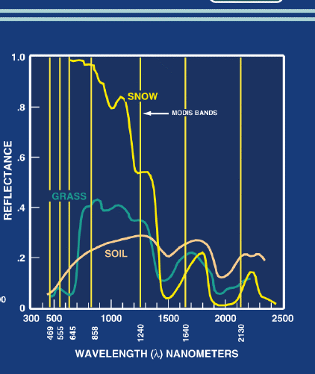

Slide 78
Soil and crop reflectance

Slide 79

Simple Ratio (SR)
It was the first index to be used (Jordan, 1969)
Defined as the ratio X_{nir}/X_{red}
For densely vegetated areas X_{red} tends to 0 and SR increases without bounds

Slide 80

Normalized Difference Vegetation Index (NDVI)
Defined as the ratio
(X_{nir} - X_{red})/(X_{nir} + X_{red})
Correlated with:
Plant Biomass | Crop Yield
Plant Nitrogen | Plant Dhlorophyll
Water Stress | Plant Diseases
Insect Damage
Applications:
Vegetation Monitoring | Agricultural Activities
Drought studies | Landcover Change
Public Health Issues (mosquitos) | Climate Change Detection
Net Primary Production | Carbon Balance

Slide 81



NIR and VIS over Vegetation and Ocean
Vegetation
Ocean
NIR (.86 micron)
Green (.55 micron)
Red (0.68 micron)
RGB
NIR

Slide 82




RED
NIR
Dense Vegetation
Less Vegetation
NIR
Less Vegetation
Barren Soil
Ocean
True Color
RED

Slide 83

MODIS 1km NDVI Product
Day

Slide 84
Using MODIS Sun Glint Patterns
What is sun glint?
Application
  Identifying oil spills
  Identifying regions of calm waters
  Relationship of calm waters and sea surface temperatures

Slide 85


Sun Glint
Simple example where your eye is the sensor
Sun Glint Ellipse Defined by: θ_{r} < 36
cos θ_{r} = sin θ_{v} cos θ_{s} cos ΔΦ + sin θ_{v} cos θ_{s}
Where θ_{v} = Viewing Zenith Angle
θ_{s} = Solar Zenith Angle
ΔΦ = Relative Angle – difference between the Solar and Viewing azimuth angles.

Slide 86

Aqua MODIS Sun Glint Example
9 July 2014

Slide 87

Sun Glint Patterns
9 July 2014

Slide 88


NASA Feature Article
30 April 2010
Gulf Oil Spill
Data Acquired
and Processed
at the University
of Wisconsin-
Madison from
MODIS Direct
Broadcast.
http://www.nasa.gov/topics/earth/features/oil-creep.html

Slide 89


Example From Lake Michigan
4 June 2009

Slide 90

Numerical Weather Prediction
Wind analysis 18 UTC 4 June 2009

Slide 91


MODIS Sea Surface Temperatures
4 June 2009

Slide 92


MODIS 4 μm Brightness Temperatures

Slide 93

MODIS Sunglint Pattern
8 June 2009

Slide 94

VIIRS DNB Moonglint Pattern
4 February 2015

Slide 95


MODIS LST and buggers
Reference: X. Porcasi, , S. S. Catala, H. Hrellac, M. C. Scavuzzo, D. E. Gorla, 2006: Infestation of Rural Houses by Triatoma Infestans
(Hemiptera: Reduviidae) in Southern Area of Gran Chaco in Argentina, J. Med. Entomol. 43(5): 1060-1067.

