Slide 1
Polar Orbiter Product Environmental Applications: Part 1
Kathleen Strabala
Miami Direct Broadcast Polar Orbiter Workshop
Atlantic Oceanographic and Meteorological Laboratory (AOML) of NOAA
11 February 2015

Slide 2
AOML Polar Orbiter DB Products
Products Created from:
Community Satellite Processing Package (CSPP) – VIIRS, CrIS and ATMS
International MODIS/AIRS Processing Package(IMAPP) – MODIS, AIRS and AMSR-E
SeaDAS – NASA Ocean Biology Group
http://seadas.gsfc.nasa.gov/
MODIS L1B software
Ocean products from MODIS and VIIRS
NASA science products distributed through the NASA Direct Readout Lab (DRL)
http://directreadout.sci.gsfc.nasa.gov/

Slide 3
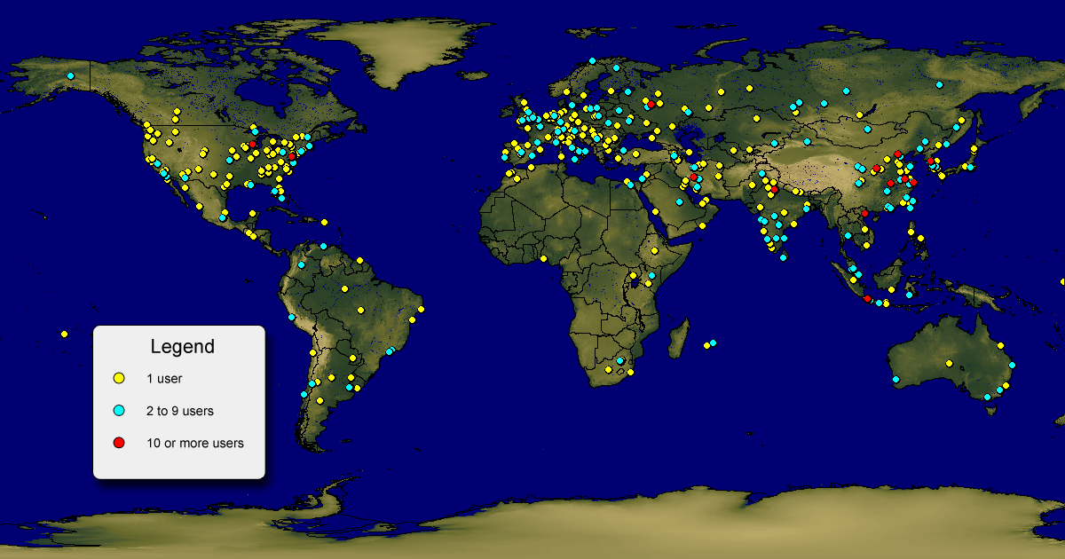
Global IMAPP Downloads
More than 2000 people have downloaded some part of the IMAPP suite of products representing 70 different countries and all 7 continents (since 2007)

Slide 4
http://cimss.ssec.wisc.edu/imapp/

Slide 5
IMAPP Software Suite
MODIS Atmosphere and Polar Products Cloud mask Cloud top pressure and temperature Cloud optical depth and effective radius Temperature and moisture profiles Total precipitable water Stability indices Aerosol optical depth Ice Surface Temperature Snow Mask Ice Cover and Ice Concentration Inversion Strength and Inversion Depth MODIS Land Products Land Surface Reflectance BRDF MODIS Image Software MODIS in Google Earth (true color) AIRS Level 1B Calibrated and geolocated radiances and brightness temperatures (AIRS) Calibrated and geolocated antenna temperatures (AMSU) | AIRS Retrievals JPL 3x3 FOV Dual Regression Single FOV AIRS Utilities Collocating AIRS/MODIS utility AIRS HDF to BUFR utility AMSR-E Level 1B Calibrated and Geolocated Antenna Temperatures AMSR-E Products Rain Rate, Soil Moisture, Snow Water EquiIvalent NWP Products Globally configurable regional numerical weather prediction model that assimilates MODIS DB products - DBCRAS Aviation/Severe Weather Products Overshooting Tops Identification including turbulence and lightning potential Air Quality Forecast Product – IDEA-I Complete DB Processing System VA for Mac, Windows and Linux

Slide 6
http://cimss.ssec.wisc.edu/cspp/

Slide 7
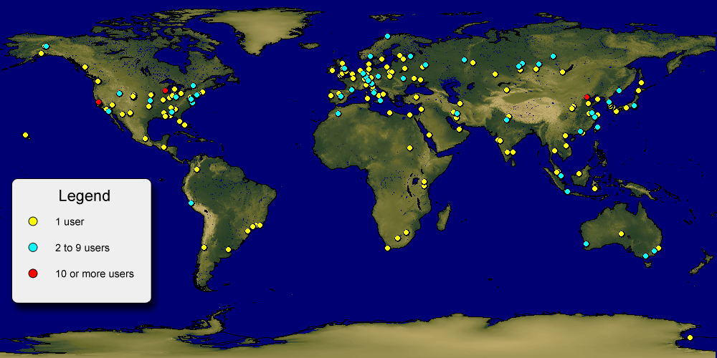
Global CSPP Registrants
More than 800 people have registered since the first CSPP release in March 2012.

Slide 8
CSPP Software Suite http://cimss.ssec.wisc.edu/cspp
Suomi NPP CrIS, VIIRS and ATMS SDR (geolocation and calibration)
Suomi NPP VIIRS EDR (cloud mask, active fires, surface reflectance, NDVI, EVI, Surface Type, SST, Aerosol Optical Thickness, Suspended Matter, Land Surface Temperature)
CrIS, IASI, and AIRS Dual Regression Retrieval
VIIRS SDR GeoTIFF and AWIPS Reprojected Imagery
Microwave Integrated Retrieval System (MIRS)
Clouds from AVHRR Extended (CLAVR-x)
HYDRA2 Multispectral Data Analysis Toolkit
VIIRS Imagery EDR (projected imagery for AWIPS)

Slide 9
AOML DB Data Server Directory Structure

Slide 10
AOML MODIS DB Data Server Directory Structure

Slide 12
Hawaii MODIS Standard Level 2 Products
a1.15039.1951.mod04.hdf – MODIS Aerosol Product file
a1.15039.1951.mod04_3k.hdf – MODIS Aerosol High Resolution Product file
a1.15039.1951.mod06ct.hdf – MODIS Cloud Top Properties file
a1.15039.1951.mod07.hdf – MODIS Atmospheric Profiles file
a1.15039.1951.mod14.hdf – MODIS Fire Product
a1.15039.1951.mod28.hdf – IMAPP MODIS SST file
a1.15039.1951.mod35.hdf – MODIS Cloud Mask file
a1.15039.1951.mask_byte1.hdf – MODIS Cloud Mask First Byte stripped file
a1.15039.1951.modlst.hdf – MODIS Land Surface Temperature file
a1.15039.1951.ndvi.1000.(500,250)m.hdf – MODIS NDVI 1km resolution file
a1.15039.1951.seadas.hdf– MODIS SeaDAS Ocean Color product file
a1.15039.1951.wvnir.hdf – MODIS Near-IR Atmospheric Water Vapor file

Slide 13
AOML VIIRS DB EDR Data Server

Slide 14
Hawaii VIIRS Standard
Environmental Data Record (EDR) Products
VIIRS EDR Products
Aerosol Optical Depth
VAOOO_npp*.h5 files
Sea Surface Temperatures
VSSTO_npp*.h5 files
Cloud Mask
IICMO_npp*.h5 files
Active Fires
AVAFO_npp*.h5 files
Surface Reflectance
IVISR*.h5
Vegetation Indices (NDVI and EVI)
VIVIO*.h5
Land Surface Temperature
VLSTO*.h5
Land Surface Type (17 surface types)
VSTYO*.h5

Slide 15
Images Directory
Contain Images of L1B reflectances and Brightness Temperatures
Quick look product images
Directory also contains GeoTiff files of every VIIRS band, a subset of MODIS Bands
True color GeoTIFF
.0001 Radian Resolution (about 600m)

Slide 16
VIIRS True Color GeoTIFF 17:45 UTC 2 February 2015

Slide 17
VIIRS True Color GeoTIFF 17:45 UTC 2 February 2015

Slide 18
CSPP Polar2Grid Software
Easy to use, efficient package to reproject MODIS L1B and VIIRS SDR data onto user defined grid.
Bash shell script interface to python.
Runs corrected reflectance software as part of true color image generation (one command).
Proj4 grids can be used.
Default grid is Google projection.
Github site:
http://github.com/davidh-ssec/polar2grid

Slide 19
VIIRS aerosol Optical Depth Quick Look

Slide 20
MODIS Sea Surface Temperature Quick Look

Slide 21
Quick Review of Remote Sensing Basic Theory Paolo Antonelli CIMSS University of Wisconsin-Madison
Notes:
In the past thirty five years NOAA, with help from NASA, has established a remote sensing capability on polar and geostationary platforms that has proven useful in monitoring and predicting severe weather such as tornadic outbreaks, tropical cyclones, and flash floods in the short term, and climate trends indicated by sea surface temperatures, biomass burning, and cloud cover in the longer term. This has become possible first with the visible and infrared window imagery of the 1970s and has been augmented with the temperature and moisture sounding capability of the 1980s. The imagery from the NOAA satellites, especially the time continuous observations from geostationary instruments, dramatically enhanced our ability to understand atmospheric cloud motions and to predict severe thunderstorms. These data were almost immediately incorporated into operational procedures. Use of sounder data in the operational weather systems is more recently coming of age. The polar orbiting sounders are filling important data voids at synoptic scales. Applications include temperature and moisture analyses for weather prediction, analysis of atmospheric stability, estimation of tropical cyclone intensity and position, and global analyses of clouds. The Advanced TIROS Operational Vertical Sounder (ATOVS) includes both infrared and microwave observations with the latter helping considerably to alleviate the influence of clouds for all weather soundings. The Geostationary Operational Environmental Satellite (GOES) Imager and Sounder have been used to develop procedures for retrieving atmospheric temperature, moisture, and wind at hourly intervals in the northern hemisphere. Temporal and spatial changes in atmospheric moisture and stability are improving severe storm warnings. Atmospheric flow fields are helping to improve hurricane trajectory forecasting. Applications of these NOAA data also extend to the climate programs; archives from the last fifteen years offer important information about the effects of aerosols and greenhouse gases and possible trends in global temperature.
This talk will indicate the present capabilities and foreshadow some of the developments anticipated in the next twenty years.

Slide 22
Visible
(Solar Reflective Bands)
Infrared
(Emissive Bands)

Slide 23
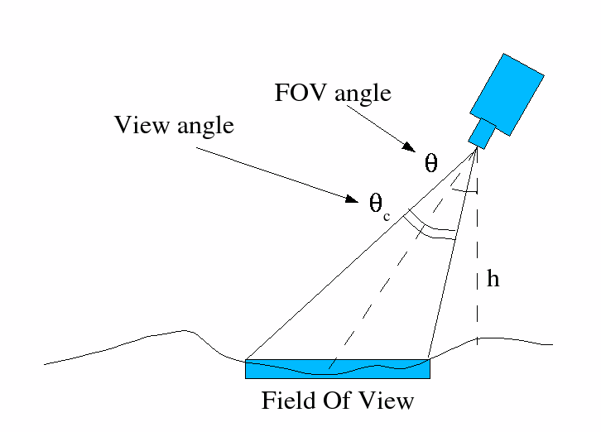
Sensor Geometry
Electronics
Sensor
Optics

Slide 24
Terminology of radiant energy
Energy from
the Earth Atmosphere
over time is
Flux
which strikes the detector area
Irradiance
at a given wavelength interval
Monochromatic
Irradiance
over a solid angle on the Earth
Radiance observed by
satellite radiometer
is described by
The Planck function
Can be converted to
Reflectance or Brightness Temperatures

Slide 25
Solar: Reflective Bands
Used to observe solar energy reflected by the Earth system in the:
Visible between .4 and .7 µm
NIR between .7 and 3 µm
About 99% of the energy observed between 0 and 4 µm is solar reflected energy
Only 1% is observed above 4 µm

Slide 26
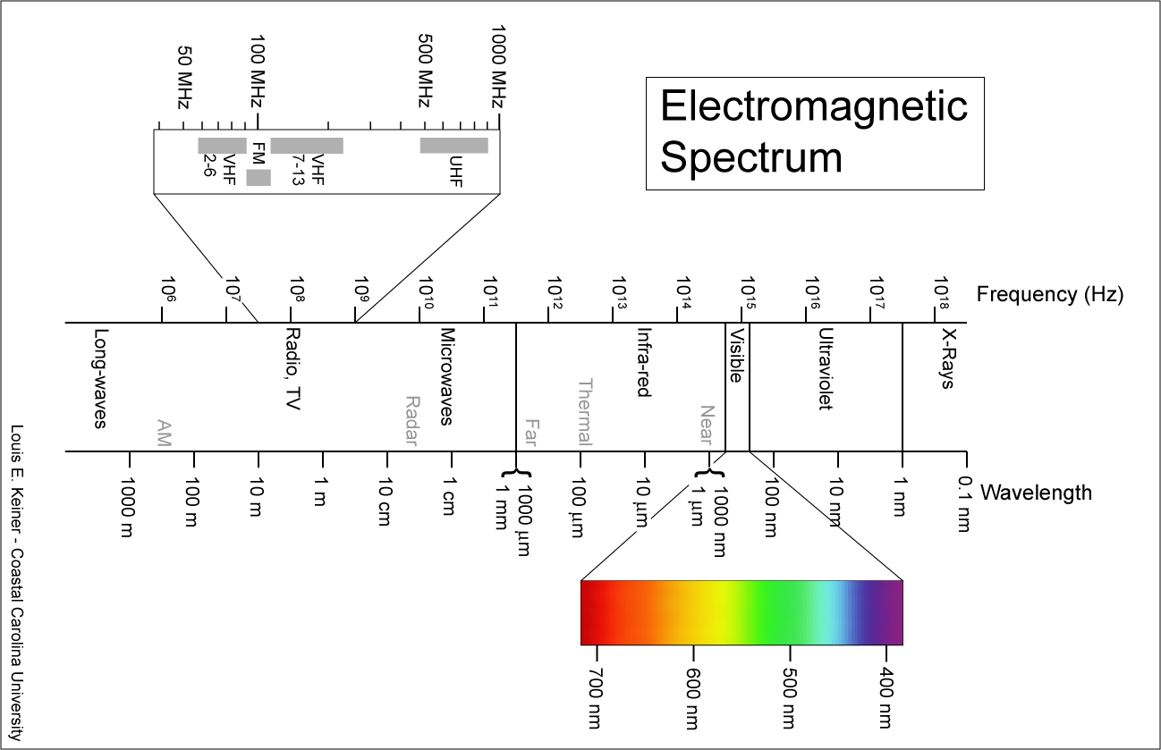

Slide 27
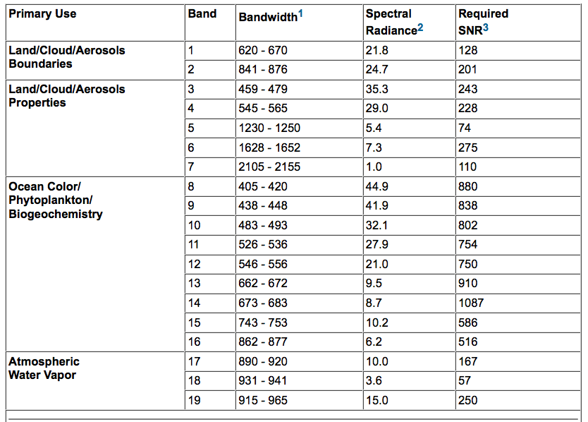
MODIS Reflectance Bands

Slide 28
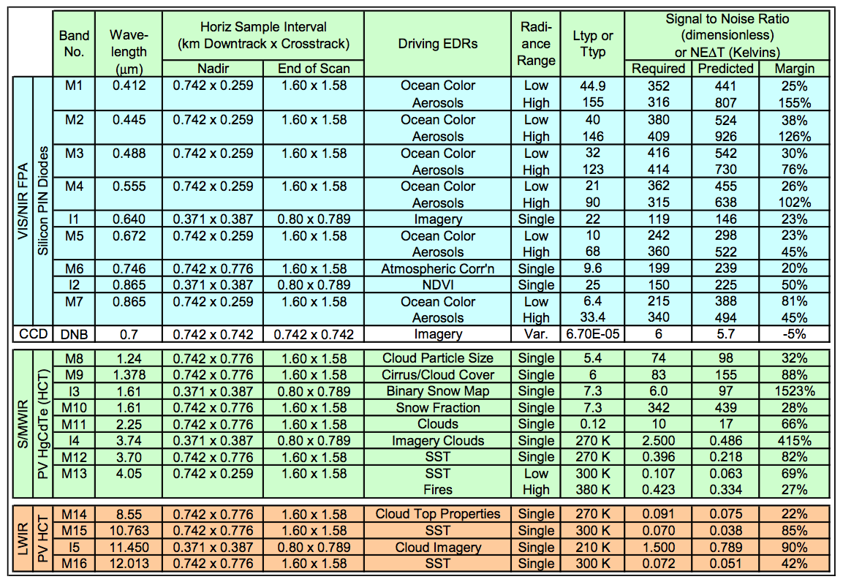
VIIRS Instrument Characteristics

Slide 29
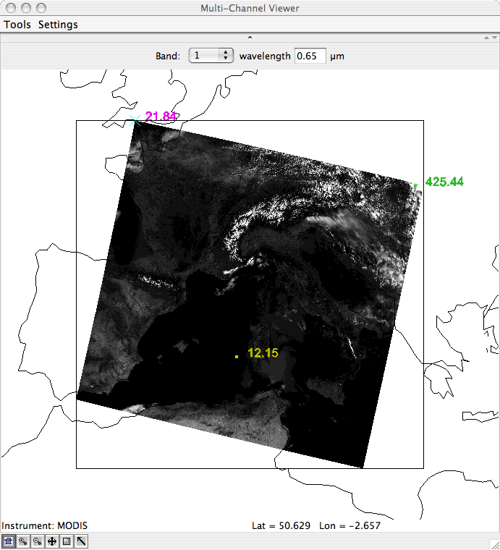
Ocean: Dark
Vegetated Surface: Dark
NonVegetated Surface: Brighter
Clouds: Bright
Snow: Bright
Sunglint

Slide 30
Reflectance
To properly compare different reflective channels we need to convert observed radiance into a target physical property
In the visible and near infrared this is done through the ratio of the observed radiance divided by the incoming energy at the top of the atmosphere
The physical quantity is the Reflectance i.e. the fraction of solar energy reflected by the observed target

Slide 31
Emissive Bands
Used to observe terrestrial energy emitted by the Earth system in the IR between 4 and 15 µm
About 99% of the energy observed in this range is emitted by the Earth
Only 1% is observed below 4 µm
At 4 µm the solar reflected energy can significantly affect the observations of the Earth emitted energy

Slide 32
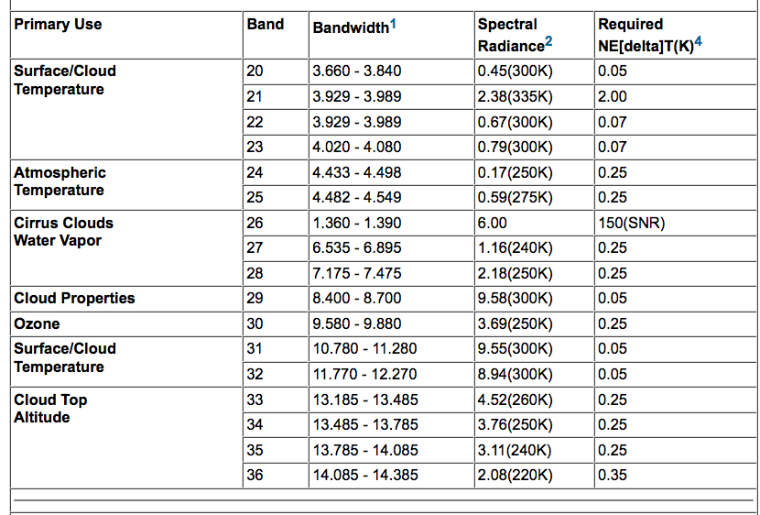
MODIS Emissive Bands

Slide 33
VIIRS Instrument Characteristics

Slide 34
Spectral Characteristics of Energy Sources and Sensing Systems
IR
4 µm
11 µm

Slide 35
Brightness Temperature
To properly compare different emissive channels we need to convert observed radiance into a target physical property
In the Infrared this is done through the Planck function
The physical quantity is the Brightness Temperature i.e. the Temperature of a black body emitting the observed radiance

Slide 37
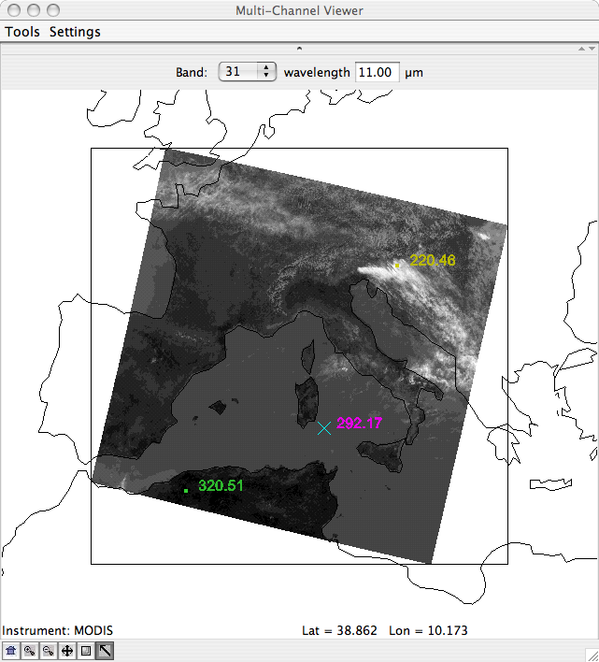
Observed BT at 11 micron
Window Channel:
little atmospheric absorption
surface features clearly visible
Range [220K 320K]
Celsius=Kelvin - 273.16
Clouds are cold
Values over land
Larger than over water
Undetectable Reflected Solar
Even over Sunglint

Slide 38
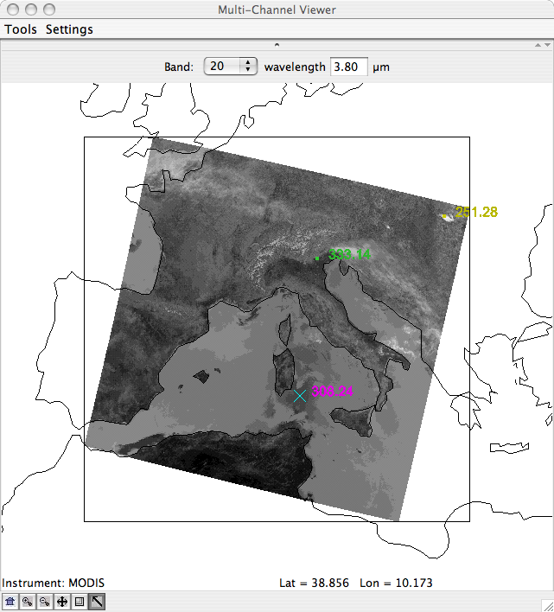
Observed BT at 4 micron A very Special Spectral Region
Window Channel:
little atmospheric absorption
surface features clearly visible
Range [250K 335K]
Celsius=Kelvin - 273.16
Clouds are cold
Values over land
Larger than over water
Reflected Solar everywhere
Stronger over Sunglint

Slide 39
VIIRS and MODIS observations and products in AWIPS

Slide 41
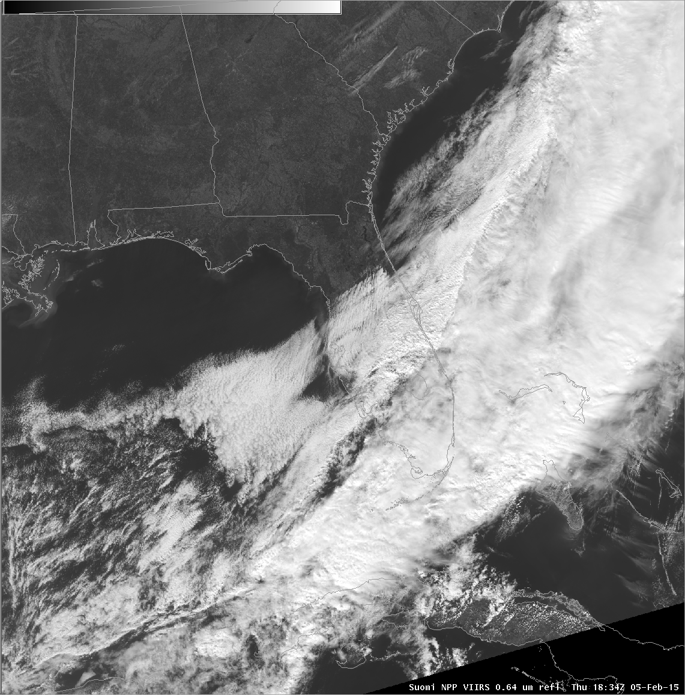
Suomi-NPP VIIRS Visible I-Band 1 - .64 micron Reflectances
Day

Slide 42
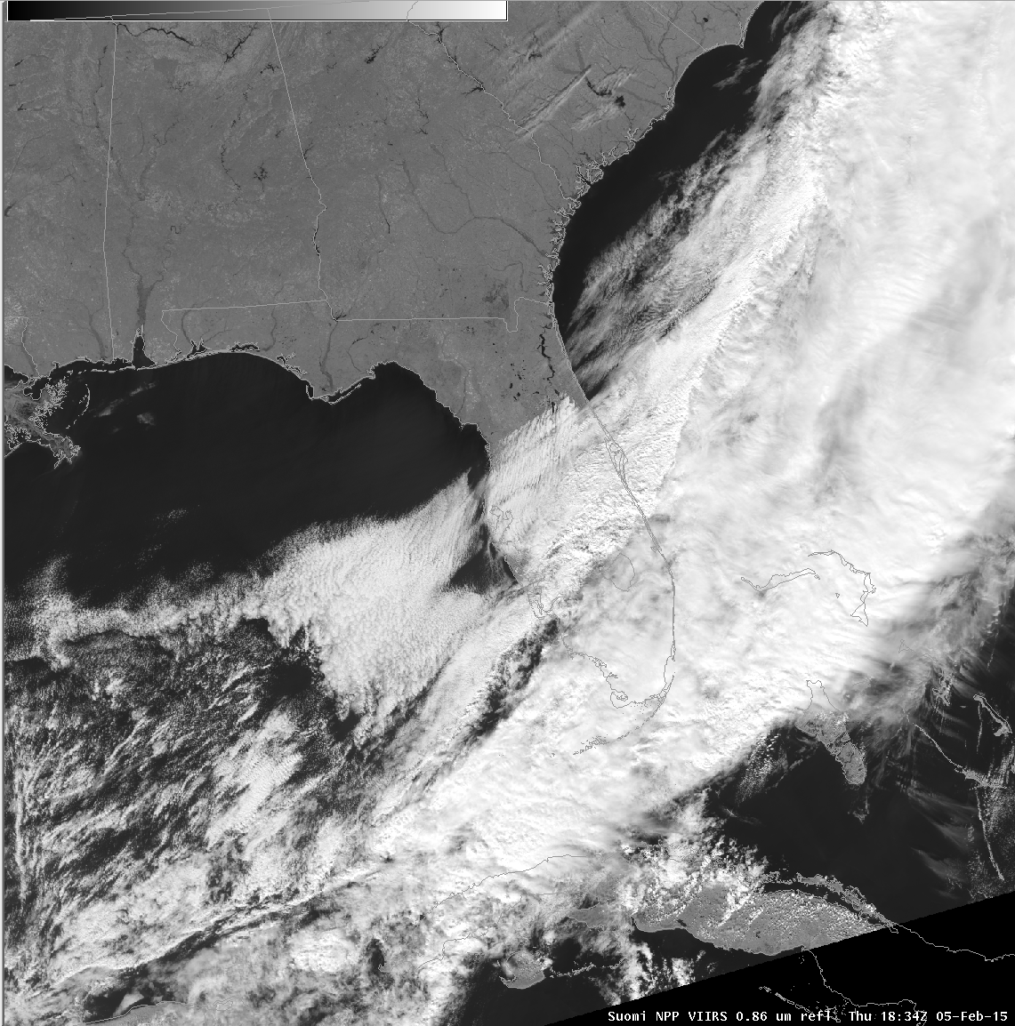
Suomi-NPP VIIRS Land/Water I-Band 2 - .86 micron Reflectances
Suomi-NPP VIIRS Land/Water Band .86 micron Reflectances
Day

Slide 43
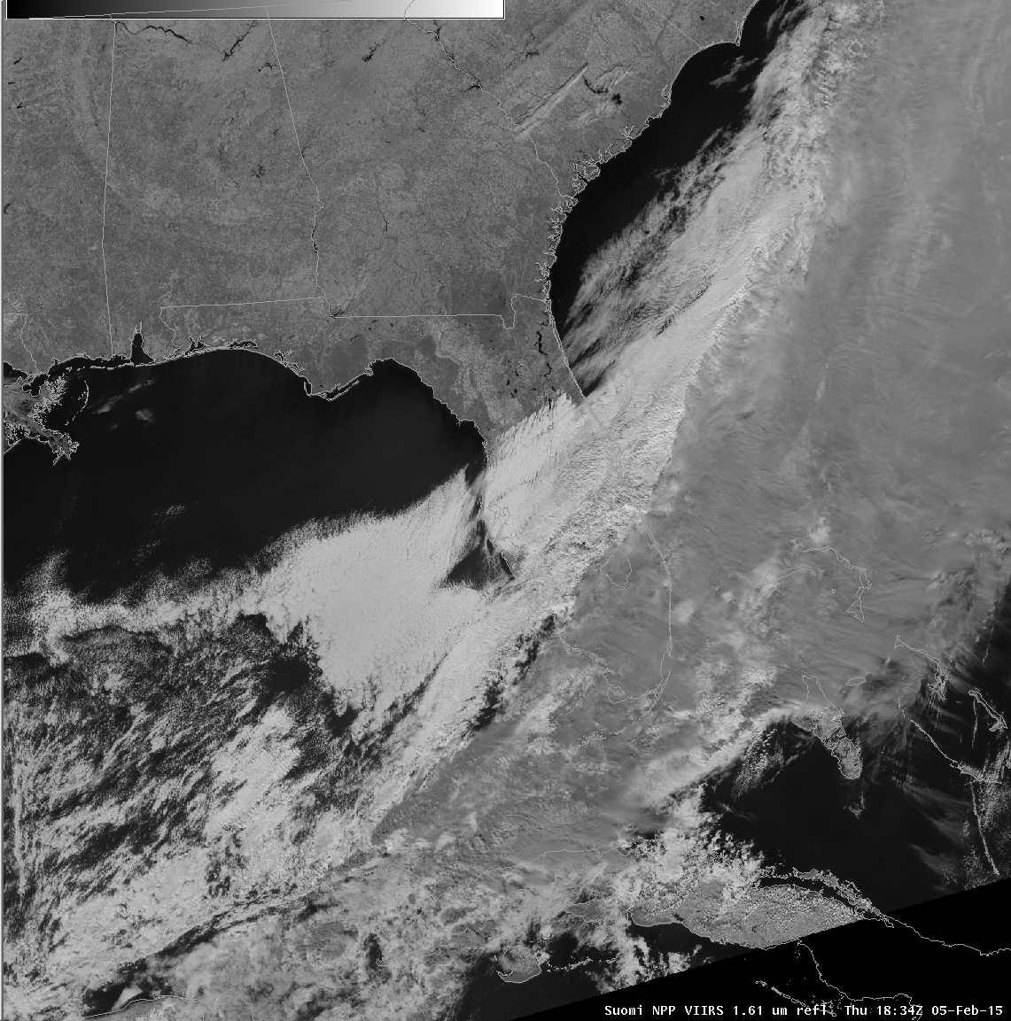
Suomi-NPP VIIRS I-Band 3 - 1.6 micron Reflectances
Suomi-NPP VIIRS Snow/Ice Band 1.6 micron Reflectances
Day

Slide 45
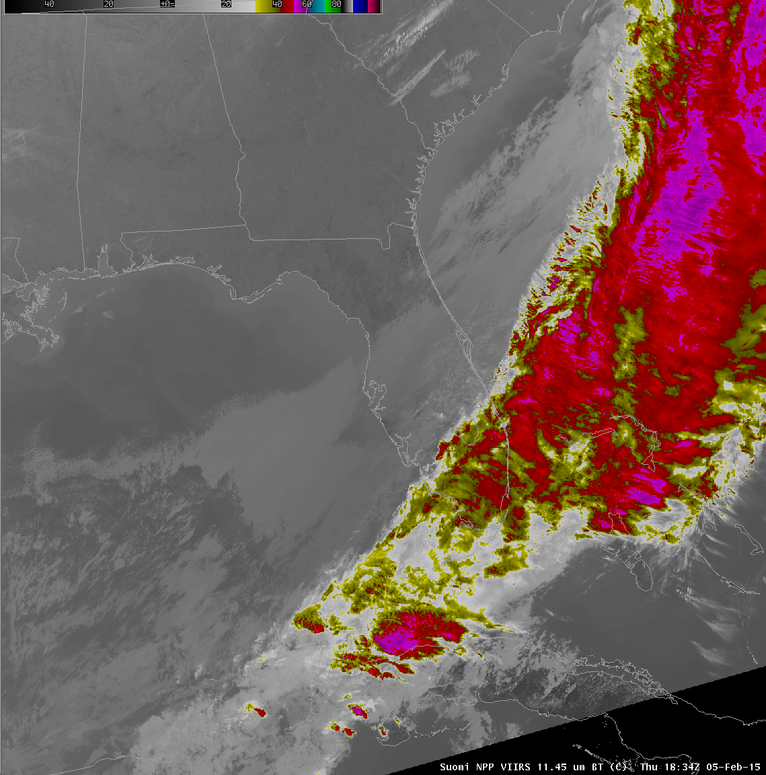
S-NPP VIIRS Longwave IR I-Band 5 - 11 μm Brightness Temperatures
Suomi-NPP VIIRS 11 micron Brightness Temperatures
Day

Slide 46
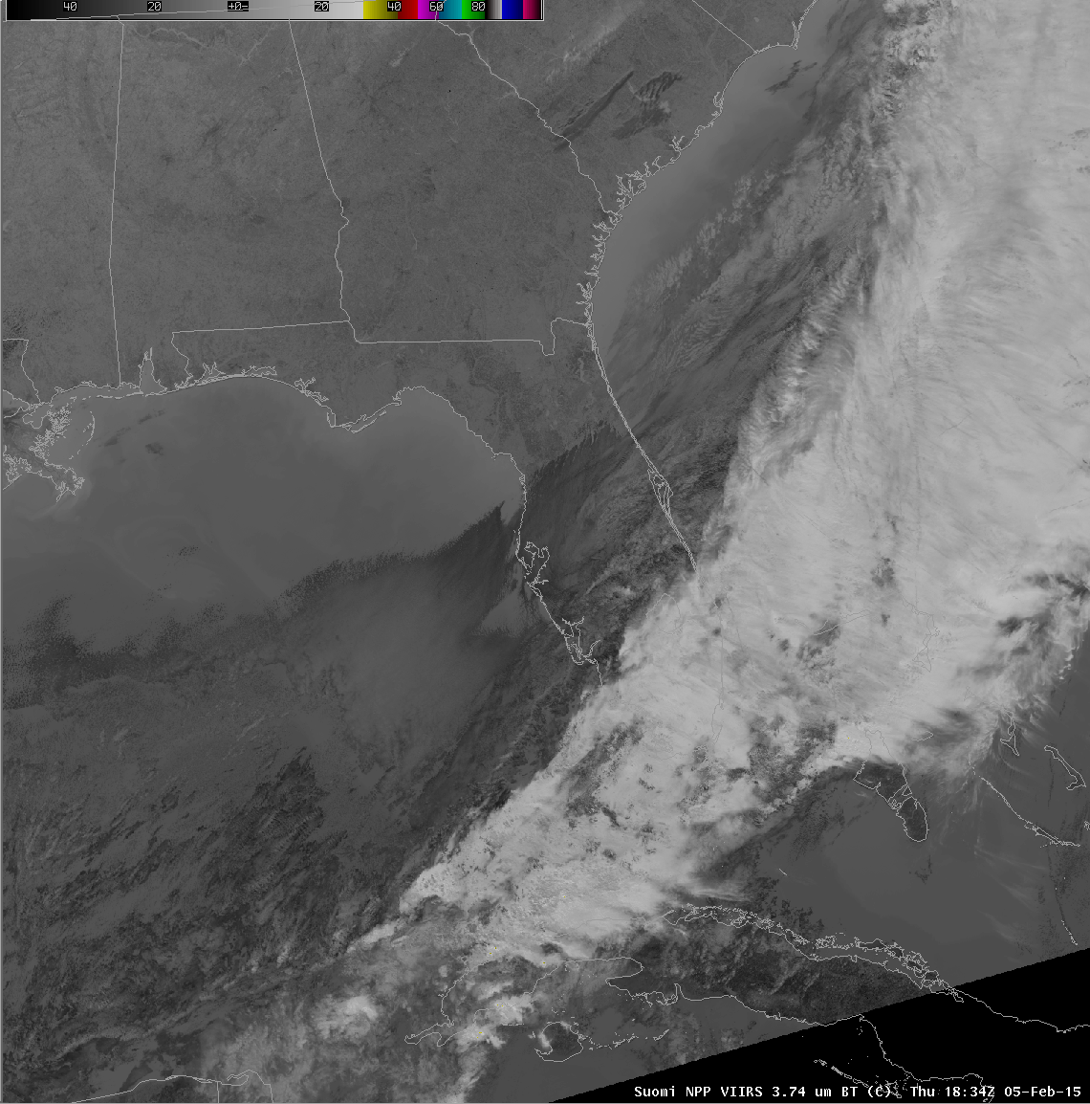
S-NPP VIIRS Shortwave IR I-Band 4 - 3.74 μm Brightness Temperatures
Suomi-NPP VIIRS 3.7 micron Brightness Temperatures
Day

Slide 47
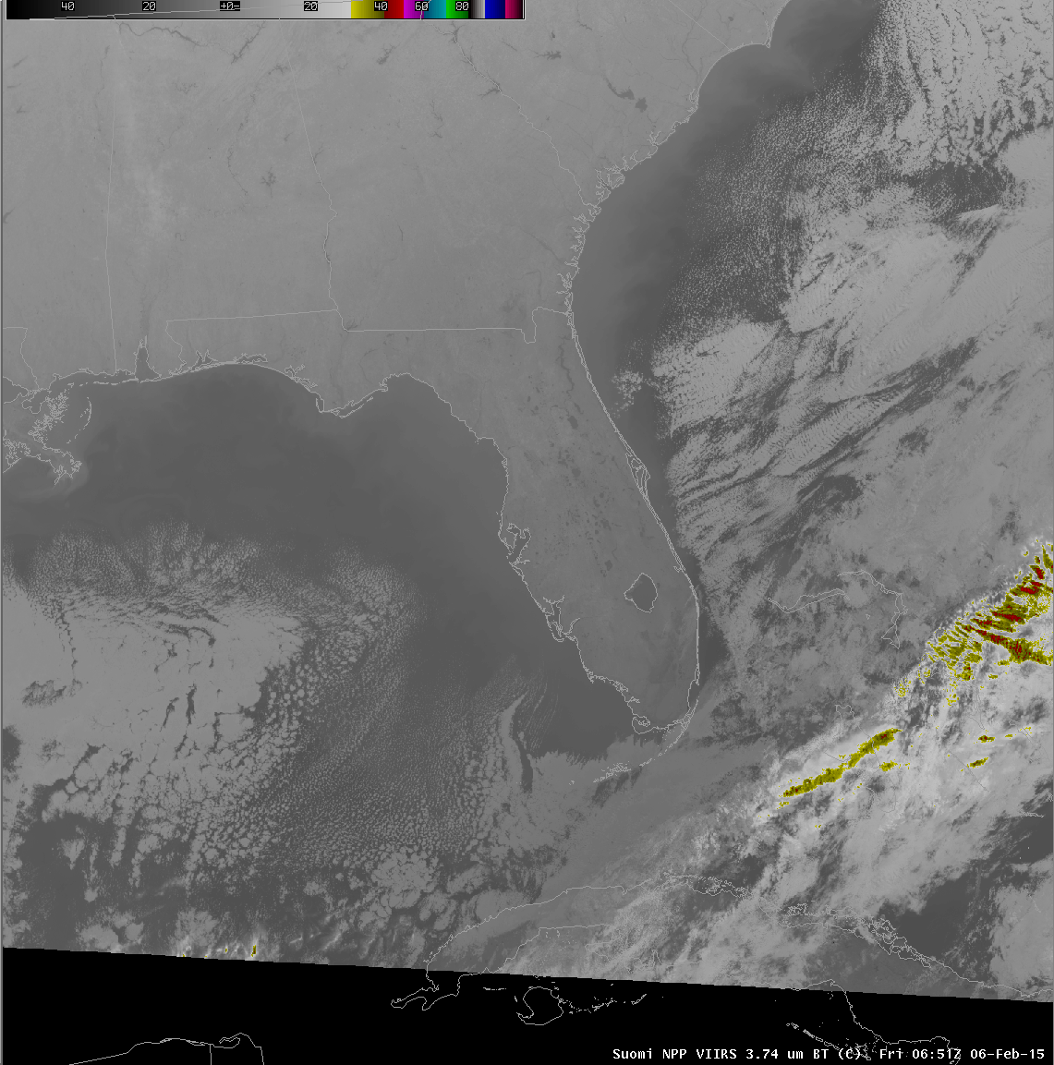
S-NPP VIIRS Shortwave IR I-Band 4 - 3.74 μm Brightness Temperatures
Suomi-NPP VIIRS 11 micron Brightness Temperatures
Night

Slide 48
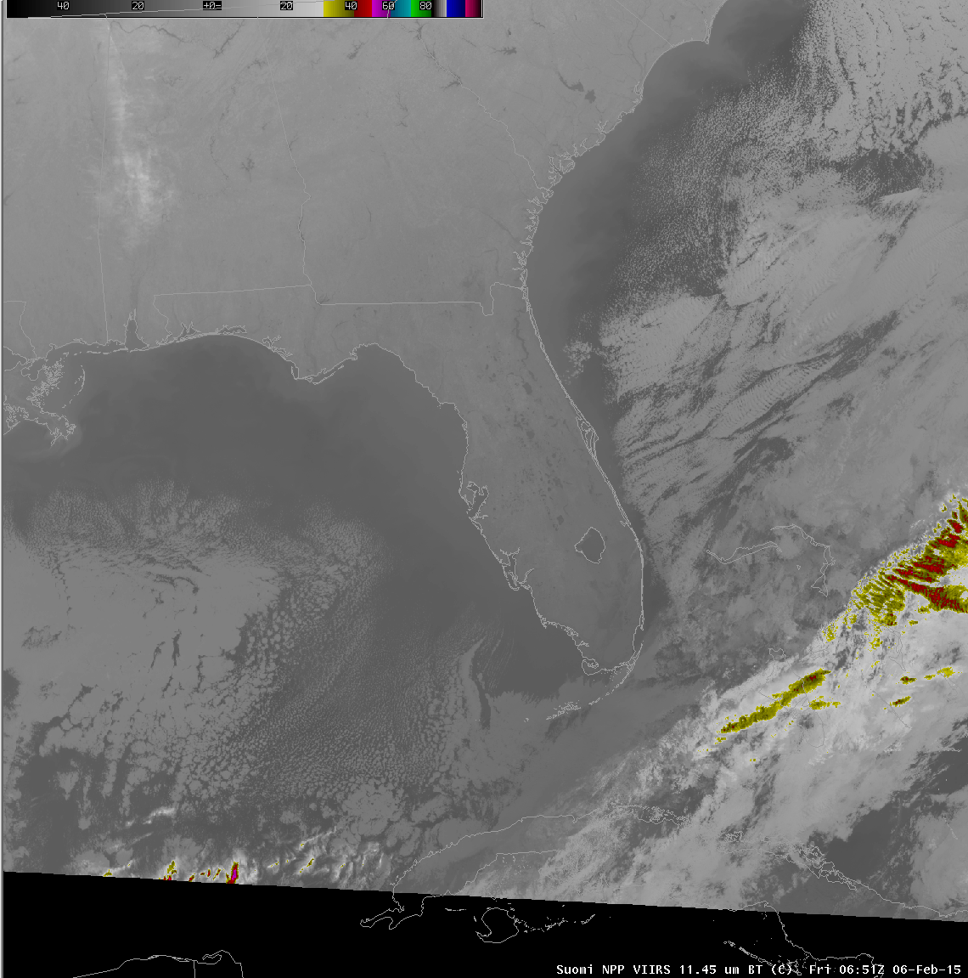
S-NPP VIIRS Longwave IR I-Band 5 - 11 μm Brightness Temperatures
Suomi-NPP VIIRS 11 micron Brightness Temperatures
Night

Slide 49
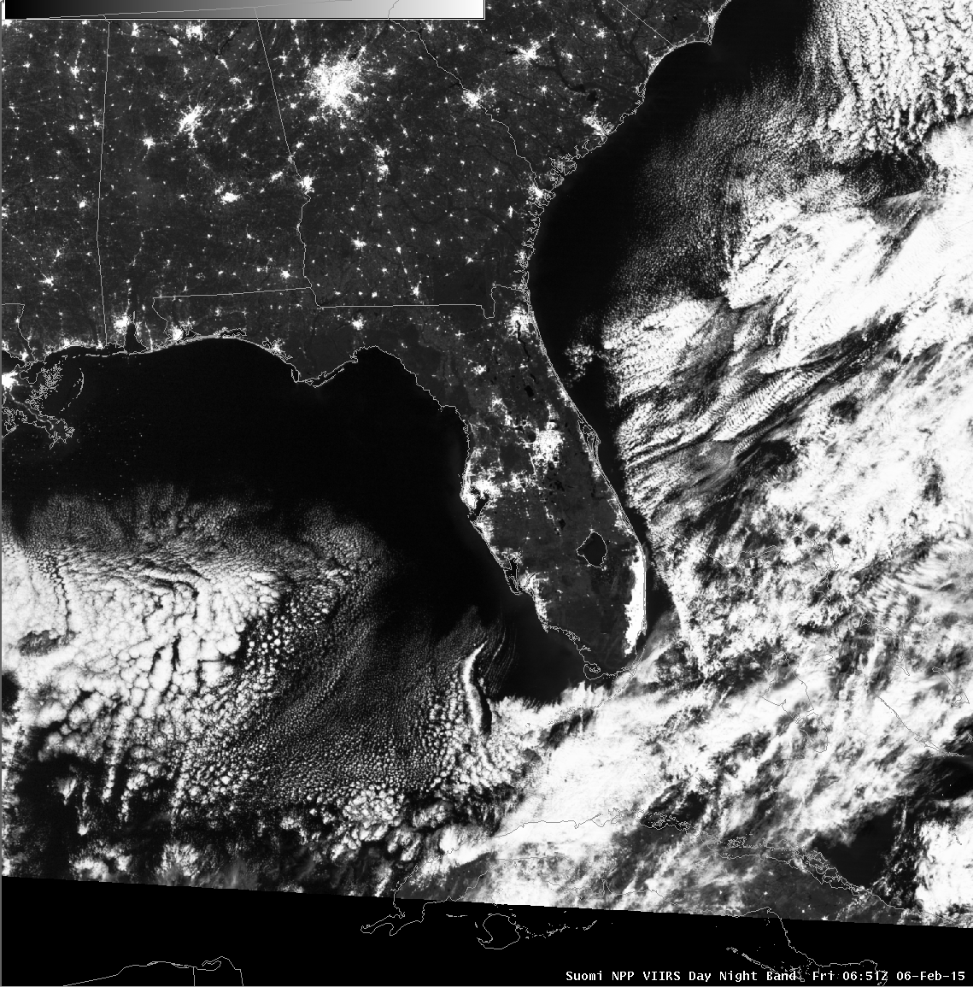
S-NPP VIIRS Day/Night Band - .7 μm Reflectances
Suomi-NPP VIIRS Day/Night Band Radiances
Night

Slide 50
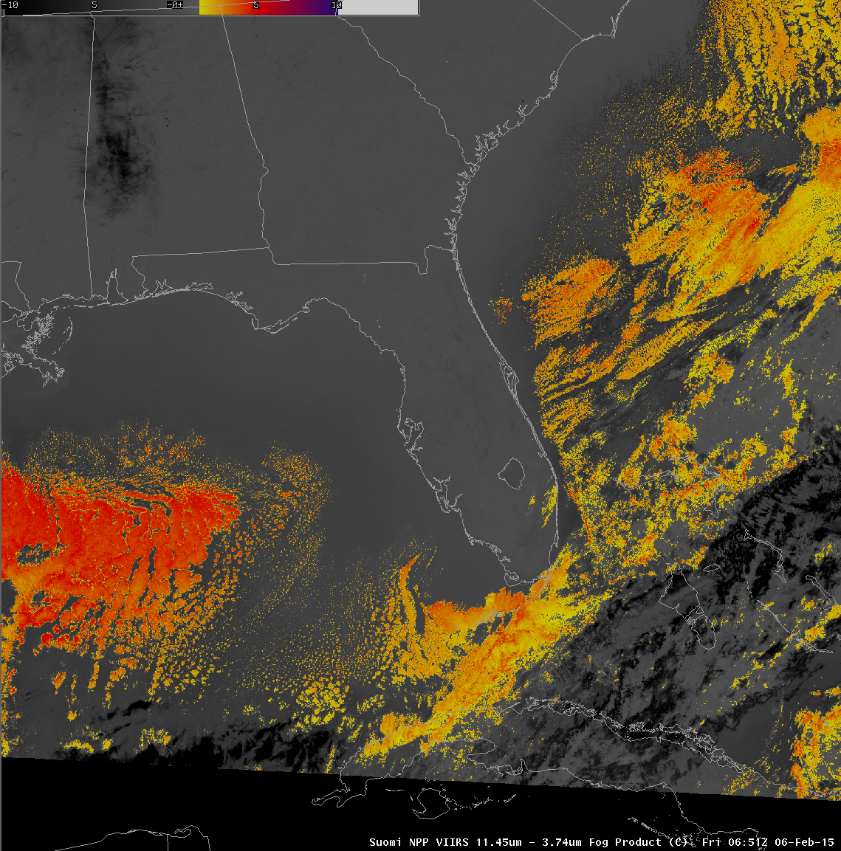
S-NPP 4-11 micron Brightness Temperature Diff. Fog Product
Suomi-NPP VIIRS Day/Night Band Radiances
Night

Slide 51
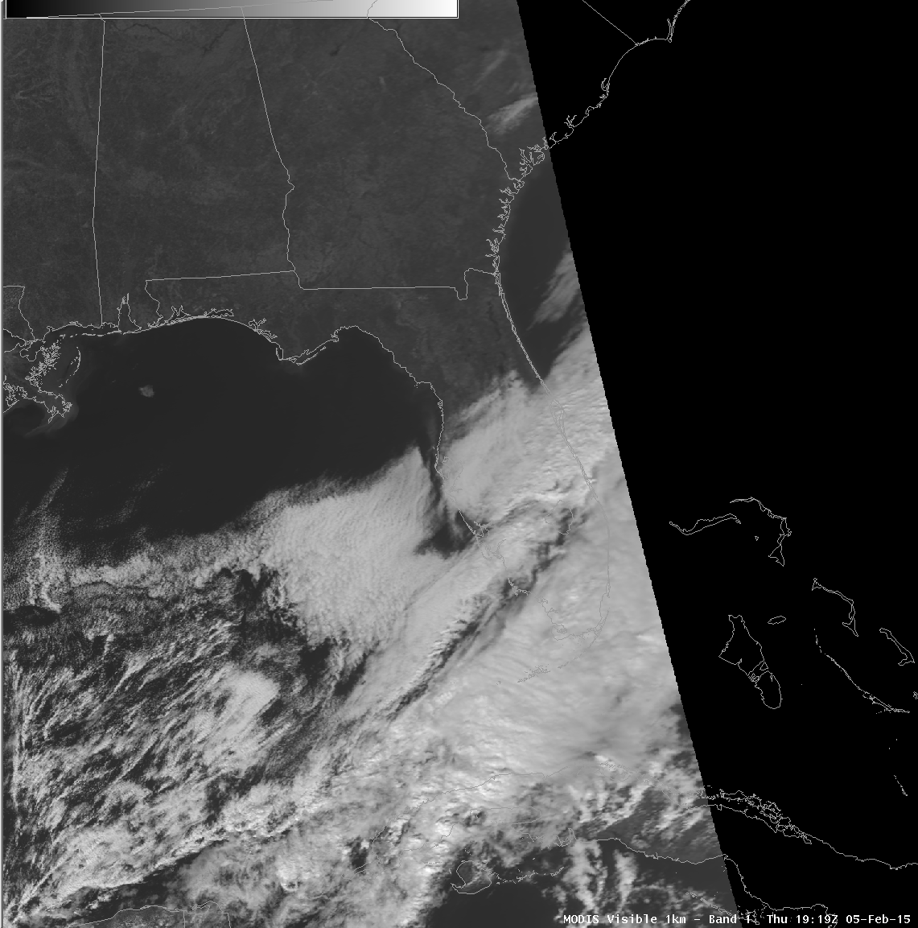
MODIS Visible Band 1 - .65 micron Reflectances
MODIS .68 micron Reflectances
Day

Slide 52
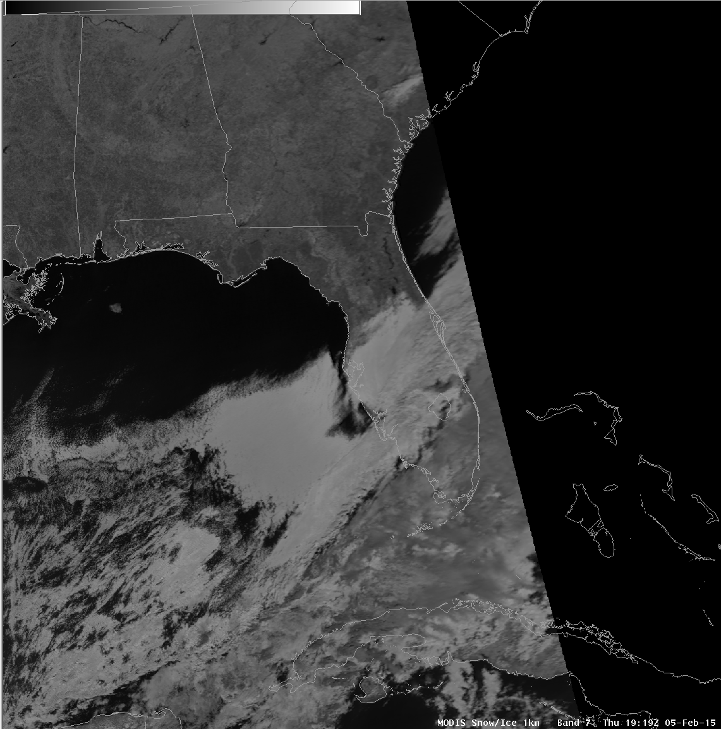
MODIS Visible Band 7 - 2.1 micron Reflectances
MODIS Snow/Ice Band 2.1 micron Reflectances
Day

Slide 53
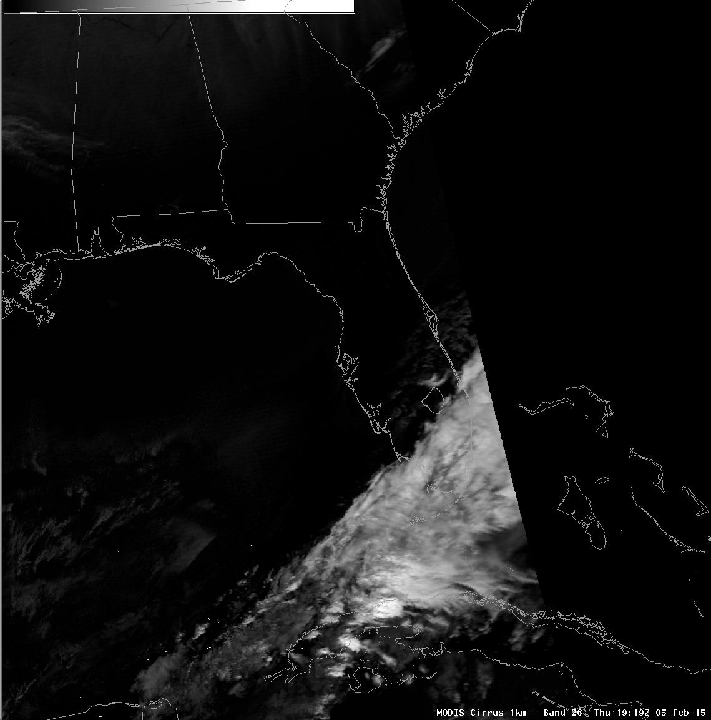
MODIS Visible Band 26 - 1.38 micron Reflectances
MODIS Cirrus Band 1.38 micron Reflectances
Day

Slide 54
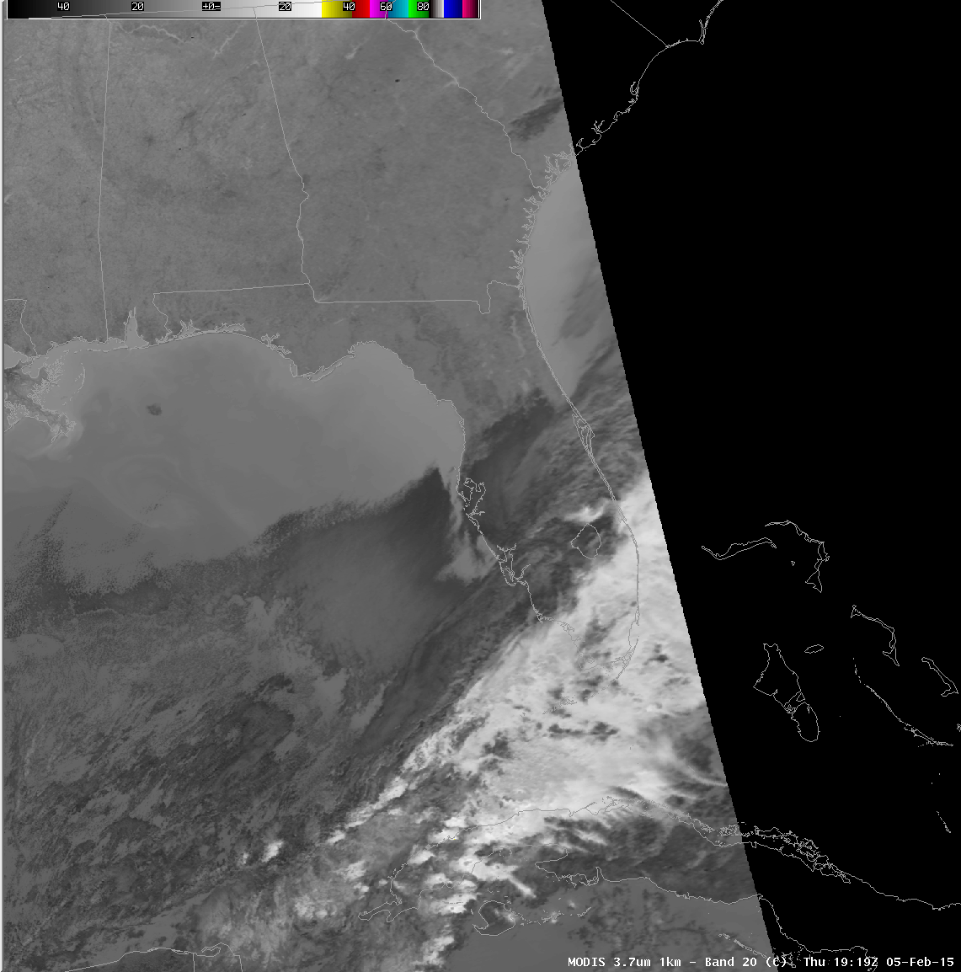
MODIS Shortwave IR Band 20 - 3.7 μm Brightness Temperatures
MODIS 4 micron Brightness Temperatures
Day

Slide 55
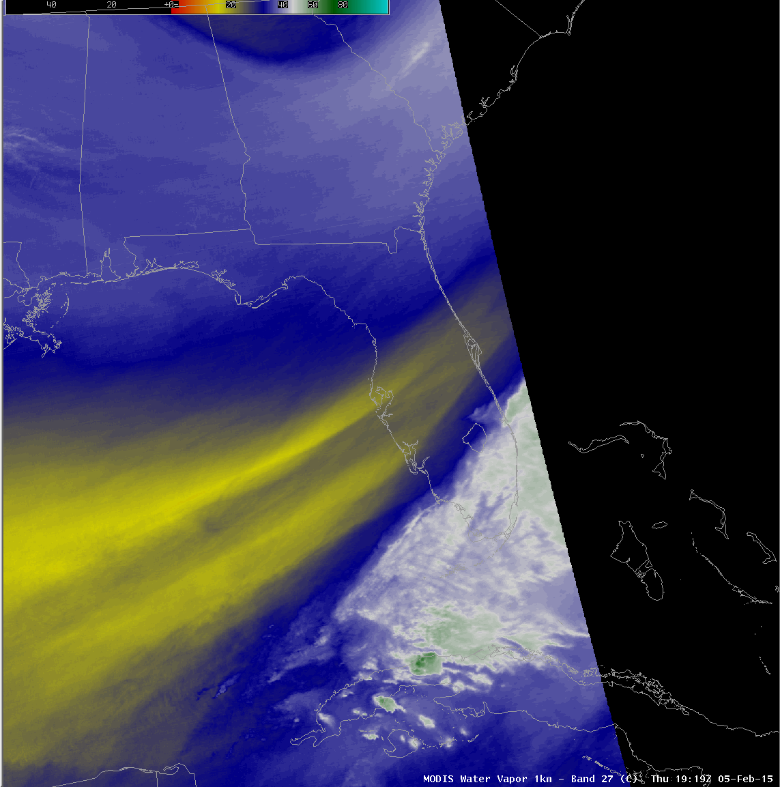
MODIS Shortwave IR Band 27 - 6.7 μm Brightness Temperatures
Terra MODIS Water Vapor 6.7 micron Brightness Temperatures
Day

Slide 57
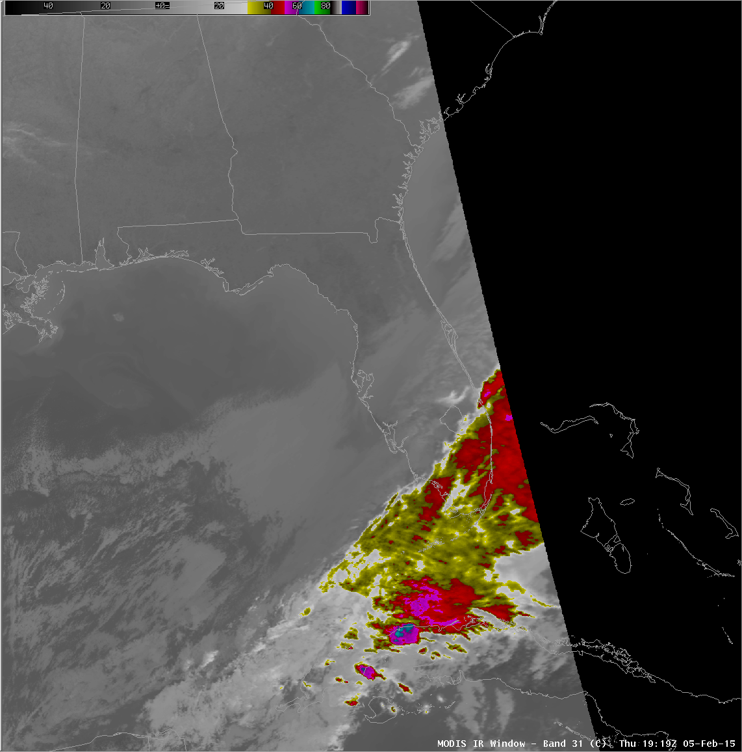
MODIS 11 micron Brightness Temperatures
Day

Slide 58
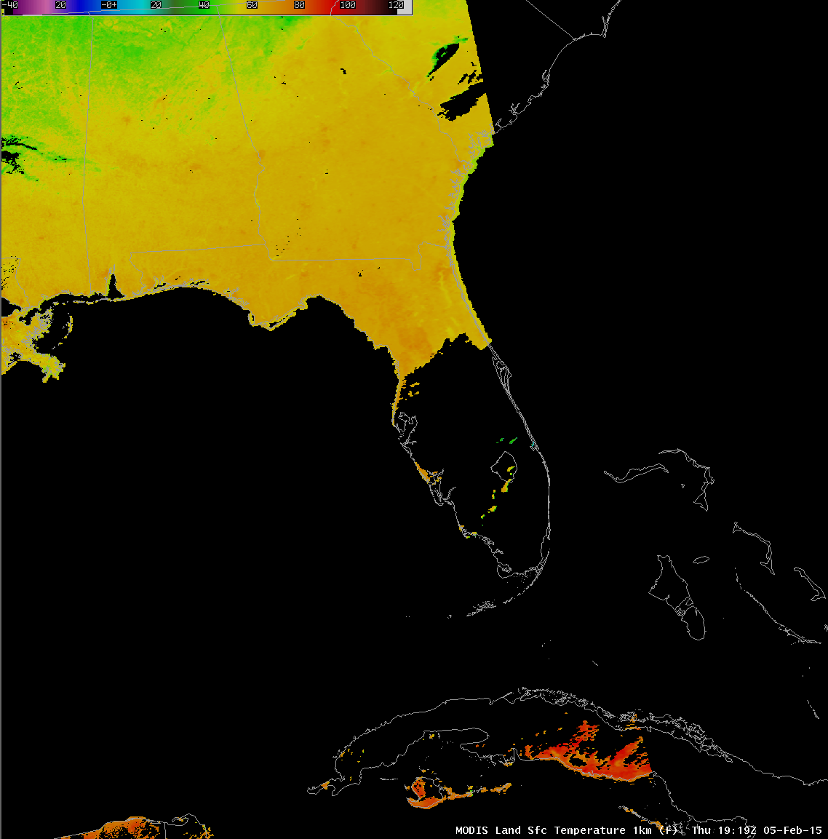
Day
MODIS 1km Land Surface Temperature Product
MODIS Land Surface Temperatures Nighttime

Slide 59
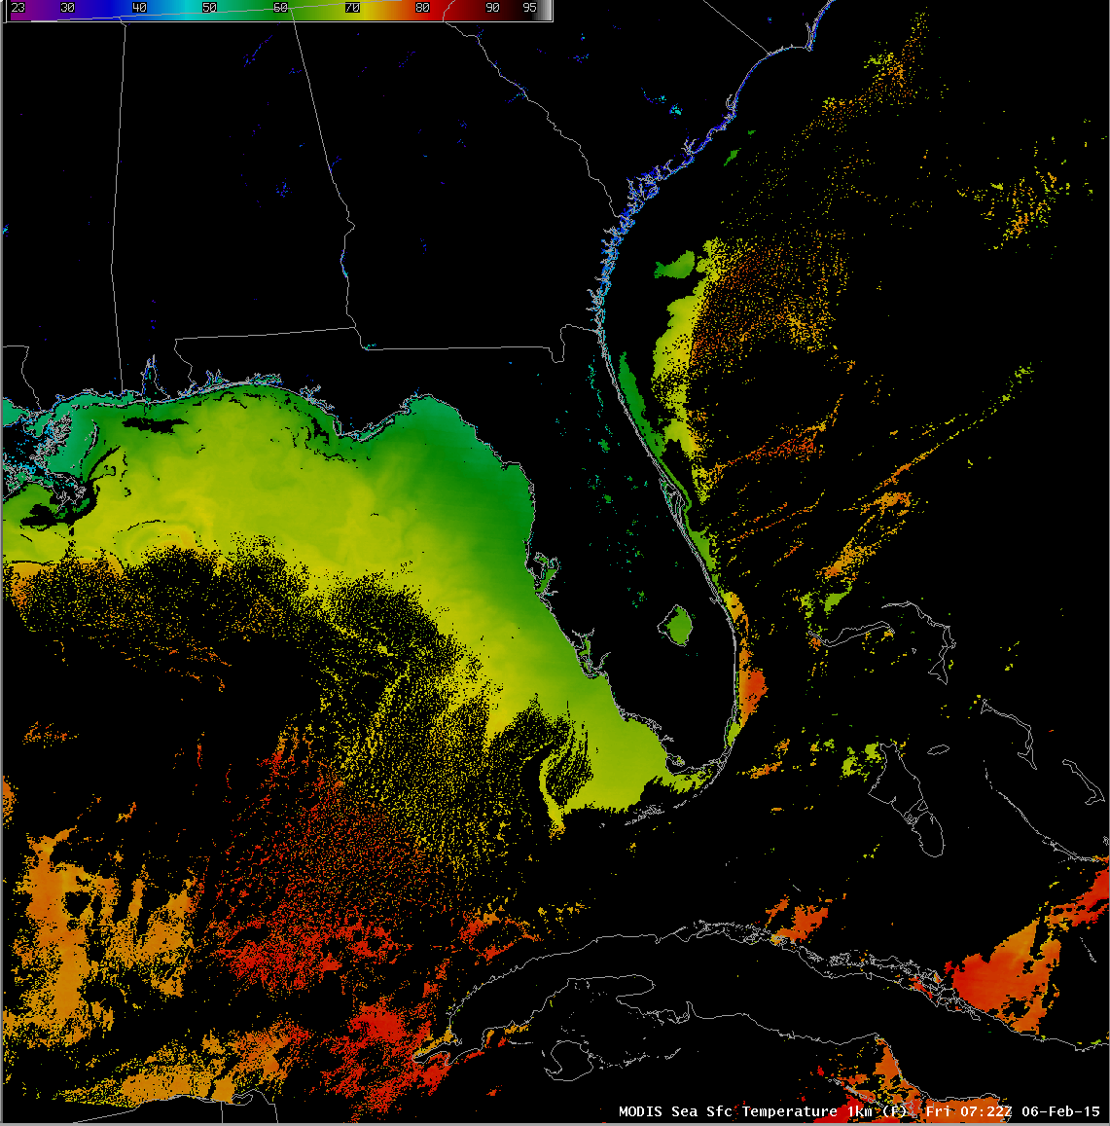
MODIS 1km Sea Surface Temperature Product
MODIS Sea Surface Temperatures

Slide 60
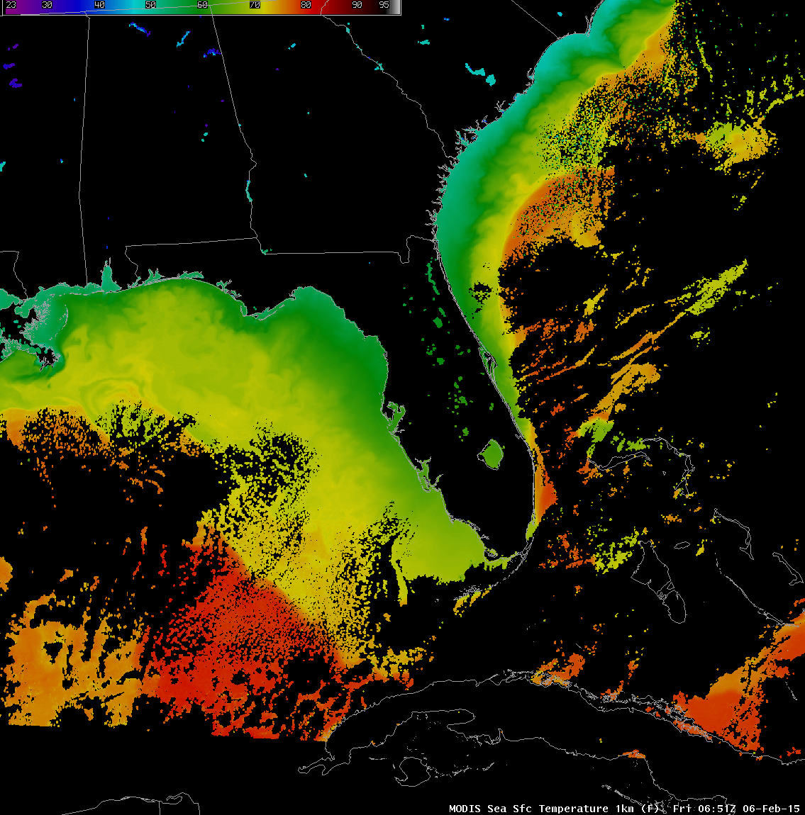
VIIRS 1km Sea Surface Temperature Product
MODIS Sea Surface Temperatures

Slide 61
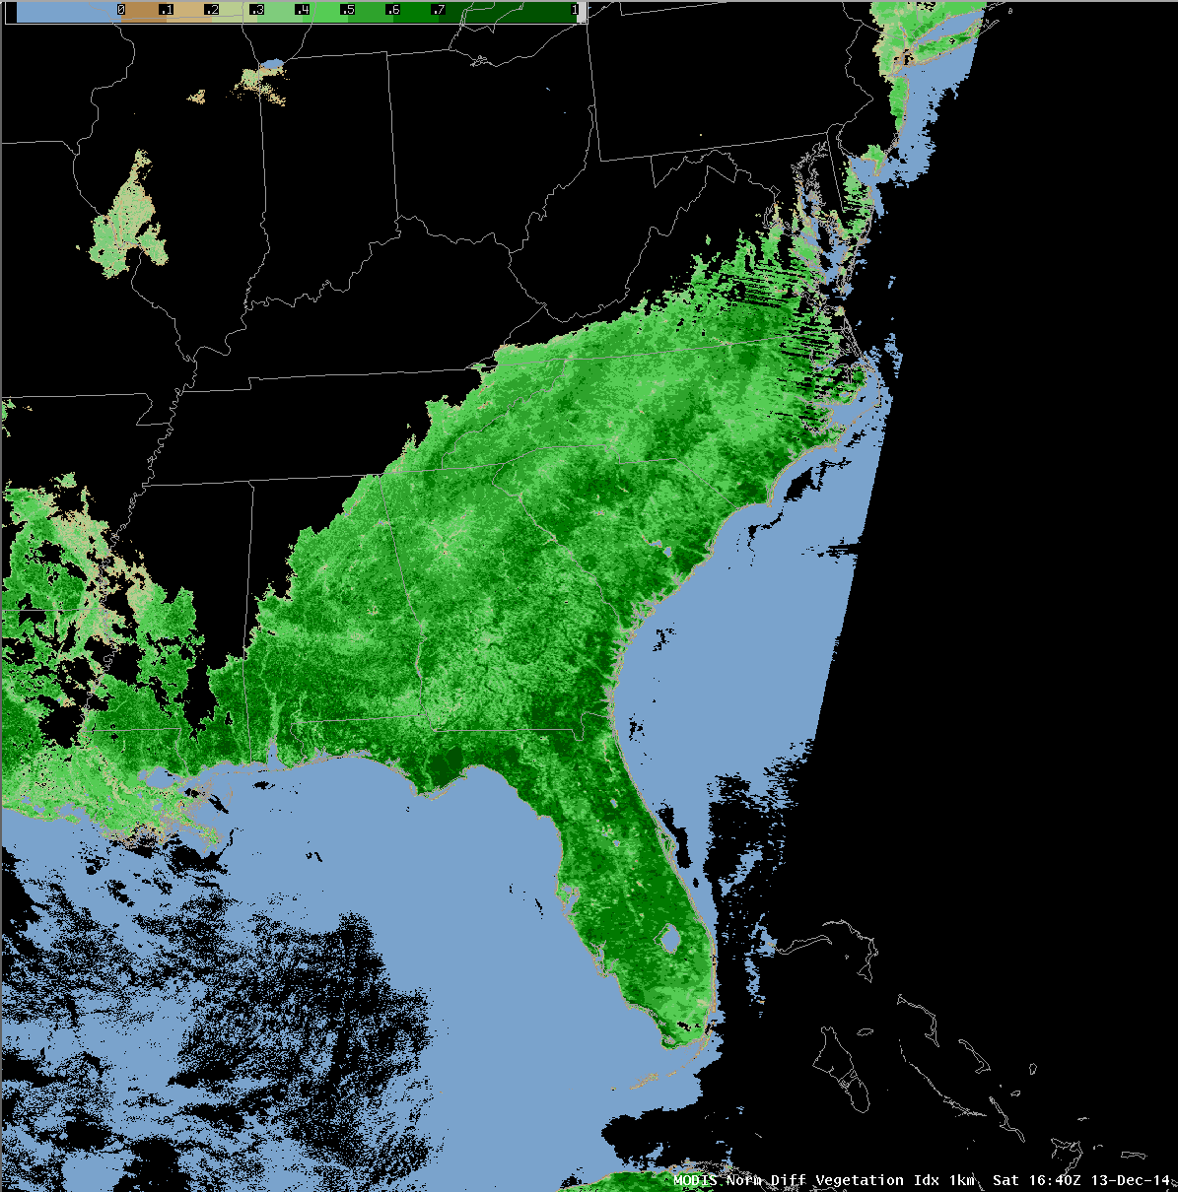
MODIS 1km NDVI Product
Day

Slide 62
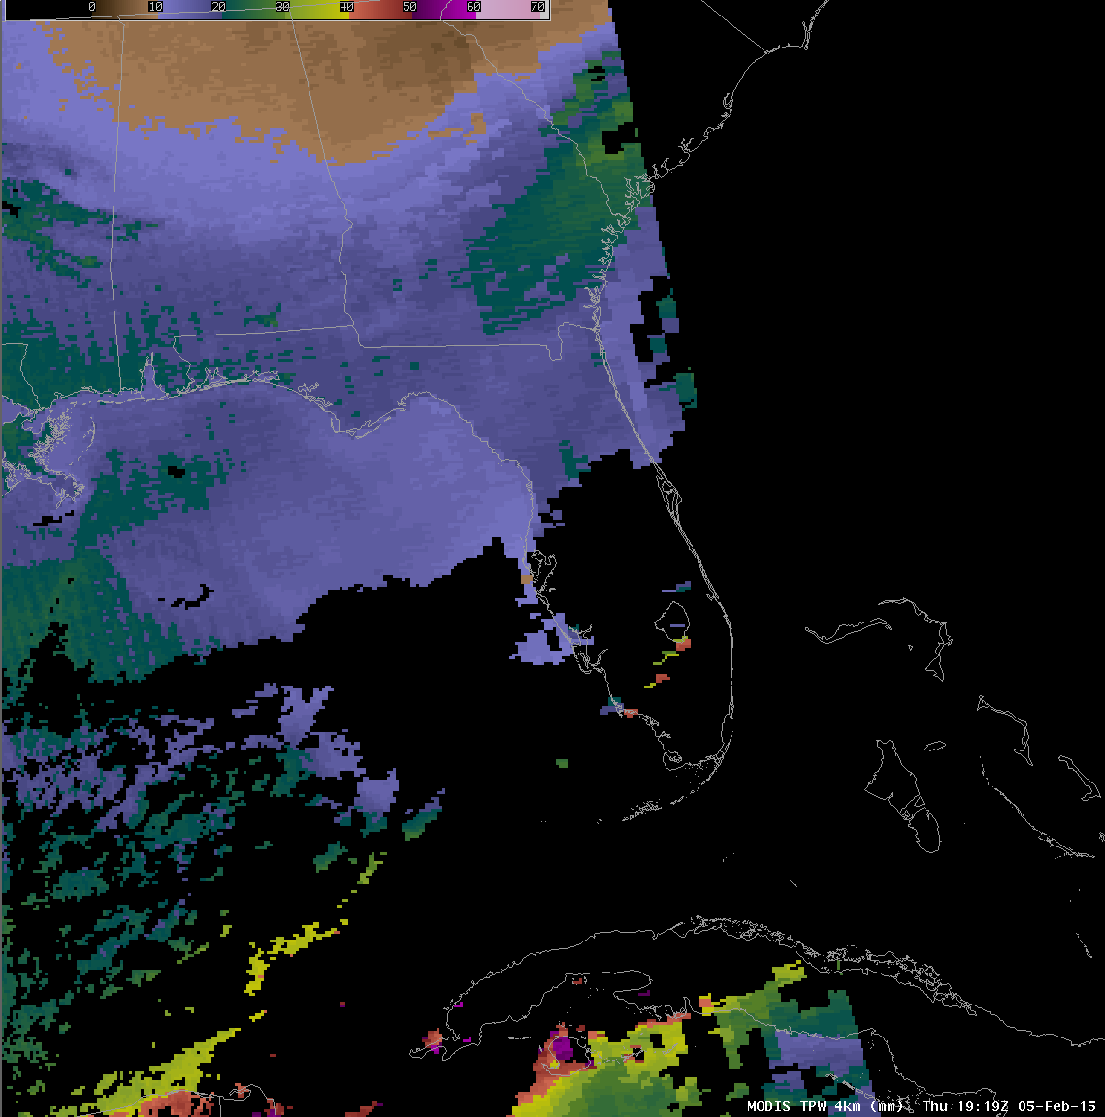
MODIS 4km Total Precipitable Water Vapor Product

Slide 63
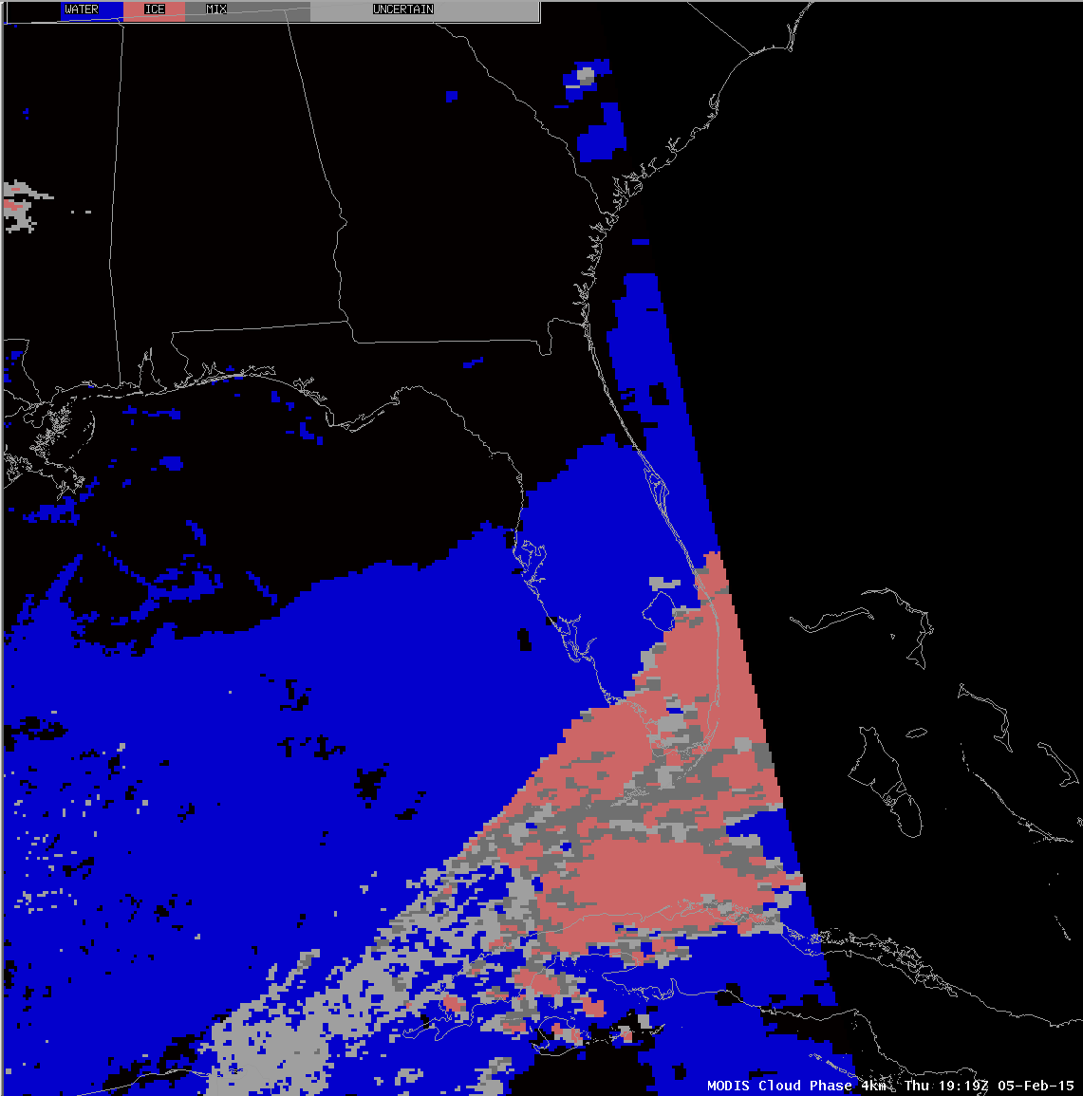
MODIS 4km Cloud Phase Product

Slide 64
Ocean Color Bands

Slide 65
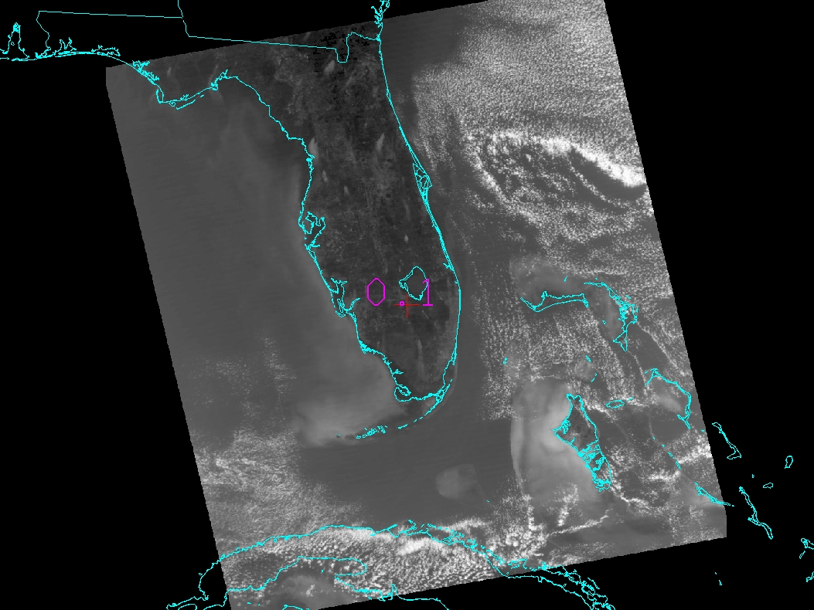
MODIS Band 8 .412 micron Reflectances

Slide 66
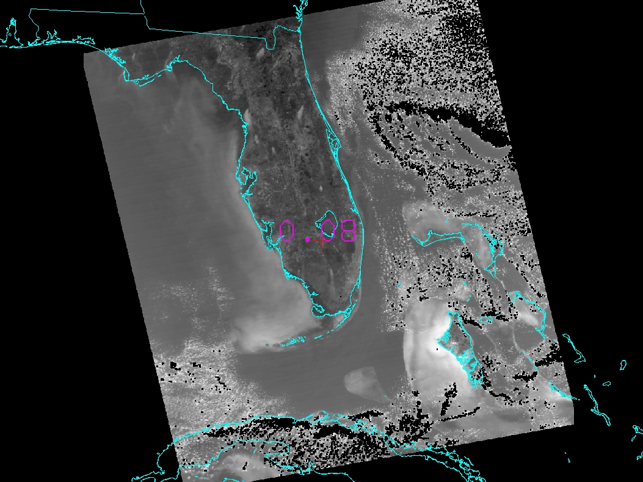
MODIS Band 9 .45 micron Reflectances

Slide 67
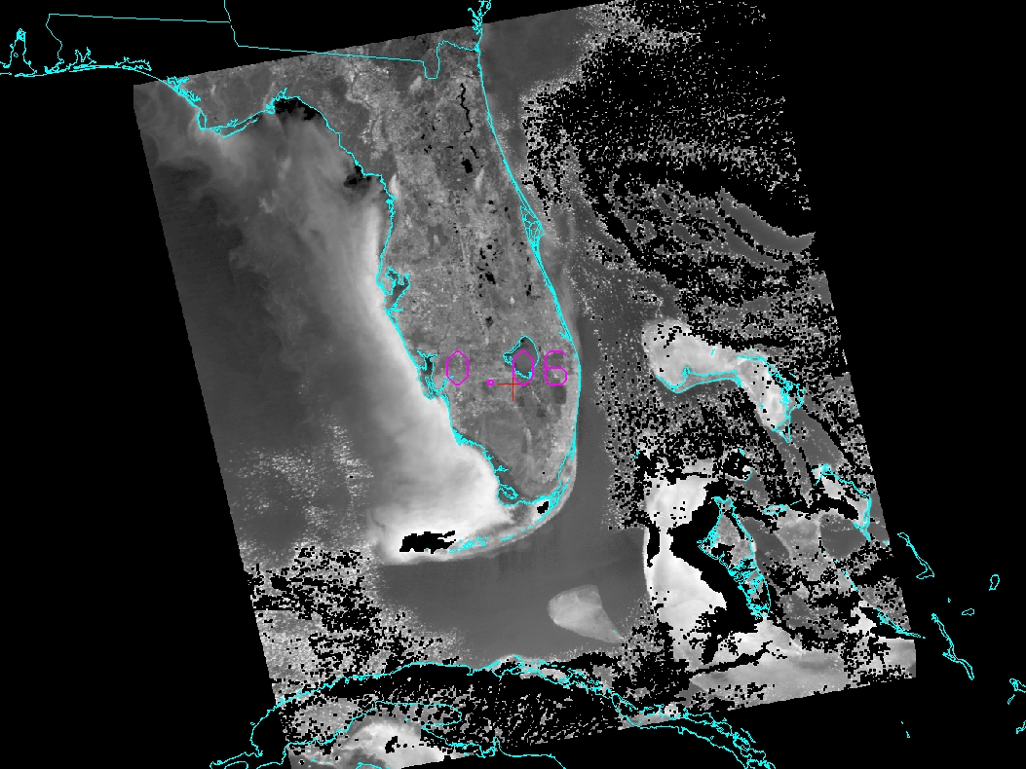
MODIS Band 10 .487 micron Reflectances

Slide 68
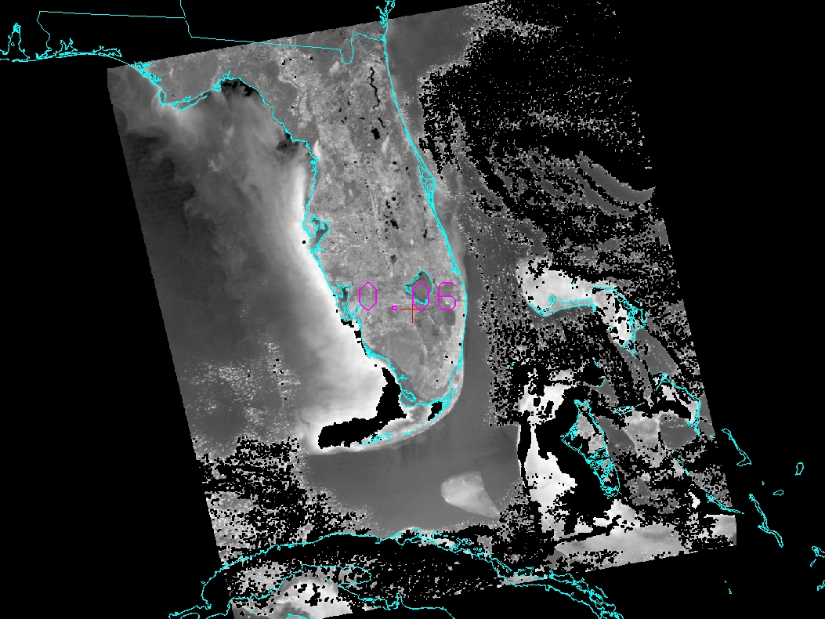
MODIS Band 11 .531 micron Reflectances

Slide 69
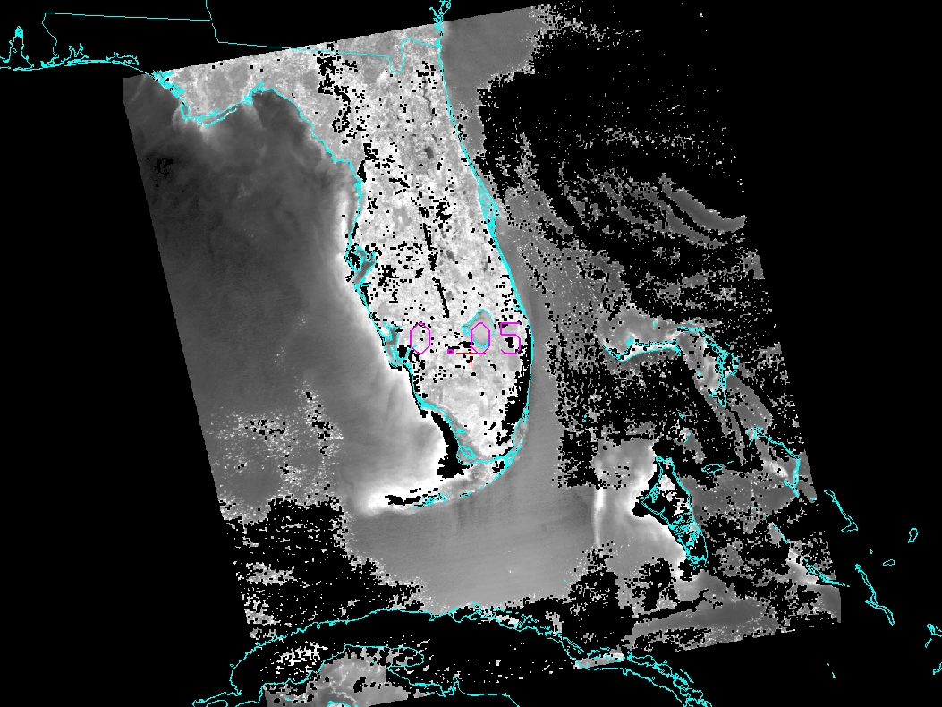
MODIS Band 12 .551 micron Reflectances

Slide 70
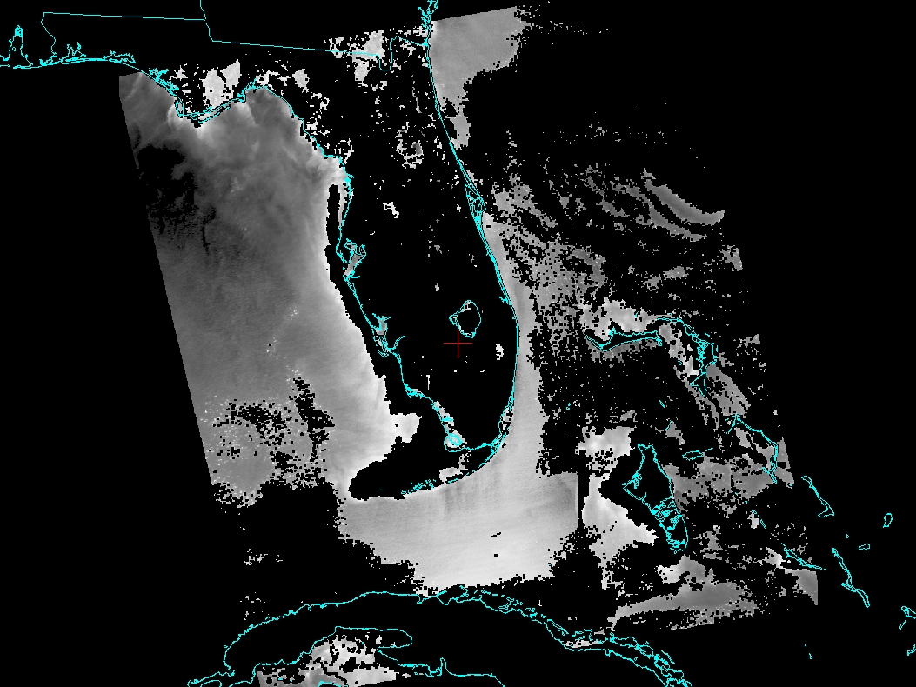
MODIS Band 13lo .666 micron Reflectances

Slide 71
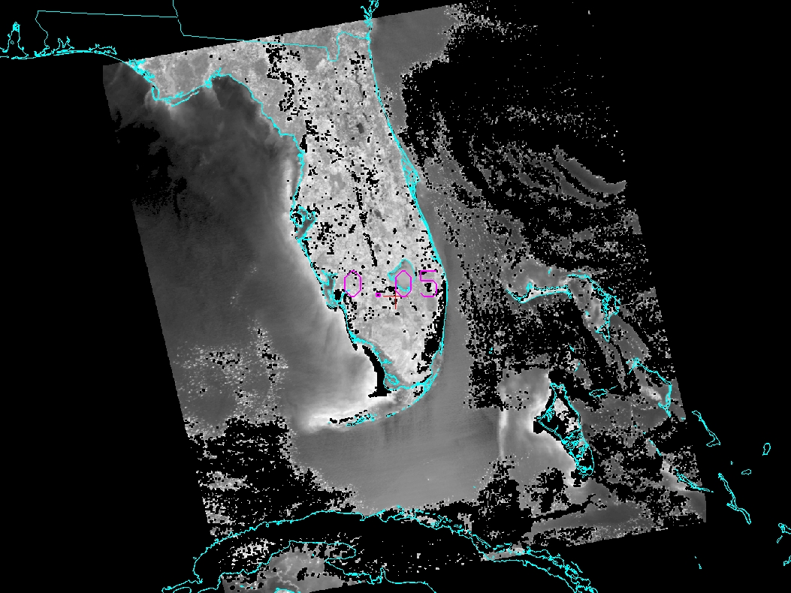
MODIS Band 13hi .668 micron Reflectances

Slide 72
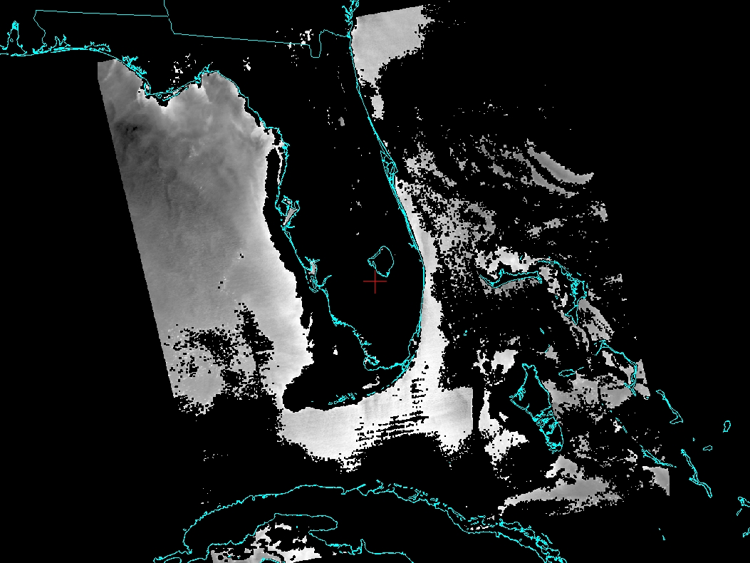
MODIS Band 14lo .677 micron Reflectances

Slide 73
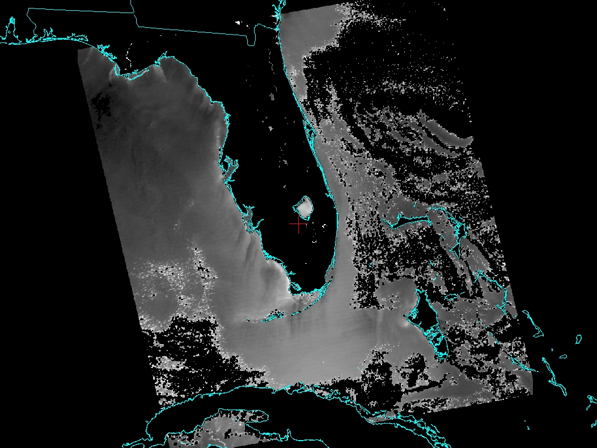
MODIS Band 14hi .679 micron Reflectances

Slide 74
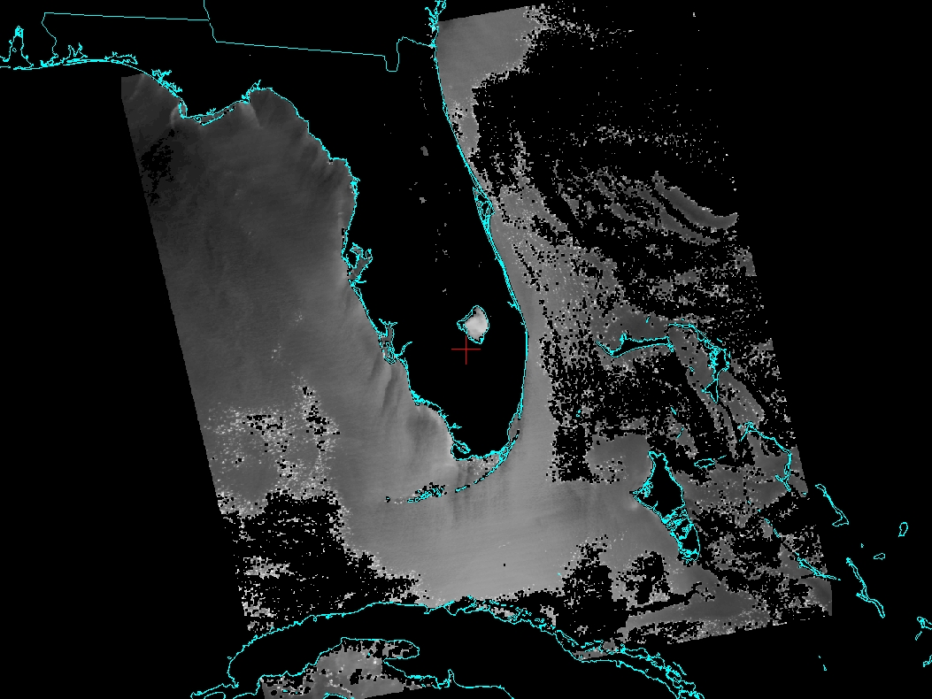
MODIS Band 15 .748 micron Reflectances

Slide 75
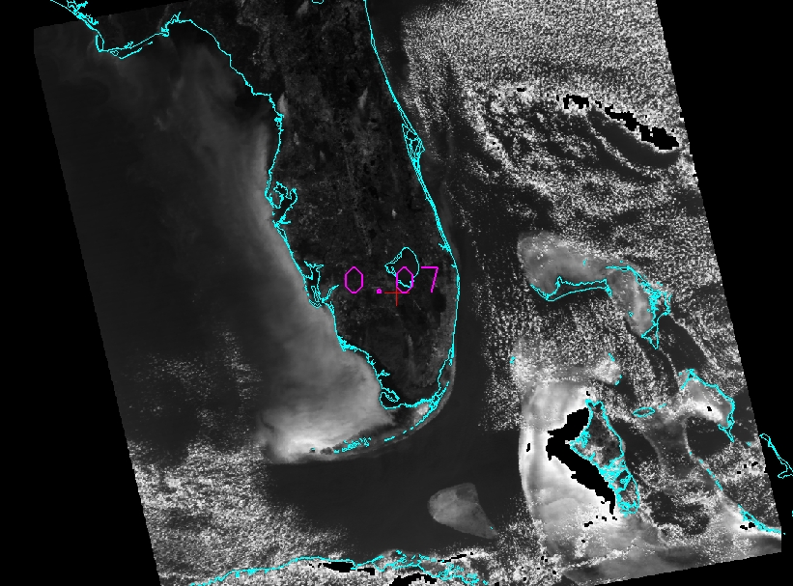
MODIS Band 16 .869 micron Reflectances

Slide 76
S-NPP, Aqua and Terra DB Applications
Weather Observation and Forecasting
Often thought of as research satellites
Data is Complimentary to Geostationary
Higher Spatial Resolution (data at 250 m - 1 km, products at 250 m - 5 km)
Unique spectral bands (such as Day/Night band)
New products (such as true color imagery)
Preparation for next generation of geo instruments
Key for forecasts is timeliness of data
DB data and software allow processing and delivery of products to be usable
Temporal coverage is limiting

Slide 77
Weather and Forecasting
Complimentary to Geostationary

Slide 78
Example of Improved Spatial Resolution

Slide 79
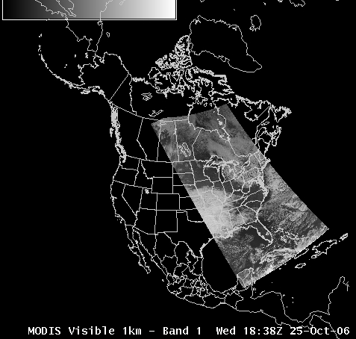
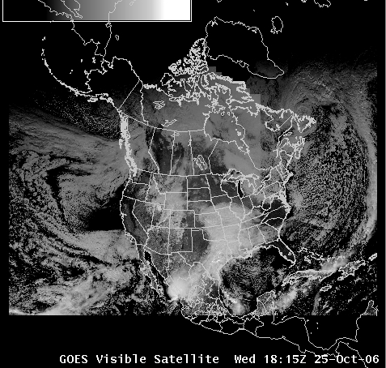
MODIS Imagery in AWIPS
Band 1: Visible channel (0.6µm)
MODIS visible channel
GOES visible channel

Slide 80
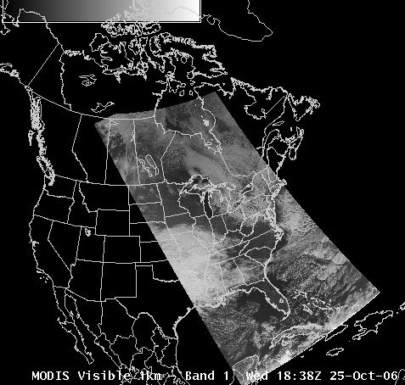
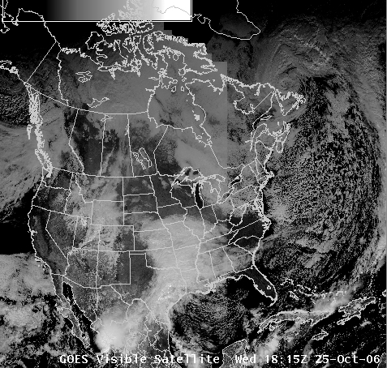
MODIS Imagery in AWIPS
Band 1: Visible channel (0.6µm)
MODIS visible channel
GOES visible channel

Slide 81
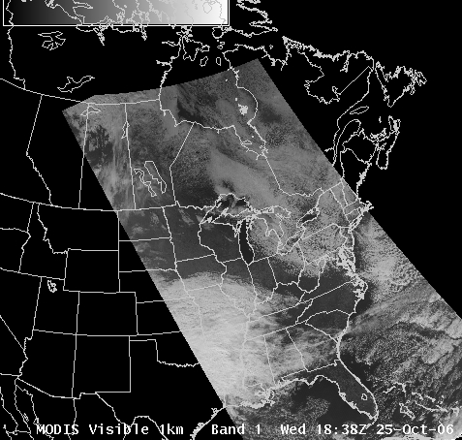
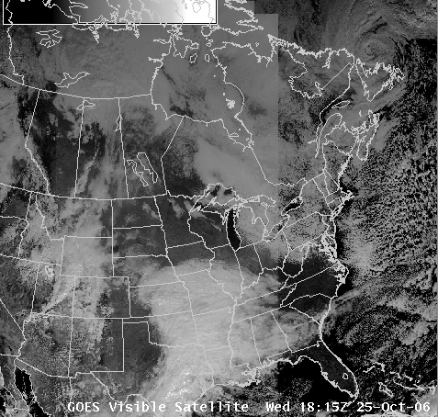
MODIS Imagery in AWIPS
Band 1: Visible channel (0.6µm)
MODIS visible channel
GOES visible channel

Slide 82
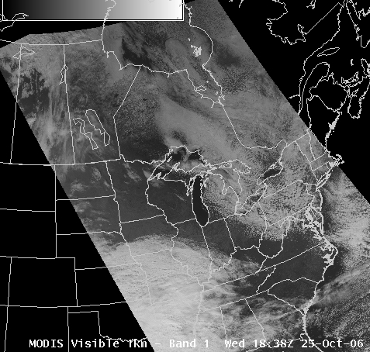
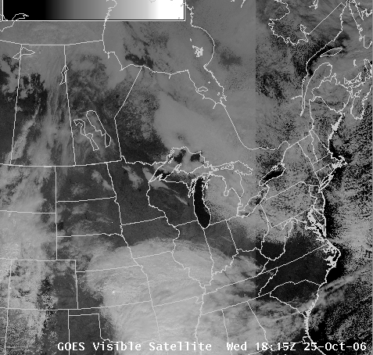
MODIS Imagery in AWIPS
Band 1: Visible channel (0.6µm)
MODIS visible channel
GOES visible channel

Slide 83
MODIS Imagery in AWIPS
Band 1: Visible channel (0.6µm)
MODIS visible channel
GOES visible channel

Slide 84
MODIS Imagery in AWIPS
Band 1: Visible channel (0.6µm)
MODIS visible channel
GOES visible channel

Slide 85
MODIS Imagery in AWIPS
Band 1: Visible channel (0.6µm)
MODIS visible channel
GOES visible channel

Slide 86
MODIS Imagery in AWIPS
Band 1: Visible channel (0.6µm)
MODIS visible channel
GOES visible channel

Slide 87
GEO versus LEO perspective

Slide 88
GEO versus LEO perspective

Slide 89
GEO versus LEO perspective

Slide 90
GEO versus LEO perspective

Slide 91
GEO versus LEO perspective

Slide 92
GEO versus LEO perspective

Slide 93
How Important Is Spatial Resolution?
A Quantitative Analysis of the Enhanced-V Feature in Relation to Severe Weather Jason C. Brunner, Steven A. Ackerman, A. Scott Bachmeier, and Robert M. RabinWeather and Forecasting Volume 22, Issue 4 (August 2007) pp. 853–872

Slide 94
MODIS Imagery in AWIPS
Band 26: Cirrus detection (1.38 µm)

Slide 95
MODIS Imagery in AWIPS
Band 26: Cirrus detection (1.38 µm)

Slide 96
Can Polar Orbiter Data Really Be That Useful to Forecasters?

Slide 97
MODIS data to the NWS
University of Wisconsin providing Direct Broadcast MODIS products to NWS since June 2006
1 km Reflectances and Brightness Temperatures
Bands 1 (.68 μm), Band 26 (1.38 μm), Band 7 (2.1 μm)
Band 20 (3.7 μm), Band 27 (6.7 μm), Band 31 (11 μm)
Products
1 km
Sea Surface Temperature, NDVI, Land Surface Temperature, Fog Product
5 km
Cloud Top Pressure, Total Precipitable Water, Cloud Phase
True Color 250 m Imagery

Slide 98
VIIRS data to the NWS
University of Wisconsin providing Direct Broadcast VIIRS products to NWS in May 2012
1km Reflectances and Brightness Temperatures
M-Bands 5 (.67 μm), M-Band 7 (.86 μm), M-Band 10 (1.6 μm)
M-Band 12 (3.7 μm), M-Band 15 (11 μm)

Slide 99
Virtual Institute for Satellite Integration Training (VISIT) lesson - offered since October 2006

Slide 101
MODIS Products in AWIPS
(October 2006 - January 2009)
53 NWS forecast offices participating so far

Slide 104
MODIS Imagery in AWIPS
Fog/stratus product (11.0µm - 3.7µm)
1-km MODIS
4-km GOES
Improved fog/stratus detection capability

Slide 105
AREA FORECAST DISCUSSION
NATIONAL WEATHER SERVICE STATE COLLEGE PA
601 AM EDT TUE AUG 20 2013
.SYNOPSIS...
HIGH PRESSURE OFF OF THE EAST COAST WILL CONTROL THE WEATHER
ACROSS PA THROUGH MIDWEEK. A COLD FRONT WILL PUSH THROUGH THE
REGION LATE THURSDAY OR EARLY FRIDAY. CANADIAN HIGH PRESSURE WILL
THEN BUILD SOUTHEAST INTO PENNSYLVANIA NEXT WEEKEND.
&&
.NEAR TERM /UNTIL 6 PM THIS EVENING/...
MODIS 11-3.7UM IMAGERY SHOWING WIDESPREAD VALLEY FOG ACROSS
CENTRAL PA EARLY THIS AM. MANY LOCATIONS AOB 1/4SM VSBY AT
09Z...SO HAVE ISSUED A DENSE FOG ADVISORY THRU 13Z. 3KM HRRR SFC
RH SUGGESTS THE FOG WILL BURN OFF IN MANY LOCATIONS BY ARND
12Z...BUT WILL LIKELY LINGER IN A FEW LOCATIONS UNTIL 14Z.

Slide 106
Supporting Visibility Forecasts
AREA FORECAST DISCUSSION
NATIONAL WEATHER SERVICE STATE COLLEGE PA
543 AM EDT MON JUL 30 2012
.NEAR TERM /UNTIL 6 PM THIS EVENING/...
MODIS 11-3.7UM IMAGERY SHOWING DENDRITIC PATTERN OF VALLEY FOG ACROSS THE ALLEGHENIES EARLY THIS MORNING...THE RESULT OF A CALM WIND AND TEMPS MUCH COOLER THAN THE RIVER/STREAM WATER. ACROSS
SOUTHEAST PA...A MOIST SERLY FLOW...COMBINED WITH RADIATIONAL COOLING...IS CAUSING LOW CLOUDS/FOG TO DEVELOP. LATEST MESOSCALE
MDL DATA INDICATES THE ALLEGHENY VALLEY FOG WILL BURN OFF BY ARND 13Z. MDL SOUNDINGS SUGGEST THE LOW CLOUDS/FOG ACROSS THE SOUTHEASTCOUNTIES WILL LIFT INTO A SCT-BKN CU LYR BY LATE AM.

Slide 107
MODIS NDVI product
used to determine
extent of hail damage
July 2008

Slide 108
Support for Fire Weather Forecasts
AREA FORECAST DISCUSSION
NATIONAL WEATHER SERVICE SALT LAKE CITY UT
1024 AM MDT MON JUL 25 2011
.FIRE WEATHER...MODIS WATER VAPOR IMAGERY INDICATES THAT
PRECIPITABLE WATER VALUES APPROACHING ONE INCH HAVE PUSHED AS FAR
NORTH AS THE SOUTHERN WASATCH FRONT THIS MORNING. THIS SURGE OF
MOISTURE IS ALSO BRINGING EXTENSIVE CLOUD COVER TO CENTRAL AND
NORTHERN UTAH THIS MORNING….WITH DEEP MOISTURE MOVING NORTH
BELIEVE THAT RISK FOR DRY THUNDERSTORMS IS LIMITED PRIMARILY TO THE
LEADING EDGE OF THE MOISTURE SURGE ACROSS NORTHERN UTAH...ALTHOUGH
FEEL COVERAGE OF POTENTIAL DRY STORMS WOULD BE LIMITED
MODIS Imagery from UW SSEC Antenna 10:17 UTC 25 July 2011

Slide 109
MODIS SST supports Small Craft Advisory
AREA FORECAST DISCUSSION
NATIONAL WEATHER SERVICE MILWAUKEE/SULLIVAN WI
1056 PM CDT MON SEP 10 2012
.MARINE...TIGHTENING PRESSURE GRADIENT AND LOW LEVEL MIXING
ENCROACHING ON THE VERY LOW LEVELS TO RESULT IN GUSTY WINDS
PERSISTING THROUGH THE NIGHT ACROSS NORTHERN MARINE ZONES.
OCCASIONAL GUSTS TO 25 KNOTS EXPECTED AT THE SHORE...MORE FREQUENT AWAY FROM THE SHORE DUE TO THE LOW LEVEL UNSTABLE AIR OVER THELAKE SURFACE. MODIS IMAGERY SHOWS THE LAKE TEMP IN THE NEAR SHORE WATERS AROUND 20C.
HENCE PUSHED UP START TIME OF SMALL CRAFT ADVISORY ACROSS NORTHERNTWO ZONES TO PRESENT TIME...AND ALSO EXPANDED ADVISORY TO INCLUDE WIND POINT TO WINTHROP HARBOR ZONE WHICH BEGINS TUESDAY MORNING.

Slide 110
MODIS SST Supports Waterspout Forecasts
AREA FORECAST DISCUSSION
NATIONAL WEATHER SERVICE MILWAUKEE/SULLIVAN WI
330 AM CDT FRI SEP 7 2012
.MARINE...TIGHTENING PRESSURE GRADIENT ASSOCIATED WITH DEEPENING LOW PRESSURE MOVING ALONG A FRONTAL BOUNDARY TO THE SOUTH OF LAKE MICHIGAN ALONG WITH A STEEPENING LOW LEVEL LAPSE RATE WILL RESULT IN GUSTY NORTH WINDS REACHING SMALL CRAFT ADVISORY LEVELS TONIGHT INTO SATURDAY. LATEST MODIS IMAGERY SHOWS LAKE SURFACE TEMPERATURE IN THE NEARSHORE WATERS 68-70F. STRONG LOW LEVEL COLD AIR ADVECTION IS EXPECTED TO INCREASE THE DELTA-T OVER THE LAKE TO 12-13 DEGREES THIS EVENING WITH CONVECTIVE CLOUD DEPTH INCREASING TO 15 TO 20K. WATERSPOUT INDEX INCREASES TO 8 TO 10 UNITS. WL ADD MENTION OF
WATERSPOUTS TO HWO FOR LATE AFTERNOON INTO THE EVENING.

Slide 111
Marine Gale Force Wind Forecasts
AREA FORECAST DISCUSSION
NATIONAL WEATHER SERVICE CHARLESTON SC
632 PM EST TUE NOV 12 2013
MARINE...
TONIGHT...CONDITIONS ARE SET FOR A DANGEROUS AND WIDESPREAD GALE EVENT. WINDS WILL INCREASE QUICKLY THIS EVENING AS THE ARCTIC FRONT PUSHES OFFSHORE AND STRONG COLD AIR ADVECTION ENSUES. SOLID GALES APPEAR LIKELY FOR ALL MARINE LEGS WITH WINDS TOPPING 30-35KT WITH GUSTS 40-45 KT NEARSHORE WATERS AND 35-40 KT WITH GUSTS TO 45 KT OVER THE GEORGIA OFFSHORE LEG. ALREADY SEEING WINDS GUSTING OVER 40 KT OFF THE NORTH CAROLINA OUTER BANKS. GALE WARNINGS ARE IN PLACE FOR ALL WATERS AND WILL WILL BE MAINTAINED. THERE IS CONCERN THAT FREQUENT GUSTS TO STORM FORCE COULD OCCUR ALONG THE EASTERN PORTIONS OF THE GEORGIA OFFSHORE WATERS WHERE 1KM MODIS SEA SURFACE TEMPERATURE DATA SHOWED THE WESTERN WALL STREAM IS LURKING.

Slide 112
Fog Formation Forecast
26 November 2013 Brownsville Texas

Slide 113
Fog Formation Forecast
AREA FORECAST DISCUSSION
NATIONAL WEATHER SERVICE BROWNSVILLE TX
238 PM CST TUE NOV 26 2013
DATA FROM A RECENT MODIS POLAR ORBITING SATELLITE PASS AND NEARSHORE
TEMPERATURE OBSERVATIONS SHOW THE FRONT AND PERSISTENT NORTH WINDS
HAVE DRASTICALLY REDUCED THE TEMPERATURE OF THE NEARSHORE GULF OF
MEXICO DUE TO UPWELLING. THE SATELLITE SUGGESTS THE MORE DRASTIC
DEPARTURE IS WITHIN 5 TO 15 MILES OF THE COASTLINE...WHICH IS FAIRLY
TYPICAL. WITH EASTERLY WINDS PROJECTED TO FLOW OVER THE GRADIENT OF
RELATIVELY WARM...76F ACCORDING TO BUOY 20...OFFSHORE WATER...TO THE
RELATIVELY COLD NEARSHORE WATER...A SETUP FAVORABLE FOR SEA
ADVECTION FOG EXISTS. ADDED FOG TO THE OVERNIGHT GROUP THURSDAY
NIGHT INTO FRIDAY...BUT IN LOCALIZED AREAS THE TIME OF DAY MAY NOT
MAKE A SIGNIFICANT DIFFERENCE REGARDING FOG FORMATION WITH PARTS OF
SOUTH PADRE ISLAND AND THE NEARSHORE WATERS POSSIBLY EXPERIENCING
FOG FOR AN EXTENDED PERIOD OF TIME.

Slide 114
Location of Fog/Status
AREA FORECAST DISCUSSION
NATIONAL WEATHER SERVICE STATE COLLEGE PA
436 AM EST THU FEB 20 2014
.NEAR TERM /UNTIL 6 PM THIS EVENING/...
EARLY AM MODIS 11-3.7UM IMAGERY SHOWING EXTENSIVE VALLEY FOG AND STRATUS ACROSS NORTHWEST PA...THE RESULT OF CLEAR SKIES AND CALM WIND UNDER HIGH PRES SYSTEM. LAMP AND RAP DATA BOTH INDICATE AREAS OF FOG WILL LIFT BTWN 12Z-14Z. FOCUS WILL THEN BE ON BAND OF SHRA LIFTING NORTHEAST FROM THE OHIO VALLEY ALONG APPROACHING WARM FRONT. REGIONAL RADAR MOSAIC ALREADY SHOWING THIS DEVELOPING BAND OF RAIN ACROSS ILLINOIS/INDIANA...WHERE NOSE OF LL JET INTERSECTS RETREATING 8H BAROCLINIC ZONE. ALL NEAR TERM MDL DATA TIMES THIS FEATURE THRU CENTRAL PA BTWN 17Z-23Z. ENSEMBLE MFLUX VALUES AND QPF PROBS SUPPORT NEAR 100 PCT CHC OF RAIN ACROSS THE NWMTNS...WITH PROGRESSIVELY LOWER CHC OF SHOWERS FURTHER SE.

Slide 115
Forecasting POPs
AREA FORECAST DISCUSSION
NATIONAL WEATHER SERVICE
BROWNSVILLE TX
359 AM CDT FRI JUN 20 2014
FOR THE FORECAST BASED IT AROUND A SCENARIO WHERE THE GULF TROUGHINESS IS NOT QUITE AS PRONOUNCED...BUT THE DEEP 30 KNOT EASTERLY WINDS IN THE 850/700MB LAYER DO NOT GET QUITE AS CARRIED AWAY EITHER. THE WAVES IN QUESTION ARE CLEARLY PRETTY PRONOUNCED ON SATELLITE IMAGERY BUT NOT ASSOCIATED WITH MUCH PRECIP AT THE MOMENT AND AMSU/SSMI AND MODIS TOTAL PRECIPITABLE WATER IMAGERY APPEAR TO SUGGEST THERE IS NOT AS MUCH AVAILABLE MOISTURE AS THE ECMWF
INITIALIZED. EVEN IF THE SYNOPTIC ECMWF SOLUTION WERE TO VERIFY THE 40 AND 50 PCT POPS PRESENTED BY ECX MOS APPEAR FAR TOO HIGH AND THUNDER WOULD BE DIFFICULT/IMPOSSIBLE IN A ZONE WITH LAPSE RATES AS POOR AS SHOULD BE IN PLACE. SO PAINTED LOW GRADE POPS/SHOWERS
STARTING IN THE MORNING ALONG THE COAST WORKING INLAND THROUGH THE DAY AND INTO THE MORE FAVORED SEABREEZE ZONES BY AFTERNOON WEDNESDAY AND THURSDAY AND HUGGED BACK TOWARDS A DRIER SOLUTION ON FRIDAY.

Slide 116
Identification of Stratus at Night
FXUS61 KRLX 030605
AFDRLX
AREA FORECAST DISCUSSION
NATIONAL WEATHER SERVICE CHARLESTON WV
105 AM EST TUE FEB 3 2015
.AVIATION /06Z TUESDAY THROUGH SATURDAY/...
LOW STRATO CU...EVIDENT IN MODIS SATELLITE IMAGES
...CONTINUING TO PRODUCE LIGHT SNOW SHOWERS OR FLURRIES ACROSS THE SOUTHERN HALF OF THE AREA. SOME CLEARING IS NOTED IN SATELLITE IMAGES AND SFC OBS ACROSS PORTIONS OF SOUTHEAST OHIO INCLUDING PKB. HOWEVER...ADDITIONAL CLOUDS ARE EXPECTED TO MOVE OVER THIS AREA FROM THE WEST. CODED MVFR CEILINGS UNDER LIGHT SNOW AT BKW...HTS...AND CRW. EXPECT SNOW SHOWERS TO END FROM WEST TO EAST THROUGH 09Z...PERHAPS PERSISTING OVER EKN AND BKW THROUGH 12Z. VERY LIGHT OR LITTLE ACCUMULATIONS EXPECTED WITH THESE SNOW SHOWERS.

Slide 117
Identification of Fog at Night
Area Forecast Discussion
National Weather Service Missoula MT
334 AM MST SAT NOV 8 2014
…
.AVIATION...Moderate high pressure situated over the area will bring a chance for fog to develop at KGPI, KMSO and KSMN. The VIIRS night-time visible satellite image at 08/1010z revealed some valley fog across Clearwater County, Idaho and also north across the Idaho Panhandle. Any fog that develops near the aforementioned terminals will dissipate by noon. Expect light and variable surface winds at all the terminals.

Slide 118
Low Cloud/ Fog Identification at Night
AREA FORECAST DISCUSSION
NATIONAL WEATHER SERVICE SAN FRANCISCO BAY AREA
443 AM PDT FRI MAR 14 2014
.DISCUSSION...AS OF 4:10 AM PDT FRIDAY...THE DRY TAIL END OF A WEATHER SYSTEM MOVING IN TO THE PACIFIC NORTHWEST IS APPROACHING OUR DISTRICT...AND RESULTING IN ENHANCEMENT OF THE MARINE LAYER AND A RETURN OF THE MARINE STRATUS. LATEST GOES FOG PRODUCT IMAGERY...AND IN RATHER SPECTACULAR DETAIL JUST REC'D SUOMI VIIRS NIGHTTIME HIGH RES VISUAL IMAGE...SHOW COVERAGE ALONG MUCH OF THE COAST FROM PT REYES SOUTH TO THE VICINITY OF THE MONTEREY PENINSULA...AND A BROAD SWATH EXTENDING INLAND ACROSS SAN FRANCISCO AND THROUGH THE GOLDEN GATE TO THE EAST BAY. LATEST BODEGA BAY AND FT ORD PROFILER DATA INDICATE A MARINE LAYER DEPTH OF ABOUT 1300 FT. SOME THIN HIGH CLOUDS ARE ALSO PASSING THROUGH ABOVE.

Slide 119
AREA FORECAST DISCUSSION
NATIONAL WEATHER SERVICE GRAND RAPIDS MI
1156 AM EST MON FEB 24 2014
ON A SIDE NOTE IT WILL BE INTERESTING TO SEE THE MODIS SAT PIC
FROM TODAY AS THERE APPEARS TO BE SOME THIN ICE AGAIN IN PLACE
ACROSS THE FAR SOUTH PART OF THE LAKE AND UP THE WESTERN SHORE
TOWARDS MILWAUKEE. THIS WILL HAVE SOME AFFECT ON FETCH LENGTH IN A
SOUTHWEST FLOW. OBVIOUSLY THE LAKE IS MUCH MORE OPEN THAN IT WAS A
WEEK OR SO AGO. THE MODIS PASSES OVER LAKE MICHIGAN AT 1710Z TODAY
OR IN ABOUT 15 MINS.
So we have gone from “Can Research Satellite be Used in Operations?”
to forecasters knowing the MODIS orbit overpass times, and expecting
the data to be useful.

Slide 120
Thunderstorms
Characteristics of Severe Weather as Observed from Satellite
Overshooting Tops
Gravity Wave Generation

Slide 121
How Important Is Spatial Resolution?
A Quantitative Analysis of the Enhanced-V Feature in Relation to Severe Weather Jason C. Brunner, Steven A. Ackerman, A. Scott Bachmeier, and Robert M. RabinWeather and Forecasting Volume 22, Issue 4 (August 2007) pp. 853–872

Slide 122
Overshooting Top
A dome-like protrusion above a thunderstorm anvil, representing a very strong updraft and hence a higher potential for severe weather with that storm. A persistent and/or large overshooting top often is present on a supercell.

Slide 123
Severe Thunderstorm Example 2
Including
Lightning
Detection
04:11 UTC
19 June 2009
During the 15-minute interval ending at 04:15 UTC this
storm produced over 900 lightning strikes

Slide 124
Severe Thunderstorm Case 2
Including
Lightning
and Hail
Reports
13 May 2009

Slide 125
Bedka, K., Brunner, J., Dworak, Feltz, W., Otkin, J. and T. Greenwald: 2010. Objective Satellite-Based Detection of Overshooting Tops Using Infrared Window Channel Brightness Temperature Gradients, Journal of Applied Meteorology and Climatology, Vol. 49, pp. 181-202.

Slide 126
IMAPP GeoCAT Output HDF4 File
geocatL2.Terra.2013140.041735.hdf
Dimensions: lines = 4610, elements = 1354 ;
1 km resolution
Variables:
short pixel_latitude(lines, elements) ;
short pixel_longitude(lines, elements) ;
short pixel_solar_zenith_angle(lines, elements) ;
short pixel_satellite_zenith_angle(lines, elements) ;
short pixel_relative_azimuth_angle(lines, elements) ;
byte pixel_surface_type(lines, elements) ;
byte pixel_ecosystem_type(lines, elements) ;
float ot_overshooting_top_grid_magnitude(lines, elements) ;
short ot_overshooting_top_grid_number_of_anvil_pixels(lines, elements) ;

Slide 129
GOES versus MODIS

Slide 132
IMAPP Overshooting Top Lightning Risk Image
According to the study by Bedka et al. 2010 (JAM), with the presence of an overshooting top, there is a 35% chance or greater, 50% chance or greater, 65% chance or greater, or 70% chance or greater of experiencing CG lightning within 10 km of the overshooting top center depending on the brightness temperature of the overshooting top. The colder the overshooting top brightness temperature is, the greater the chance of CG lightning. These relationships are shown on this image with each colored region identifying the area within a 10 km radius of the overshooting top center.

Slide 134
IMAPP Overshooting Top Turbulence Risk Image
According to the study by Bedka et al. 2010 (JAM), with the presence of an overshooting top there is a 25% or greater chance of experiencing turbulence within 25 km of the overshooting top center. This relationship is shown on this image with each red region representing the area within a 25 km radius of the respective overshooting top center.

