Slide 1
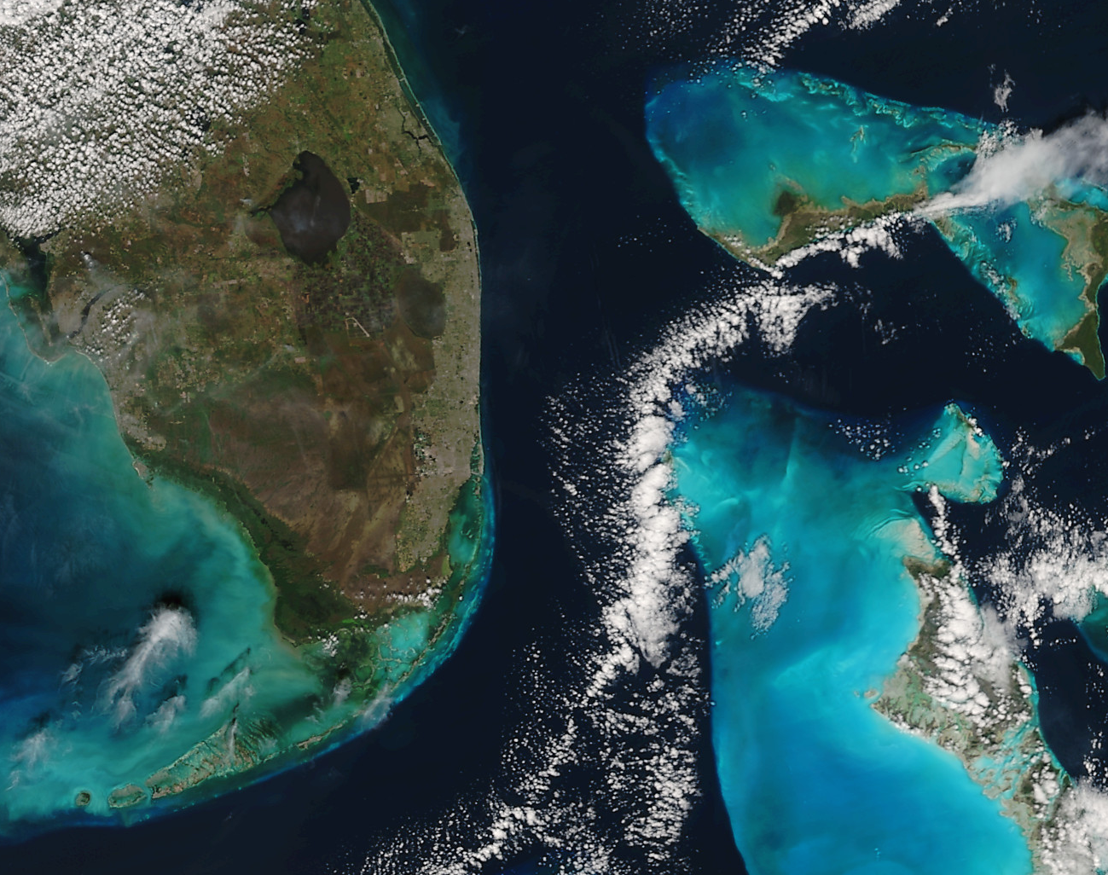

DB Applications Workshop AOML:
Practical Aspects of Real-Time
Suomi NPP Imagery and Products
Liam Gumley
Space Science and Engineering Center
University of Wisconsin-Madison
VIIRS True Color, 2015/01/30

Slide 2
What is Suomi NPP?
About Suomi NPP
Launched into a polar sun-synchronous orbit on Oct 28, 2011.
Developed by NASA and industry; operated by NOAA.
Spacecraft and sensors were developed by industry.
Science algorithms were also developed by industry.
Question: Can the science products (e.g., global cloudiness) continue the Climate Data Record established by previous NASA and NOAA satellites?
Climate Data Record = "A time series of measurements of sufficient length, consistency, and continuity to determine climate variability. and change.”

Slide 3
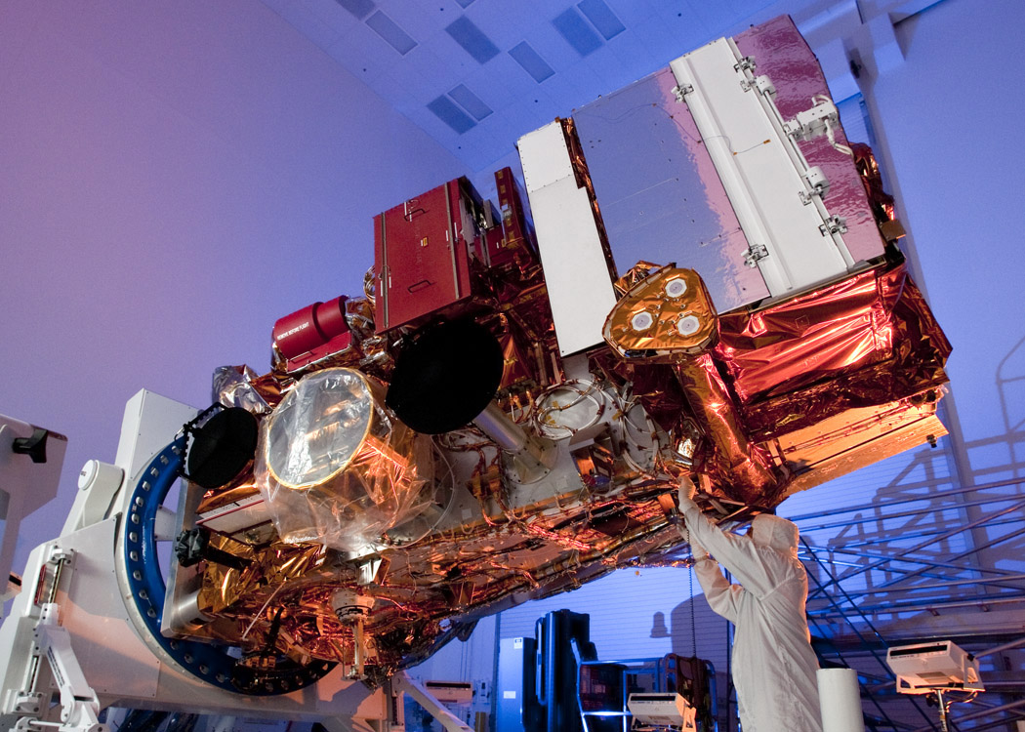
Suomi NPP at Ball Aerospace
July 2010

Slide 4
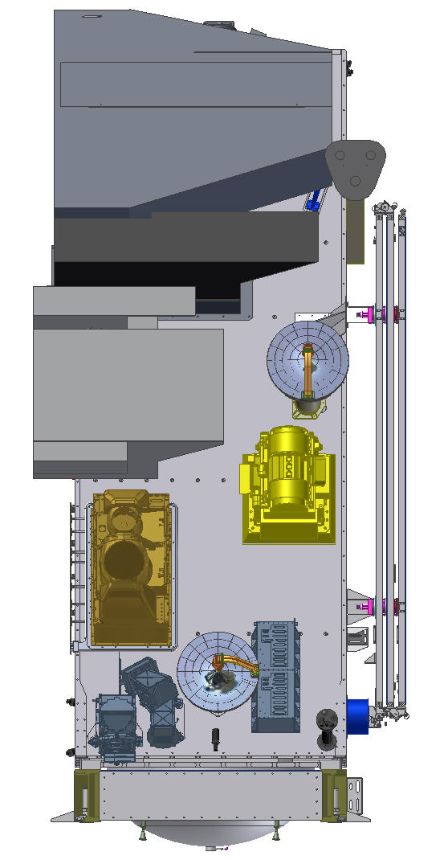
Suomi NPP Sensor Suite
VIIRS – Medium Resolution Visible & Infra-red Imager
CrIS – Fourier Transform Spectrometer for IR Temperature and Moisture sounding
ATMS – Microwave sounding radiometer
OMPS – Total Ozone Mapping and Ozone Profile measurements
CERES - Earth Radiation Budget
VIIRS
CrIS
CERES
ATMS
OMPS Limb
OMPS Nadir

Slide 5
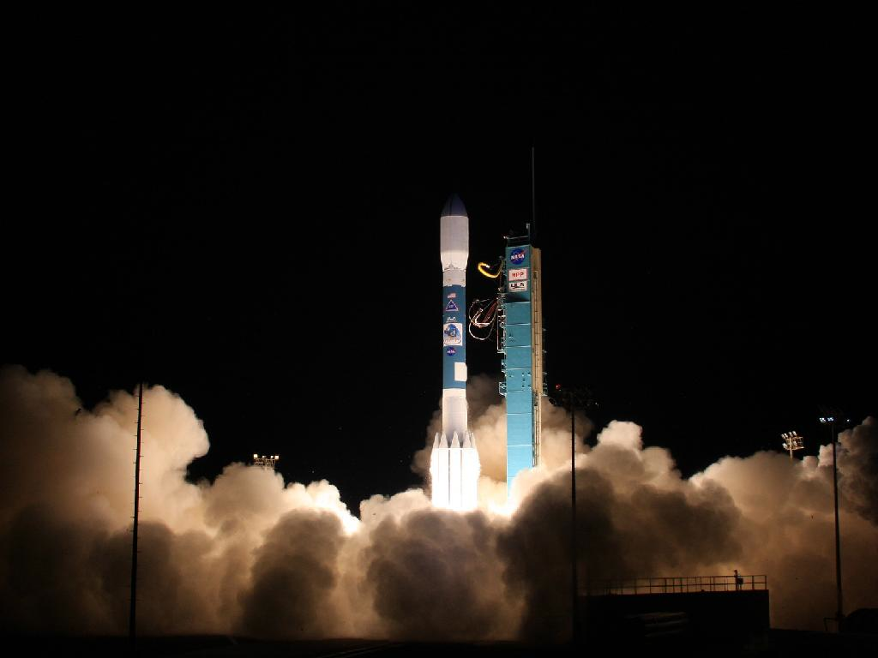
Suomi NPP Launch 2011/10/28

Slide 6
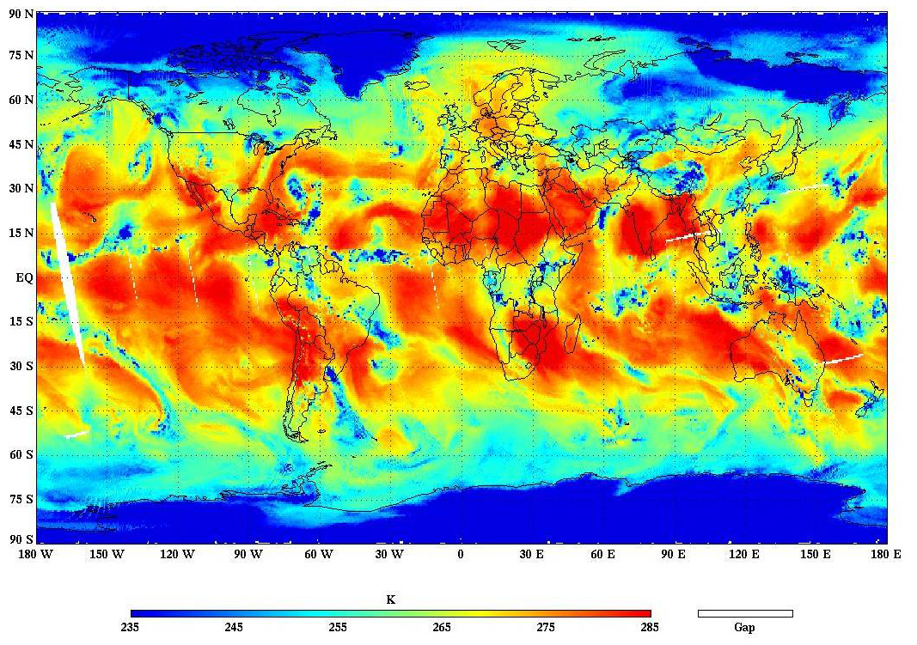
ATMS First Light image
Suomi NPP ATMS channel 18 antenna temperature, 8 November 2011

Slide 7
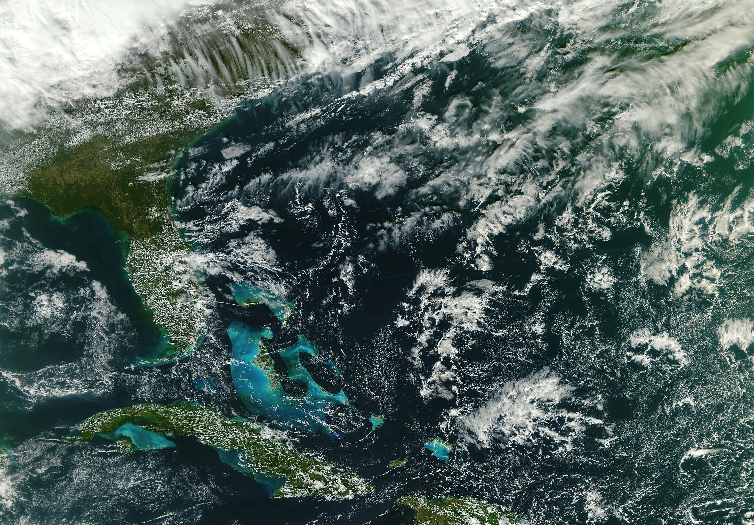
VIIRS First Light Image
Suomi NPP VIIRS M-band True Color, 21 November 2011

Slide 8
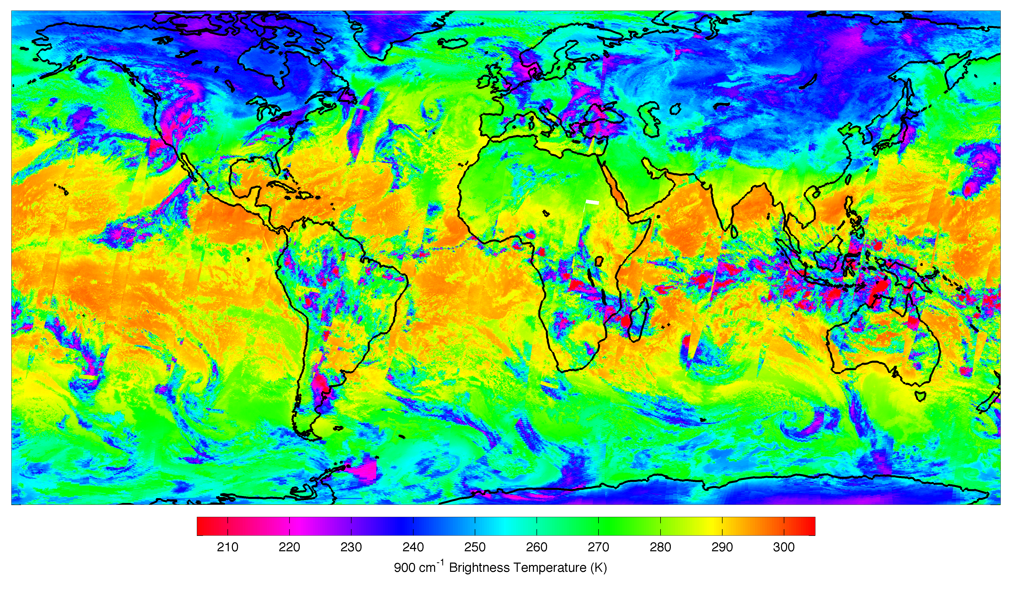
CrIS First Light Image
Suomi NPP CrIS thermal infrared, 21/23/25 January 2012

Slide 9
What is new about VIIRS?
VIIRS native resolution is 375 and 750 meters (vs. 250 and 1000 meters for MODIS).
VIIRS has 22 spectral bands while MODIS has 36 spectral bands.
VIIRS has a thermal infrared band at 375 meter resolution.
VIIRS has a Day/Night visible band.
VIIRS has near constant FOV size across the scan.
Redundant “bow-tie” pixels on VIIRS are not transmitted to the ground (“bowtie deletion”).

Slide 10
Where To Obtain VIIRS Data

Slide 11
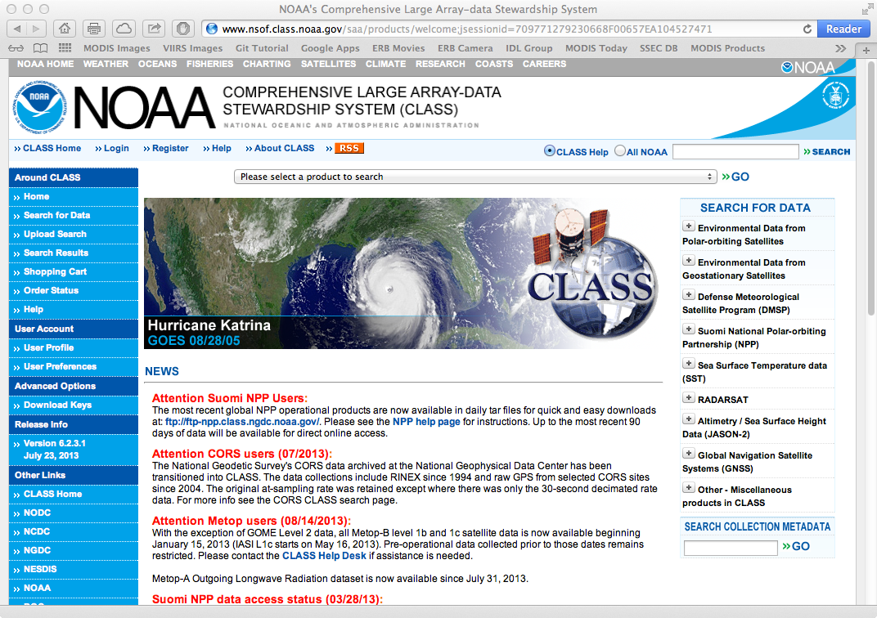
Suomi NPP Data Archive: NOAA CLASS
http://www.class.noaa.gov/
Notes:
NOAA CLASS is the best place to order Suomi NPP data including VIIRS. Ad-hoc download requests can be submitted and subscriptions can be set up (push or pull).

Slide 12
Notes about NOAA CLASS
CLASS is the official archive for NPP and JPSS data.
Ad-hoc orders are supported.
Subscription orders are supported.
A detailed tutorial on ordering Suomi NPP data is available.
NASA Atmosphere PEATE at UW/SSEC also provides VIIRS SDRs.

Slide 13
VIIRS Scanner Characteristics

Slide 14
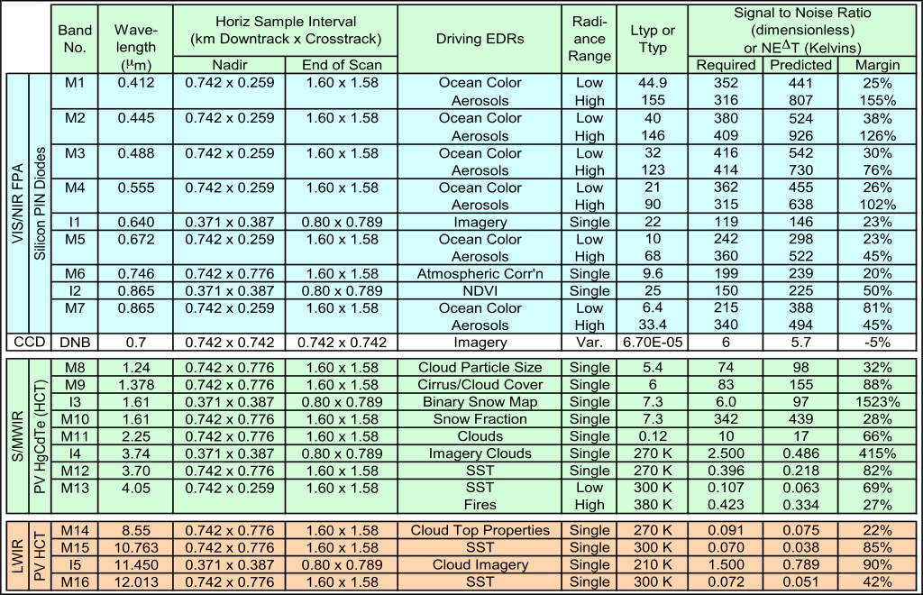
VIIRS Spectral Bands

Slide 15
VIIRS Scan Details
16 detectors along track (M-bands)
32 detectors along track (I-bands)
Swath width 3000 km
Granule size 85.7 sec
Usually 48 scans per granule (sometimes 47)
Calibrated TOA reflectance is calculated using the terrain corrected solar zenith angle.

Slide 16
VIIRS Scan Overlap

Slide 17
VIIRS Bowtie Deletion Zones

Slide 18
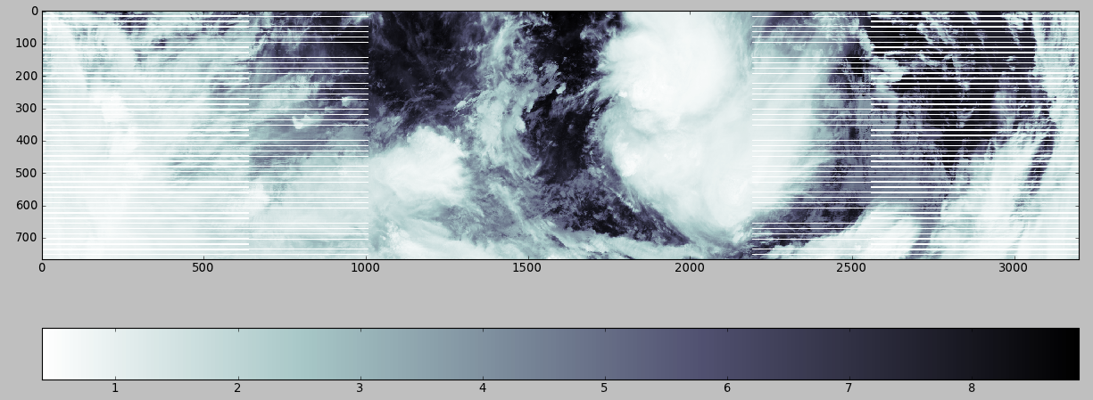
Visualization of a VIIRS
M-band SDR granule (Python)
Dimensions are 3200x768 pixels
Note bowtie deletion zones
Fill value in these zones is 65533

Slide 19
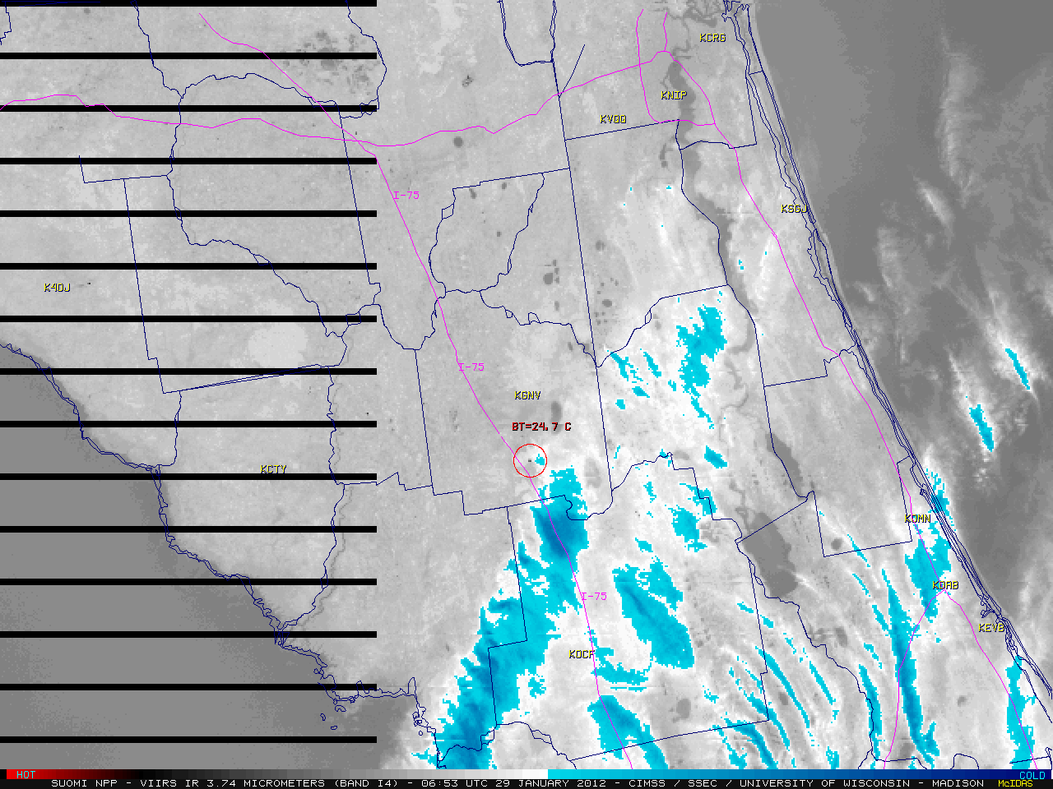
Another example of bowtie deletion
McIDAS-X, served by VIIRS SDR ADDE

Slide 20
VIIRS aggregation zones
(to maintain near constant FOV size)
32 deg
43 deg
56 deg

Slide 21
VIIRS Calibration
For thermal emissive (infrared) bands, a full aperture black body (BB) with accurately-known emissivity and temperature, and deep space, are viewed on every scan.
For reflected solar (visible, near-infrared) bands, a full aperture solar diffuser (SD) providing precisely-attenuated sunlight in the visible region of the spectrum is viewed on every scan.
Since the diffusing surface of the SD may degrade slightly over time on orbit, the sensor also includes a Solar Diffuser Stability Monitor (SDSM) to detect changes in the SD reflected radiance.
SD and SDSM data are valid during a one minute window each orbit that occurs near the Earth’s south pole when the sun illuminates the respective input ports.

Slide 22
Anatomy of a VIIRS File Name
GITCO_npp_d20120207_t0456502_e0458143_b01444_c20120207112240904333_noaa_ops.h5
GITCO = product name (5 characters; GITCO = VIIRS I-band geolocation)
npp = platform name (3 characters)
d20120207 = date of observation (yyyymmdd)
t0456502 = start time of granule (hhmmsss)
e0458143 = end time of granule (hhmmsss)
b01444 = orbit number
c20120207112240904333 = file creation date and time
noaa = originator of the file (4 characters; noaa = NOAA/NESDIS/IDPS)
ops = domain description (3 characters; ops = operational)
The file naming convention is described in detail in JPSS CDFCB External Volume 1: Overview, available at
http://npp.gsfc.nasa.gov/science/documents.html

Slide 23
VIIRS Detailed Information
For detailed information on VIIRS sensor data formats, scanning geometry, bowtie deletion, detector aggregation, etc., see
“NPOESS Common Data Format Control Book - External Volume VII – Part I – NPOESS Downlink Data Formats D34862-07-01 Rev C” from
http://npp.gsfc.nasa.gov/documents.html

Slide 24
VIIRS M-band SDR Contents

Slide 25
VIIRS M-band Geolocation Contents

Slide 26
VIIRS Product Types

Slide 27
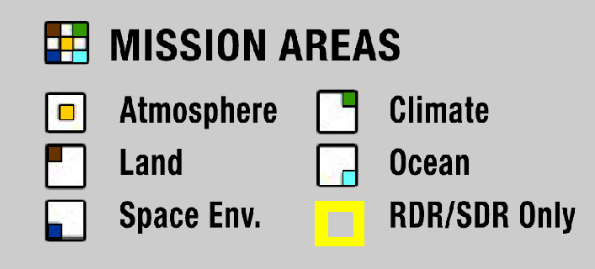
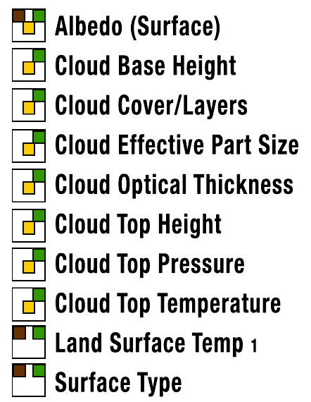
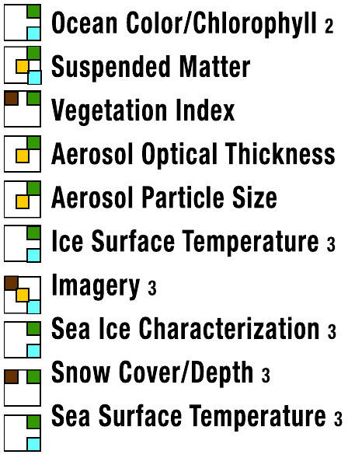
VIIRS Products

Slide 28
VIIRS Product Types
Raw Data Record (RDR) = MODIS Level 0
Sensor Data Record (SDR) = MODIS Level 1B
Intermediate Product (IP) = MODIS Level 2
Environmental Data Record (EDR) = MODIS Level 2
Climate Data Record (CDR) = MODIS Level 3
Product format is HDF5; described in CDFCB volumes available at
http://npp.gsfc.nasa.gov/science/documents.html

Slide 29
How many VIIRS SDR files per day?
16 M-bands, 5 I-bands, and 1 day/night band (16+5+1 = 22)
Geoid and terrain corrected geolocation for M, I, and DNB (2x3 = 6)
85.7 sec per granule
(86400 sec/day) / (85.7 sec/granule) = 1008 granules per day
VIIRS SDR: (1008 granules/day) x (28 files/granule) = 28224 files/day
MODIS L1B: 288 granules/day x 4 files/granule = 1152 files/day

Slide 30
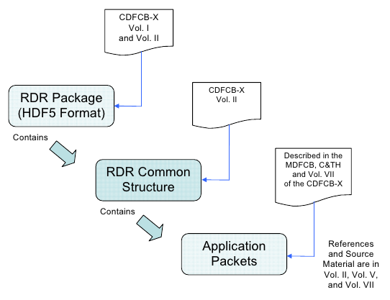
Raw Data Record (RDR)
The RDR is an accumulation of binary data generated by sensors on board the NPP spacecraft and assembled into groups called application packets (APs).
The ground software collects one or more groups of related APs together into granules which are then assembled into common RDR structures and combined with metadata to create the delivered HDF5 file.
Similar to MODIS Level 0
CDFCB-X documents at right can be obtained
from...

Slide 31
Sensor Data Record (SDR)
The SDR is an accumulation of binary data generated by sensors on board the NPP spacecraft and assembled into groups called application packets (APs).
Processing an RDR into an SDR involves unpacking and decommutating the Application Packet (AP) data, as necessary, applying calibration (radiometric, geometric, engineering), and finally geo-locating, as needed, using ephemeris and attitude information and earth model information.
An SDR contains the following:
- Calibrated sensor data
- Geolocation data (where applicable)
- Quality flags
- Metadata at the granule and aggregation level
Product names GMODO, GMTCO, GIMGO, GITCO, SVM[01-16], SVI[01-05]

Slide 32
Intermediate Product (IP)
IPs are defined as a data subset or retrieval by-product that is required within another primary data product’s generation sequence or is used as an input to secondary processing or analysis.
Generally are pixel-level products like the SDRs (750m resolution).
Certain IPs (Cloud Mask, Quarterly Surface Type) are packaged and delivered to the end-user, and are used to create further IPs (Cloud Optical Properties, Cloud Top Parameters, Aerosol etc...).
Other IPs (Quarterly Surface Type/Land Water Mask [QSTLWM IP] are generated during the creation of IPs and EDRs but are not delivered.
Atmosphere Product Names:
- IICMO (Cloud Mask)
- IVAOT (Aerosol Optical Thickness)
- IVCOP (Cloud Optical Properties [COT, EPS])
- IVCTP (Cloud Top Parameters [CTP, CTT, CTH])

Slide 33
Environmental Data Records (EDR)
Environmental Data Records (EDRs) are data records containing environmental parameters or imagery generated by the IDPS system as products deliverable to the user.
An EDR contains the following:
- EDR specific data
- Appropriate geolocation values
- Quality Flags
- Metadata represented as Attributes in the HDF5 file that are provided at the granule and aggregation level
Atmosphere Product names VAOOO (AOT), VCEPO (EPS), VCOTO (COT), VCTPO (CTP), VCTTO( CTT), VCTHO (CTH)...

Slide 34
Software to Read VIIRS Data

Slide 35
Hydra2
Hydra2 is an interactive application for viewing and interrogating imager and sounder data.
Supported satellites include Suomi NPP, Terra, Aqua, NOAA, Metop, FY-3.
Supported sensors include:
  Imagers VIIRS, MODIS, AVHRR, MERSI
  IR Sounders CrIS, IASI, AIRS
  MW Sounders ATMS, AMSU
Software is free; runs on PC/Mac/Linux

Slide 36
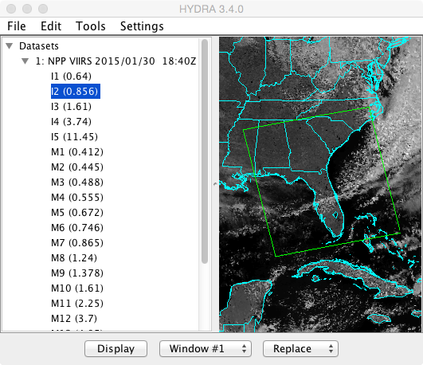
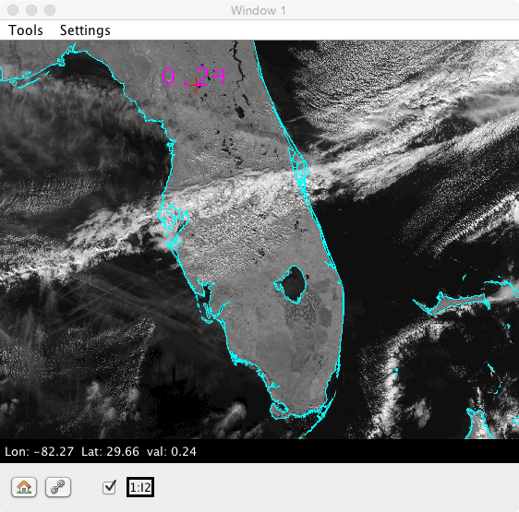
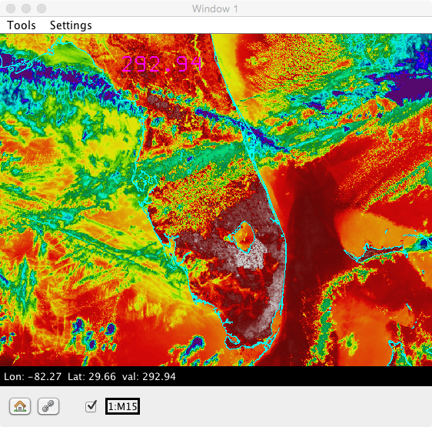
Hydra2

Slide 37
HDF5 Software
http://www.hdfgroup.org/HDF5/
Software library (API) for C, Fortran, Java
Command line utilities (e.g., h5dump) for Windows, Mac, Linux
HDFView interactive viewer
IDL, Matlab, and Python all have well developed HDF5 APIs
ENVI and other commercial software does not support VIIRS (yet)

Slide 38
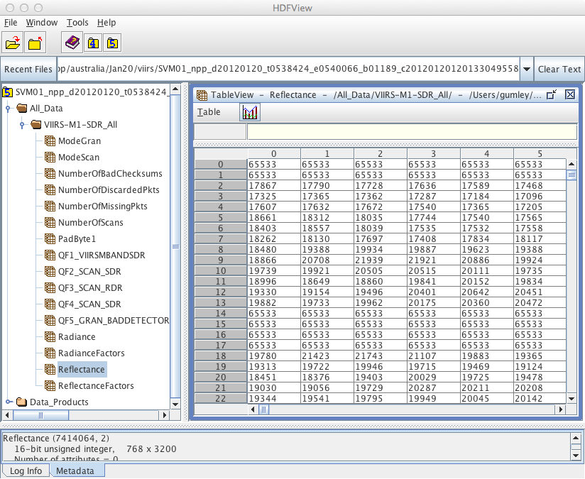

Slide 39
Interrogation of VIIRS files using h5dump
VIIIRS RDR, SDR, EDR, CDR and IP files are in HDF5 format
HDF5 format is hierarchical in nature, and HDF5 data structure shares a similarity with a UNIX file system. We can dump the basic file structure using "h5dump -n "...
h5dump -n SVM16_npp_d20120120_t0534262_e0535504_b01189_c20120120120117709679_noaa_ops.h5
HDF5 "SVM16_npp_d20120120_t0534262_e0535504_b01189_c20120120120117709679_noaa_ops.h5" {
FILE_CONTENTS {
group /
group /All_Data
group /All_Data/VIIRS-M16-SDR_All
dataset /All_Data/VIIRS-M16-SDR_All/BrightnessTemperature
dataset /All_Data/VIIRS-M16-SDR_All/BrightnessTemperatureFactors
dataset /All_Data/VIIRS-M16-SDR_All/ModeGran
dataset /All_Data/VIIRS-M16-SDR_All/ModeScan
dataset /All_Data/VIIRS-M16-SDR_All/NumberOfBadChecksums
dataset /All_Data/VIIRS-M16-SDR_All/NumberOfDiscardedPkts
dataset /All_Data/VIIRS-M16-SDR_All/NumberOfMissingPkts
dataset /All_Data/VIIRS-M16-SDR_All/NumberOfScans
dataset /All_Data/VIIRS-M16-SDR_All/PadByte1
dataset /All_Data/VIIRS-M16-SDR_All/QF1_VIIRSMBANDSDR
dataset /All_Data/VIIRS-M16-SDR_All/QF2_SCAN_SDR
dataset /All_Data/VIIRS-M16-SDR_All/QF3_SCAN_RDR
dataset /All_Data/VIIRS-M16-SDR_All/QF4_SCAN_SDR
dataset /All_Data/VIIRS-M16-SDR_All/QF5_GRAN_BADDETECTOR
dataset /All_Data/VIIRS-M16-SDR_All/Radiance
dataset /All_Data/VIIRS-M16-SDR_All/RadianceFactors
group /Data_Products
group /Data_Products/VIIRS-M16-SDR
dataset /Data_Products/VIIRS-M16-SDR/VIIRS-M16-SDR_Aggr
dataset /Data_Products/VIIRS-M16-SDR/VIIRS-M16-SDR_Gran_0
}
}

Slide 40
Interrogation of VIIRS SDR files using h5dump
To examine the details about a particular dataset, say the M16 radiance...
h5dump -H -d /All_Data/VIIRS-M16-SDR_All/Radiance
SVM16_npp_d20120120_t0534262_e0535504_b01189_c20120120120117709679_noaa_ops.h5
HDF5 "SVM16_npp_d20120120_t0534262_e0535504_b01189_c20120120120117709679_noaa_ops.h5" {
DATASET "/All_Data/VIIRS-M16-SDR_All/Radiance" {
DATATYPE H5T_STD_U16BE
DATASPACE SIMPLE { ( 768, 3200 ) / ( 768, 3200 ) }
}
}
Examining the data values in the radiance dataset...
h5dump -d /All_Data/VIIRS-M16-SDR_All/Radiance
SVM16_npp_d20120120_t0534262_e0535504_b01189_c20120120120117709679_noaa_ops.h5
HDF5 "SVM16_npp_d20120120_t0534262_e0535504_b01189_c20120120120117709679_noaa_ops.h5" {
DATASET "/All_Data/VIIRS-M16-SDR_All/Radiance" {
DATATYPE H5T_STD_U16BE
DATASPACE SIMPLE { ( 768, 3200 ) / ( 768, 3200 ) }
DATA {
(0,0): 65533, 65533, 65533, 65533, 65533, 65533, 65533, 65533, 65533,
(0,9): 65533, 65533, 65533, 65533, 65533, 65533, 65533, 65533, 65533,
(0,18): 65533, 65533, 65533, 65533, 65533, 65533, 65533, 65533, 65533,
(0,27): 65533, 65533, 65533, 65533, 65533, 65533, 65533, 65533, 65533,
(0,36): 65533, 65533, 65533, 65533, 65533, 65533, 65533, 65533, 65533
...
...

Slide 41
IDL code to read VIIRS SDR M15
;- Open the file
file = 'SVM15_npp_d20120120_t0528446_e0530088_b01189_c20120120115158805940_noaa_ops.h5'
file_id = h5f_open(file)
;- Read the data array
data_id = h5d_open(file_id, '/All_Data/VIIRS-M15-SDR_All/BrightnessTemperature')
data = h5d_read(data_id)
h5d_close, data_id
;- Read the scale factors
data_id = h5d_open(file_id, '/All_Data/VIIRS-M15-SDR_All/BrightnessTemperatureFactors')
factors = h5d_read(data_id)
h5d_close, data_id
;- Apply the scale factors
data = data * factors[0] + factors[1]
;- Close the file
h5f_close, file_id

Slide 42
Software supporting HDF5
IDL
Matlab
Python
C/Fortran APIs
Java
ENVI (see VIIRS Conversion Toolkit)

Slide 43
Reprojection/Remapping Software
MS2GT from NSIDC
  http://cires.colorado.edu/~tharan/ms2gt/
Developed for MODIS, but low level routines (ll2cr and fornav) are sensor agnostic
For 6 concatenated M-band SDR granules:
$ ll2cr -v -f 3200 288 16 lat.dat lon.dat remap.gpd image_proj
$ fornav 1 -v -t u2 –f 65533 -F 0 -D 40 3200 28 16 \
image_proj_cols_03200_00288_00000_16.img \
image_proj_rows_03200_00288_00000_16.img \
image.dat 2772 3559 image_proj.dat

Slide 44
Defining the projected grid
where lat.dat, lon.dat contain 32-bit floating point lat/lons and image.dat contains 16-bit unsigned integers (all 3200x4608 values).
Grid Parameter Definition (GPD file) remap.gpd contains:
Map Projection: Cylindrical Equidistant
Map Reference Latitude: 36.50000
Map Reference Longitude: -77.82500
Grid Map Units per Cell: 0.750
Grid Width: 2772.0
Grid Height: 3559.0
Grid Map Origin Column: 1385.5
Grid Map Origin Row: 1779.0

Slide 45
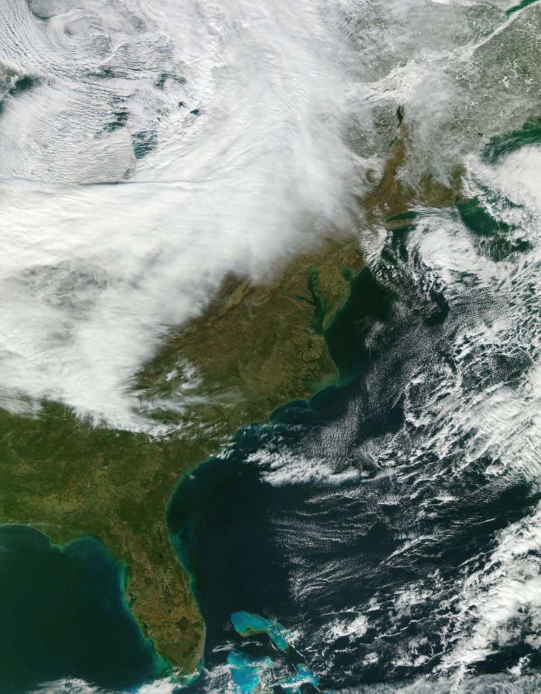
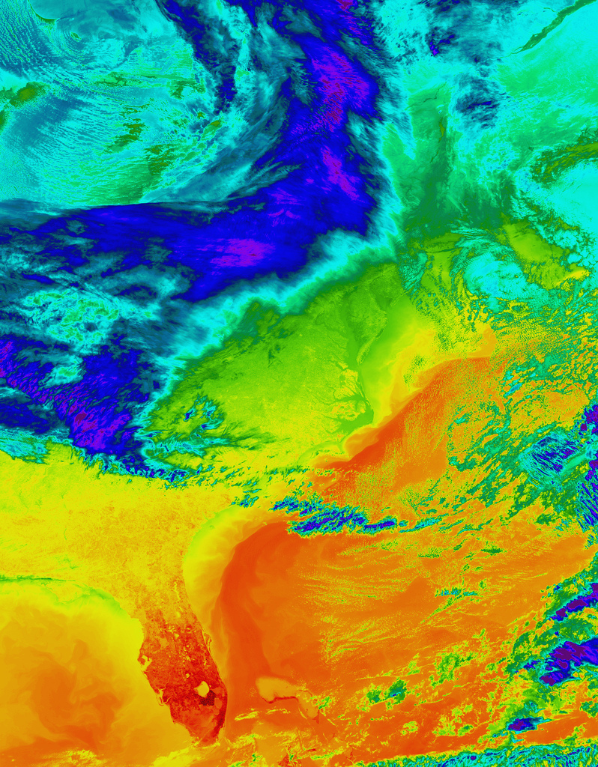
VIIRS Projected Image Examples

Slide 46
Suomi NPP Direct Broadcast and the Community Satellite Processing Package (CSPP)

Slide 47
Suomi NPP Direct Broadcast
SNPP transmits VIIRS, CrIS, and ATMS data real-time via X-band direct broadcast.
7812 MHz, 13 Mbps.
No encryption, licenses, or fees.
Downlink format is described in CDFCB External Volume VII at
  http://npp.gsfc.nasa.gov/documents.html
Software for real-time processing of SNPP DB data is available from SSEC and NASA.

Slide 48
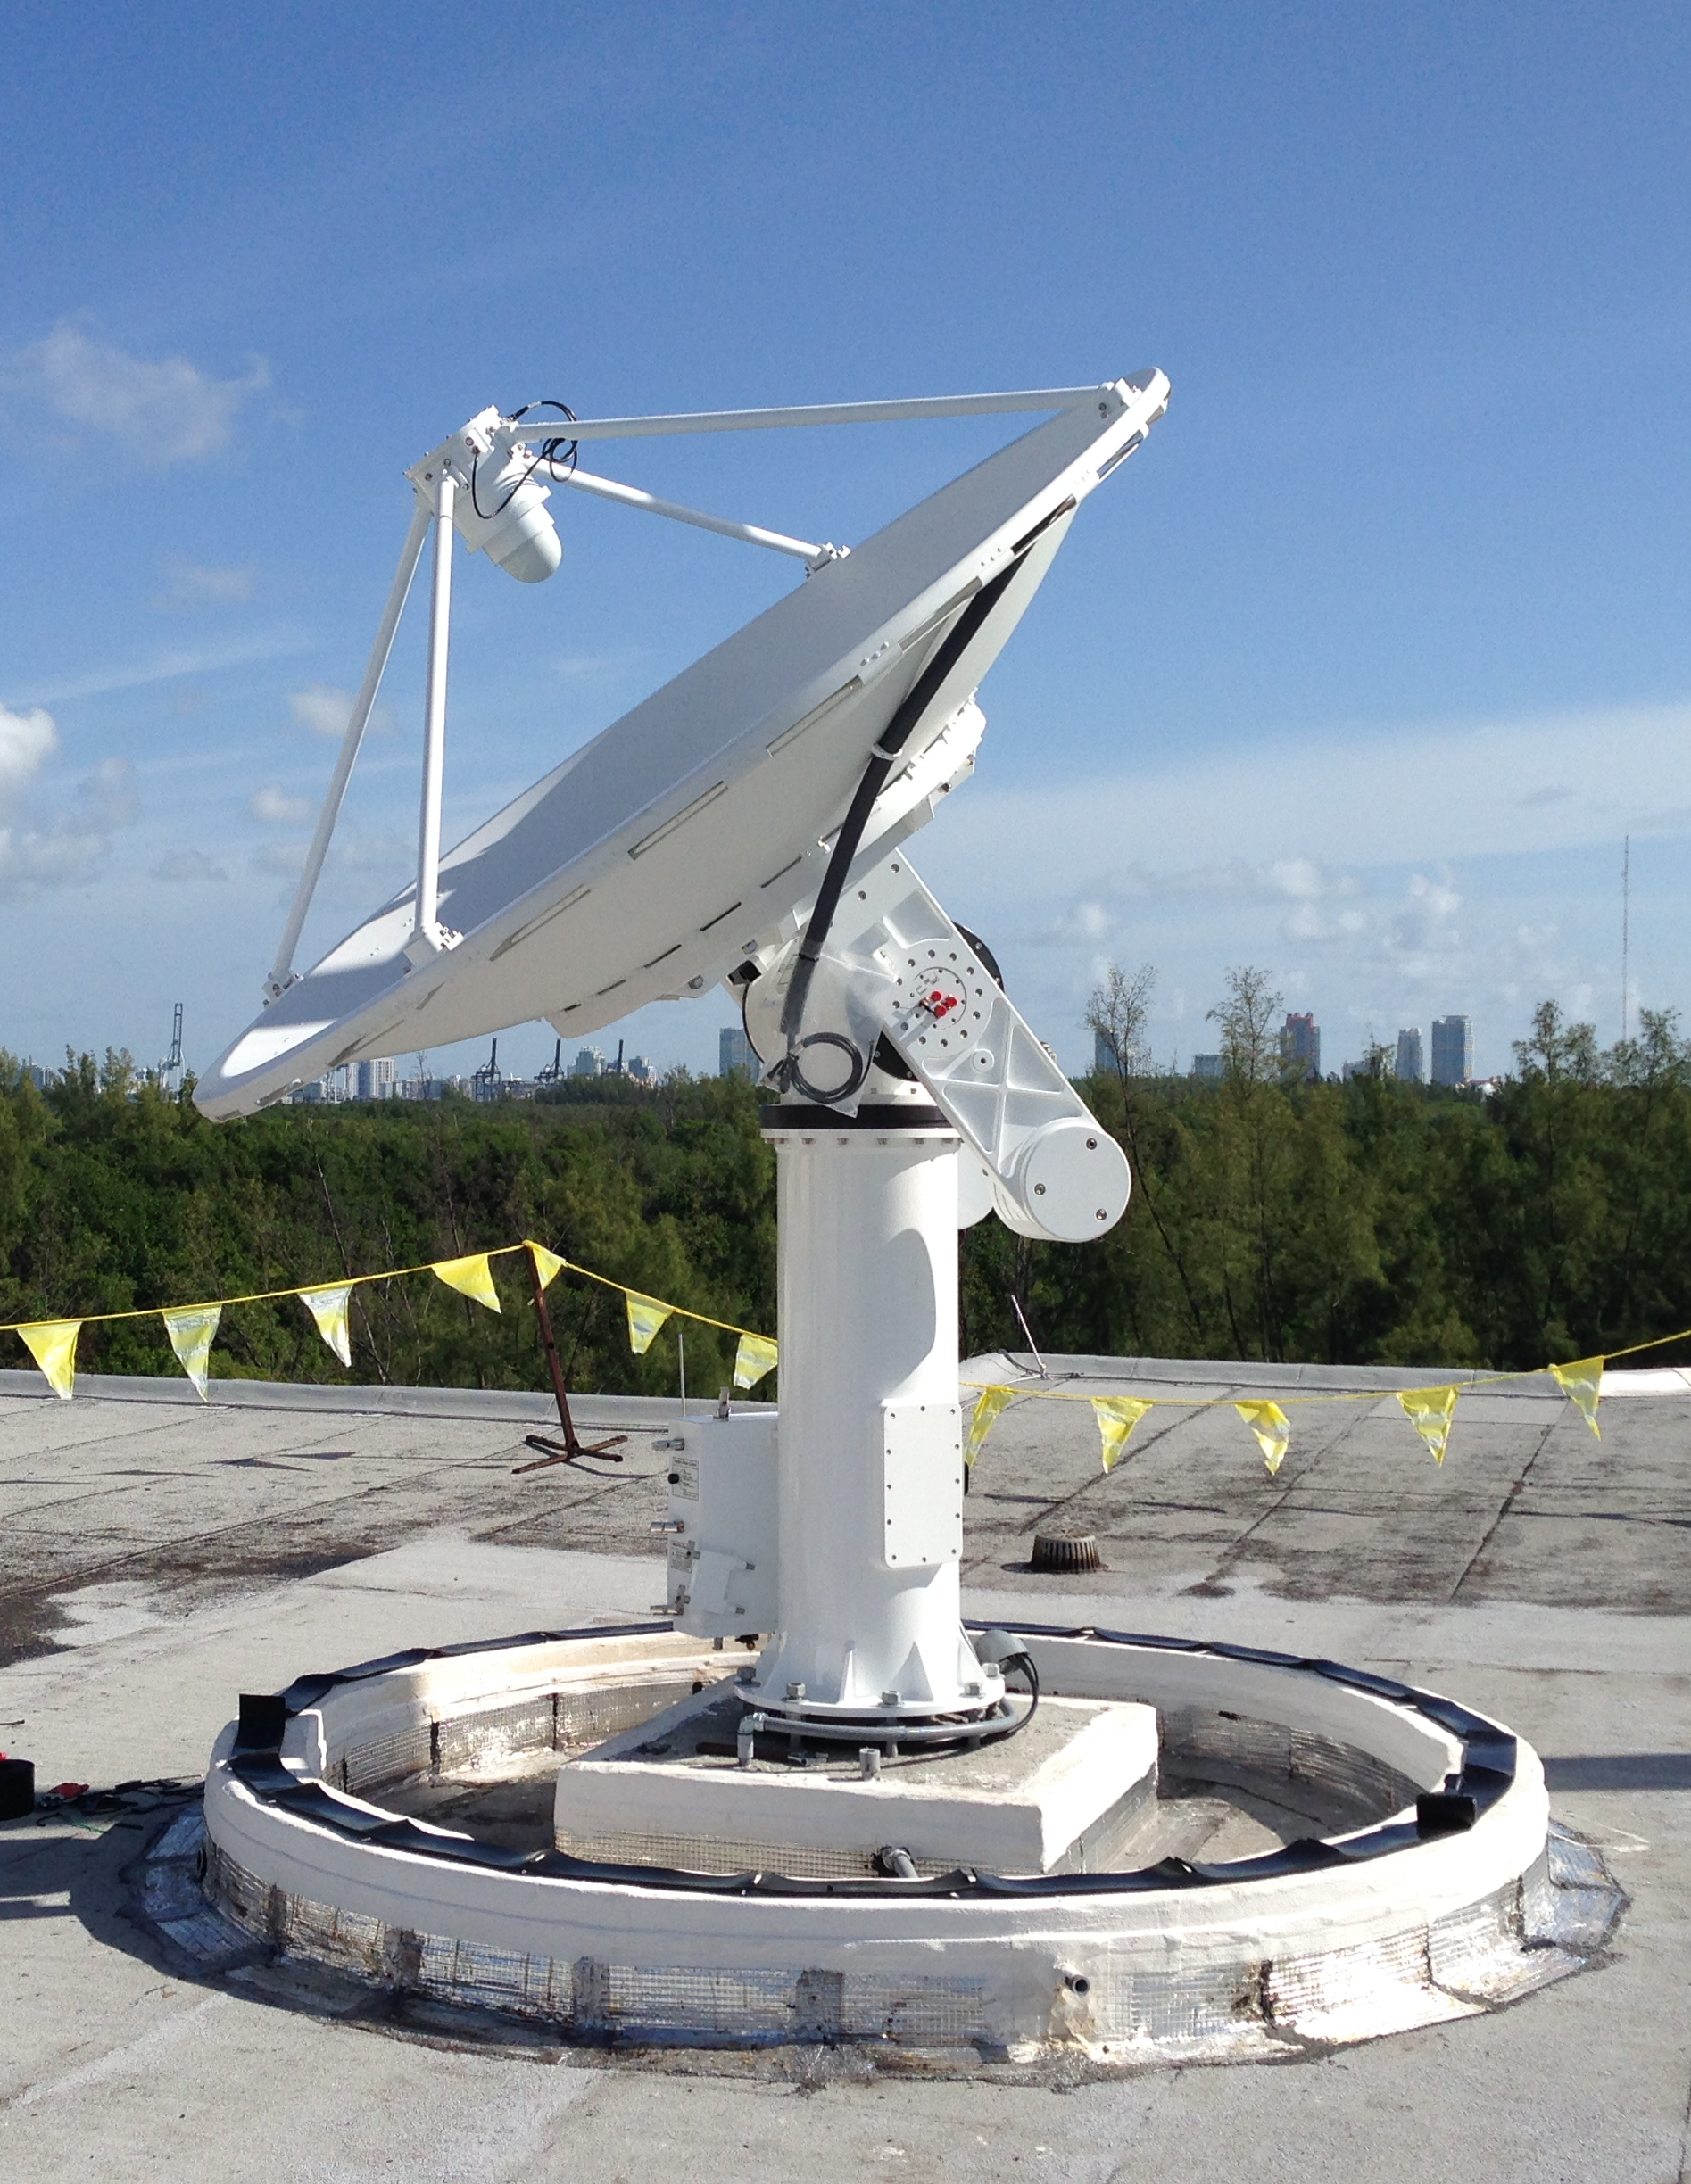
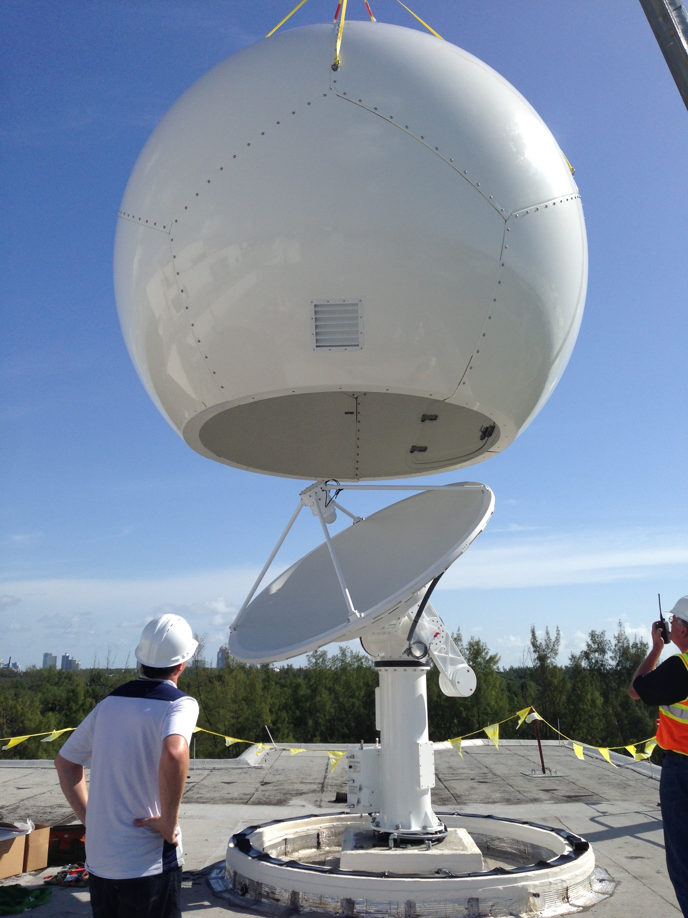
Orbital Systems 2.4-meter X/L-band Antenna Installation at AOML Sep 2014

Slide 49
Suomi NPP Sensor Suite
Primary sensors on HRD direct broadcast
VIIRS – Medium Resolution Visible & Infra-red Imager
CrIS – Fourier Transform Spectrometer for IR Temperature and Moisture sounding
ATMS – Microwave sounding radiometer
OMPS – Total Ozone Mapping and Ozone Profile measurements
CERES - Earth Radiation Budget
VIIRS
CrIS
CERES
ATMS
OMPS

Slide 50
Real-Time Applications
Numerical Weather Prediction: Infrared and Microwave Sounder Data
Wildfire Detection for Disaster Management: Thermal Infrared Imager Data (e.g, GA Sentinel)
Sea Ice Detection for Ship Navigation: Day/Night Band Imager Data
Volcanic Ash Detection: Thermal Infrared Imager
Timeliness of the Data is Key

Slide 51
NWP Forecast Error Reduction
Infrared and Microwave Sounder data from polar orbiting satellites have the largest impact on improving NWP forecast skill

Slide 52
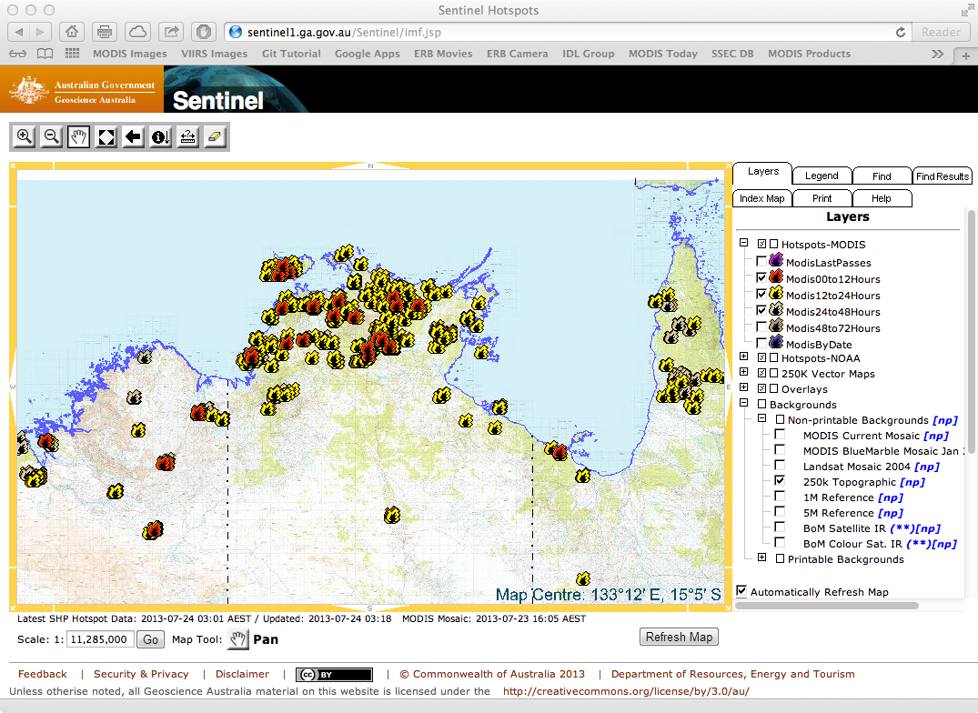
Wildfire Detection
Sentinel Hotspot Detections Derived from MODIS Infrared Imagery

Slide 53
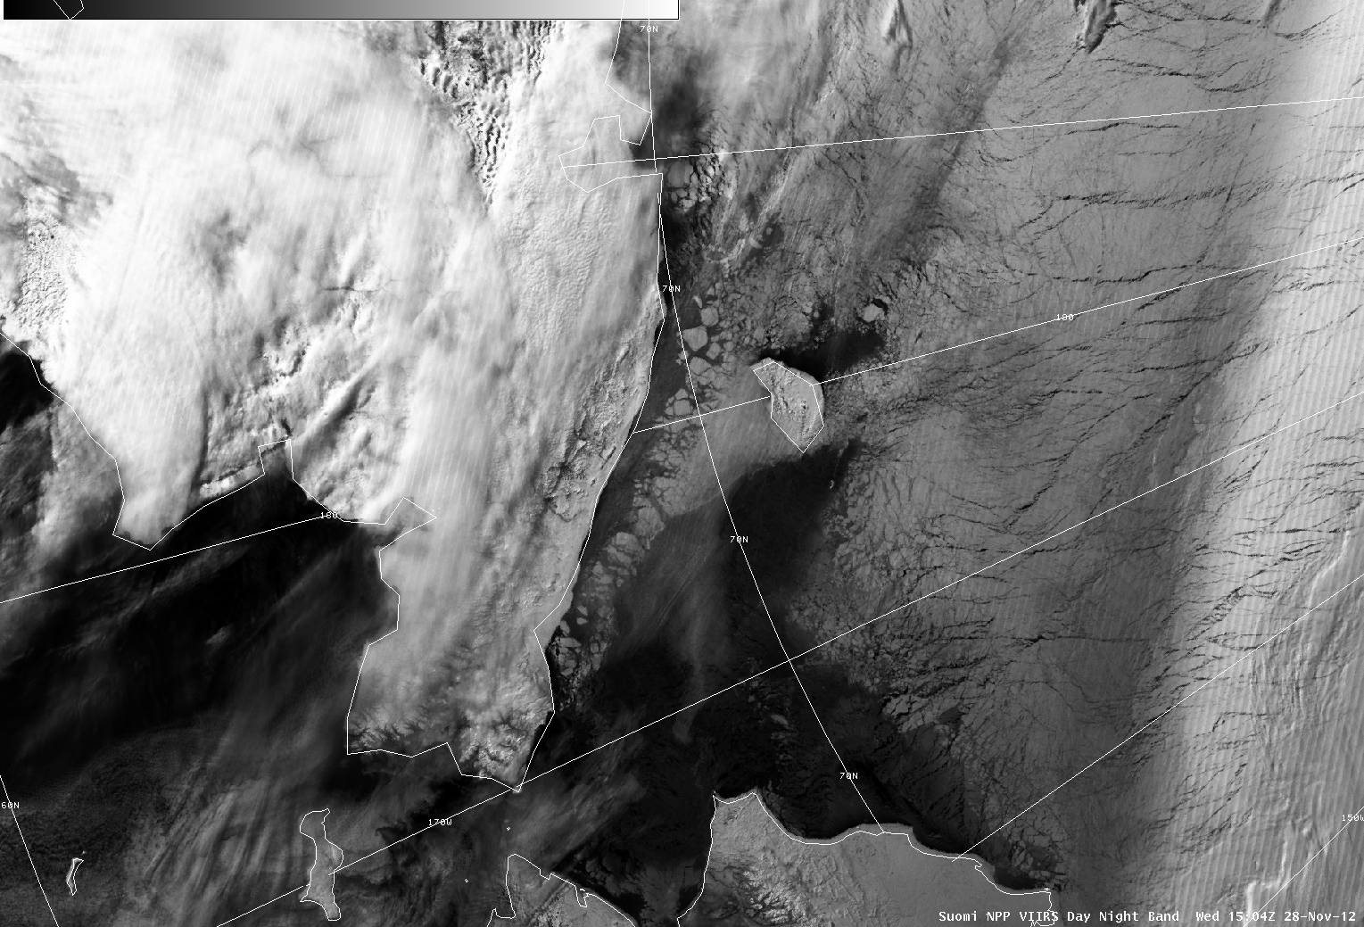
Sea Ice Mapping for Navigation
Russia
Chukchi Sea
VIIRS Day/Night Band as seen by NWS Anchorage Ice Desk

Slide 54
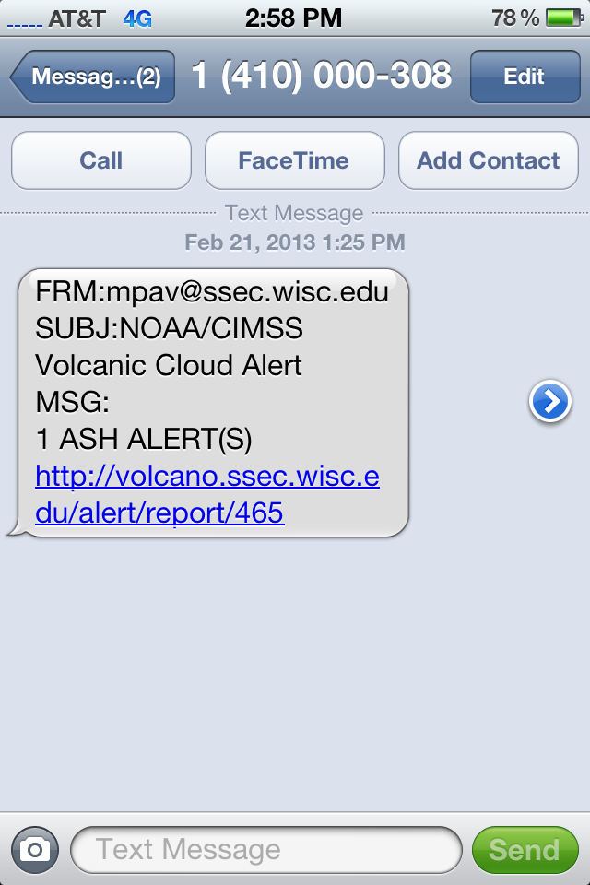
Volcanic Ash Alert System
MODIS and VIIRS Infrared Imagery are used to Detect Volcanic Ash

Slide 55
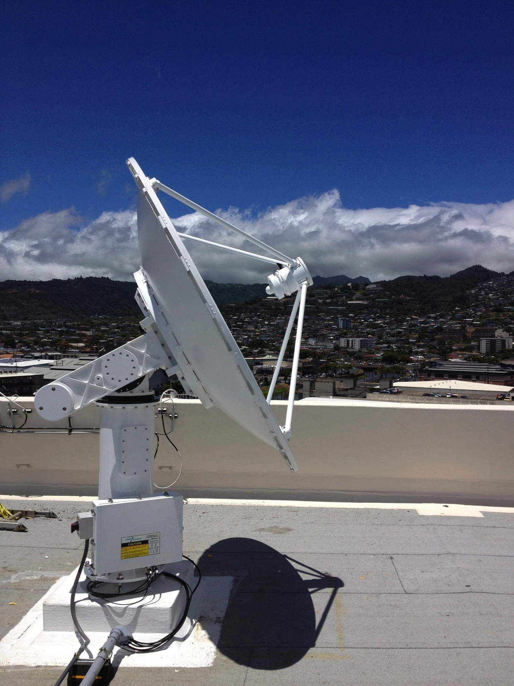
Receiving Real-Time Data
2.4-m X/L-band Antenna
NWS Honolulu
Hardware Required:
Tracking antenna with 2.4-3.0 meter reflector
LNA, Downconverter, Demodulator
X-band: Terra, Aqua, SNPP, FY-3
L-band: POES, Metop, FY-3
Raw bitstream is captured from demodulator and framed to Level 0.

Slide 56
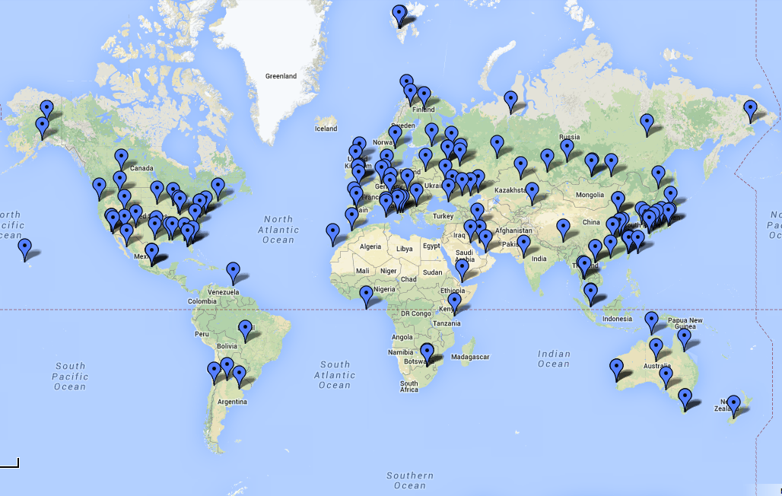
Worldwide X-band Sites

Slide 57
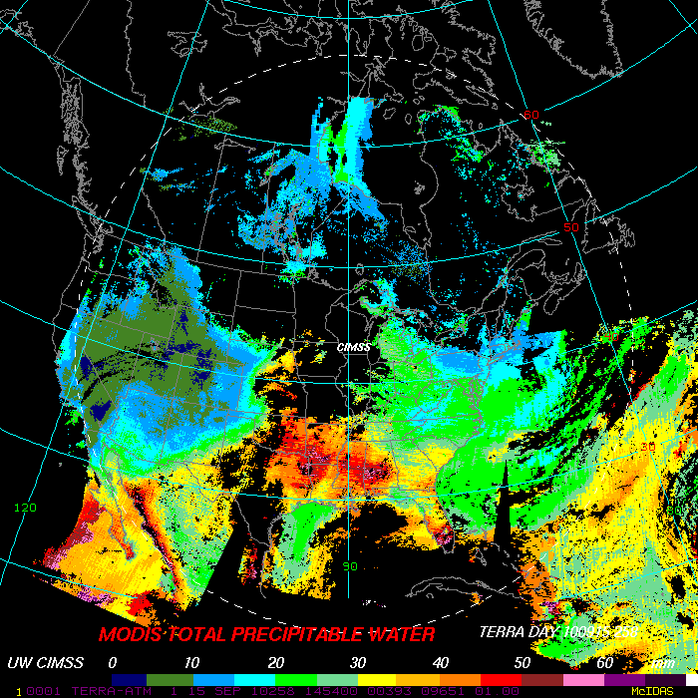
Direct Broadcast Software from SSEC
International ATOVS Processing Package (IAPP) heritage goes back to 1985. IAPP supports NOAA 15-19.
International MODIS/AIRS Processing Package (IMAPP) has been available since 2000 (funded by NASA). IMAPP supports Terra and Aqua.
Community Satellite Processing Package (CSPP) first released in 2012 (funded by JPSS).
IMAPP MODIS TPW

Slide 58
What is CSPP?
CSPP (Community Satellite Processing Package) is a collection of software systems for processing data from meteorological satellites.
The primary goal of CSPP is to support users who
Receive satellite data via direct broadcast;
Process it independently;
Create higher level products and images in real time.
Funding is supplied by JPSS and NOAA.

Slide 59
CSPP Software Philosophy
CSPP software must:
Create useful products for the DB community,
Include up-to-date algorithms,
Be pre-compiled for 64-bit Linux,
Be easy to install and operate,
Include test data for verification,
Have prompt user support,
Run efficiently on modest hardware.

Slide 60
CSPP LEO Satellites and Sensors
CSPP LEO includes support for Suomi NPP and JPSS, POES, Metop, Terra, and Aqua.
For Suomi NPP, supported sensors include VIIRS, CrIS, ATMS.
For POES and Metop, supported sensors include AVHRR, IASI, AMSU-A/B, MHS (Level 2 products only; Level 1 processing provided by AAPP).
For Aqua and Terra, supported sensors include MODIS, AIRS, and AMSU.

Slide 61
CSPP Satellite/Sensor/Product Matrix
 | Imager | Infrared Sounder | Microwave Sounder
SNPP | VIIRS Level 1B, Images, Visualization, Atmosphere, Land, Ocean | CrIS Atmospheric Profiles, Clouds, Visualization | ATMS Atmospheric Profiles, Precipitation, Visualization
Terra | MODIS Images, Visualization | N/A | N/A
Aqua | MODIS Images, Visualization | AIRS Atmospheric Profiles, Clouds, Visualization | AMSU Atmospheric Profiles, Precipitation, Visualization
Metop-A/B | AVHRR Atmosphere, Cloud, Land, Visualization | IASI, HIRS Atmospheric Profiles, Clouds, Visualization | AMSU, MHS Atmospheric Profiles, Precipitation
NOAA-18/19 | AVHRR Atmosphere, Cloud, Land, Visualization | HIRS Atmospheric Profiles | AMSU, MHS Atmospheric Profiles, Precipitation

Slide 62
Other DB Software Packages
Software | Products | Developer
International MODIS/AIRS Processing Package (IMAPP) | MODIS Atmosphere and Cloud Products; Virtual Appliance; Google Earth Imagery; Forecast Model; Air Quality Model; Imagery | UW/SSEC and MODIS Science Team
Advanced ATOVS Processing Package (AAPP) | POES and Metop Level 1B, BUFR, and HDF5 | UK Met Office, Meteo France
SeaDAS | MODIS, VIIRS, CZCZ Ocean Color and Sea Surface Temperature | NASA Ocean Biology Processing Group
Direct Readout Land Applications | MODIS and VIIRS Wild Fires and Vegetation Indices | NASA Direct Readout Laboratory

Slide 63
CSPP Users
EUMETSAT for EARS-NPP EUMETCast distribution UK Met Office Météo-France CSIR South Africa Swedish Met Service DWD – German Met Service Australia Bureau of Meteorology Taiwan Central Weather Bureau Belarus National Academy of Science Indonesia Government Space Agency (LAPAN) German Aerospace Center CONABIO Mexico EURAC Remote Sensing Institute Italy | China National Satellite Meteorological Center Brazil INPE Danish Meteorological Institute Japanese Meteorological Agency Norwegian Meteorological Institute Swedish Met Institute Kazakhstan Space Investigation Institute UK Plymouth Marine Lab Naval Research Lab Vendors SeaSpace, ScanEx, SpaceTec and others. In addition, CSPP DB products are being used in the US NWS in HI, Alaska and CONUS

Slide 64
CSPP LEO Software (Jan 2015)
VIIRS, CrIS, and ATMS Level 1B / SDRs geolocation and calibration (CSPP SDR)
VIIRS Level 2 / EDRs cloud mask, active fires, surface reflectance, NDVI, EVI, SST, LST, AOT (CSPP EDR)
CrIS, IASI, and AIRS Temperature/Moisture Profiles (HSRTV)
VIIRS and MODIS Reprojected Imagery (POLAR2GRID)
ATMS, AMSU, and MHS Profile and Surface Retrievals (MIRS)
VIIRS, MODIS, and AVHRR Cloud Products (CLAVR-x)
VIIRS, MODIS, and MERSI Interactive Data Analysis (HYDRA2)

Slide 65
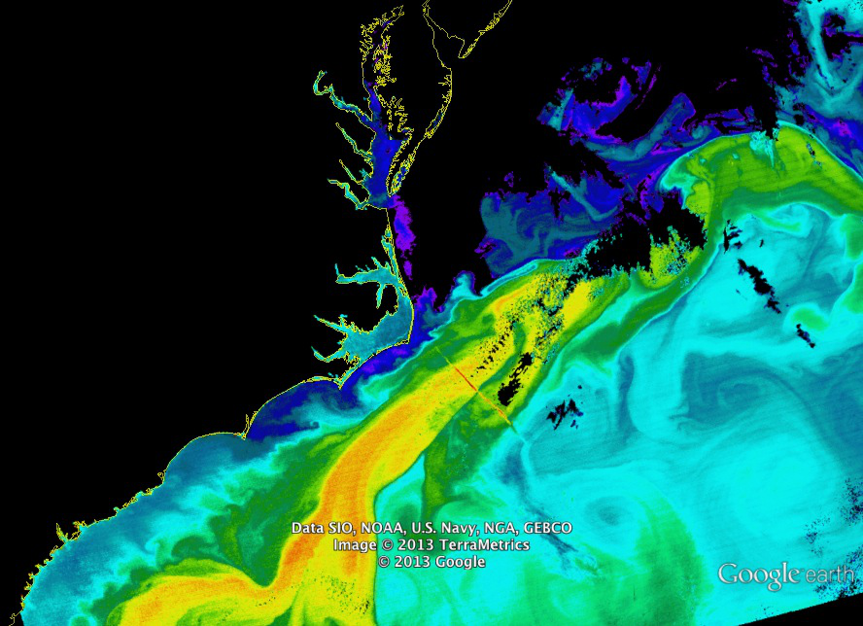
CSPP Product: VIIRS SST

Slide 66
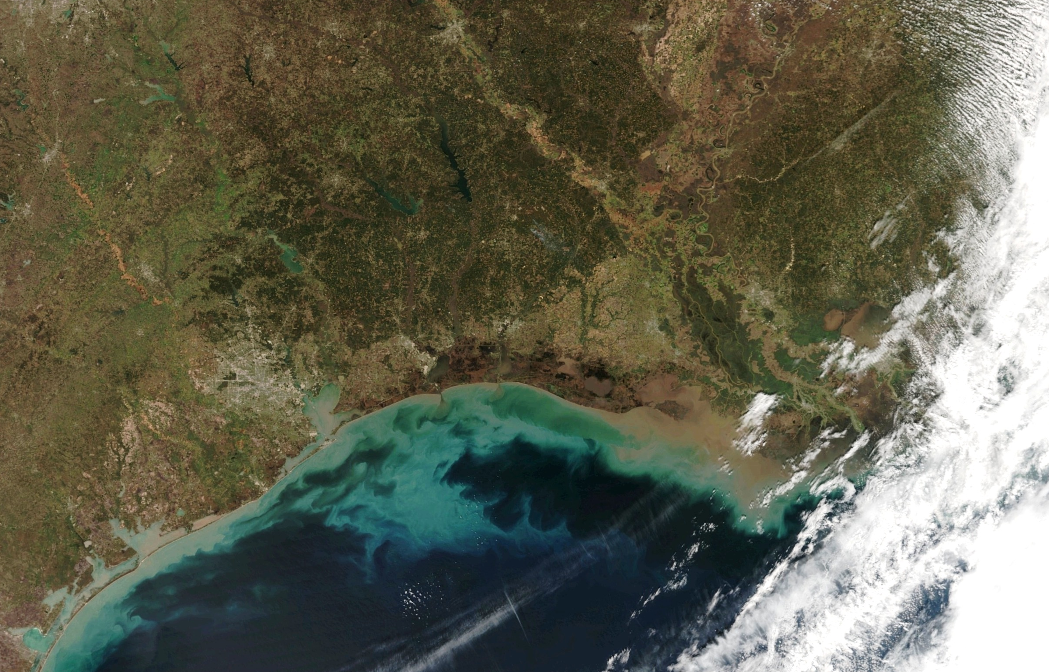
CSPP Product: VIIRS True Color

Slide 67
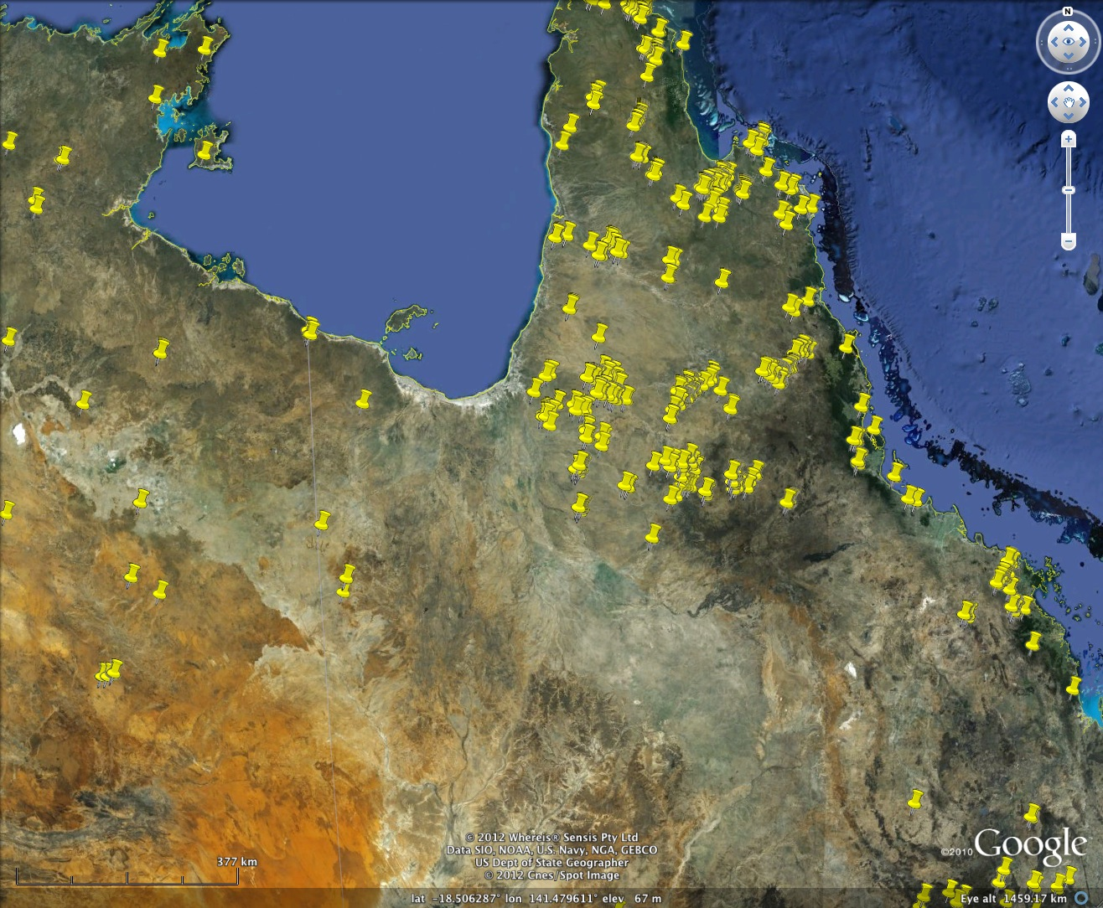
CSPP Product: VIIRS Active Fires
2012/12/10

Slide 68
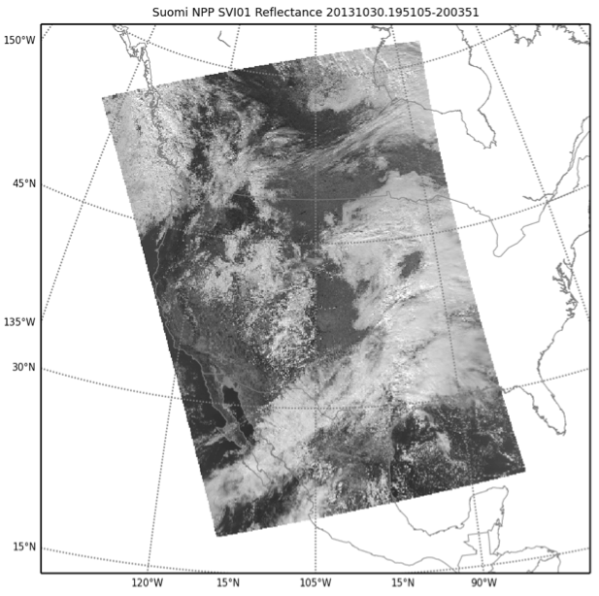
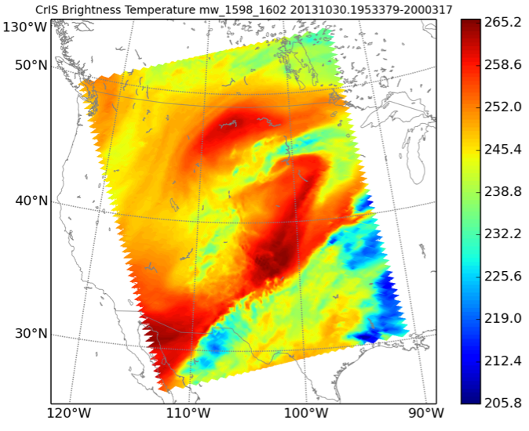
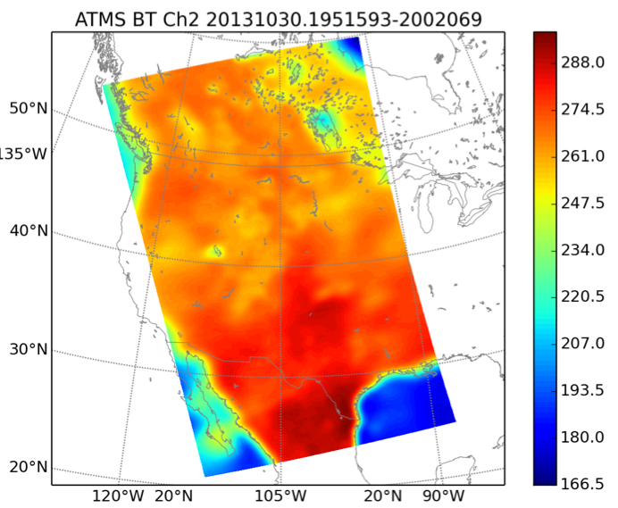
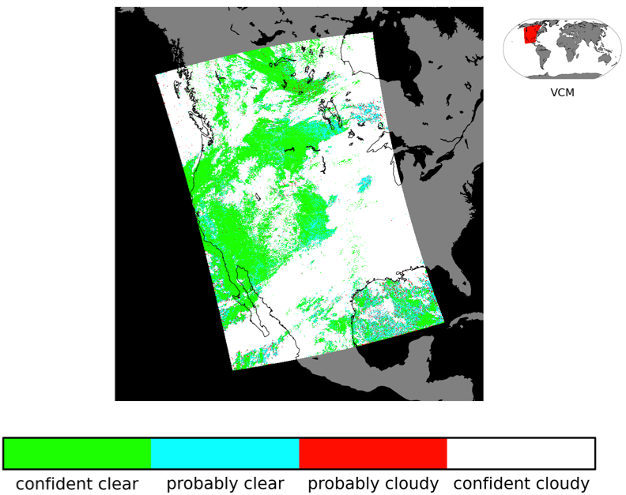
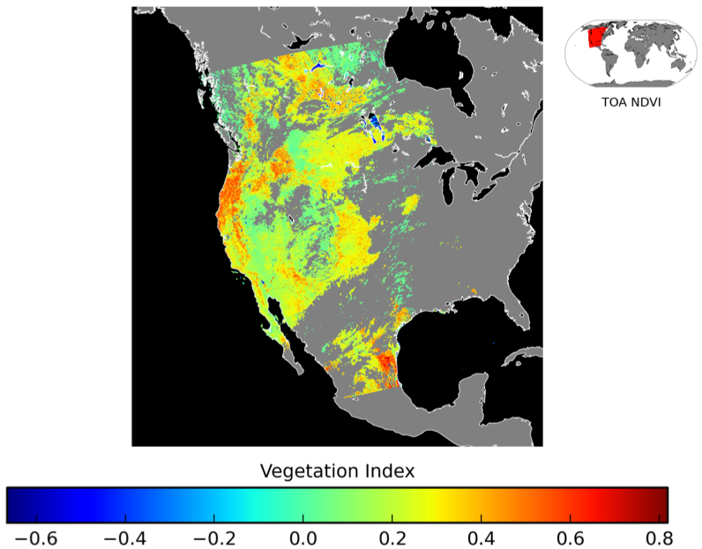
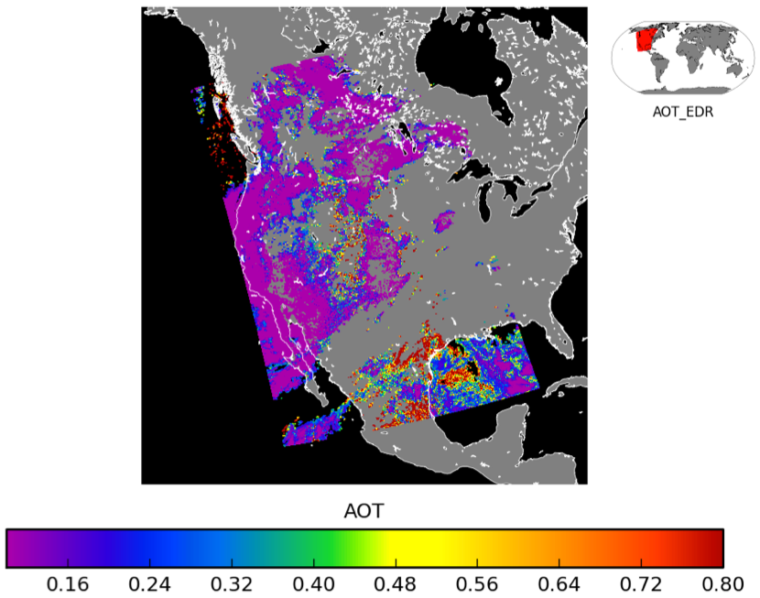
CSPP VIIRS SDR and EDRs
VIIRS SDR
CrIS SDR
ATMS SDR
VIIRS Cloud Mask
VIIRS NDVI
VIIRS AOT

Slide 69
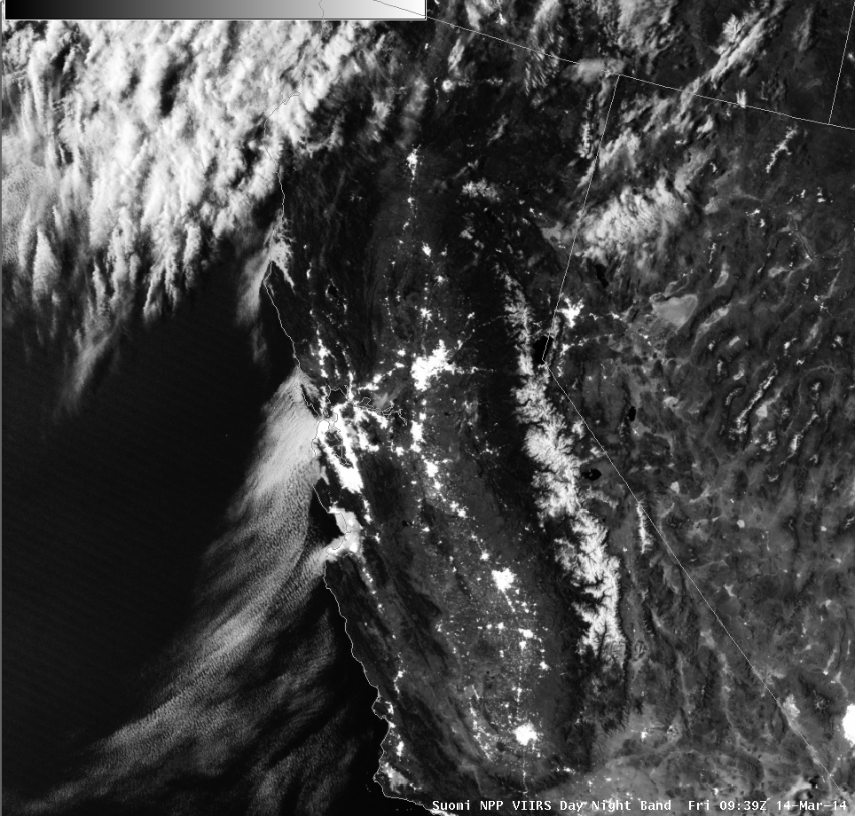
CSPP VIIRS Projected Imagery (DNB)
AREA FORECAST DISCUSSION
NATIONAL WEATHER SERVICE SAN FRANCISCO BAY AREA
443 AM PDT FRI MAR 14 2014
.DISCUSSION...AS OF 4:10 AM PDT FRIDAY...THE DRY TAIL END OF A WEATHER SYSTEM MOVING IN TO THE PACIFIC NORTHWEST IS APPROACHING OUR DISTRICT...AND RESULTING IN ENHANCEMENT OF THE MARINE LAYER AND A RETURN OF THE MARINE STRATUS. LATEST GOES FOG PRODUCT IMAGERY...AND IN RATHER SPECTACULAR DETAIL JUST REC'D SUOMI VIIRS NIGHTTIME HIGH RES VISUAL IMAGE...SHOW COVERAGE ALONG MUCH OF THE COAST FROM PT REYES SOUTH TO THE VICINITY OF THE MONTEREY PENINSULA...AND A BROAD SWATH EXTENDING INLAND ACROSS SAN FRANCISCO AND THROUGH THE GOLDEN GATE TO THE EAST BAY. LATEST BODEGA BAY AND FT ORD PROFILER DATA INDICATE A MARINE LAYER DEPTH OF ABOUT 1300 FT. SOME THIN HIGH CLOUDS ARE ALSO PASSING THROUGH ABOVE.

Slide 70
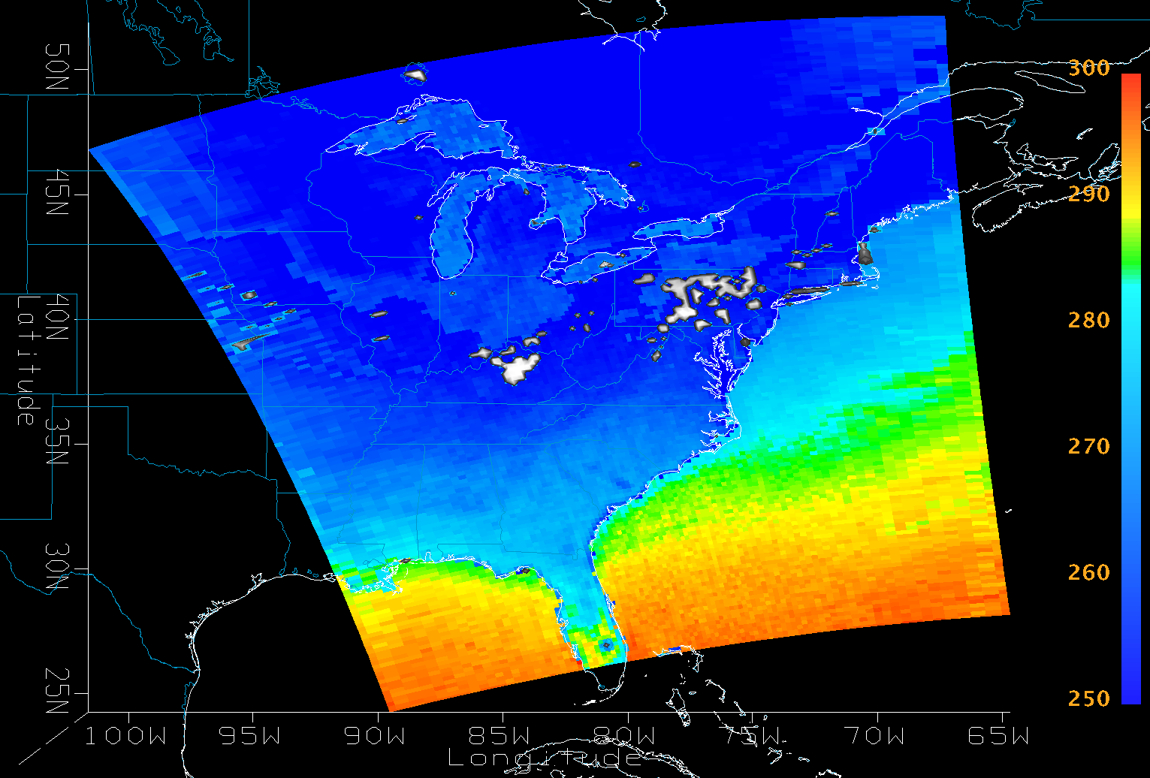
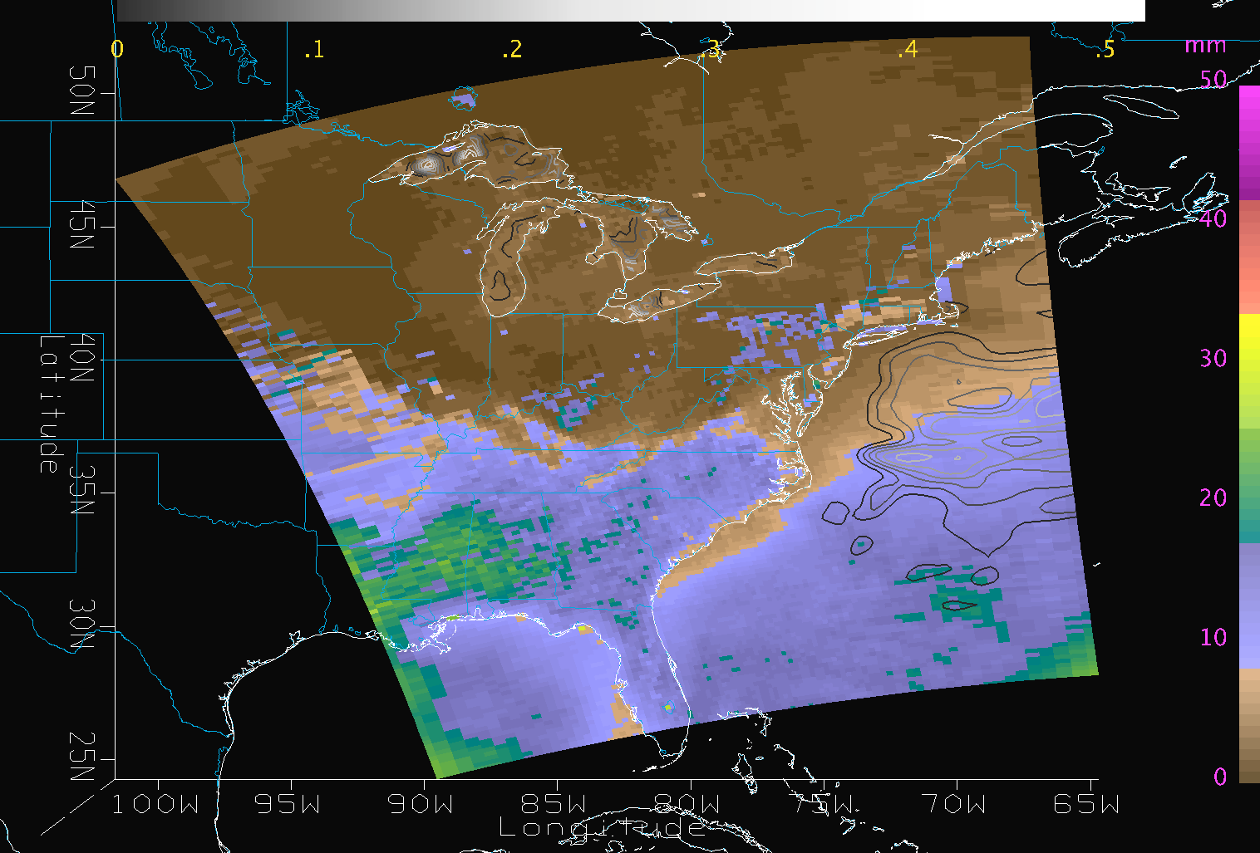
MIRS Products
Surface Temperature
with Rain Mass Profile
Total Precipitable Water
with contours of Cloud Liquid Water
Suomi NPP ATMS
2014-01-23 18:19Z

Slide 71
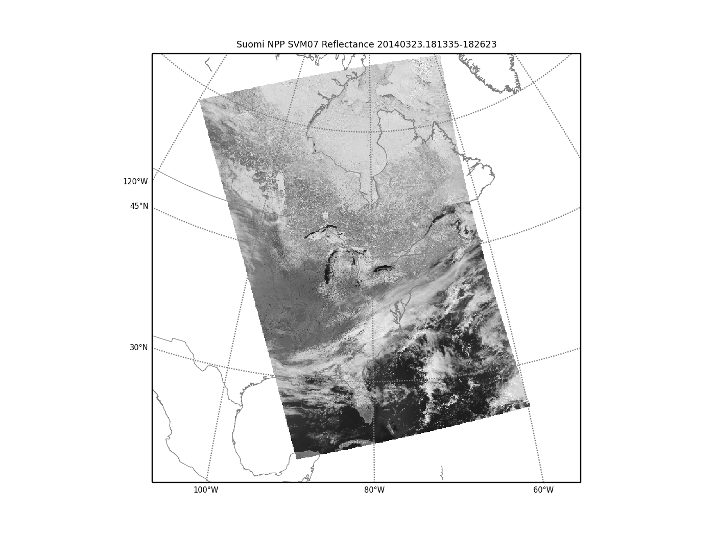
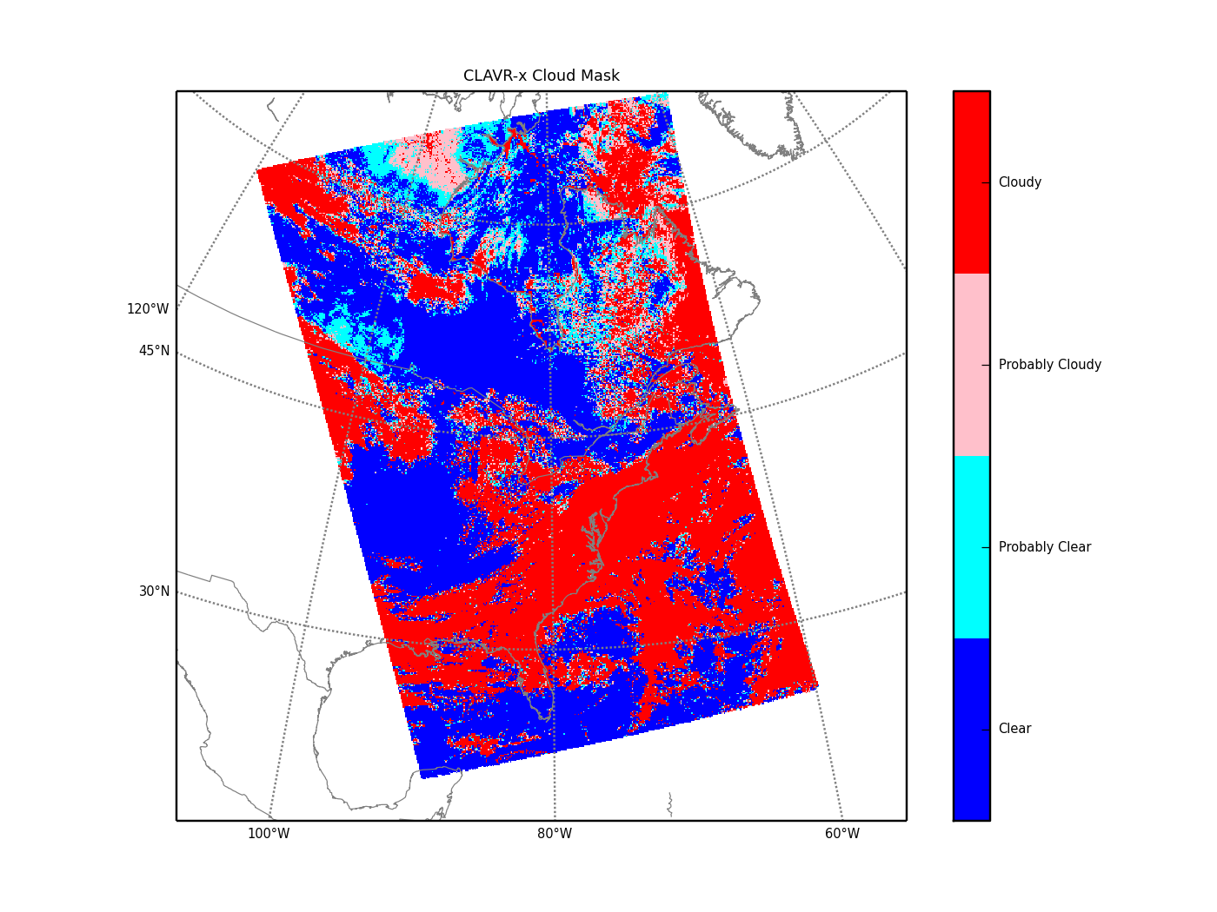
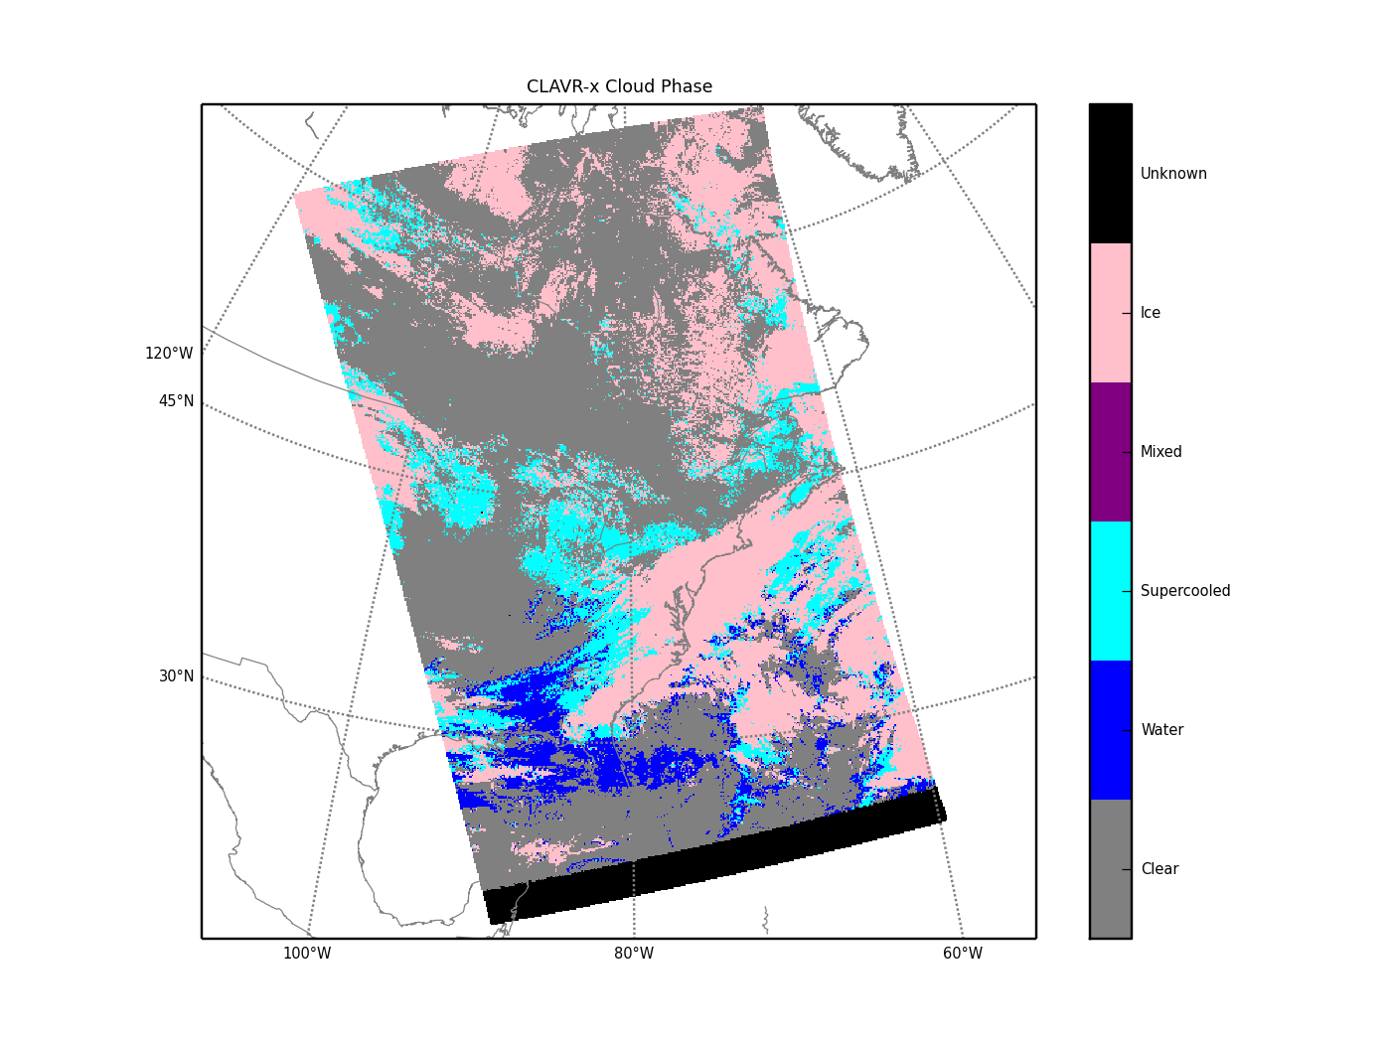
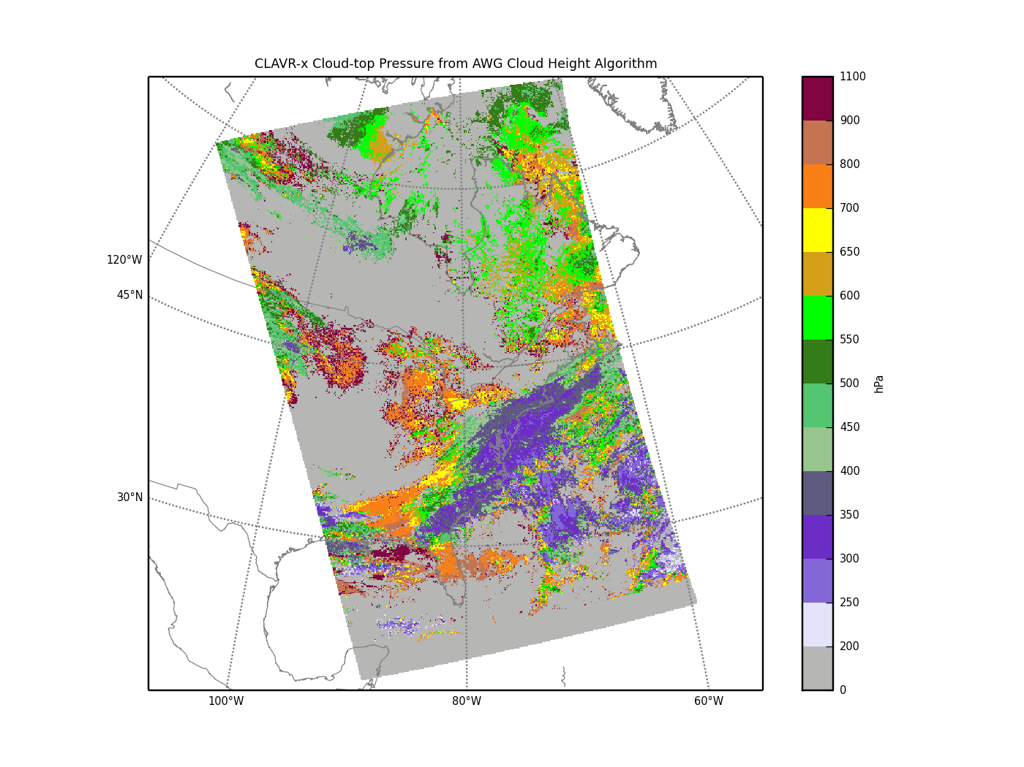
CLAVR-X Products
Suomi NPP VIIRS
2014/03/23
18:13 UTC
VIIRS SVM07
Cloud Mask
Cloud Phase
Cloud Top Pressure

Slide 72
CSPP LEO Upcoming Releases
CrIS and ATMS Temperature and Moisture Profile Physical Retrieval (NUCAPS by C. Barnet et al.). Future release will support IASI/AMSU and AIRS/AMSU.
VIIRS Sea Surface Temperature (ACSPO by A. Ignatov et al.). Future release will support MODIS and AVHRR.
CrIS Full Spectral Resolution calibration based on NOAA calibration team version of ADL (Yong Han et. al).
Items 1-3 above are in final testing and should be released by the end of 1st quarter 2015.

Slide 73
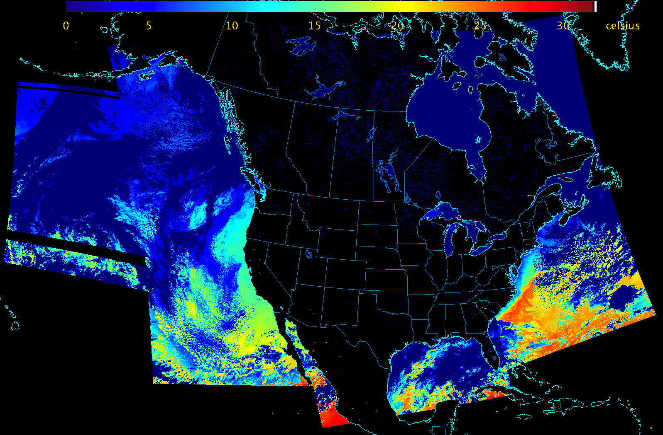
VIIRS SST from ACSPO
2015-01-01 SSEC Direct Broadcast

Slide 74
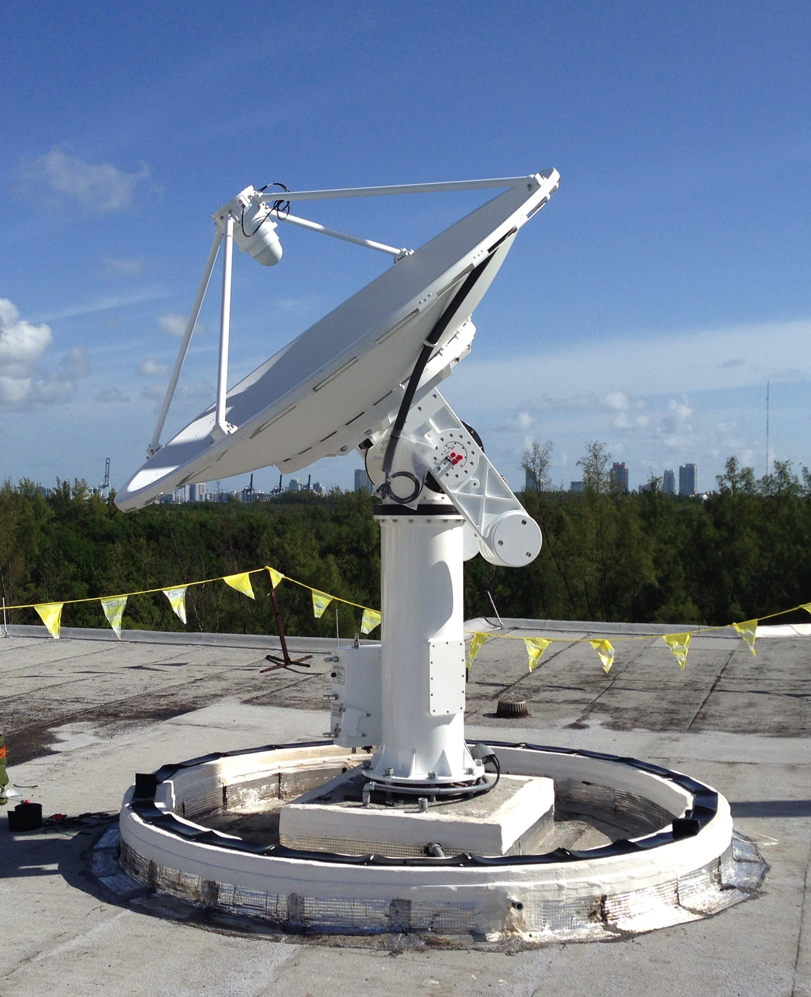
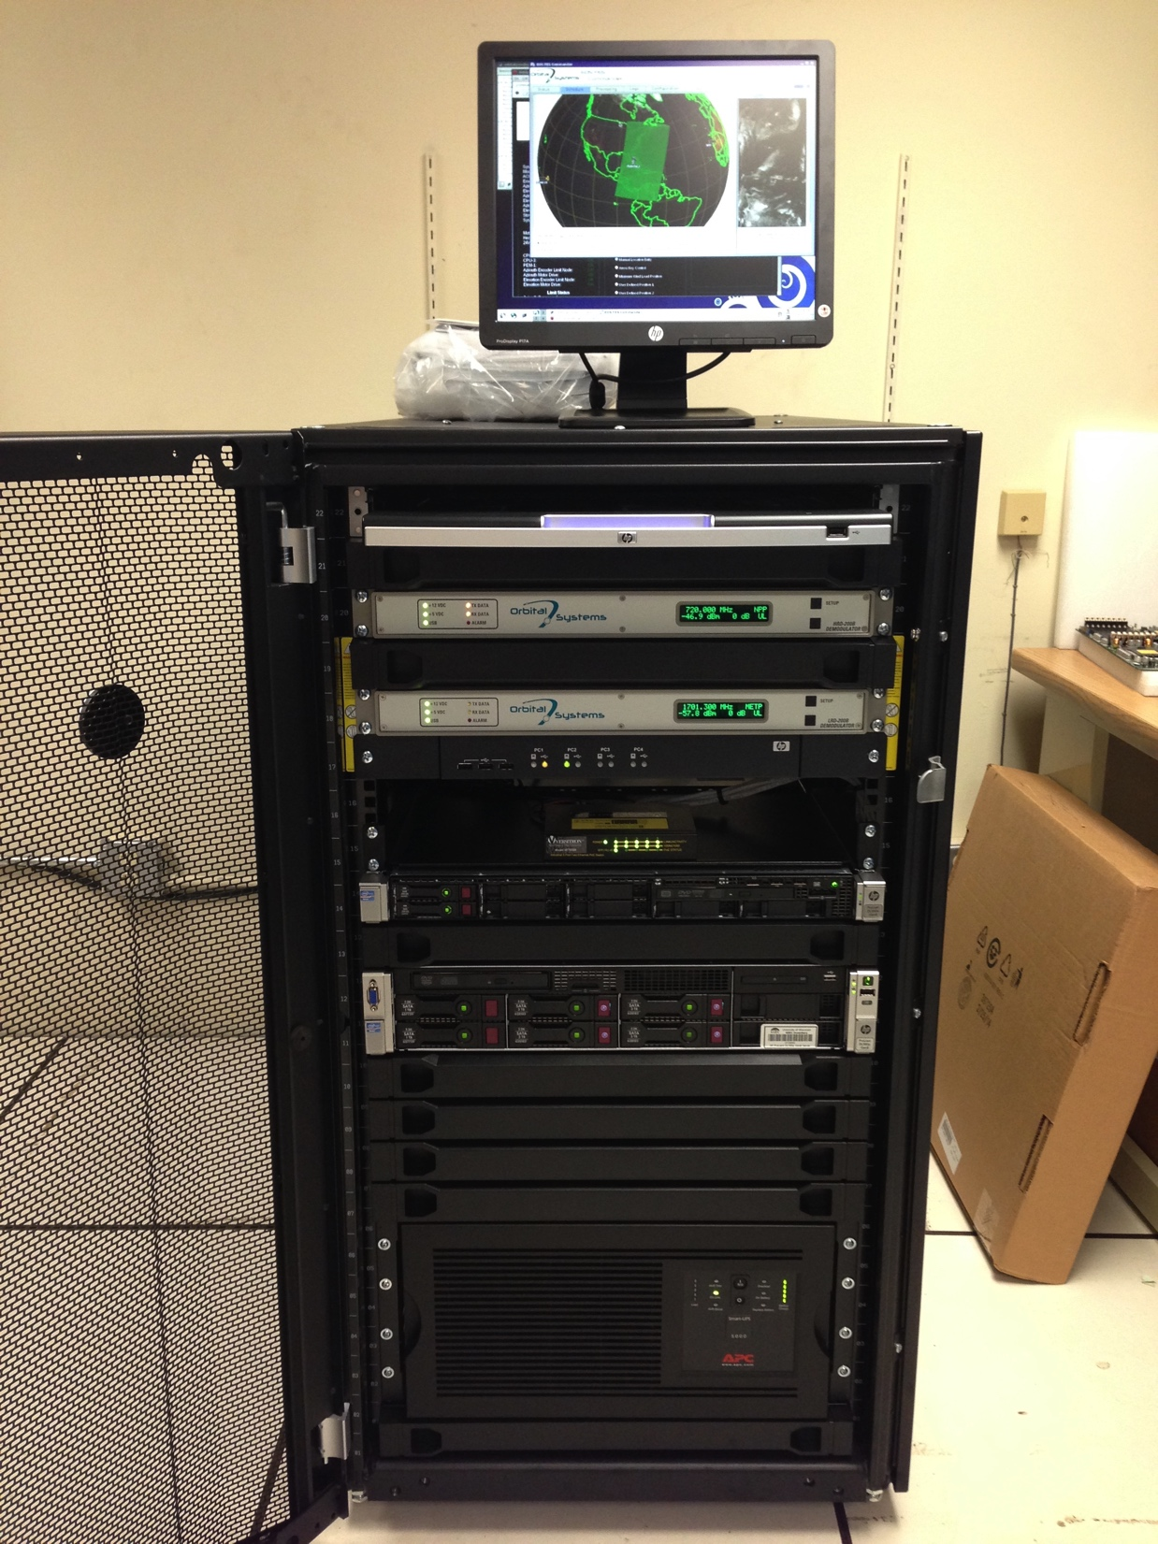
AOML X/L-Band Reception and Processing System

Slide 75
Reception System
Satellite data scheduling and reception is handled by the EOS Front End Server (EOS-FES).
The EOS-FES sends commands to the antenna positioner; schedules satellite passes; controls the demodulators; and saves decoded/framed satellite data (Level 0) to disk.
Level 0 files are pushed via FTP to the Processing System.

Slide 76
Processing System
Satellite data processing is handled by the Direct Broadcast Processing System (DBPS) server.
The DBPS server ingests Level 0 satellite data delivered from the EOS-FES and creates Level 1 and Level 2 products.
Products and images are saved to disk and are retained for 7 days.
Products and images are served via this website:
http://dbps.aoml.noaa.gov/

Slide 77
Product Directories
For each satellite series (eos, fy3, noaa, metop, jpss, gcom), the following directories contain the products:
  level0: framed uncalibrated data (binary, HDF5)
  level1: calibrated and geolocated sensor data (HDF4/5)
  level2: geophysical products (HDF4/5, netCDF4)
  images: projected imagery (JPEG, GeoTIFF, PNG, GIF)

Slide 78
DBPS Data Flow

Slide 79
EOS Data Flow

Slide 80
Suomi NPP Data Flow

Slide 81
Metop Data Flow

Slide 82
POES Data Flow

