Slide 1
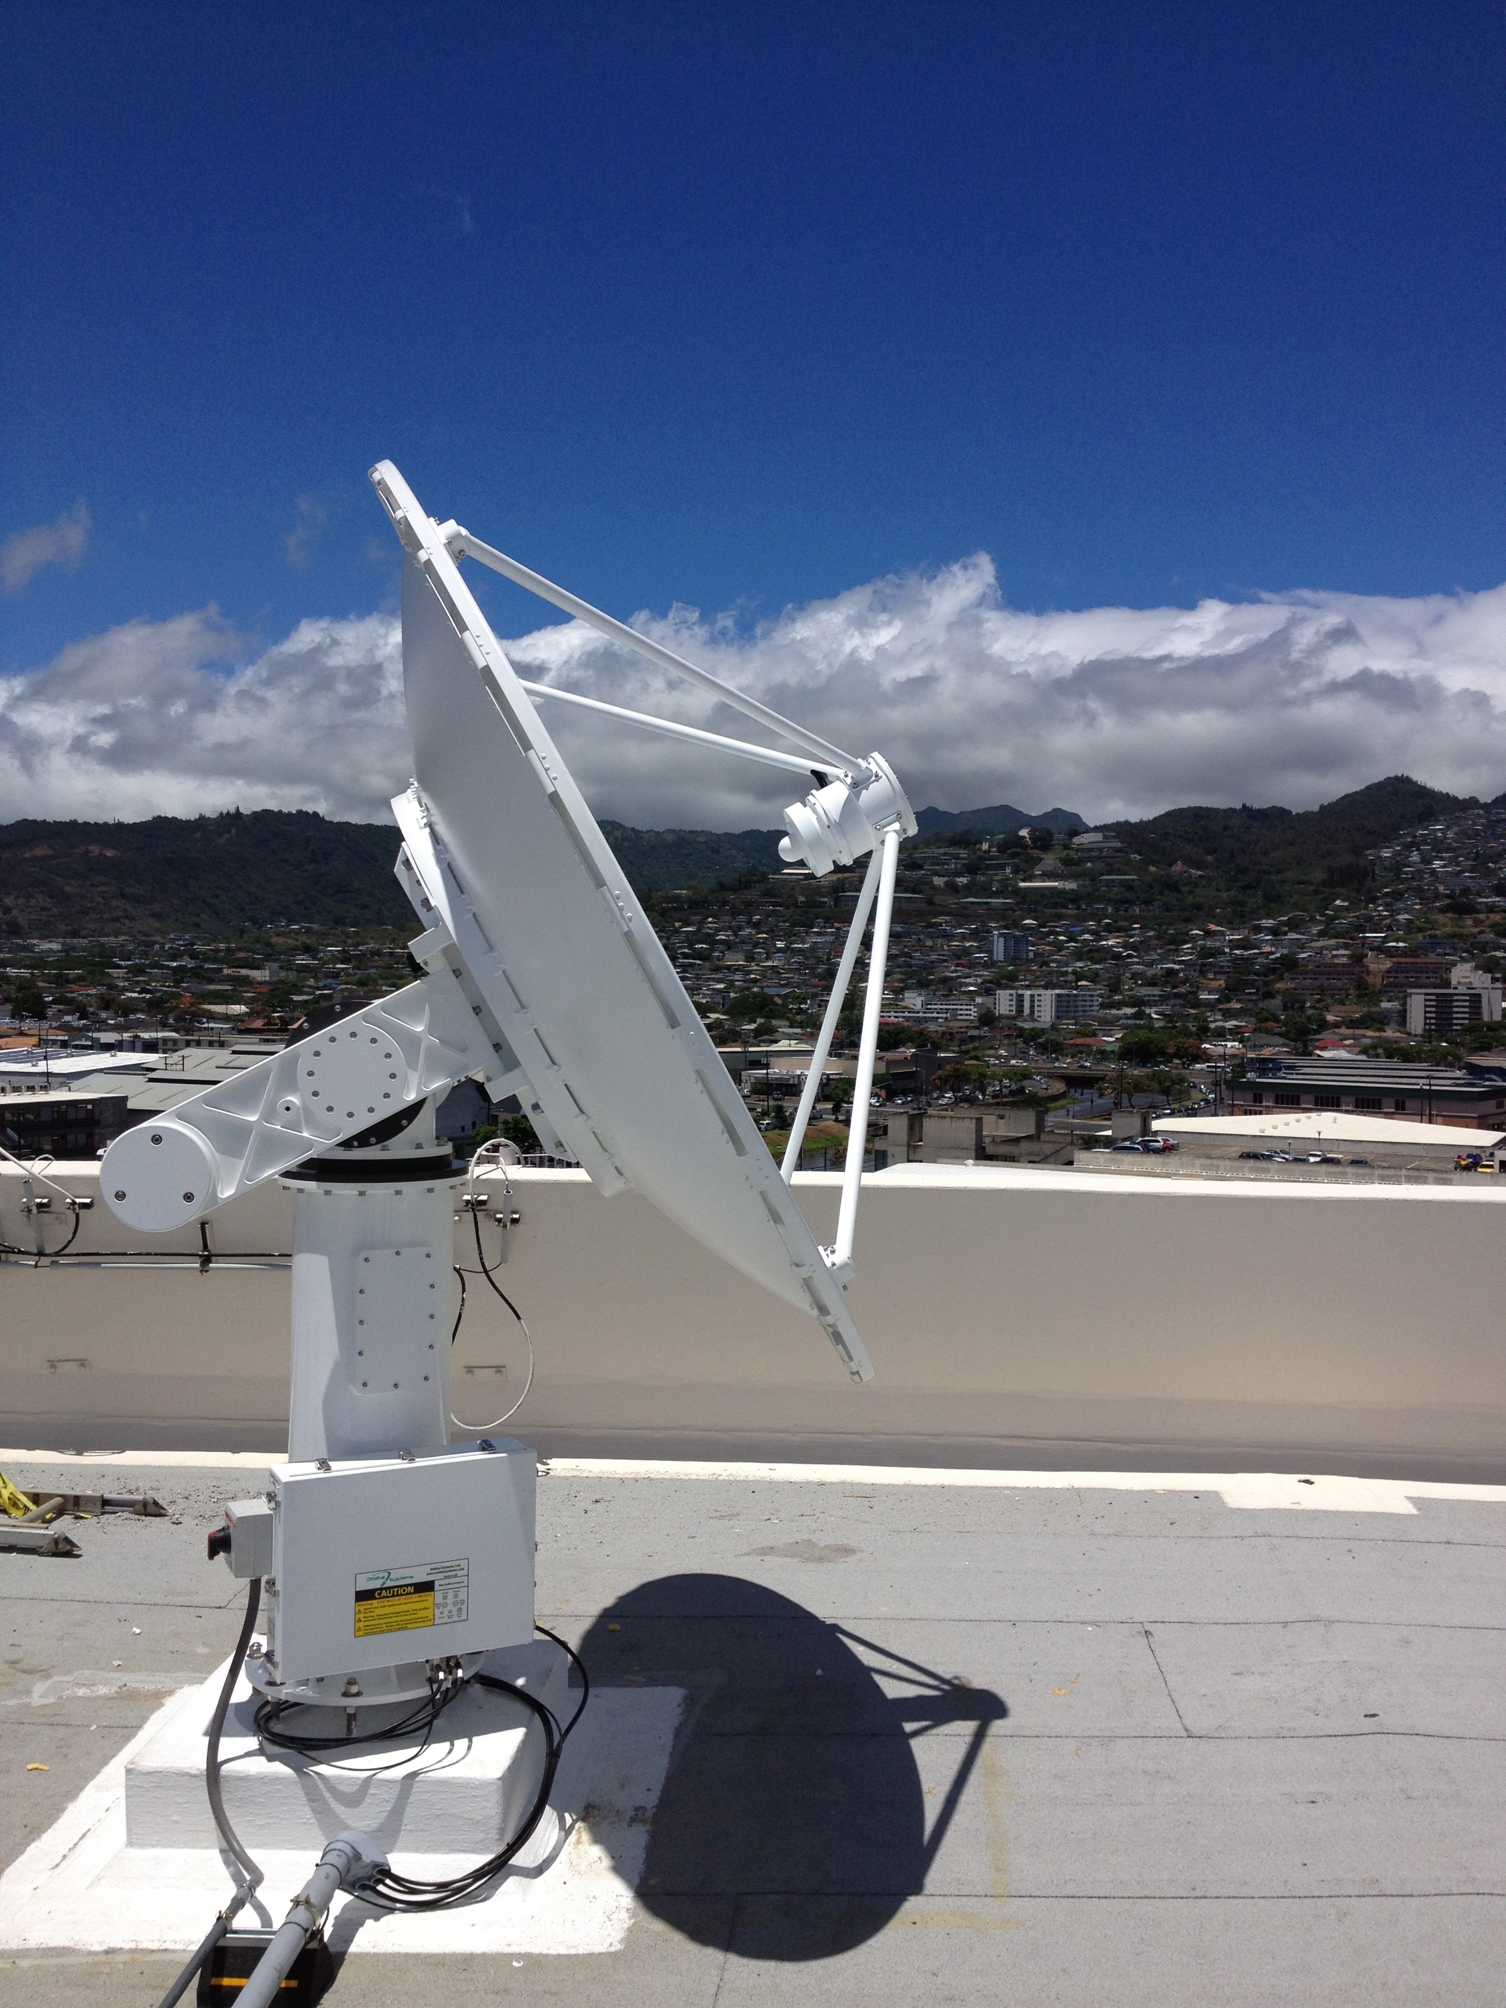
MODIS Direct Broadcast Products and Software
DB Applications Workshop
AOML Miami, FL
February 2015
Liam Gumley
Space Science and Engineering Center
University of Wisconsin-Madison
Notes:
Title slide

Slide 2
Outline
What is MODIS Direct Broadcast (DB)?
MODIS DB Image Products
MODIS DB Atmosphere Products
MODIS DB Land products
MODIS DB Ocean products
Downloading MODIS data from the Web

Slide 3
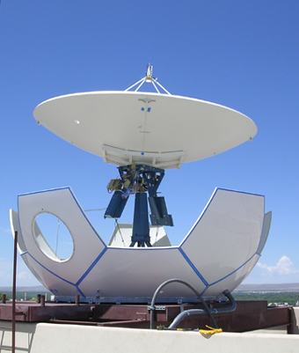
What is Direct Broadcast?
Direct Broadcast is the real-time transmission of earth observation data from the spacecraft to the ground (via X-band on Terra and Aqua)
On Terra, only MODIS is broadcast
On Aqua, all data is broadcast
Data are free and clear with no encryption
All you need is an antenna and receiver!
“Terra and Aqua are a great gift to the world” (Vladimir Gershenzon, ScanEx)

Slide 4
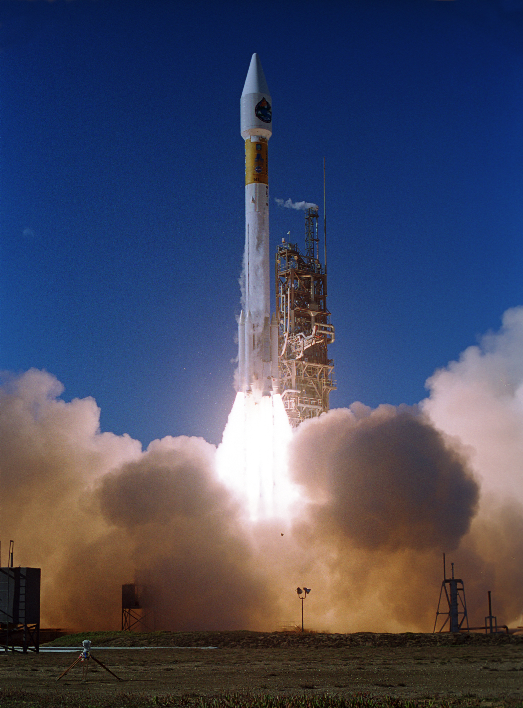
Terra
Launched: Dec. 18, 1999
10:30 am descending
ASTER: Hi-res imager
CERES: Broadband scanner
MISR: Multi-angle imager
MODIS: Multispectral imager
MOPITT: Limb sounder
Only MODIS is available by DB

Slide 5
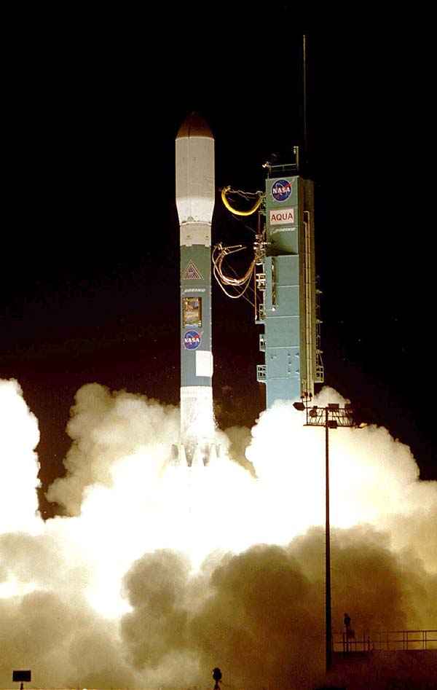
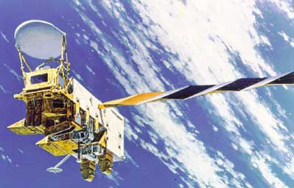
Aqua
Launched: May 4, 2002
1:30 pm ascending
AIRS: Infrared sounder
AMSR-E: Microwave scanner
AMSU: Microwave scanner
CERES: Broadband scanner
HSB: Microwave sounder
MODIS: Multispectral imager
All sensors are available via DB

Slide 6
How do I get Direct Broadcast?
Direct Broadcast X-band ground stations are available from a number of vendors
Cost is around $100-300K USD
NWS/UH operates an X/L-band ground station, and data is freely available
There are more than 150 of these stations worldwide (on every continent)
There are other ways to get MODIS data…

Slide 7
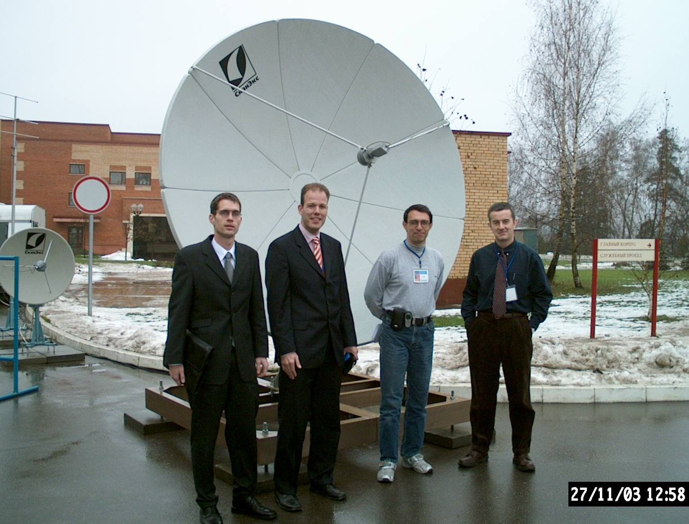
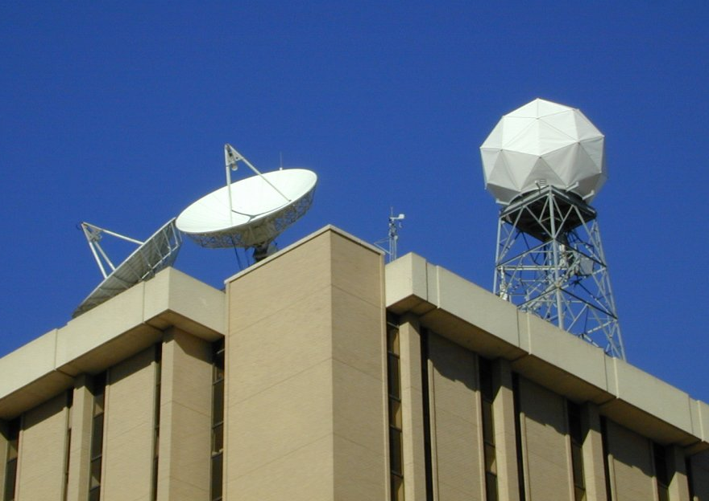
Shanghai, China
Moscow, Russia
Madison, USA
Benevento, Italy

Slide 8
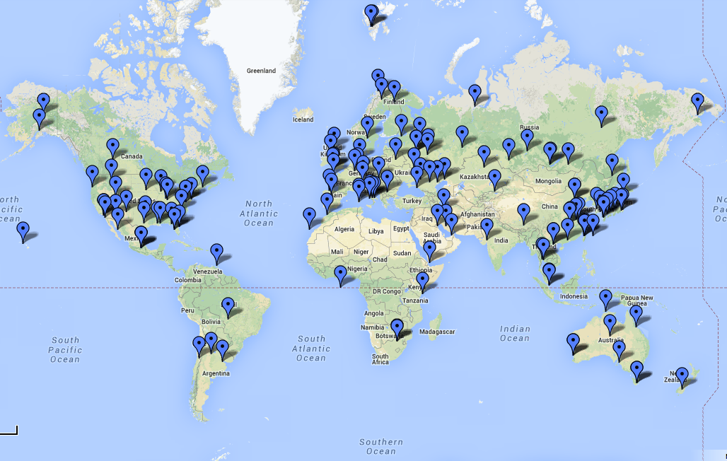
Worldwide X-band Sites

Slide 9
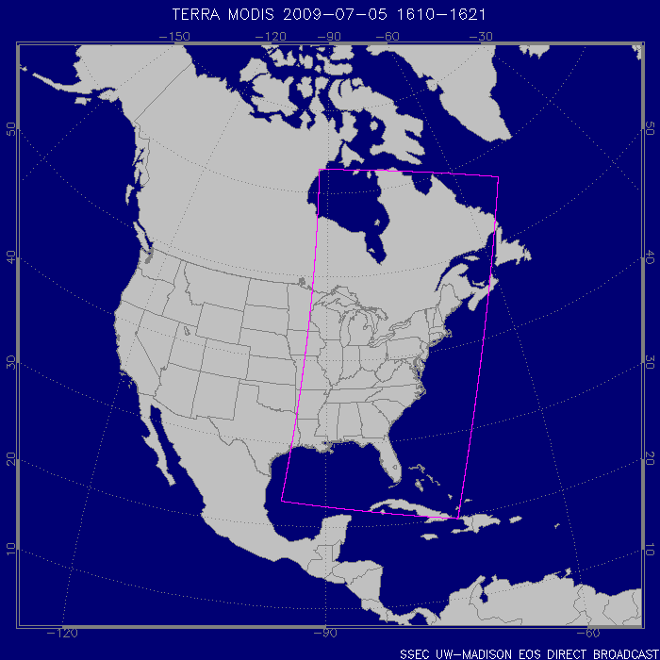
DB Coverage from
Madison, WI
Terra, 2009/07/05

Slide 10
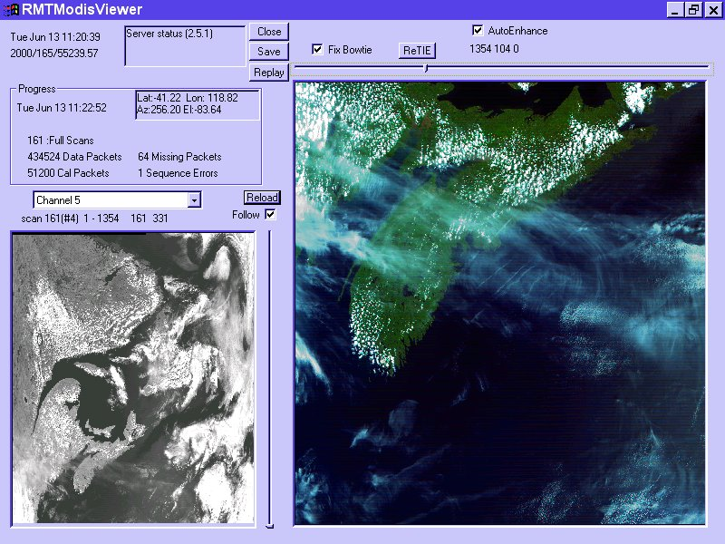
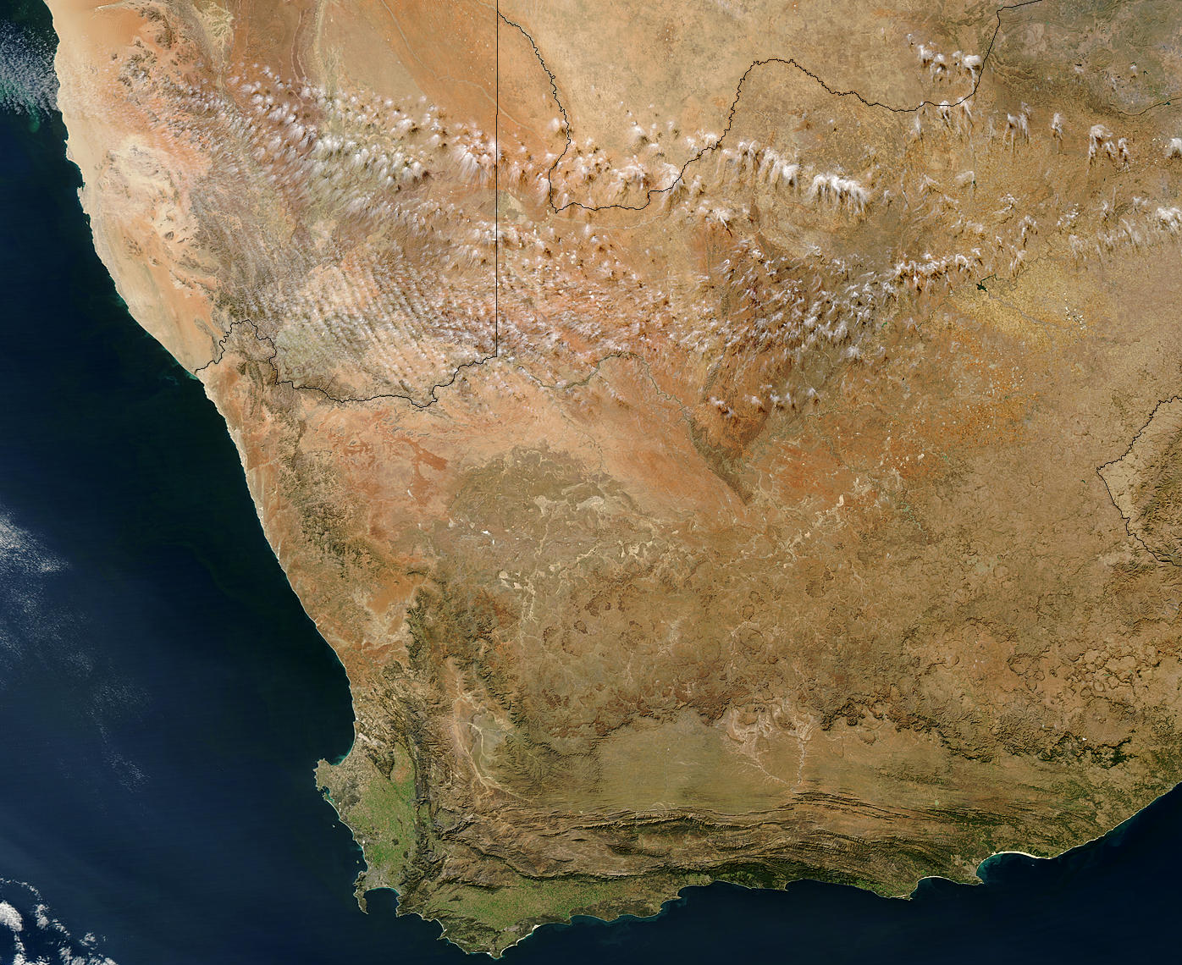
Advantages of DB
Local control gives users the freedom to tailor operations to suit local needs
Timeliness for responding to natural hazards and providing information for decision makers
Local researchers are free to develop and refine algorithms tuned for local conditions
Satellite
Ground Station
Processing Software
Products and Applications

Slide 11
Terra and Aqua DB Product Suite
MODIS Level 1B Products (MODISL1DB)
Level 0 quicklook images (visible and infrared)
Level 1B 1KM, HKM, and QKM radiances and geolocation
Destriping corrections for Level 1B 1KM infrared radiances
MODIS Atmosphere Level 2 Products (IMAPP)
Cloud Mask
Cloud Top Pressure, Phase, Emissivity, Optical Depth
Aerosol Optical Depth
Temperature and Water Vapor Profiles
Total Column Precipitable Water Vapor
Total Column Ozone
Level 2 browse images for all Atmosphere Products
MODIS Land Products (DRL)
Corrected Reflectance 1KM, HKM, QKM
Fire Detection / Thermal Anomalies
Land Surface Temperature (LST)
Normalized Difference Vegetation Index (NDVI)
Enhanced Vegetation Index (EVI)
Land Surface Reflectance
MODIS Ocean Products (SeaDAS)
Chlorophyll-A Concentration
Sea Surface Temperature (SST)
MODIS Images (HDFLook)
Level 1B browse images (visible, infrared, true color)
Level 2 Land browse images (NDVI, LST)
Level 2 Ocean browse images (Chlorophyll-A, SST)
MODIS Google Earth KML (IMAPP)
MODIS 250 meter resolution true color JPEG images and KML
AIRS Level 1 and Level 2 (IMAPP)
Level 1B data (including AIRS IR, AIRS VIS, and AMSU)
Level 2 retrievals of temperature and moisture
AMSR-E Level 1 and Level 2 (IMAPP)
Geolocated and calibrated antenna temperatures
Rain Rate
Soil Moisture
Snow Water Equivalent

Slide 12
Outline
What is MODIS Direct Broadcast (DB)?
MODIS DB Image Products
MODIS DB Atmosphere Products
MODIS DB Land products
MODIS DB Ocean products
Downloading MODIS data from the Web

Slide 13
MODIS DB Level 1 Image Products
Software: MODISL1DB
Developers: MODIS Characterization Support Team, MODIS Science Team, NASA Ocean Biology Processing Group
Distributor: NASA Ocean Biology Processing Group
Platforms: Linux, OS X, Windows (VM)
http://oceancolor.gsfc.nasa.gov/seadas/modisl1db/
Free Download

Slide 15
What does MODISL1DB do?
Purpose: Convert raw MODIS telemetry files to calibrated and geolocated Level 1B image products
Input Data: Level 0 CCSDS Packet Files containing APID 64 (MODIS) for Terra and Aqua; and APID 957 (GBAD) for Aqua
Output Data: MODIS Level 1B 1KM, HKM, QKM, and Geolocation (HDF4 format)

Slide 16
MODIS Level 1B Data
MODIS Level 1B data contains calibrated and geolocated radiance or reflectance values observed by the instrument (top of atmosphere)
MYD02 is the Aqua product ID (Terra=MOD02)
MYD021KM = 1000 meter resolution
(1354 pixels across track by 2030 pixels along track for a standard 5-minute granule or scene)
MYD02HKM = 500 meter resolution (2708 x 4060)
MYD02QKM = 250 meter resolution (5416 x 8120)
DB granules may be larger (up to 14 minutes long)

Slide 17
MODIS Level 1B Contents
Format is Hierarchical Data Format v4 (HDF4)
Image data are stored as scaled integers, with linear slope and intercept to convert to calibrated radiance or reflectance
Geolocation data at 1000 meter resolution are stored in a separate file (MYD03), along with sensor viewing geometry and solar geometry
Daytime 1KM granules contain all 36 bands at 1000 meter resolution
Nighttime 1KM granules contain bands 20-36 only
HKM and QKM granules are daytime only

Slide 18
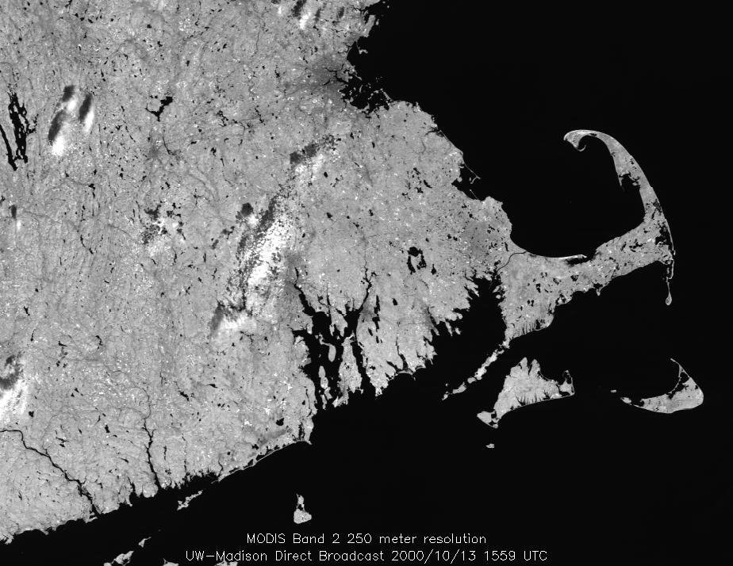
SSEC Direct Broadcast 2000/10/13
Terra MODIS
Band 2 (0.87 μm) at 250 meter resolution

Slide 19
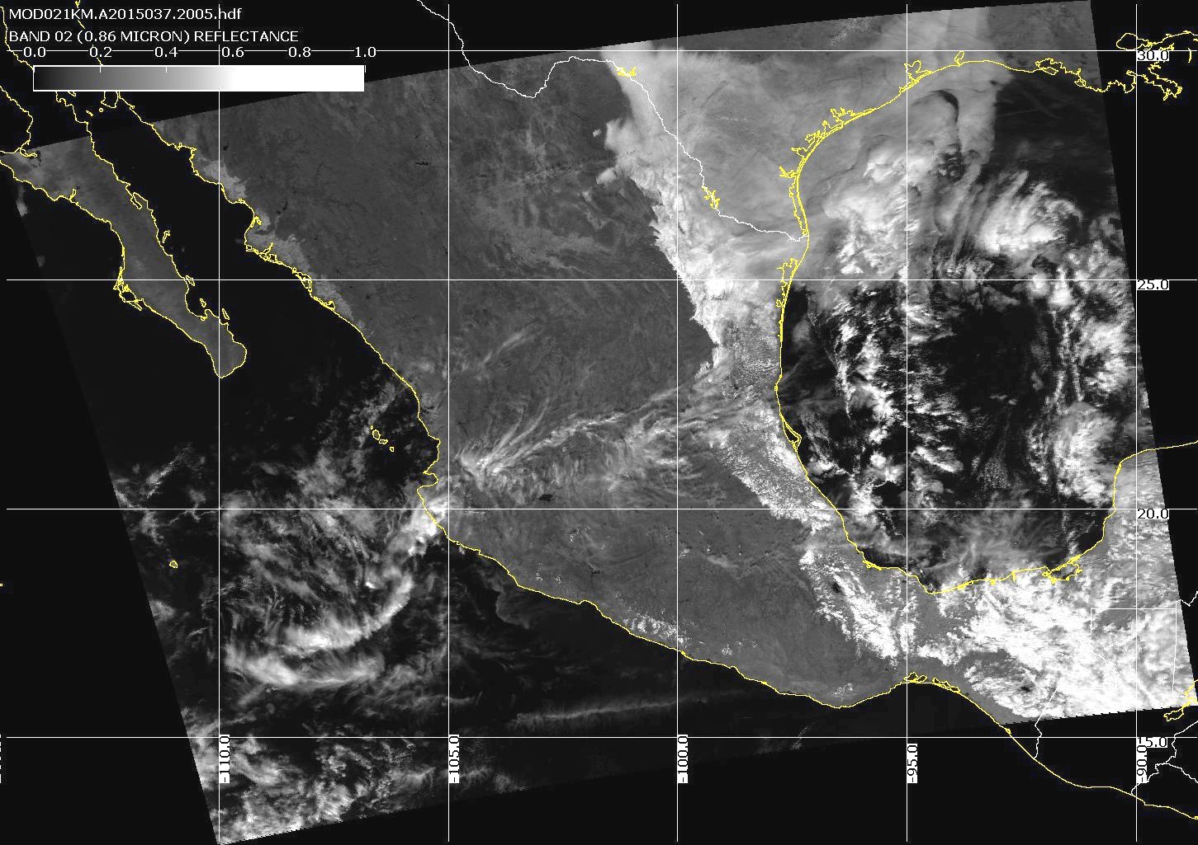
Band 2 (visible)
Aqua MODIS
2015/02/06
20:05 UTC

Slide 20
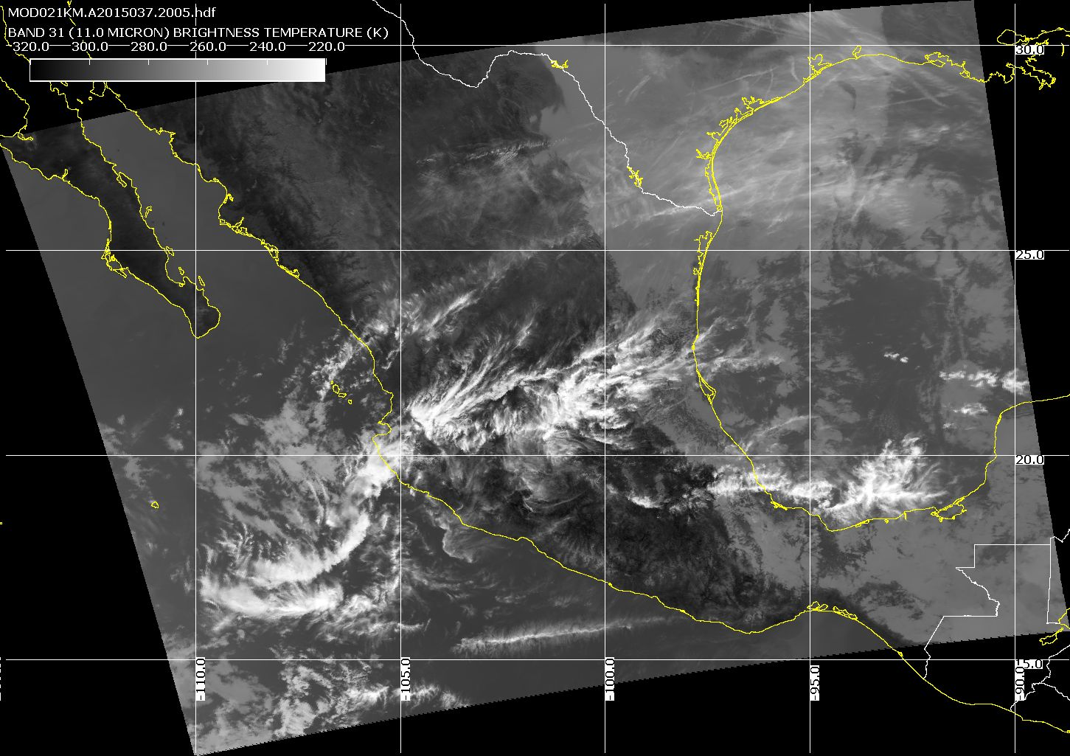
Band 31 (infrared)
Aqua MODIS
2015/02/06
20:05 UTC

Slide 21
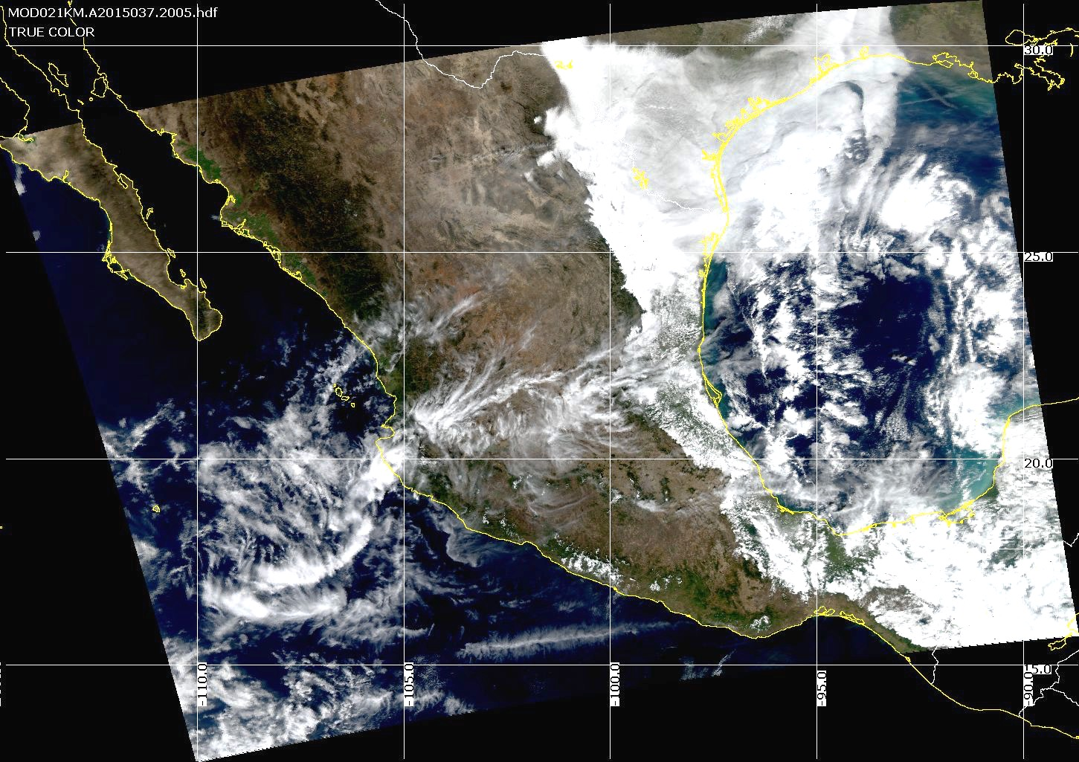
True Color
Aqua MODIS
2015/02/06
20:05 UTC

Slide 22
Outline
What is MODIS Direct Broadcast (DB)?
MODIS DB Image Products
MODIS DB Atmosphere Products
MODIS DB Land products
MODIS DB Ocean products
Downloading MODIS data from the Web

Slide 23
MODIS DB Atmosphere Products
Software: International MODIS/AIRS Processing Package (IMAPP)
Developers: University of Wisconsin-Madison, MODIS Science Team, Remote Sensing Systems, Free University of Berlin
Distributor: University of Wisconsin-Madison
Platforms: Linux, Windows (VM)
Website: http://cimss.ssec.wisc.edu/imapp/
Free Download

Slide 24
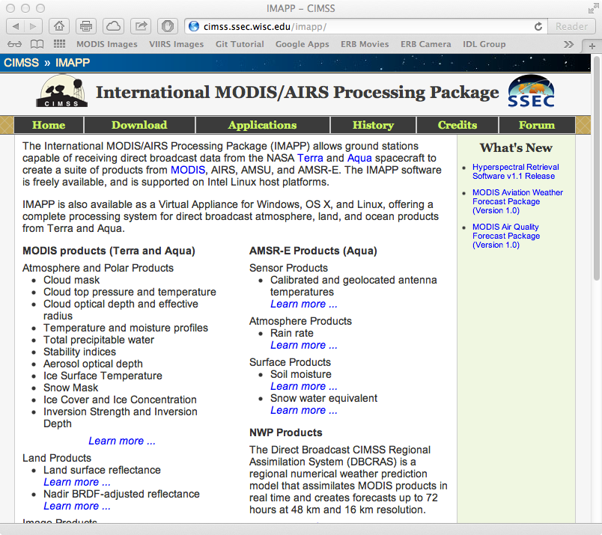

Slide 25
IMAPP Product List
MODIS Products:
Cloud Mask (MOD35)
Cloud Top Properties (MOD06CT)
Atmospheric Profiles (MOD09)
Aerosol Optical Depth (MOD04)
Sea Surface Temperature
Near Infrared Water Vapor
Level 1B Destriping
True Color Images for Google Earth
Nadir BRDF Adjusted Reflectance
Ice Surface Temperature
Snow Mask
Ice Cover and Concentration
Inversion Strength and Depth
Other Products:
AIRS/AMSU Level 1B Calibrated And Geolocated Radiances
AIRS/AMSU JPL Atmospheric Profiles
AIRS/MODIS Single FOV Atmospheric Profiles (Clear and Cloudy)
AIRS/IASI/CrIS Single FOV Retrievals
DBCRAS Numerical Weather Prediction Model
Aviation & Severe Weather Products
Air Quality Forecast Products

Slide 26
What does IMAPP do?
Purpose: Creates MODIS atmosphere, utility, and image products (and AIRS, AMSU, AMSR-E)
Input Data: MODIS Level 1B 1KM, HKM, QKM, and Geolocation (HDF4 format)
Output Data: MODIS Level 2 Cloud Mask, Cloud Top Properties, Atmospheric Temperature and Water Vapor Profiles, Total Ozone, Total Precipitable Water Vapor (HDF4 format)

Slide 27
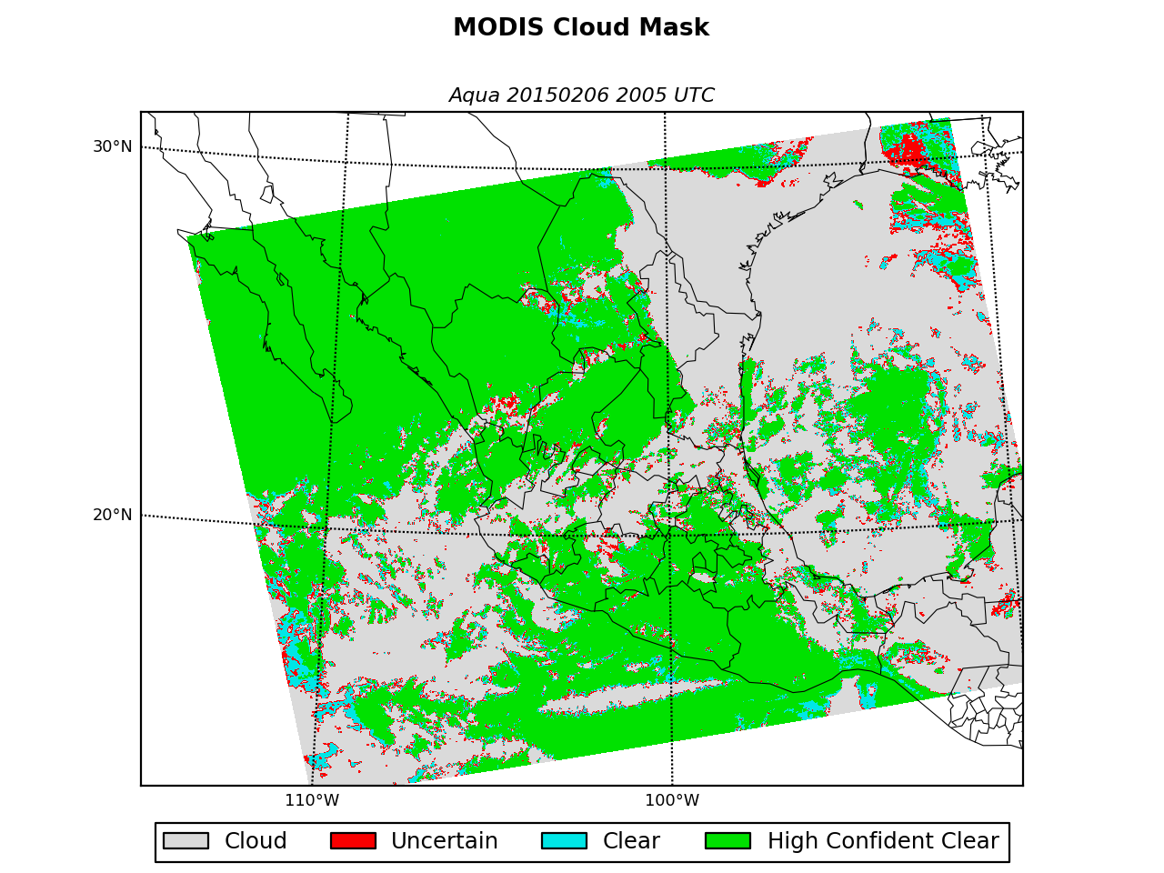
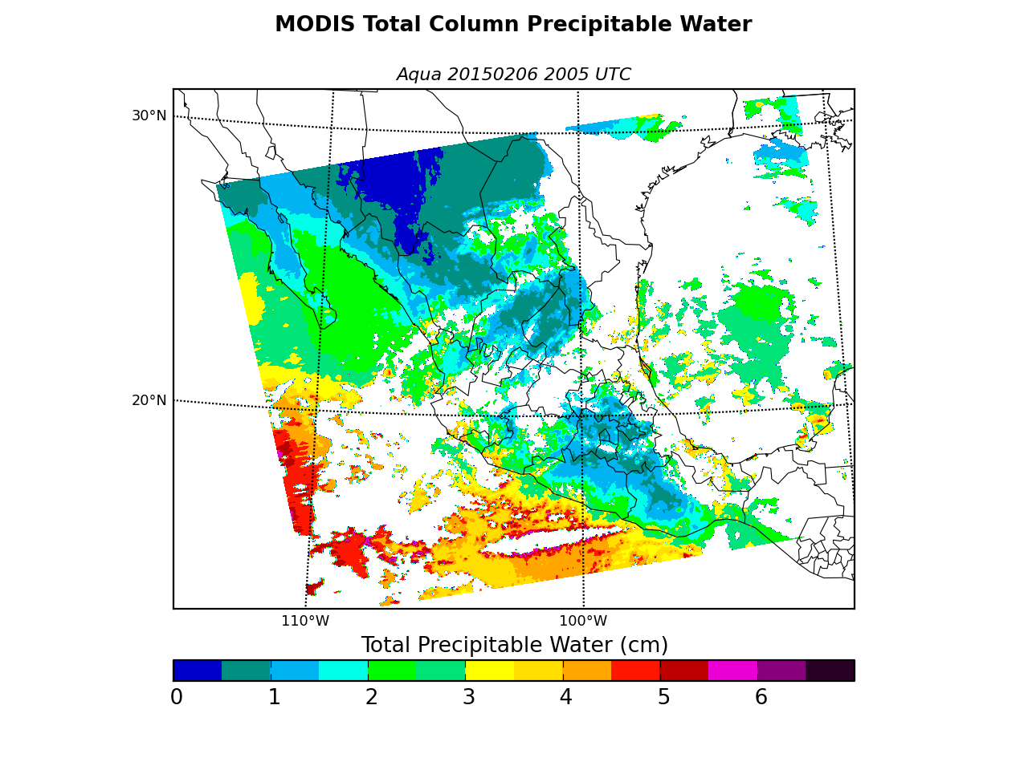
MODIS Atmosphere Products 2010/05/26 04:56
Cloud Mask
Water Vapor

Slide 28
DBCRAS NWP Model
Easy to install and easy to execute on modest PCs
NWP domain centered on your DB location
Assimilates IMAPP MOD07 TPW and MOD06CT Cloud Top Pressure and Cloud Effective Emissivity in order to adjust the cloud and moisture fields in the GFS.
Output is standard meteorological parameters in GRIB2
Creates forecast satellite imagery
72 hour forecast of 11 micron brightness temperature
(3 hour time step)

Slide 29
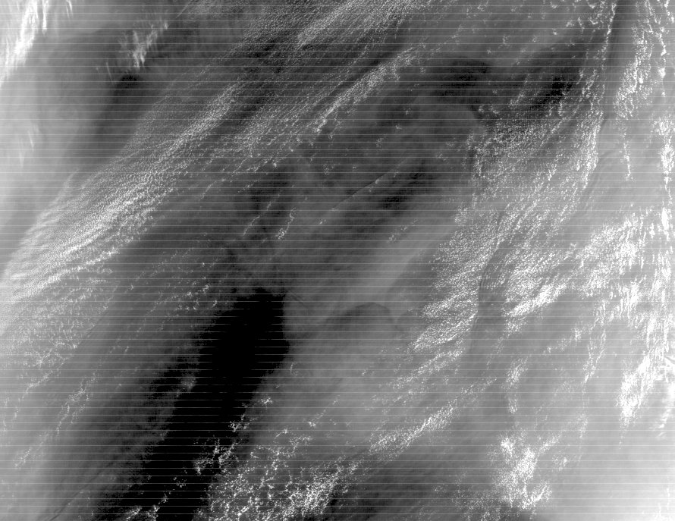
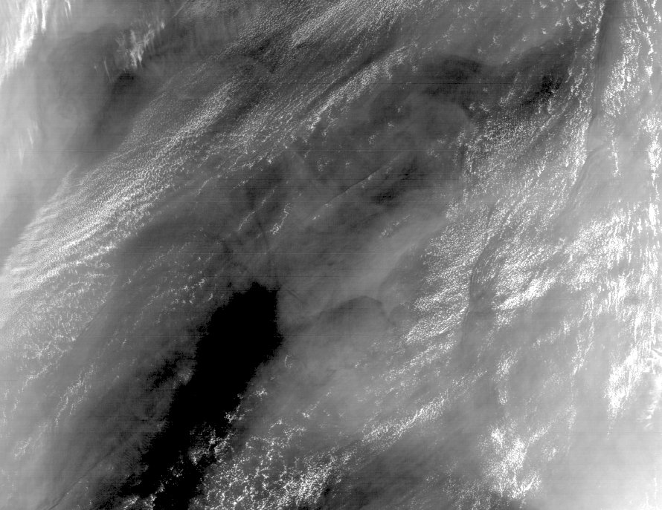
Level 1B 1KM Destriping
Removes stripes from 1KM thermal infrared bands
Each detector is adjusted to match a reference detector
Destriping is recommended before creating IMAPP Atmosphere Products (e.g., Cloud Mask)
Terra MODIS L1B 1KM, 2003094 06:05, Band 29

Slide 30
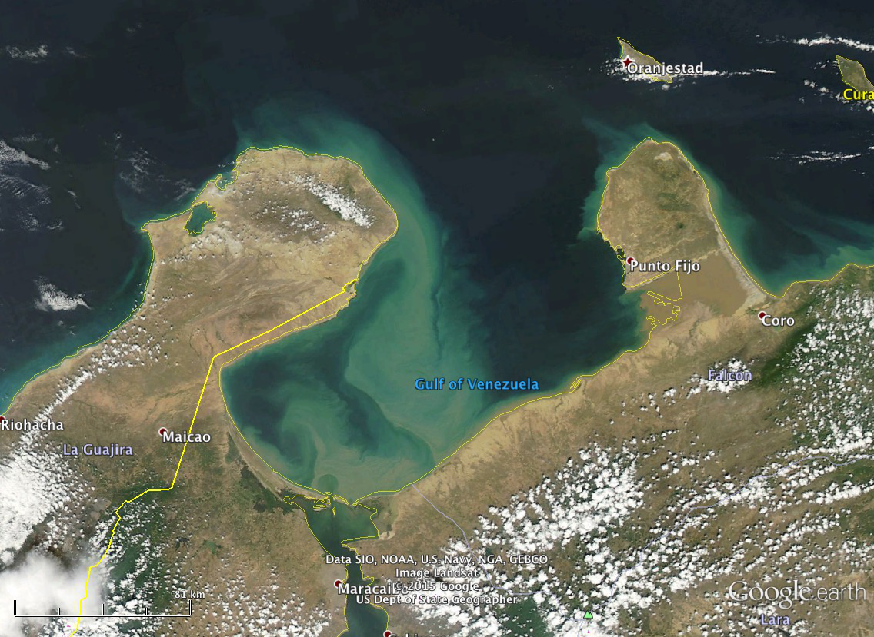
True Color Images for Google Earth
Images can be ready within 30 minutes of acquisition

Slide 31
IMAPP Virtual Appliance
The IMAPP VA makes it simple to install and run a DB processing system to create a range of atmosphere, land, and ocean products from the MODIS sensor onboard Terra and Aqua, and the AIRS, AMSU, and AMSR-E sensors onboard Aqua.
Supports Windows (XP, Vista, 7), Apple OS X, Linux
Install and run within 10 minutes
Easy to configure (e.g., turn on MODIS Land, turn off AIRS)
Easy to maintain (automated lookup table updates)
Designed for simplicity (no DBMS, no Java, no COTS; just Bash scripts)
Allow reliable automated processing
Use only open source software packages (e.g., IMAPP, SeaDAS, etc.)
Software package downloads are automated as part of the install process
Easy to add user-created processing software

Slide 32
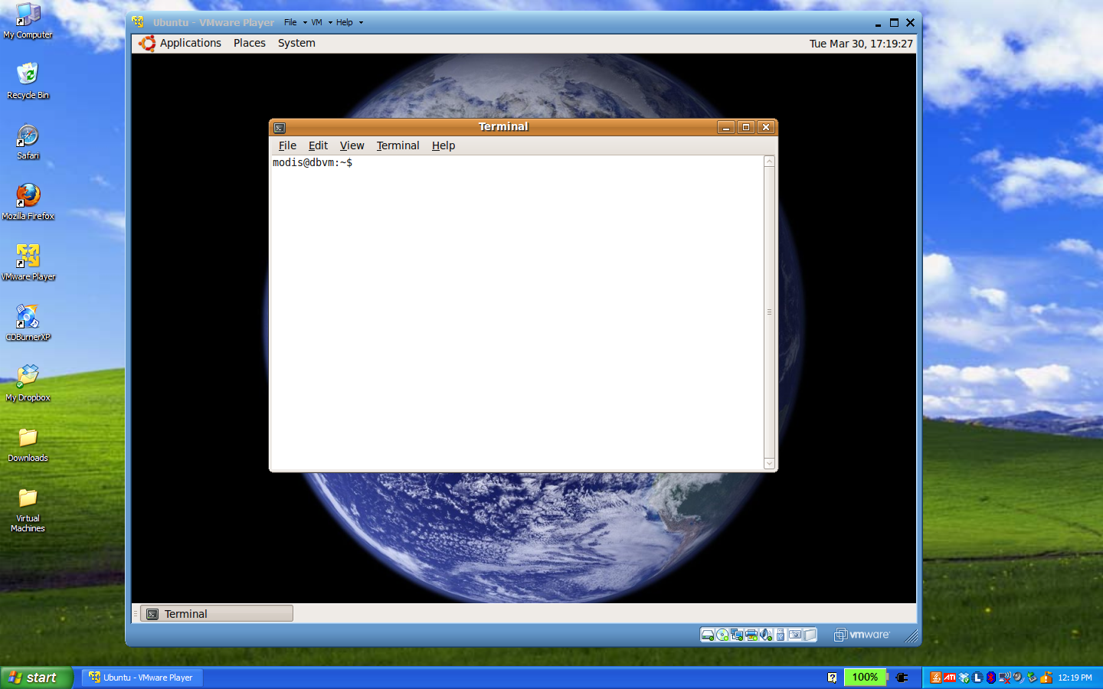
Linux
Guest
Windows
Host
Space Science and Engineering Center
University of Wisconsin-Madison

Slide 33
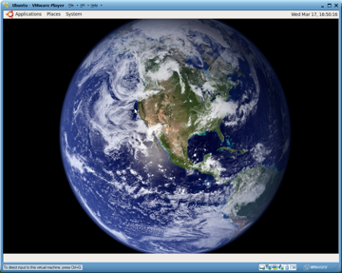
IMAPP VA Installation (Windows)
Download and run IMAPP VA self-extracting archive
Download and install VMware Player (free)
Start VMware Player and select IMAPP VA
MODIS Level 1 and Atmosphere processing packages are pre-installed.
Other packages can be added by editing a configuration file, and running an installer script.
Version 1.1 is now available on the IMAPP website

Slide 34
Outline
What is MODIS Direct Broadcast (DB)?
MODIS DB Image Products
MODIS DB Atmosphere Products
MODIS DB Land products
MODIS DB Ocean products
Downloading MODIS data from the Web

Slide 35
MODIS DB Land Products
Software: Science Processing Algorithms (SPA)
Developers: MODIS Science Team
Distributor: NASA Direct Readout Laboratory
Platforms: Linux, Windows (VM)
Website: http://directreadout.sci.gsfc.nasa.gov/
Free Download

Slide 37
What does SPA do?
Purpose: Creates DB customized Land products
Input Data: MODIS Level 1B 1KM, HKM, QKM, and Geolocation (HDF4 format)
Output Data: MODIS Level 2 Active Fires, Corrected Reflectance, NDVI, EVI, Land Surface Temperature, Land Surface Reflectance (HDF4 format)

Slide 38
Active Fires
2015/02/07 Aqua MODIS

Slide 39
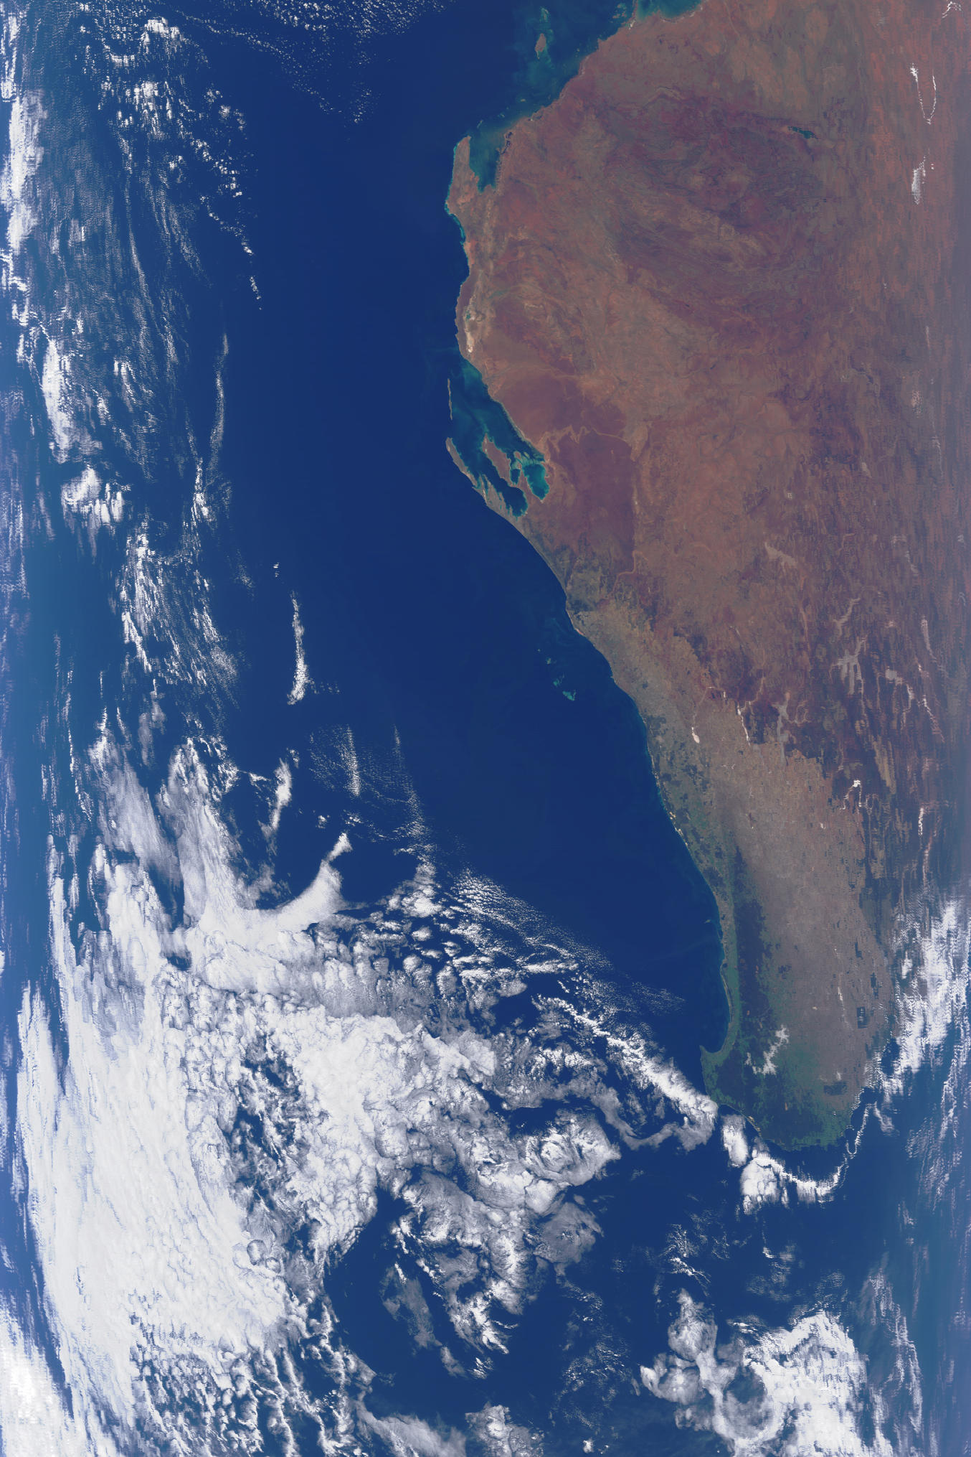
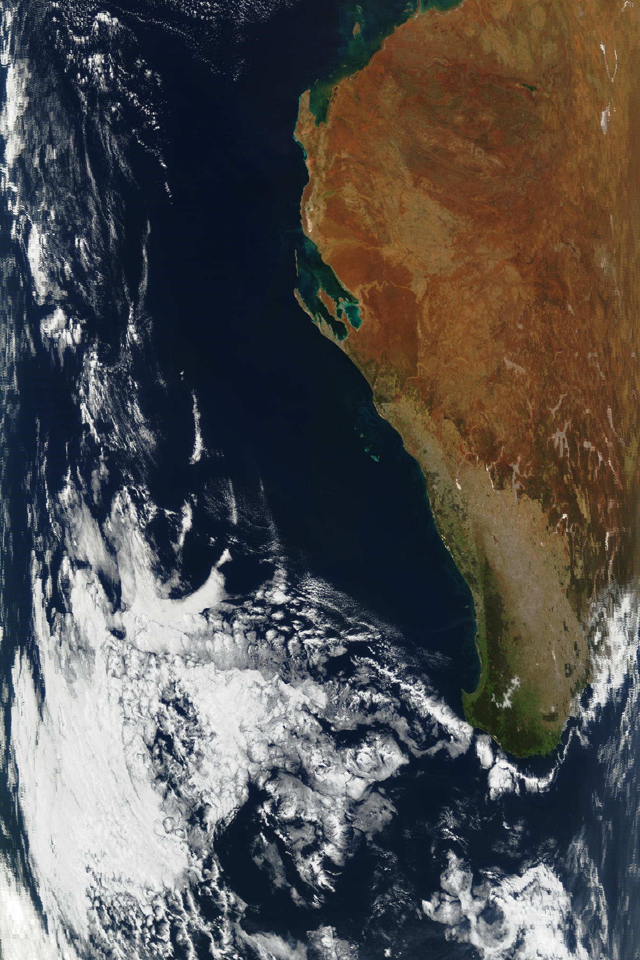
MODIS Corrected Reflectance
Before
After

Slide 40
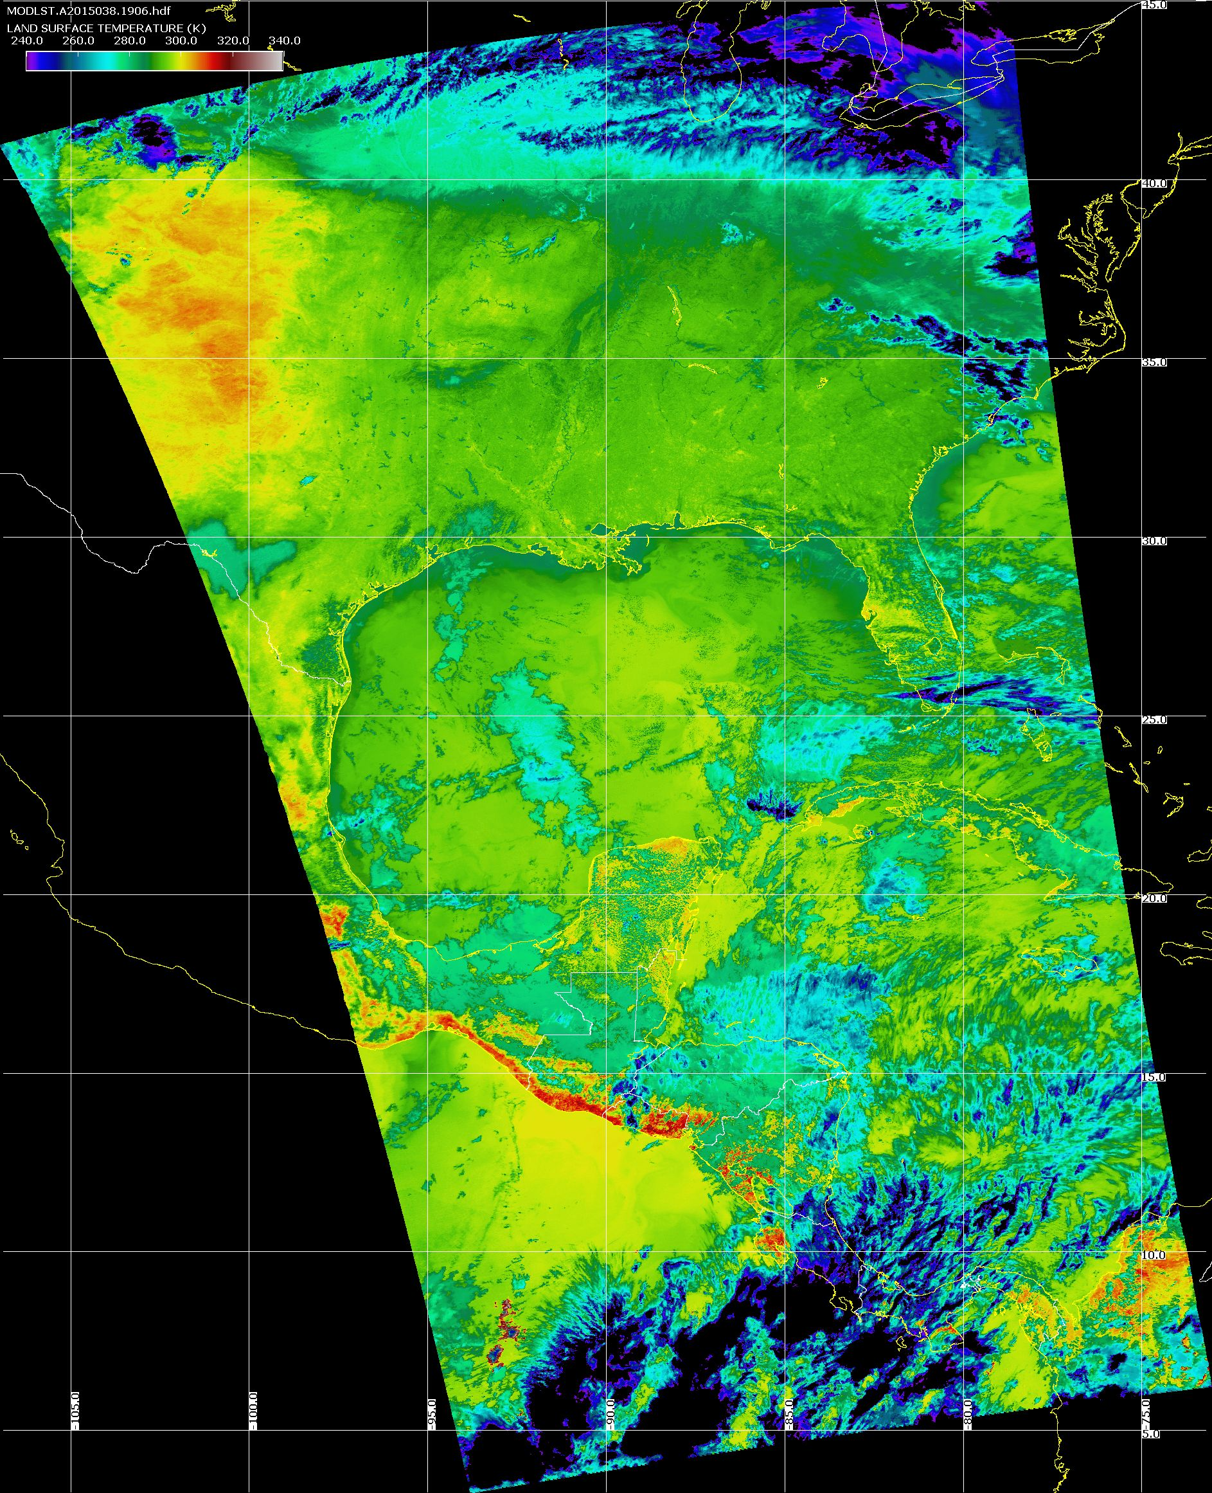
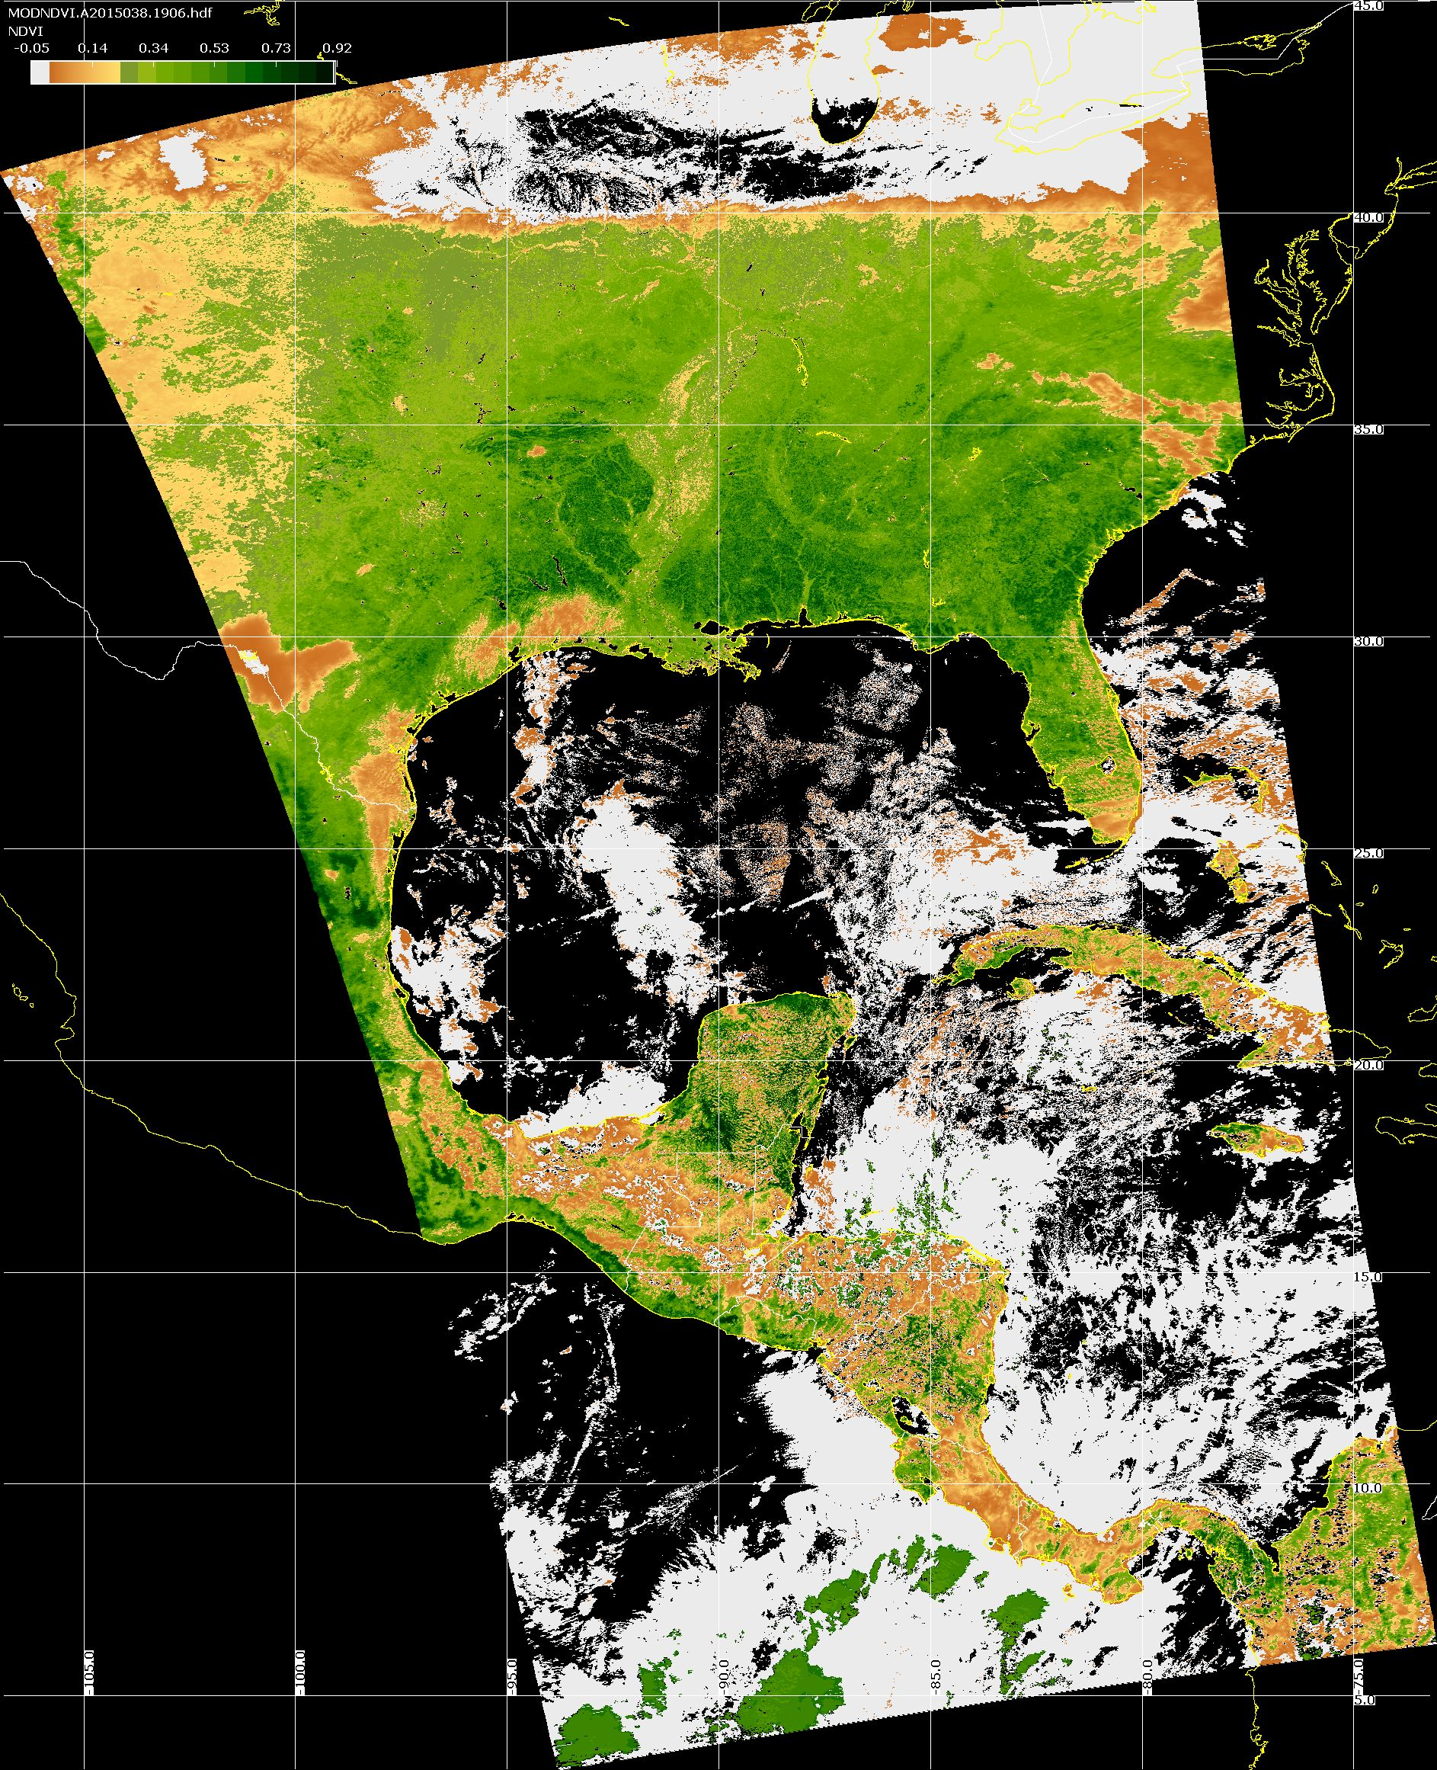
MODIS Land Products Aqua MODIS 2015/02/07
Land Surface Temperature
Vegetation Index

Slide 41
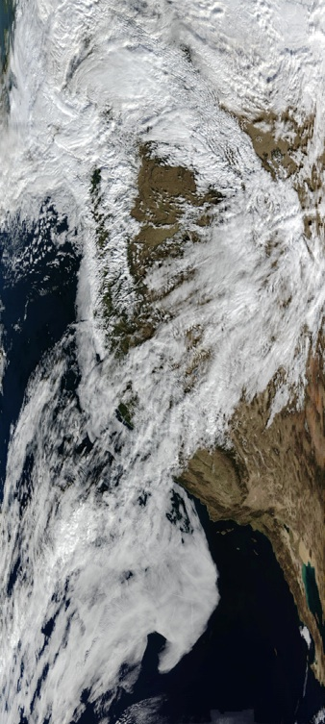
Land Surface Reflectance
MODIS Land Surface Reflectance Algorithm (MOD09) code was adapted for DB by Eric Vermote and Jim Ray. Standard HDF4 format with metadata is created.
Changes for DB included:
Code pre-compiled for Intel Linux; source code is also available
Handles arbitrary granule sizes
Able to use NCEP GFS forecast data instead of NCEP GDAS analysis data
Automatically discovers and downloads required ancillary data at runtime
Handles bad geolocation data
Night granules are handled gracefully in wrapper script
MOD09 True Color
Aqua DB

Slide 42
MODIS NBAR
MOD43B4 Nadir BRDF-Adjusted Reflectance (NBAR) Product is computed for MODIS spectral bands (1-7) at the mean solar zenith angle of each 16 day period.
View angle effects are removed from the directional reflectances.
Applications include vegetation indices, land cover change, and burned area mapping.

Slide 43
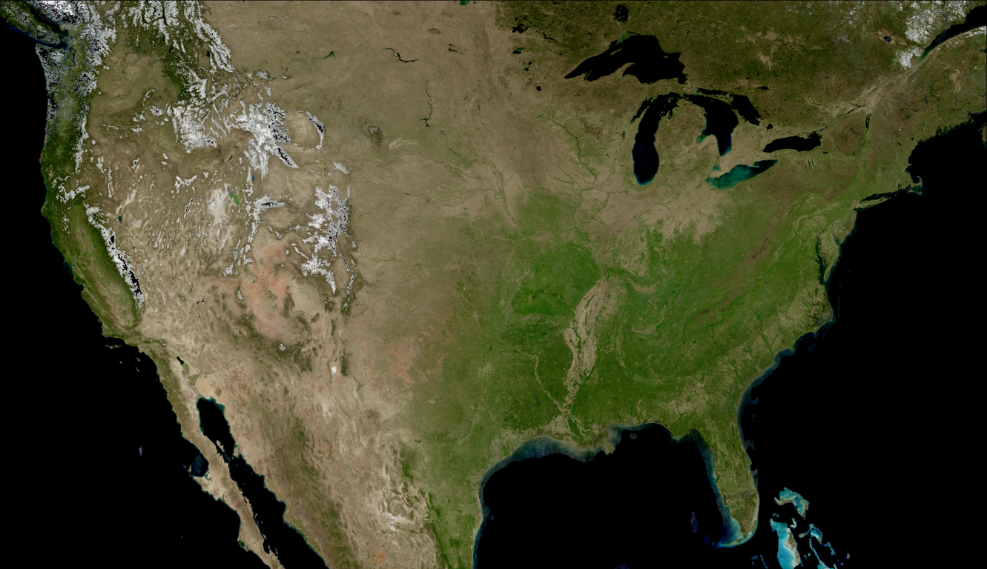
16-day MODIS Composite from DB NBAR Algorithm (True Color) visualized by HDFLook

Slide 44
Outline
What is MODIS Direct Broadcast (DB)?
MODIS DB Image Products
MODIS DB Atmosphere Products
MODIS DB Land products
MODIS DB Ocean products
Downloading MODIS data from the Web

Slide 45
MODIS DB Ocean Products
Software: SeaDAS
Developers: NASA Ocean Biology Processing Group, MODIS Science Team
Distributor: NASA Ocean Biology Processing Group
Platforms: Linux, OS X, Windows (VM)
Website: http://oceancolor.gsfc.nasa.gov/seadas/
Free Download

Slide 46
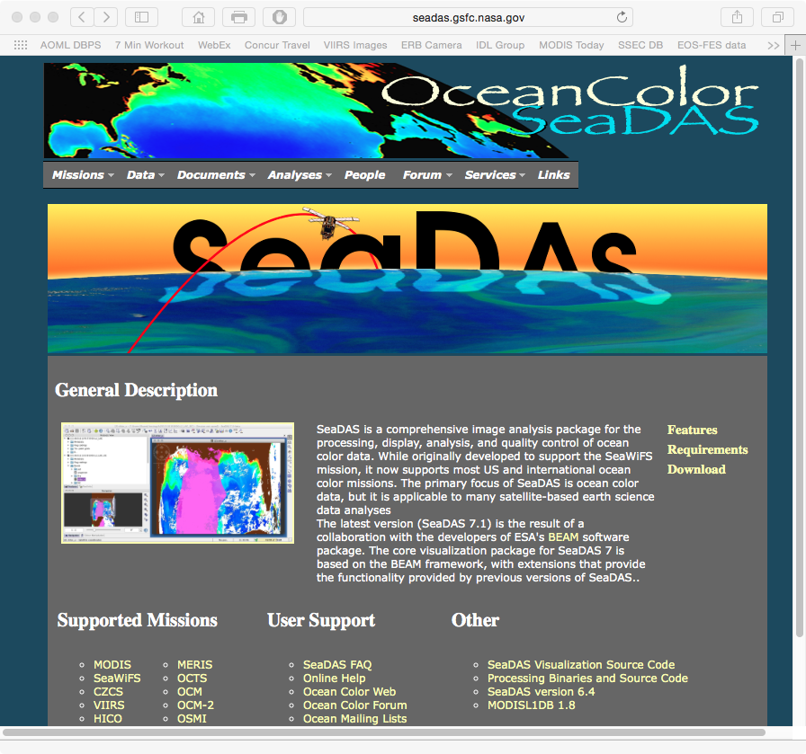

Slide 47
What does SeaDAS do?
Purpose: Creates standard ocean color and ocean temperature products. Allows interactive display and analysis of ocean products.
Input Data: MODIS Level 1B 1KM, HKM, QKM, and Geolocation (HDF4 format)
Output Data: MODIS Level 2 Water Leaving Radiance, Chlorophyll concentration, Sea Surface Temperature (HDF4 format)

Slide 48
SeaDAS Standard Products
Geophysical Parameter Name | Description
nLw_412 | Normalized water-leaving radiance at 412 nm
nLw 443 | Normalized water-leaving radiance at 443 nm
nLw_488 | Normalized water-leaving radiance at 488 nm
nLw_531 | Normalized water-leaving radiance at 531 nm
nLw_551 | Normalized water-leaving radiance at 551 nm
nLw_667 | Normalized water-leaving radiance at 667 nm
Tau_869 | Aerosol optical thickness at 869 nm
Eps_78 | Epsilon of aerosol correction at 748 and 869 nm
Chlor_a | OC3 Chlorophyll a concentration
K490 | Diffuse attenuation coefficient at 490nm
Angstrom_531 | Angstrom coefficient, 531-869 nm
SST | Sea Surface Temperature: 11 micron
SST4 | Sea Surface Temperature: 4 micron (night only)

Slide 49
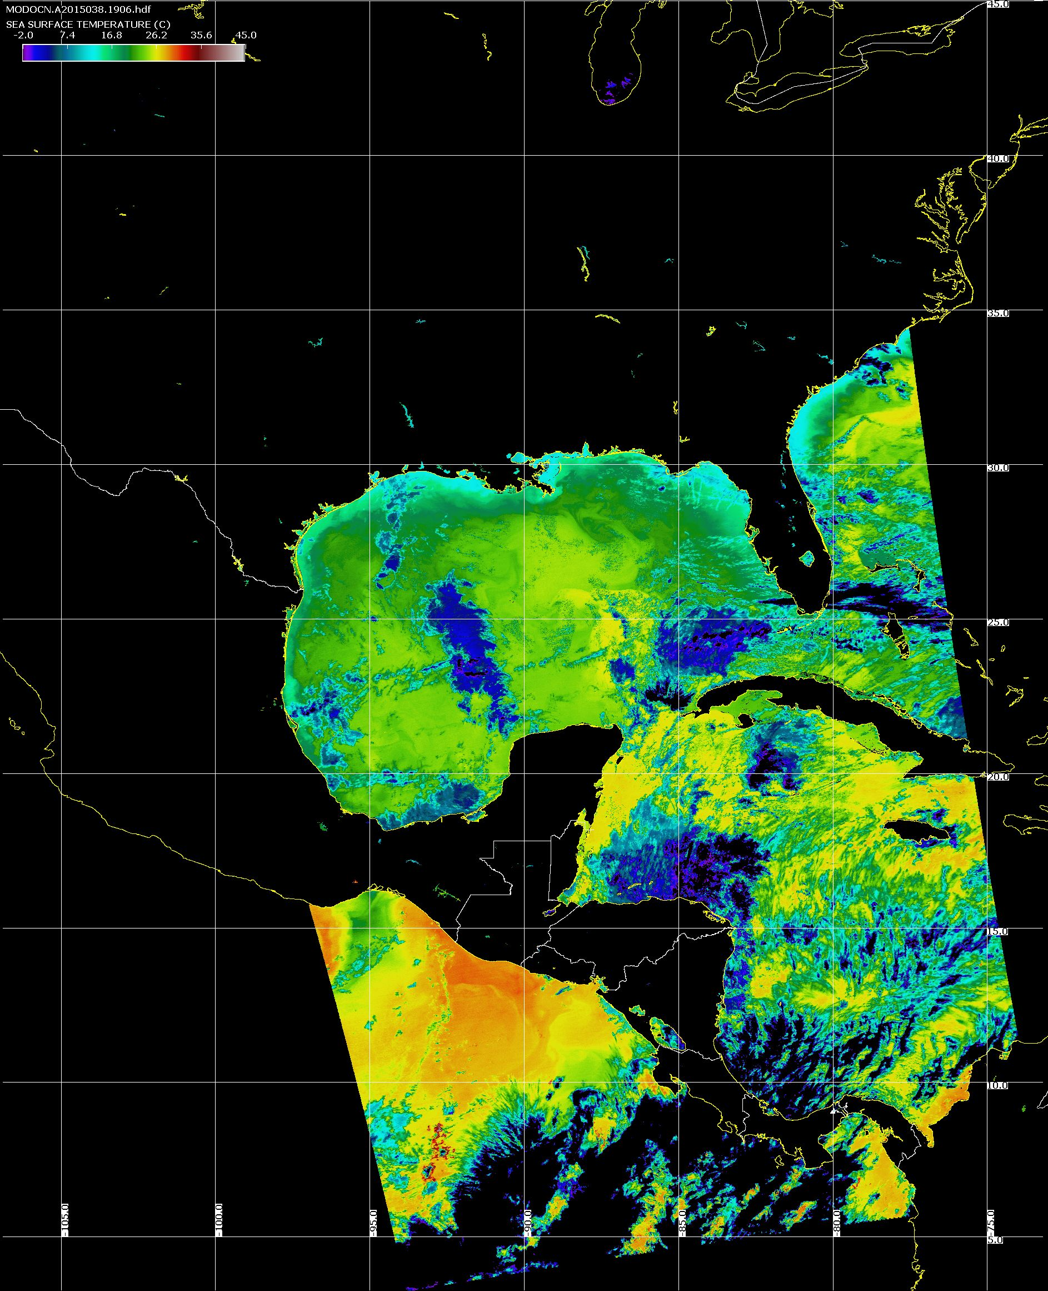
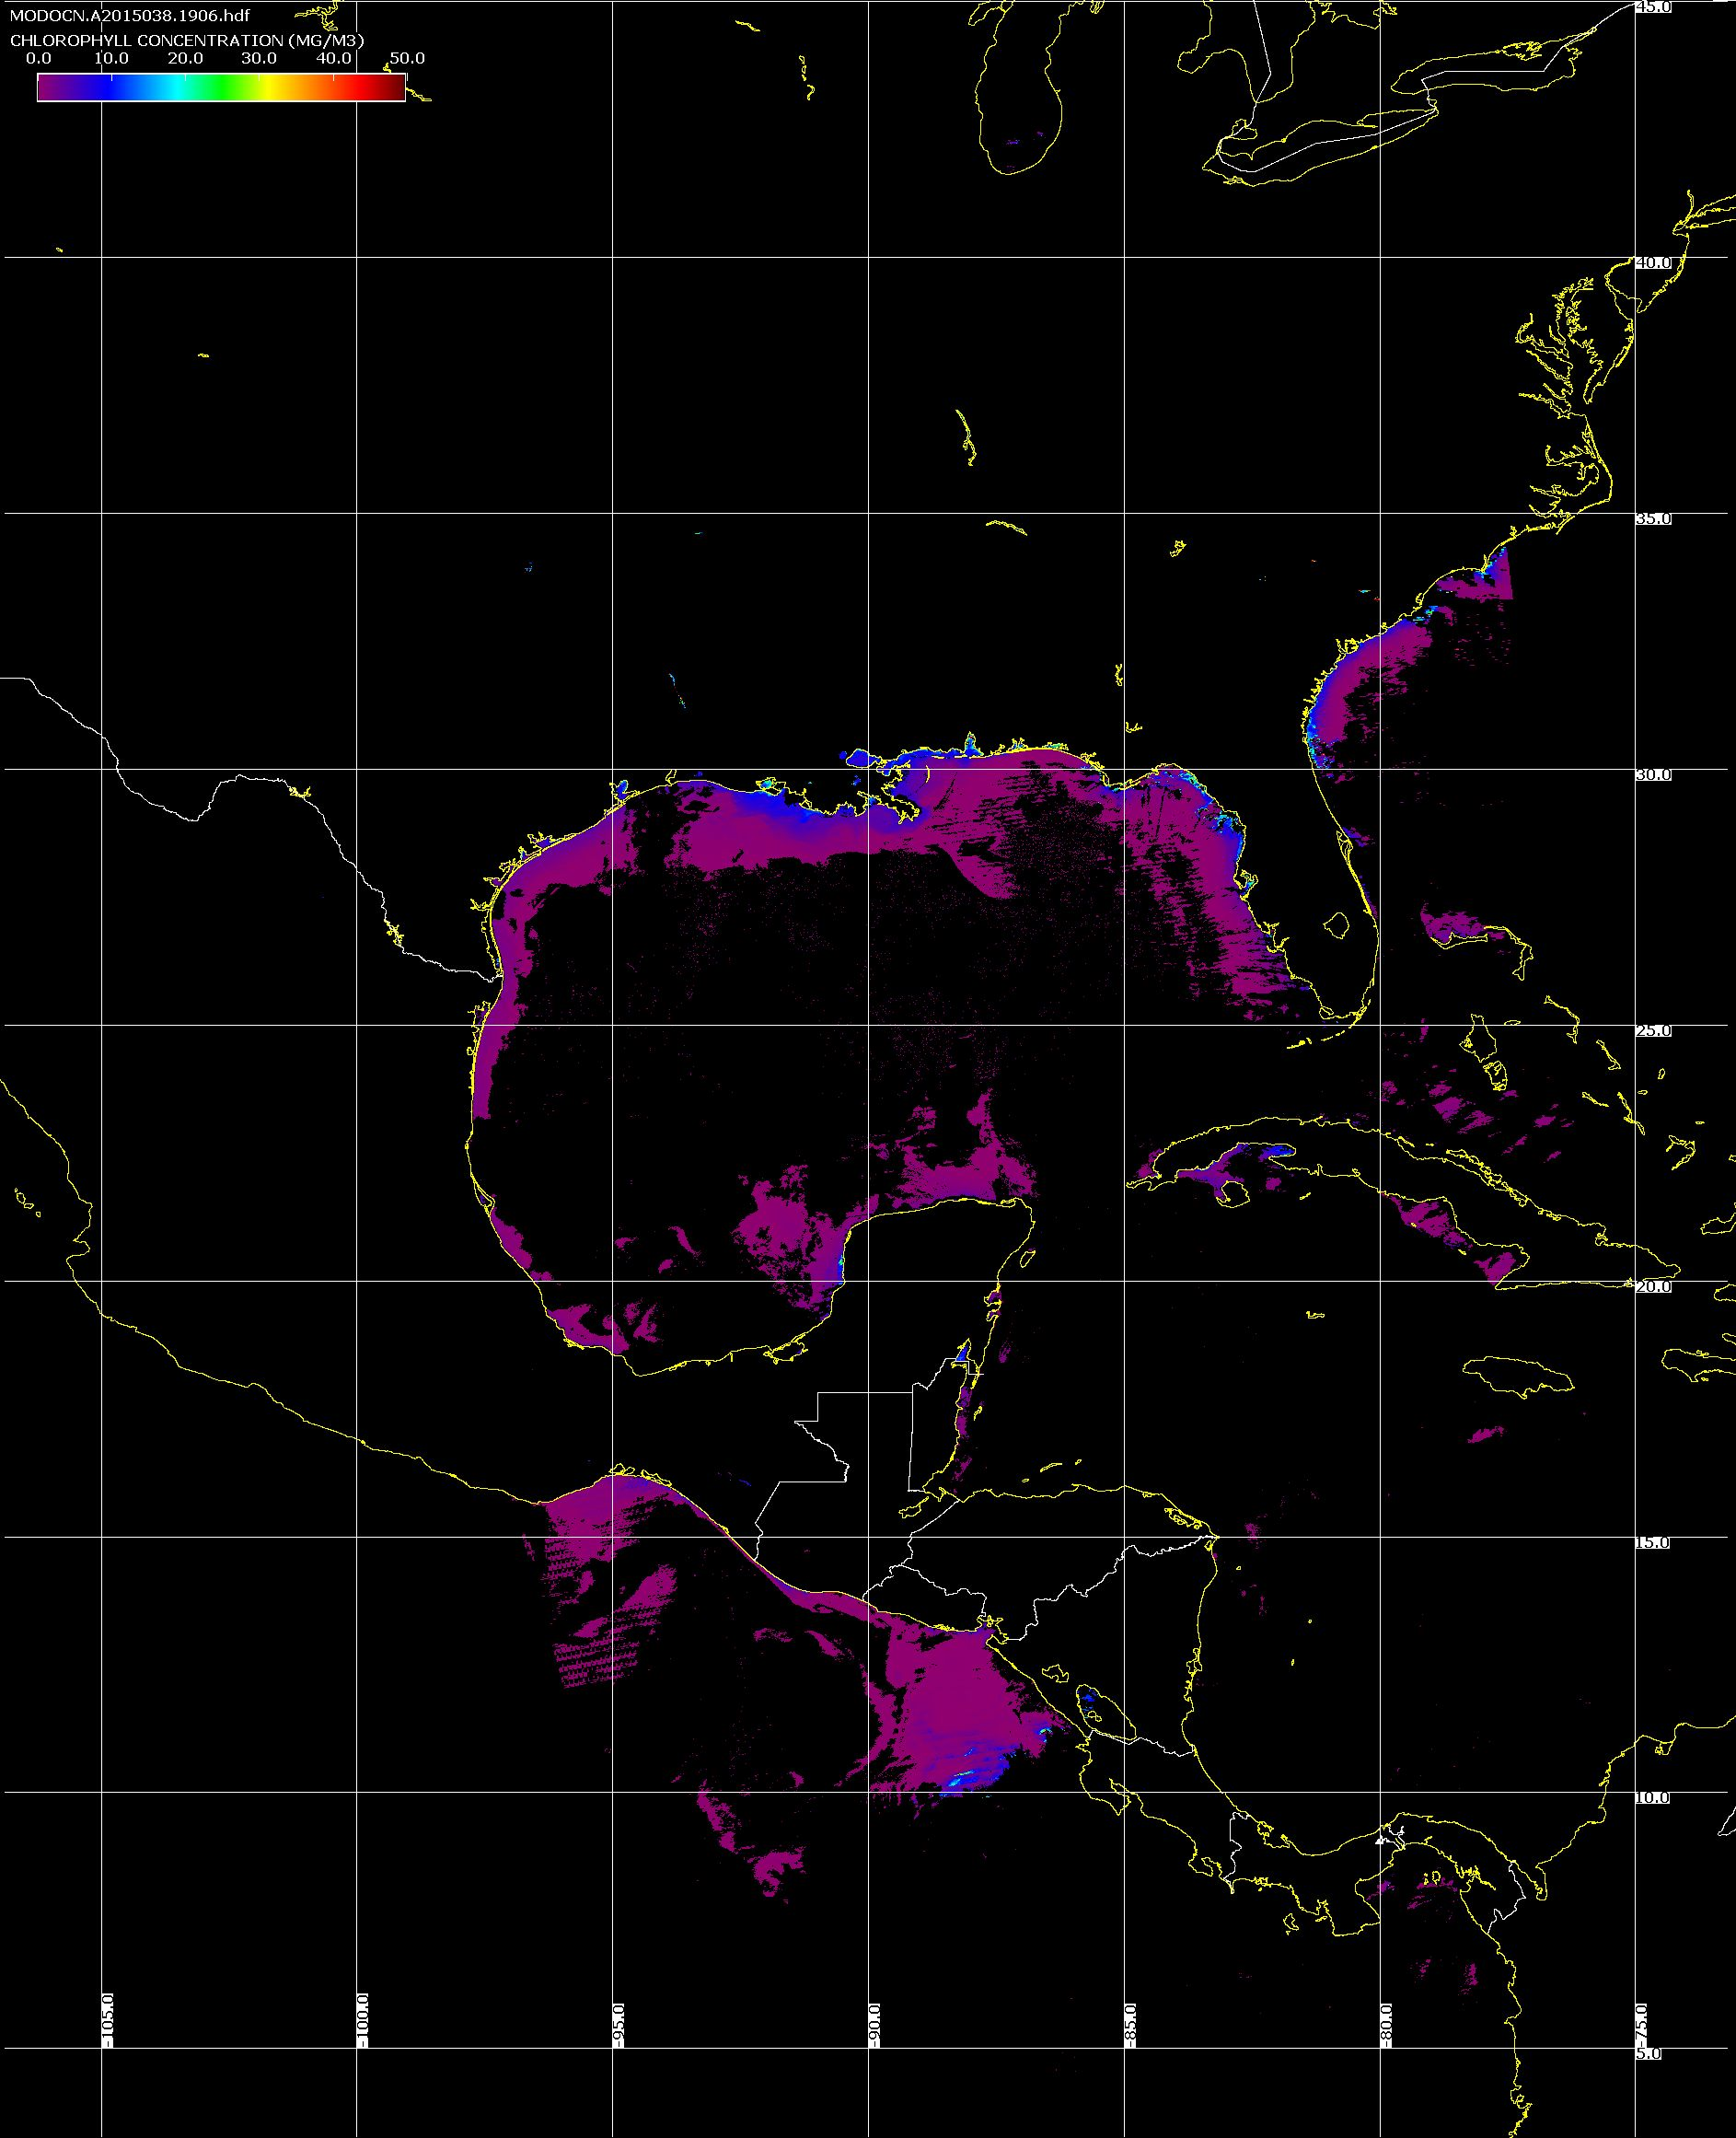
SeaDAS MODIS Products Aqua MODIS 2015/02/07
Sea Surface Temperature
Chlorophyll-A

Slide 50
Outline
What is MODIS Direct Broadcast (DB)?
MODIS DB Image Products
MODIS DB Atmosphere Products
MODIS DB Land products
MODIS DB Ocean products
Downloading MODIS data from the Web

Slide 51
MODIS Products from NASA
NASA provides MODIS Level 0, Level 1B, Land, Ocean and Atmosphere Products at no cost
Global near real-time products (about 90-120 minutes delay) are available from LANCE
Best for obtaining products in real-time; regional subscriptions are available.
Global long-term archive products (about 24 hours delay) are available from LAADS
Best for obtaining long-term historical data.

Slide 52
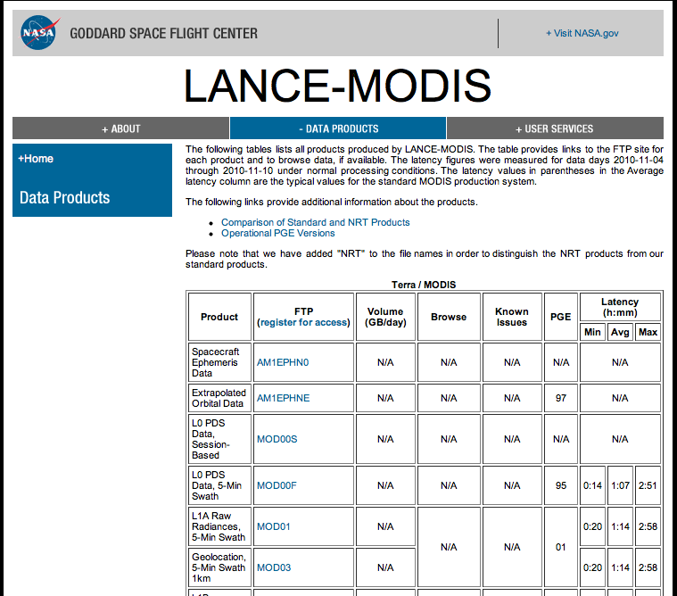
http://lance-modis.eosdis.nasa.gov/data_products/

Slide 53
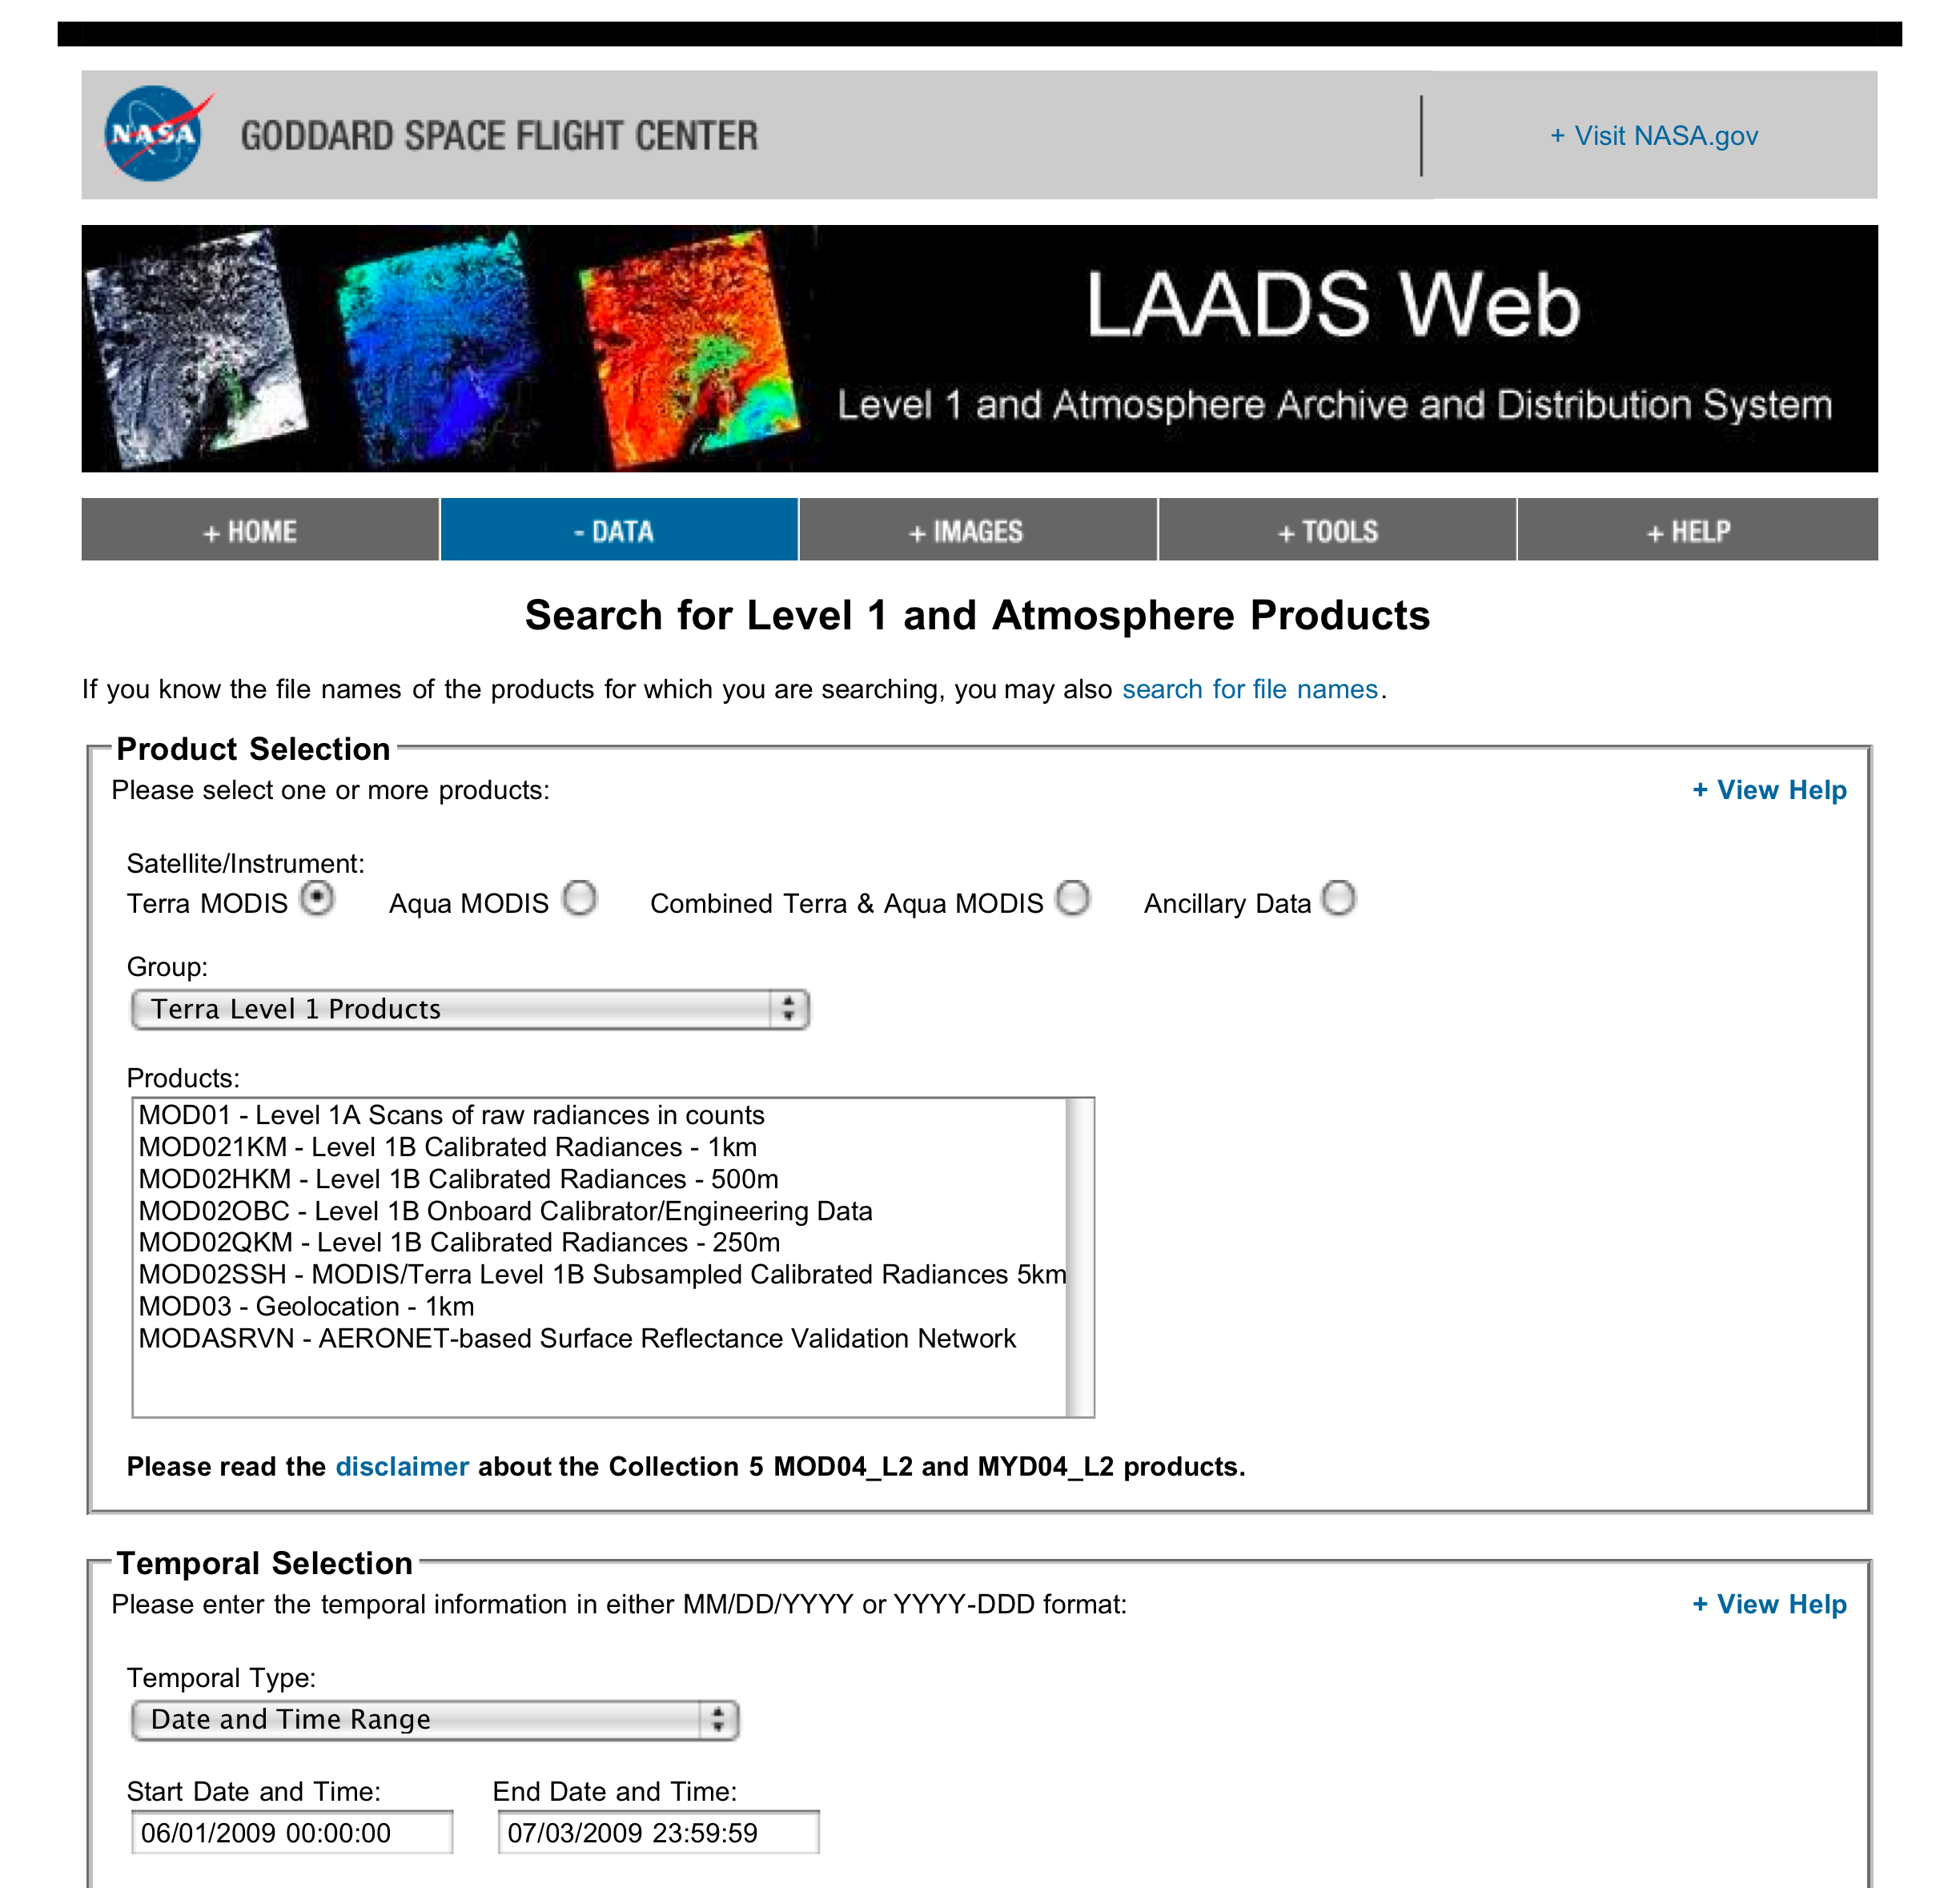
http://ladsweb.nascom.nasa.gov/data/search.html

Slide 54
MODIS Ocean Level 2 Products are available from
http://oceancolor.gsfc.nasa.gov/
MODIS Land Level 2/3 Products are available from
http://lpdaac.usgs.gov/

