Slide 1
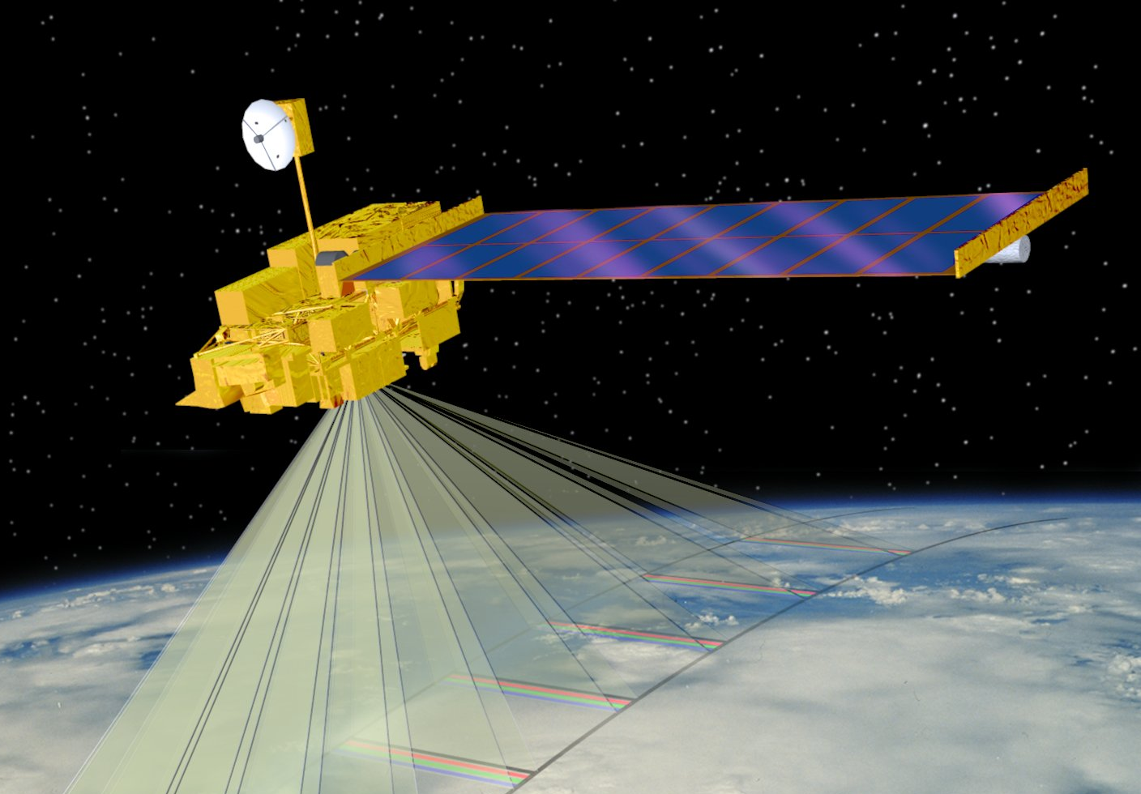

Introduction to the MODIS sensor and products
DB Applications Workshop
AOML, Miami FL
February 2015
Liam Gumley
Space Science and Engineering Center
University of Wisconsin-Madison
Notes:
Title slide

Slide 2
Earth Observing System (EOS)
The Earth Observing System is a constellation of NASA satellites for observing and quantifying global change processes
The Earth Observing System (EOS) is intended to measure the impact of human activities and other phenomena on the world’s climate over a period spanning nearly two decades …
It is the biggest single science program in the world ...
- Charles F. Kennel

Slide 3
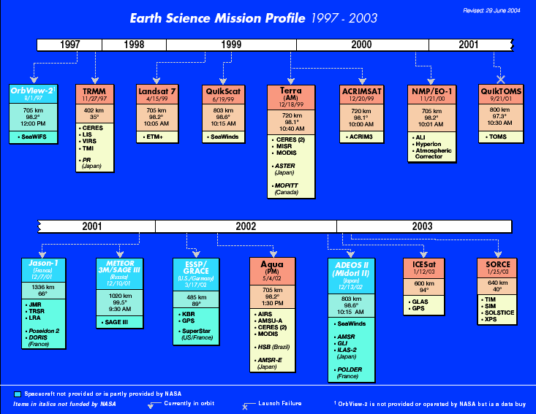
Notes:
The constellation of NASA Earth Observing Satellites provides a comprehensive suite of instrumentation for observing the Earth. Of particular note for this presentation are Terra and Aqua.

Slide 4
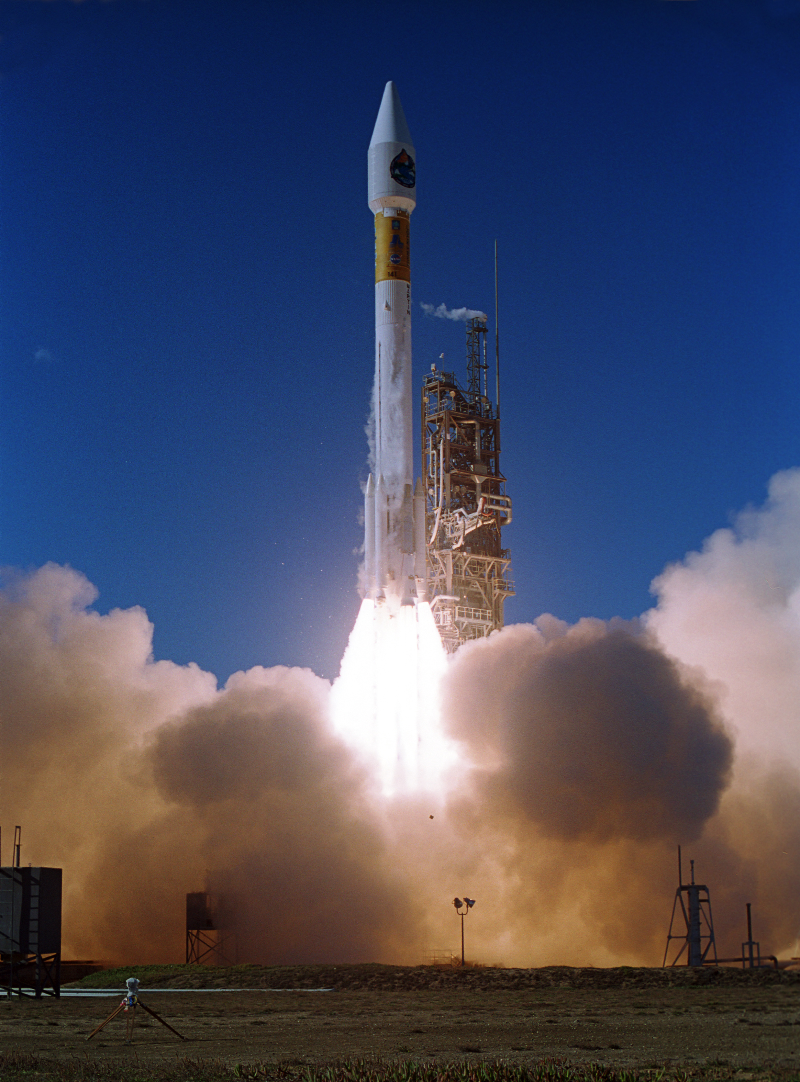
Terra
Launched: Dec. 18, 1999
10:30 am descending node
ASTER: Hi-res imager
CERES: Broadband scanner
MISR: Multi-view imager
MODIS: Multispectral imager
MOPITT: Limb sounder
Expected lifetime > 15 years
Notes:
Despite a design lifetime of only 5 years, the Terra spacecraft is expected to operate for up to 15 years.

Slide 5
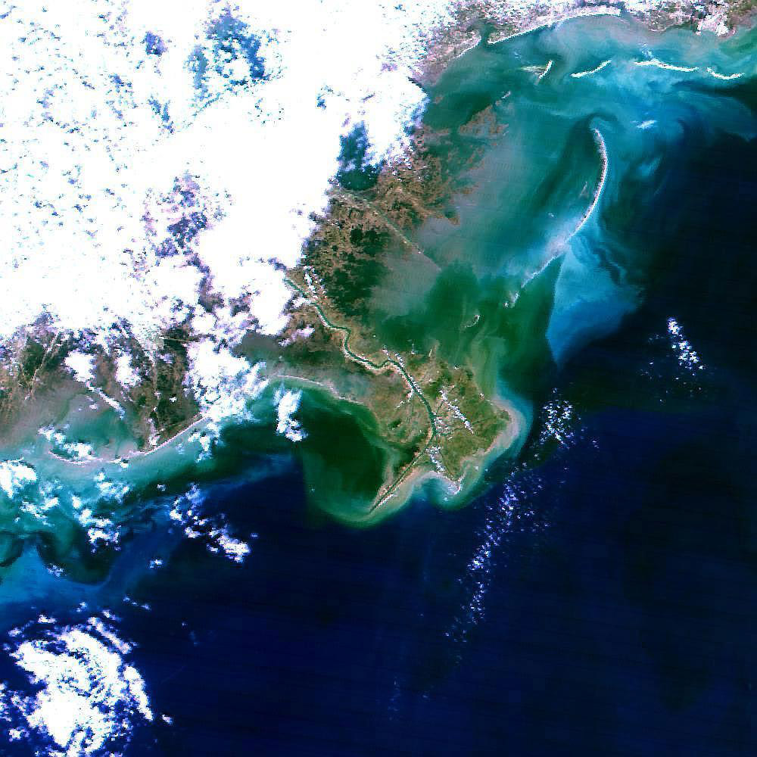
Terra MODIS first light image, 24 Feb. 2000
Birdfoot Delta
Mississippi River
USA
Notes:
The first daytime imagery from Terra MODIS was acquired on 24 February 2000.

Slide 6
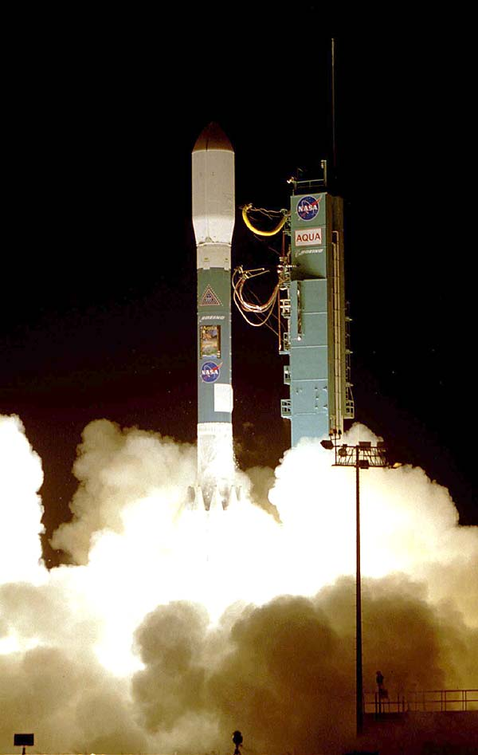
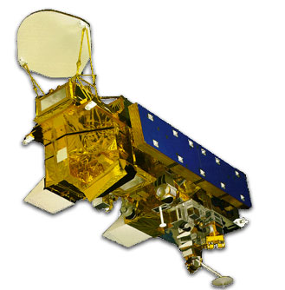
Aqua
Launched: May 4, 2002
1:30 pm ascending node
AIRS: Infrared sounder
AMSR-E: Microwave scanner
AMSU: Microwave scanner
CERES: Broadband scanner
MODIS: Multispectral imager
Expected lifetime > 15 years

Slide 7
Moderate Resolution Imaging Spectroradiometer (MODIS)
Heritage: AVHRR (land), SeaWIFS (ocean), HIRS (atmosphere)
Spectral coverage: 36 bands from 0.4 to 14.2 microns
Spatial resolution: 2 bands @ 250 m; 5 @ 500 m; 29 @ 1000 m
Major differences:
  Many spectral bands (490 detectors)
  Multiple samples along track on each earth scan
  Higher spatial resolution
  On-orbit radiometric, spatial, and spectral calibration
  Improved radiometric accuracy and precision (12-bit)
  Improved geolocation accuracy
  Higher data rate requiring X-band direct broadcast

Slide 8
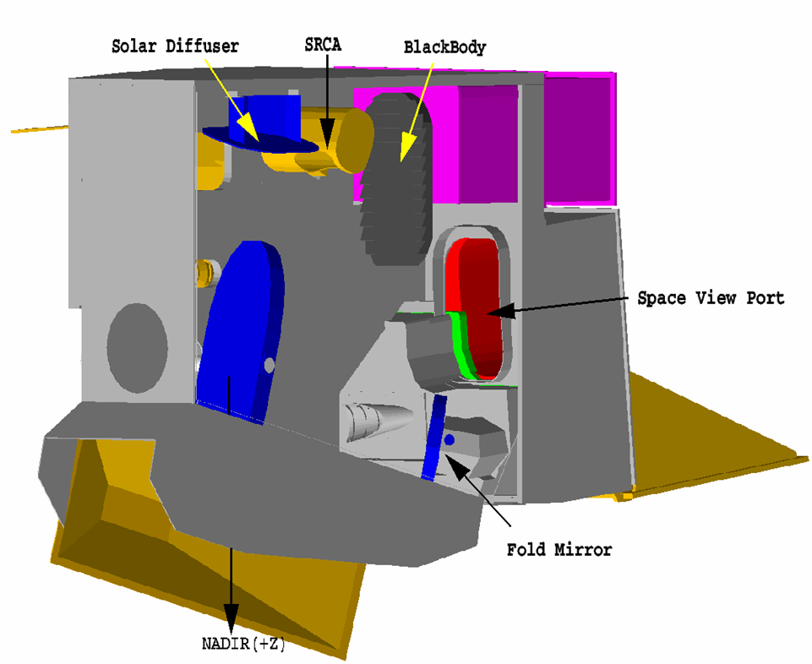
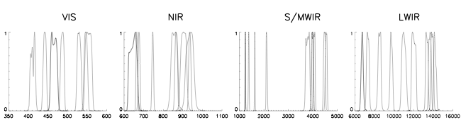
MODIS Instrument Overview
36 spectral bands (490 detectors) covering 0.4 to 14.5 μm
4 Focal Plane Arrays: Visible, Near Infrared, Shortwave Infrared, Longwave Infrared
On-Board Calibrators: SD/SDSM, SRCA, and BB (plus space view)
12 bit (0-4095) dynamic range
2-sided Paddle Wheel Scan Mirror scans 2330 km swath in 1.47 sec
Day data rate = 10.6 Mbps; night data rate = 3.3 Mbps
Solar Diffuser
SRCA
Blackbody
Velocity
Space View Port
Fold Mirror
Nadir
VIS
NIR
S/MWIR
LWIR
1
1
1
1
0
0
0
0
350
400
450
500
550
600
600
700
800
900
1000
1100
1000
2000
3000
4000
5000
6000
8000
10000
12000
14000
16000

Slide 9
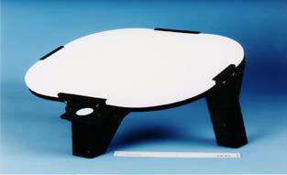
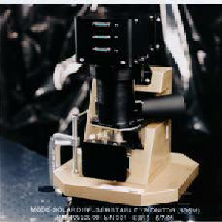
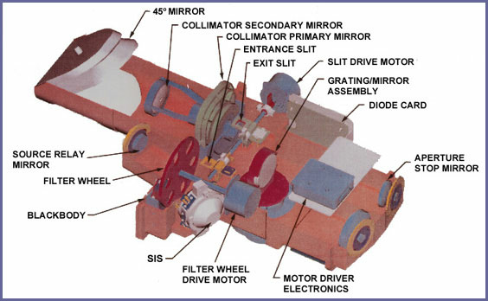
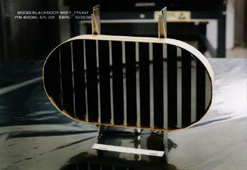
MODIS On-board Calibrators
SD – Solar Diffuser for RSB calibration, SD BRDF determined from pre-launch, referenced to a transfer standard calibrated at NIST
SDSM – Solar Diffuser Stability Monitor for tracking SD degradation
BB – Blackbody (12 thermistors reference to NIST standard) for TEB calibration. Emissivity determined from pre-launch calibration using a blackbody calibration source.
SRCA – Spectroradiometric Calibration Assembly for spectral and spatial characterization
SD
SDSM
SRCA
BB
Notes:
A special feature of the MODIS instrument is the presence of onboard calibration sources for both the infrared and visible channels. The Solar Diffuser and Solar Diffuser Stability Monitor allow accurate calibration and monitoring of the reflectaed solar channels. The Black Body and Space View allow precise calibration of the infrared channels on every Earth scan. The SRCA allows the long term stabiity of the reflected solar channel spectral responses to be monitored.

Slide 10
MODIS Challenges
Multiple detectors:
Detector differences are noticeable
Dead or out-of-family detectors must be handled
Multiple samples along track introduce bowtie distortion
Spectral information:
Many interdependent bands
How to use the spectral information? (algorithm design challenge)
Data rate:
Orders of magnitude larger than heritage sensors
Notes:
MODIS added several challenges compared to heritage instruments.

Slide 11
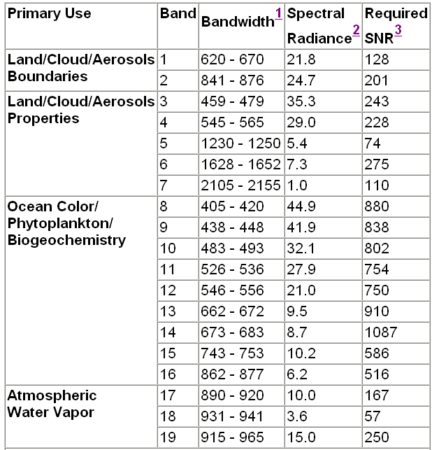
MODIS Reflected Solar Bands
250 meters
500 meters
1000 meters
Cirrus Clouds 26 1380
Notes:
MODIS reflected solar channels measure the intensity of solar photons that have been reflected or scattered into the sensor field of view by the atmosphere, land, or ocean. These bands only operate when the sun is above the horizon. Bands 1 and 2 are 250 meter resolution at nadir; Bands 3-7 are 500 meter resolution; Bands 8-19 and 26 are 1000 meter resolution.

Slide 12
MODIS Thermal Emissive Bands
Notes:
MODIS Thermal Infrared bands sense the energy of photons which are emitted by the atmosphere, land, and ocean. These bands operate day and night. The shortwave infrared bands (3-7 to 4.0 microns) do contain a small but significant reflected solar contribution during daytime.

Slide 13
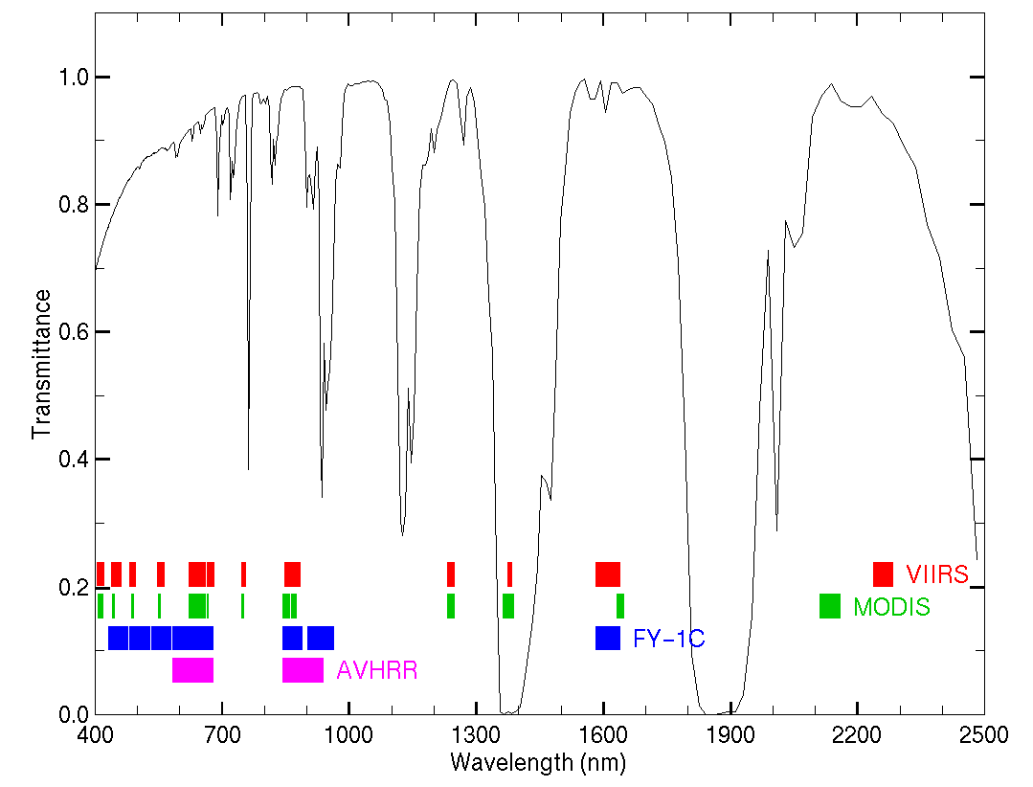
Visible/Near-Infrared Transmittance Spectrum
CO2
O2
O3
H2O
O2
H2O
H2O
O2
H2O
H2O
H2O
CO2
Notes:
The transmittance of the atmosphere from 0.4 to 2.5 microns is dominated by oxygen, ozone, water vapor, and carbon dioxide absorption. Remote sensing of cloud, land surface, and ocean features is accomplished within the transparent window regions of the spectrum. Remote sensinr of water vapor is achieved using the absoprtion bands around 0.9 microns. High cirrus clouds may be detected at 1.38 microns because very few photons can reach the surface in this water vapor absopriton band, and the only photons reaching the sensor are those that have reflected or scattered from high clouds.

Slide 14
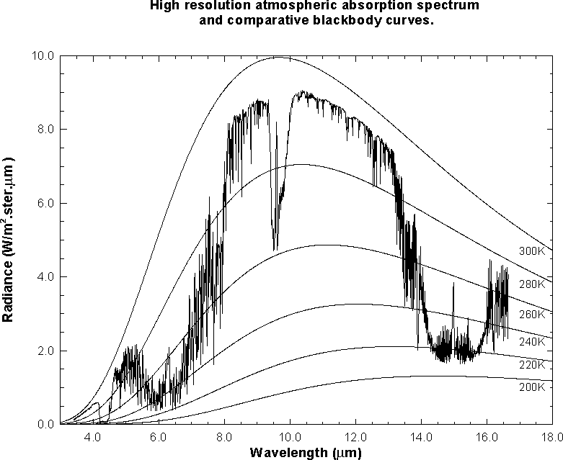
Thermal Infrared Absorption Spectrum
VIIRS
MODIS
MODIS
H2O
O3
CO2
Notes:
This slide shows an observed infrared spectrum of the earth thermal emission of radiance to space. The earth surface Planck blackbody - like radiation at 295 K is severely attenuated in some spectral regions. Around the absorbing bands of the constituent gases of the atmosphere (CO2 at 4.3 and 15.0 um, H20 at 6.3 um, and O3 at 9.7 um), vertical profiles of atmospheric parameters can be derived. Sampling in the spectral region at the center of the absorption band yields radiation from the upper levels of the atmosphere (e.g. radiation from below has already been absorbed by the atmospheric gas); sampling in spectral regions away from the center of the absorption band yields radiation from successively lower levels of the atmosphere. Away from the absorption band are the windows to the bottom of the atmosphere. Surface temperatures of 296 K are evident in the 11 micron window region of the spectrum and tropopause emissions of 220 K in the 15 micron absorption band. As the spectral region moves toward the center of the CO₂ absorption band, the radiation temperature decreases due to the decrease of temperature with altitude in the lower atmosphere.

Slide 15
MODIS Orbit and Scan Geometry
Terra: 10:30 am local descending
Aqua: 1:30 pm local ascending
Orbit period: 99 minutes
Repeat cycle: 16 days (same as Landsat; precisely controlled)
Scan mirror: Double sided, 20.3 revolutions/minute
Scan rate: 1.477 scans/sec
Scan angle: +/- 55 degrees
Swath width: 2330 km across track, 10 km along track

Slide 16
MODIS Bowtie
Consecutive “bowtie” shaped scans are contiguous at nadir, and overlap as scan angle increases…
Notes:
Each MODIS earth scan paints a bowtie-shaped outline on the surface of the Earth. As the spacecraft moves forward in time, each successive scan paints a new bowtie on the Earth, thus building up a continuous image. Ten 1000-meter samples are acquired along the ground track for each scan.

Slide 17
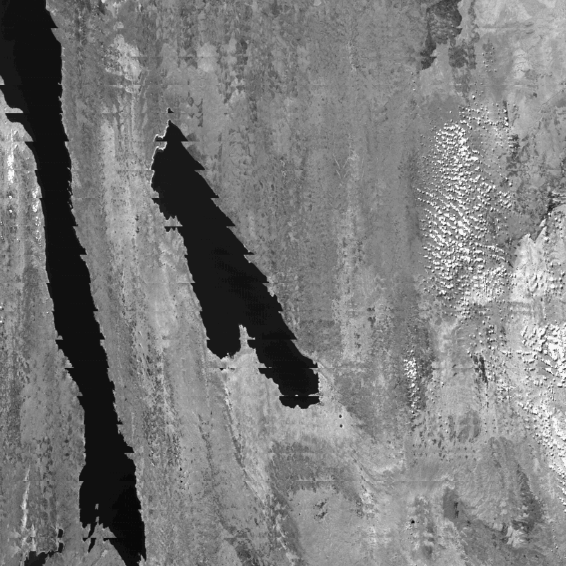
MODIS bowtie artifacts at edge of swath
Band 2 (0.87 micron)
250 meter resolution
Notes:
However a consequence of the bowtie scan is that the same region of the Earth is sensed on consecutive scans.

Slide 18
Bowtie Artifacts
Are not a ‘problem’: they are a consequence of the sensor design
Can be removed for visualization purposes by reprojecting the image onto a map
Do not affect science algorithms that run on a pixel-by-pixel basis or within one earth scan
Are also present on next generation of operational polar orbiting imagers (VIIRS on NPP/JPSS-1)

Slide 19
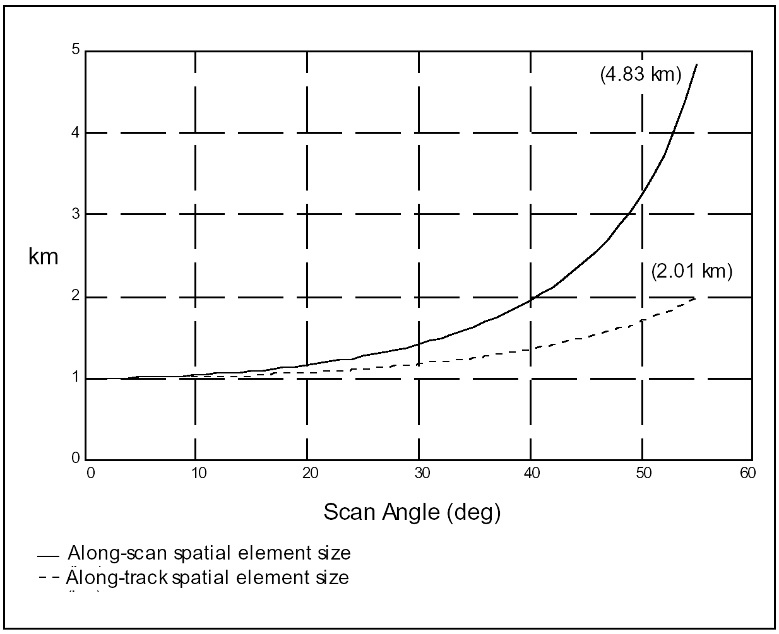
Growth of MODIS 1 km pixel with scan angle
Notes:
The area sensed by a MODIS field of view (i.e., a pixel) grows as a function of scan angle.

Slide 20
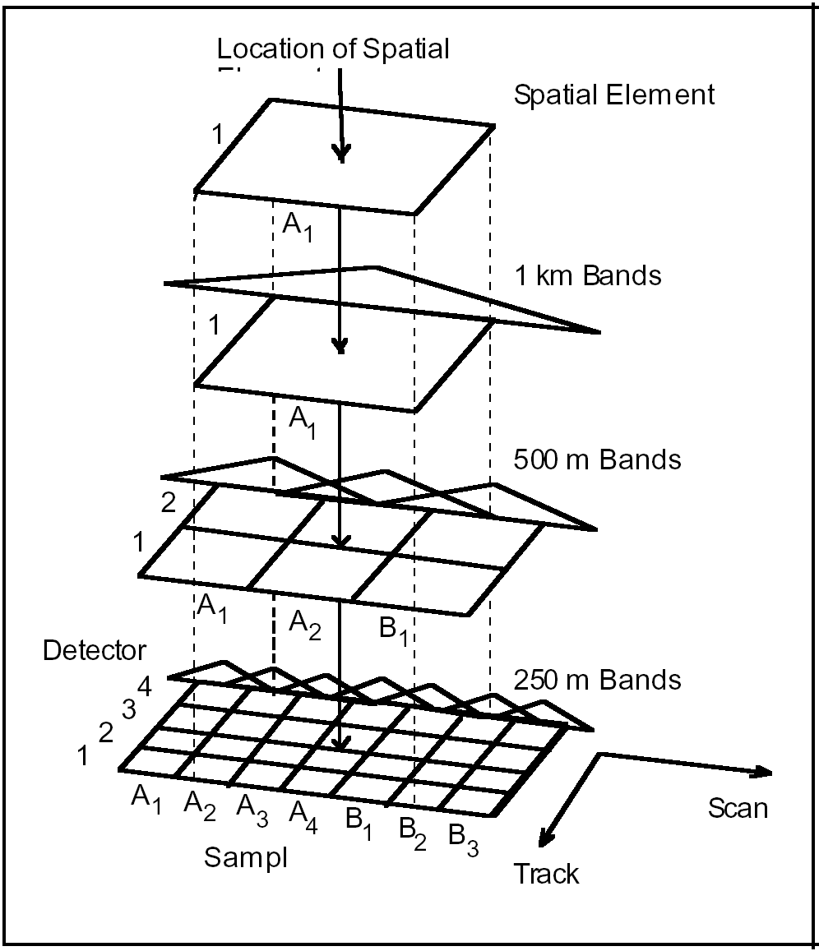
Inter-band Registration
MODIS pixel
1000 meter
500 meter
250 meter

Slide 21
Nominal MODIS inter-band registration
First 1000 m pixel
Second 1000 m pixel
Geolocation is computed here

Slide 22
MODIS Geolocation
Earth locations computed for every 1000 meter pixel (WGS84):
  Geodetic latitude (degrees, -90S to +90N)
  Geodetic longitude (degrees, -180W to +180E)
  Sensor zenith and azimuth (degrees, pixel to sensor)
  Solar zenith and azimuth (degrees, pixel to sun)
  Terrain height above geoid (meters)
  Land/Sea mask
    0: Shallow Ocean
    1: Land
    2: Ocean Coastlines and Lake Shorelines
    3: Shallow Inland Water
    4: Ephemeral (intermittent) Water
    5: Deep Inland Water
    6: Moderate or Continental Ocean
    7: Deep Ocean

Slide 23
MODIS geolocation includes terrain correction based on a digital elevation model
Line of sight to sensor
Earth location with terrain correction
Accurate to within 50 meters RMS
Earth location without terrain correction

Slide 24
MODIS Ocean Applications

Slide 25
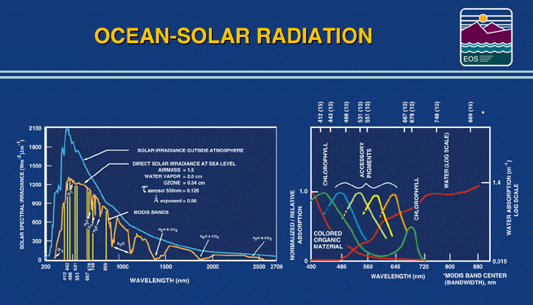
Blue
Green
Red
Notes:
For ocean applications, the MODIS team has selected several spectral bands that are on line and off line absorption features associated with chlorophyll and accessory pigments. The multispectral data will be used to reveal their respective concentrations in the ocean waters.

Slide 26
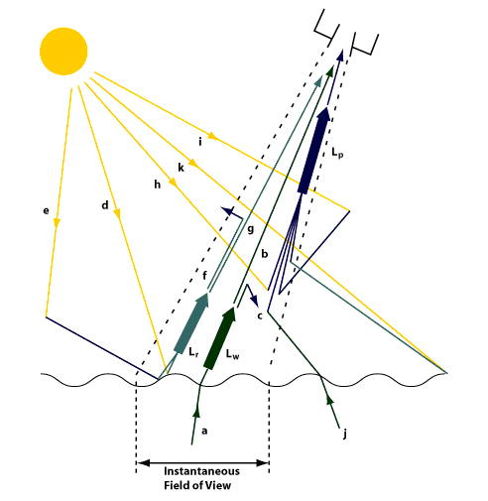
Atmospheric correction is critical for ocean color
L_{w} – only 5% of signal reaching satellite: rest due to L_{p}
L_{p} components: molecular (Rayleigh) & aerosols
Notes:
There are many pathwys via which a photon can reach the sensor. In a typical case, less than 5% of the signal received at the sensor is from the water itself. The remainder is due to scattering in the atmosphere and reflection from the ocean surface. These atmospheric conltributions to the measured radiance must be removed in order to determine the optical properties of the water.

Slide 27
MODIS Ocean Products
Geophysical Parameter Name | Description
nLw_412 | Normalized water-leaving radiance at 412 nm
nLw 443 | Normalized water-leaving radiance at 443 nm
nLw_488 | Normalized water-leaving radiance at 488 nm
nLw_531 | Normalized water-leaving radiance at 531 nm
nLw_551 | Normalized water-leaving radiance at 551 nm
nLw_667 | Normalized water-leaving radiance at 667 nm
Tau_869 | Aerosol optical thickness at 869 nm
Eps_78 | Epsilon of aerosol correction at 748 and 869 nm
Chlor_a | OC3 Chlorophyll a concentration
K490 | Diffuse attenuation coefficient at 490nm
Angstrom_531 | Angstrom coefficient, 531-869 nm
SST | Sea Surface Temperature: 11 micron
SST4 | Sea Surface Temperature: 4 micron (night only)

Slide 28
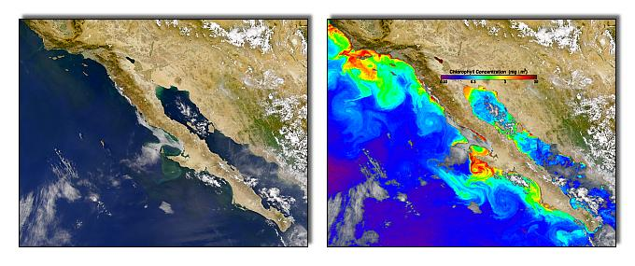
Chlorophyll
August 10, 2003
Dominant band shifts from blue to green with increasing chlorophyll concentration.
Index of the change in spectral shape ⇒ chlorophyll
Strong absorption of the blue light by phytoplankton in chlorophyll-rich waters results in low water-leaving radiance in the blue bands.
Notes:
Retrieval of chlorophyll-A relies on the change in absorption at blue and green wavelengths as a function of increasing chlorophyll.

Slide 29
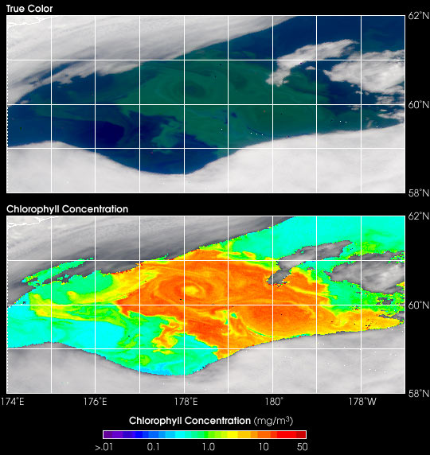
Notes:
Strong chlorophyll features may be visible in true color imagery.

Slide 30
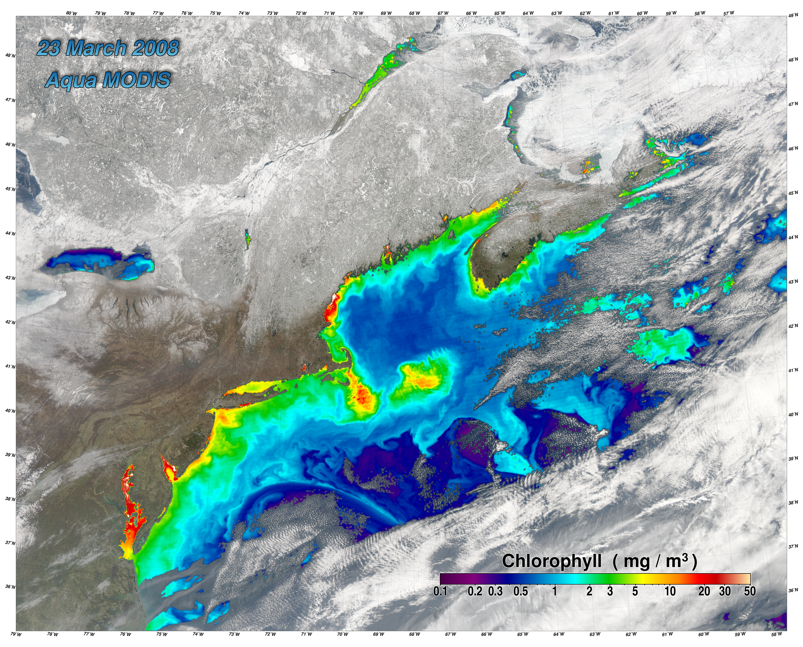
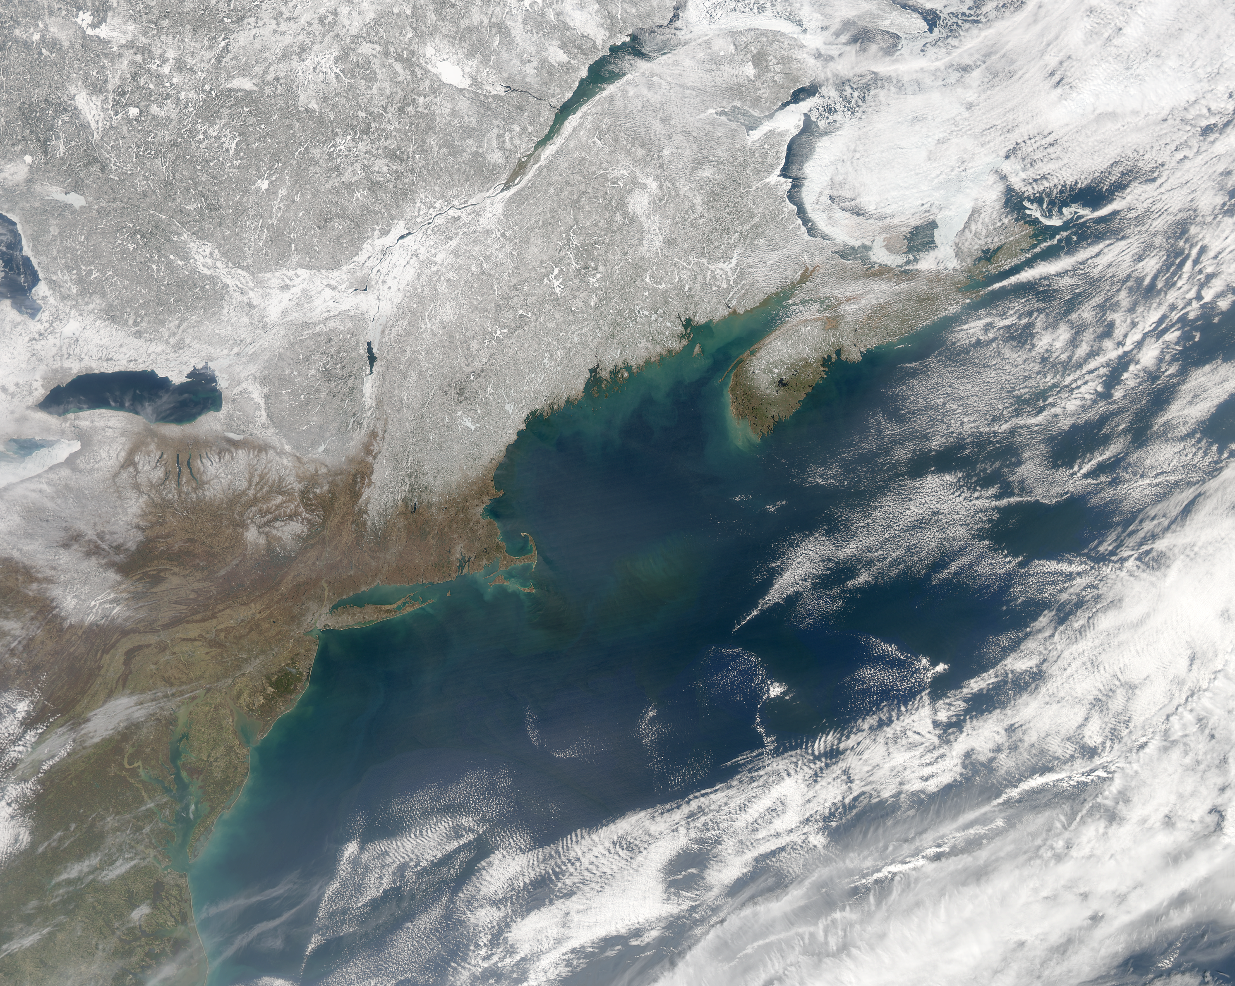
March 23, 2008 MODIS Aqua
Northeast USA and Canada
Chlorophyll concentration
True color
Notes:
But fine structure in chlorophyll concentration will only be revealed following atmospheric correction.

Slide 31
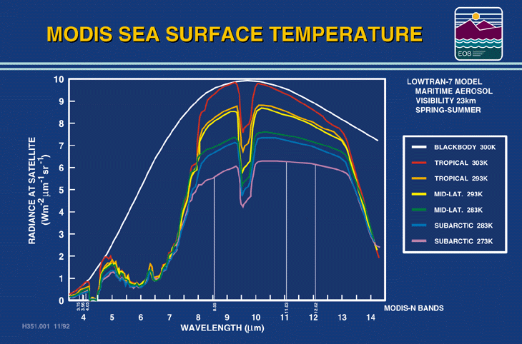
Notes:
The infrared radiance received at the satellite depends of the ocean surface temperature and emissivity, and the amount of water vapor in the atmosphere. The height of the curve indicates the surface temperature, while the difference between the 11 and 12 micron radiances indicates the amount of water vapor absoprtion (more at 12 microns than 11 microns).

Slide 32
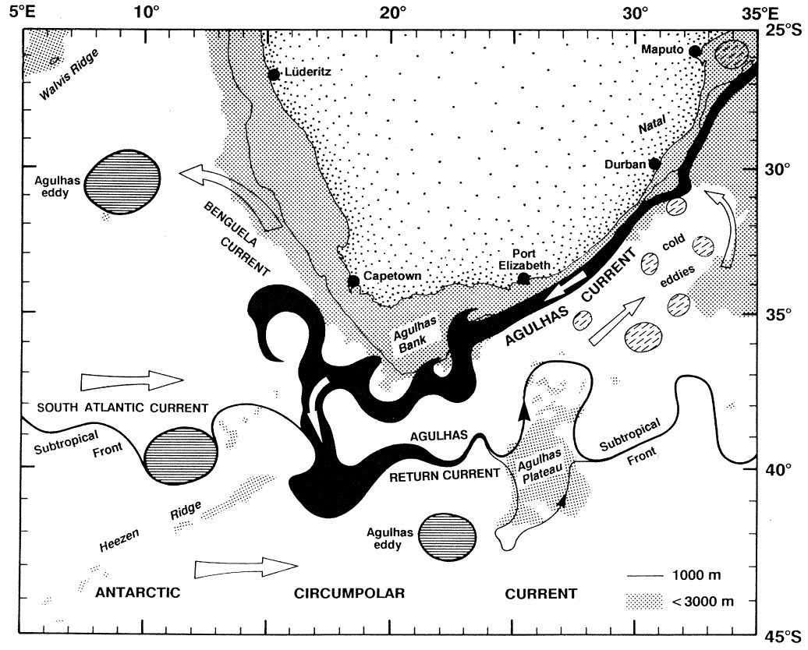
Ocean currents near Southern Africa
Peterson and Stramma, 1991
Notes:
Agulhas Current and Agulhas Retroflection (south of Africa) and associated currents and eddies (from Peterson and Stramma, 1991; after Lutjeharms and van Ballegooyen, 1988).

Slide 33
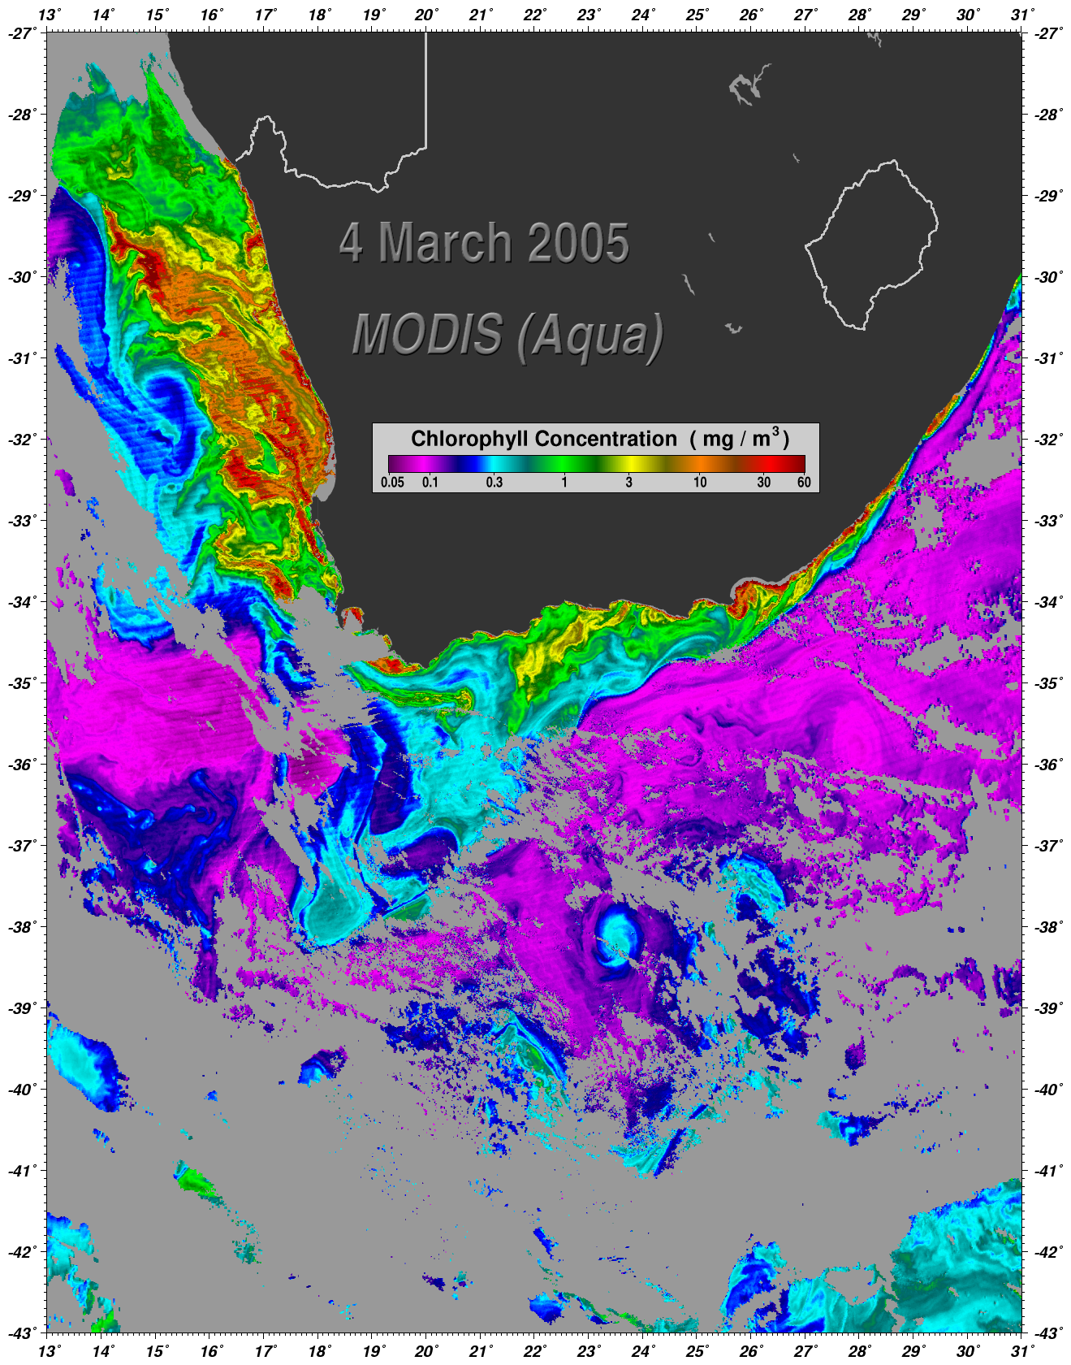
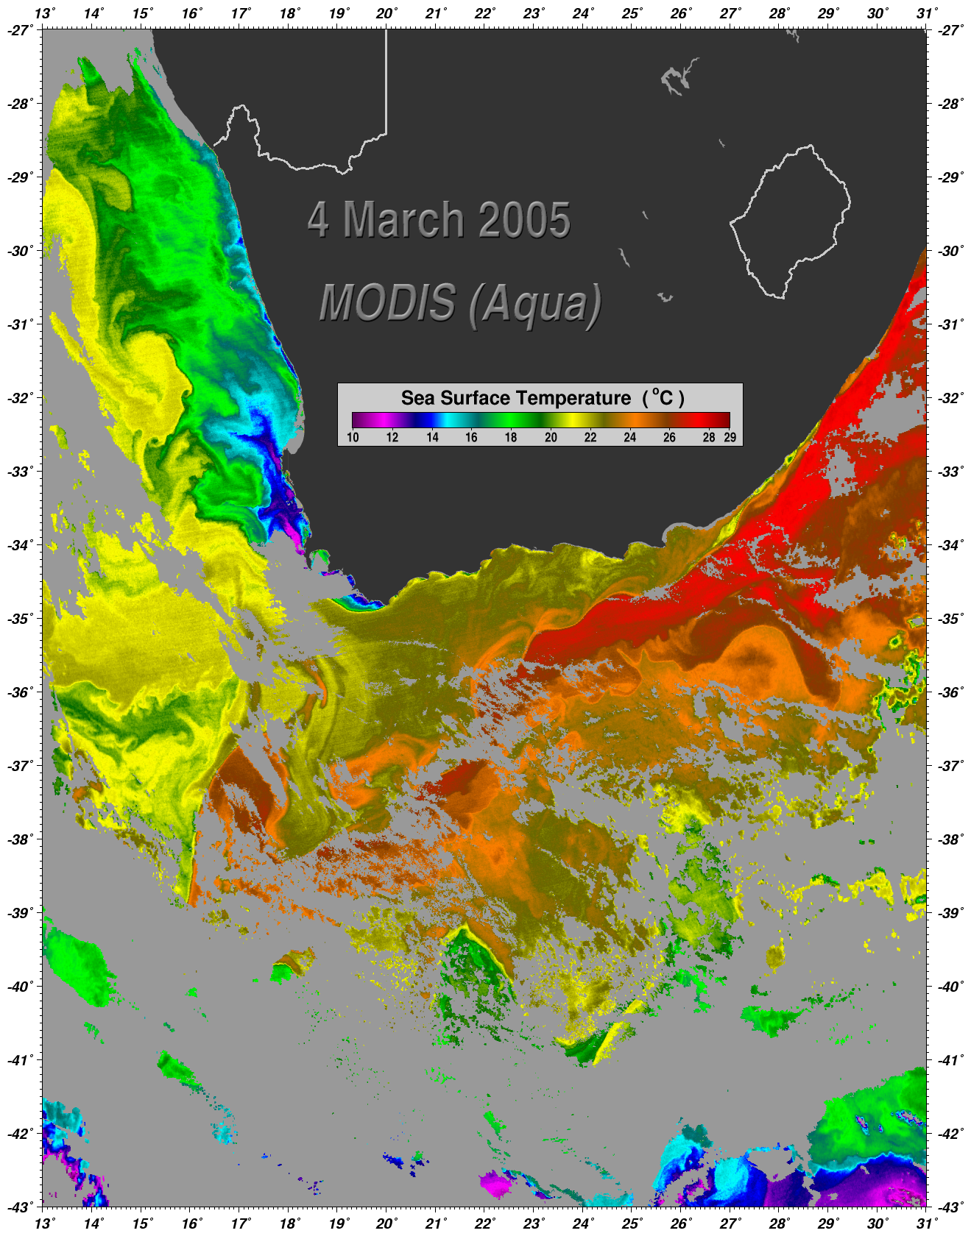
Agulhas & Benguela Currents
Notes:
In this sea surface temperature image, the Agulhas Current shows up as a tongue of warm water flowing southwest from the Indian toward the Southern Ocean. The northward flowing Benguela Current appears as a band of lower temperature along the west coast of South Africa.A corresponding chlorophyll image shows that the nutrient-poor, subtropical water in the Agulhas Current supports relatively meager populations of phytoplankton while the coastal upwelling associated with the Benguela Current supports one of the most productive phytoplankton assemblages in the world.

Slide 34
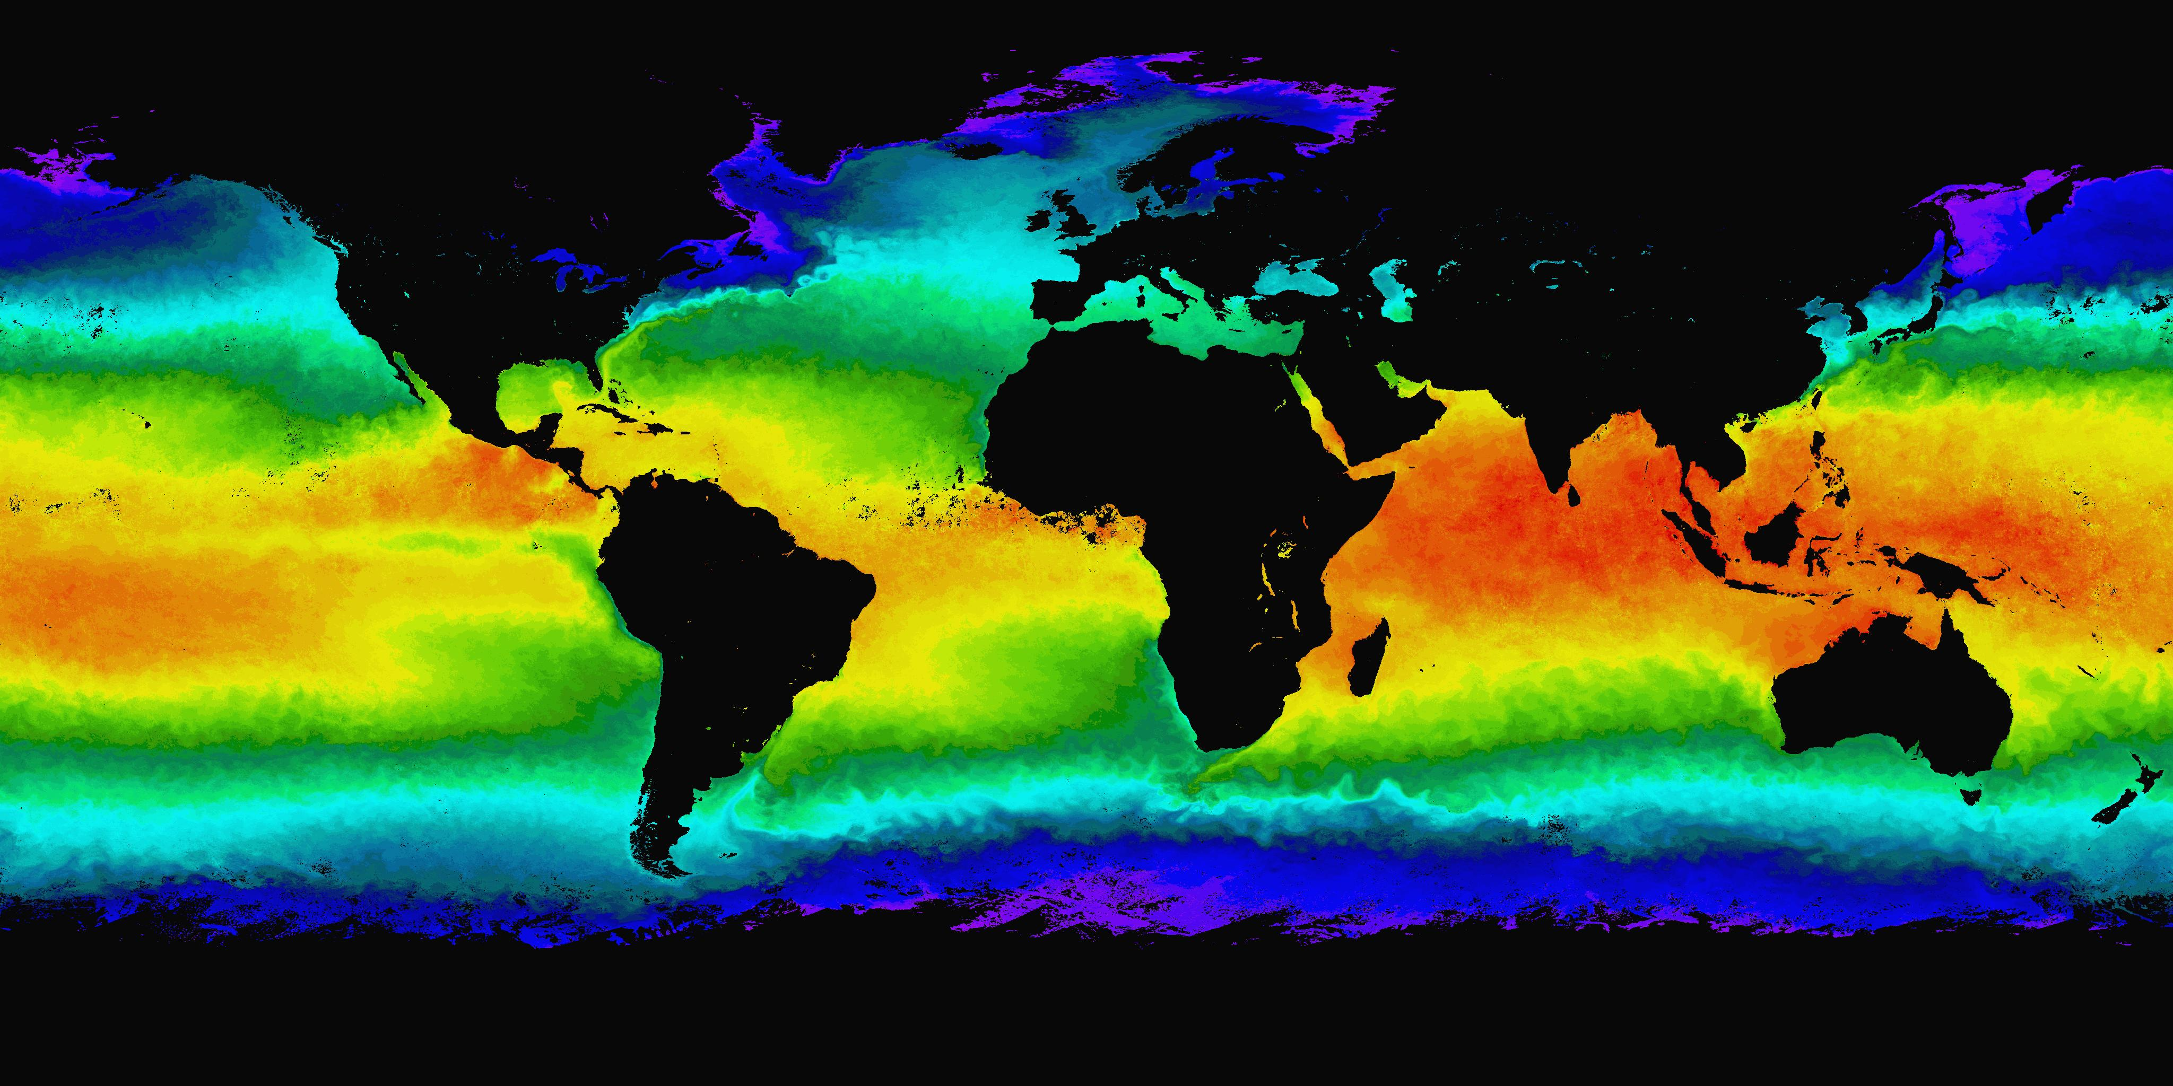

Aqua MODIS Sea Surface Temperature, April 2004
Notes:
Global composites of sea surface temperature and chlorophyll reveal the relationship between temperature and ocean productivity.

Slide 35
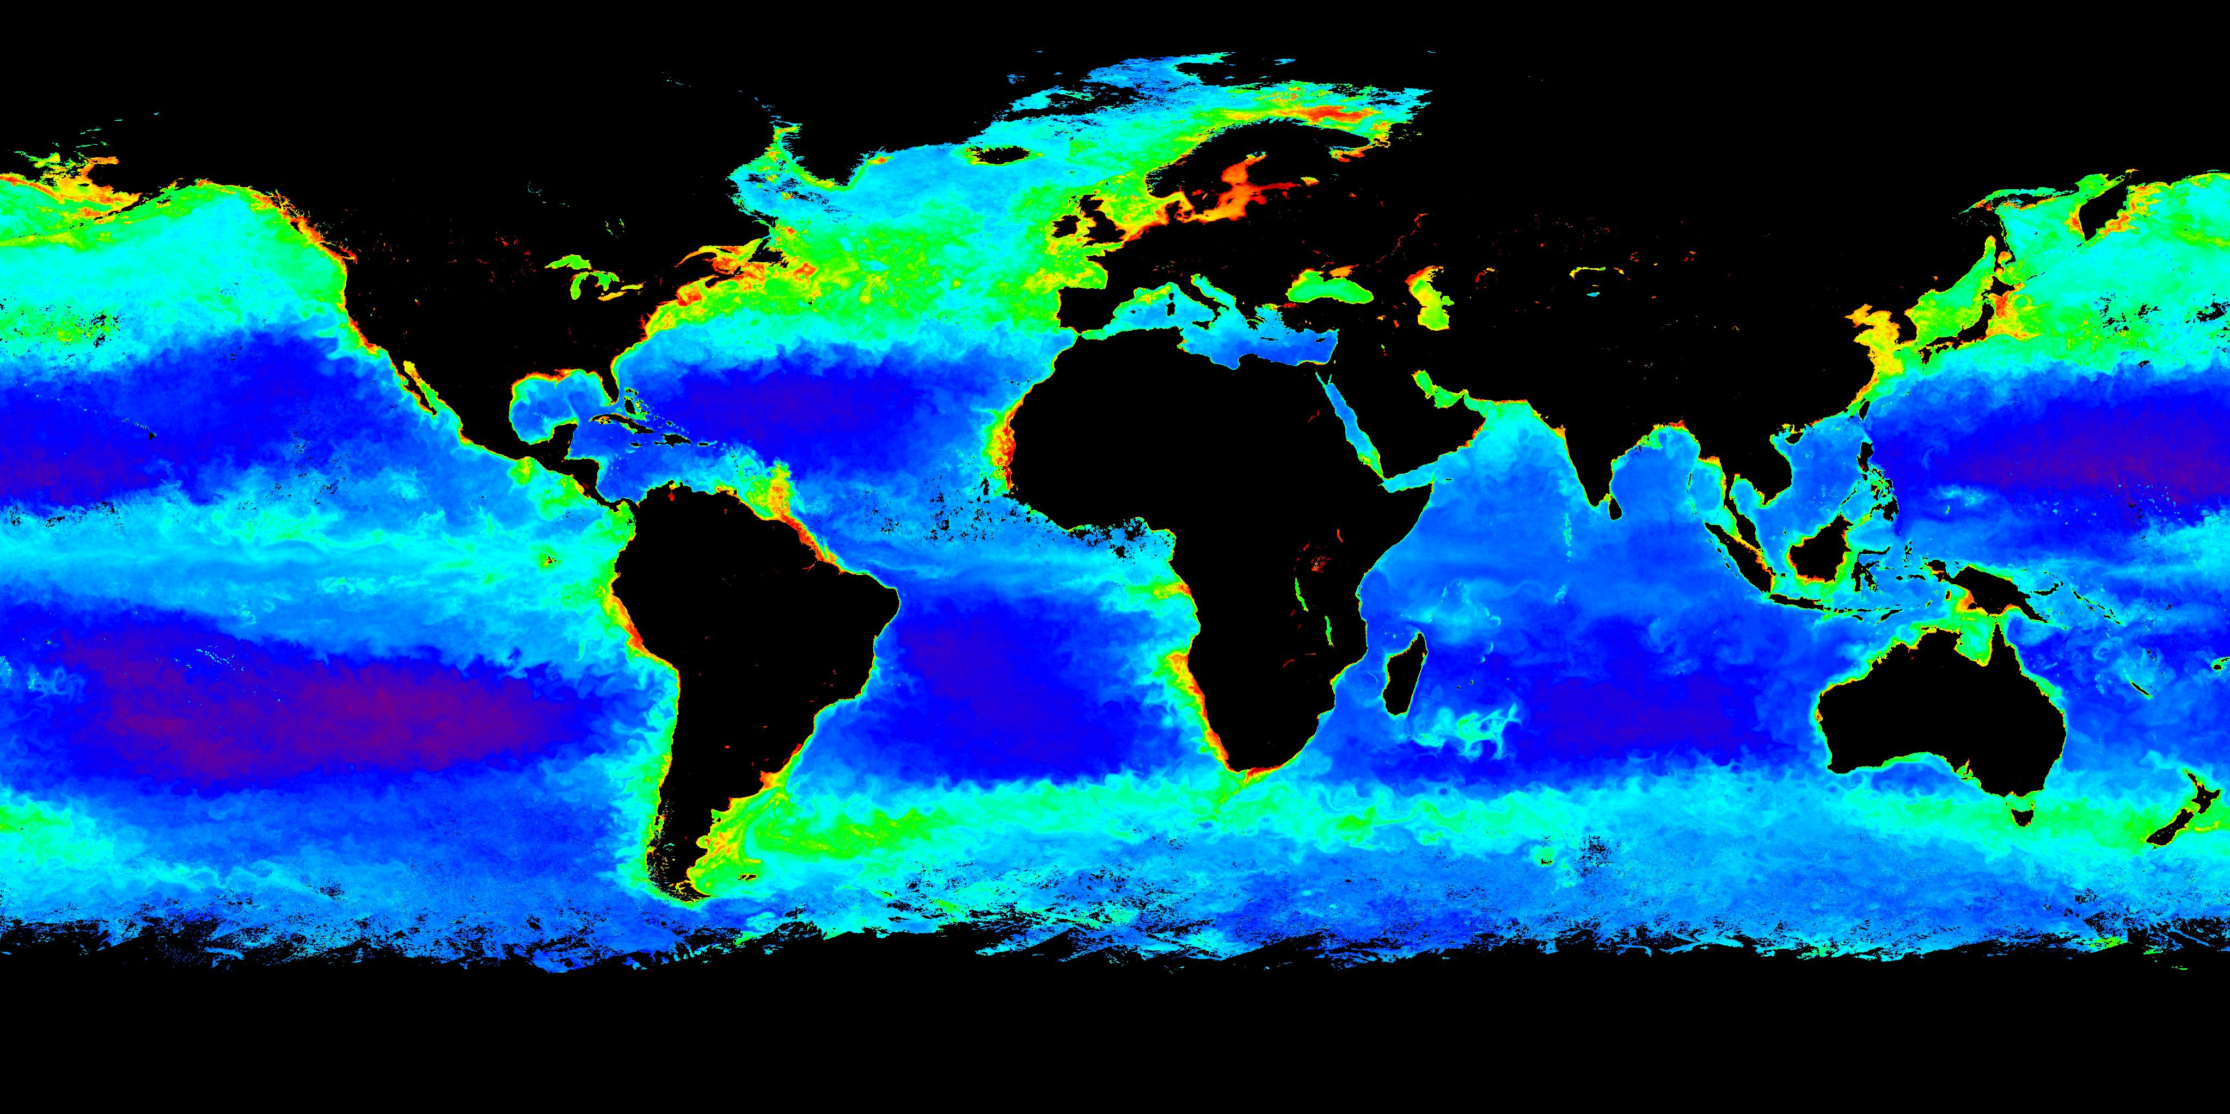

Aqua MODIS Chlorophyll Concentration, April 2004

Slide 36
MODIS Land/Surface Applications

Slide 37
MODIS Land Products
MOD 09 - Land Surface Reflectance
MOD 10 - Snow Cover
MOD 11 - Land Surface Temperature & Emissivity
MOD 12 - Land Cover/Land Cover Change
MOD 13 - Gridded Vegetation Indices (NDVI & EVI)
MOD 14 - Thermal Anomalies (Fires)
MOD 15 - Leaf Area Index & FPAR
MOD 16 - Evapotranspiration
MOD 17 - Net Photosynthesis and Primary Productivity
MOD 29 - Sea Ice Cover
MOD 43 - Nadir BRDF Adjusted Reflectance
MOD 44 - Vegetation Cover Conversion

Slide 38
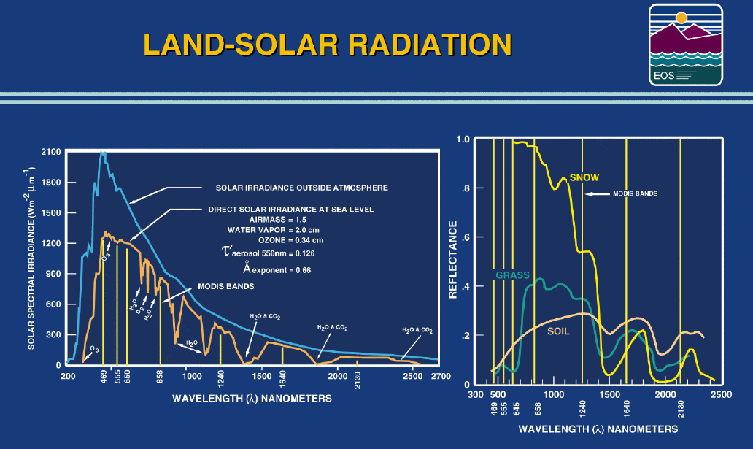
Notes:
At visible and near infrared wavelengths, surface type has a large impact on the sensed radiance and reflectance. Vegetation reflectance is low for wavelengths below 0.7 microns, and then sharply increases. Likewise, snow reflectance is high for wavelengths less than 0.9 microns, but sharply reduced at 1.6 and 2.1 microns. These reflectance changes with wavelength can be used to infer the properties of the land surface.

Slide 39
Atmospheric scattering is removed to retrieve surface properties
Top-Of-Atmosphere-Reflectance
Bottom-Of-Atmosphere-Reflectance
Terra MODIS 09/09/2003 01:27UTC 03:04UTC
Notes:
Even though surface features contribute a large part of the signal sensed over land, the contribution of the atmosphere must be removed to provide accurate characterization of the land surface, particularly when trying to detect changes (e.g., in vegetation cover).

Slide 40
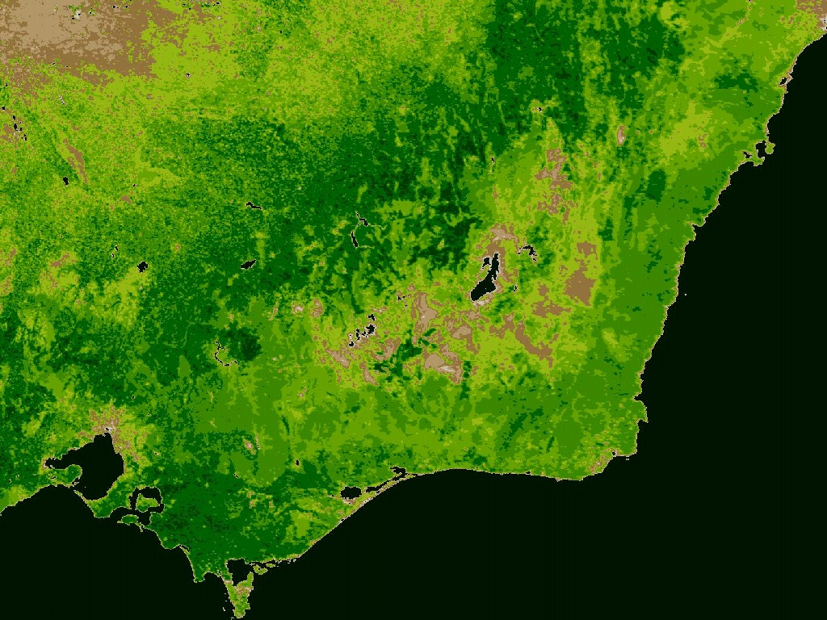
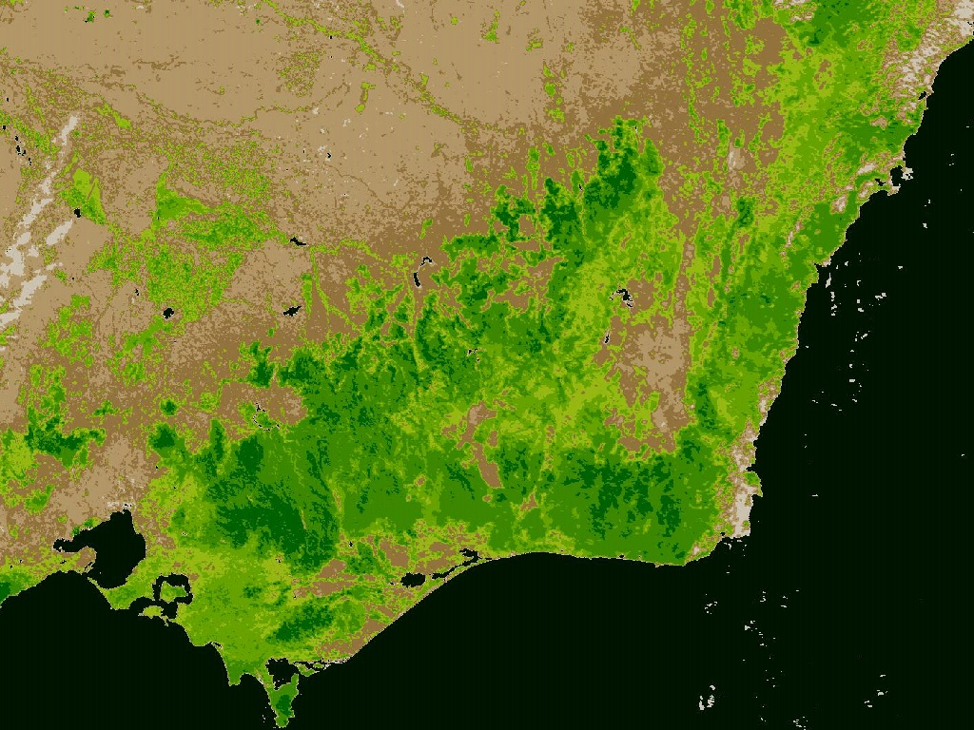
Normalized Difference Vegetation Index
South East Australia
Nov 2003
Spring
Apr 2004
Fall

Slide 41
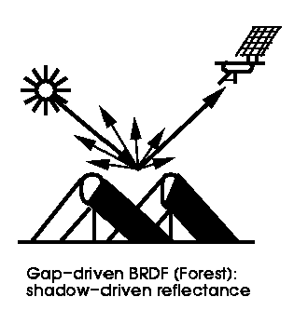
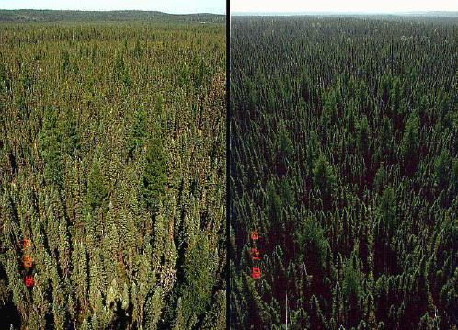
BRDF Example
Black spruce forest in Canada.
Left, looking away from the sun
Right, looking towards the sun

Slide 42
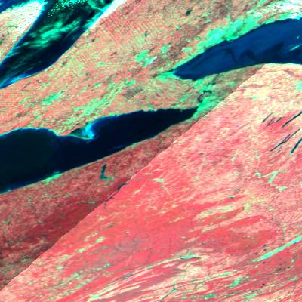
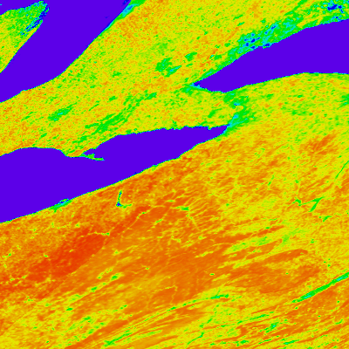
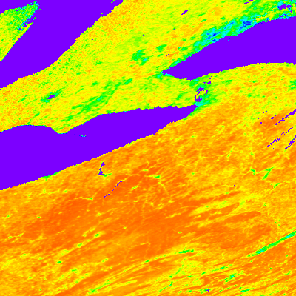

Surface Reflectance
Nadir BRDF-Adjusted Reflectance
NIR (0.10-0.45)
Red (0.0-0.1)
Green (0.0-0.15)
NDVI
0.0 1.0
Notes:
In addition, reflectance changes as a function of viewing angle must be removed for accurate change detection. In the left hand images. This is done by adjusting the reflectance to a nadir view.

Slide 43
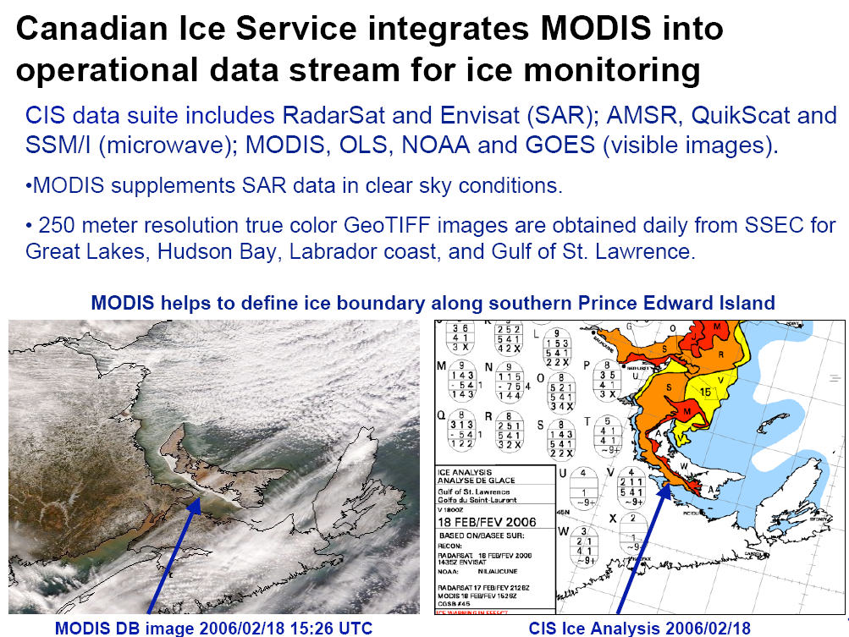
Notes:
True color imagery can also be used to identify sea ice, as seen in this example from the Canadian Ice Service. The operational MODIS algorithm for snow detection uses a normalized difference snow index (NDSI).

Slide 44
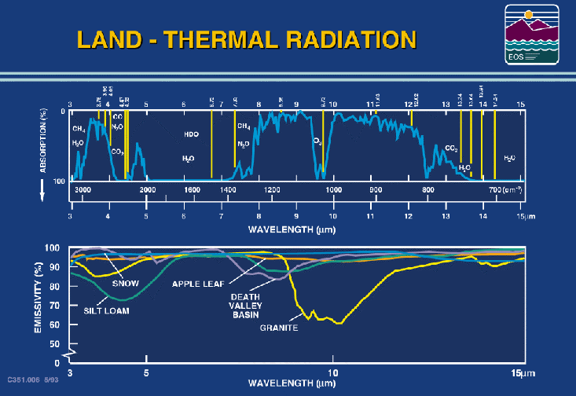
Notes:
It is important to note that the atmospheric windows are not transparent (there is some moisture absorption of radiation in the 8 to 12 um region) and that the earth surface does not exhibit blackbody behavior. These characteristics must be accounted for when using remote sensing data over land to infer temperature and moisture profiles. They are also important for mapping land surface properties. However the sensed radiance is dominated by surface temperature and emissivity over the land.

Slide 45

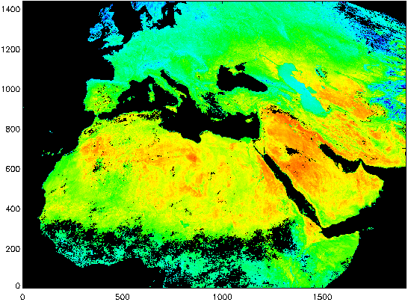
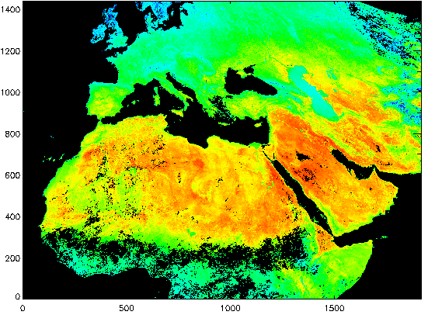
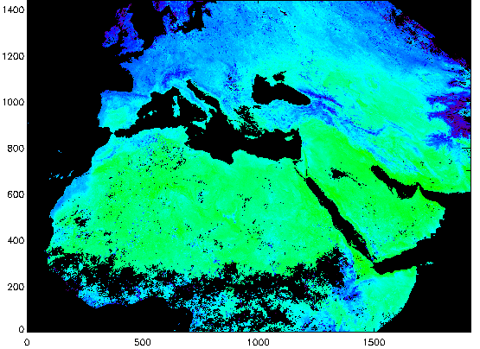
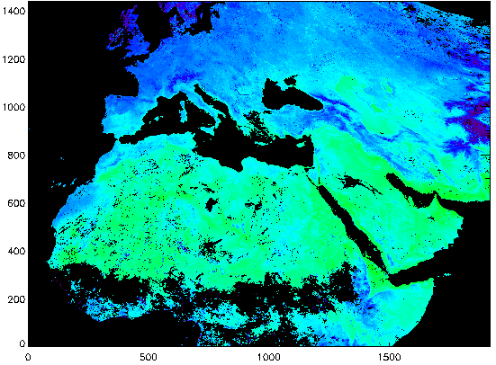

LSTs retrieved from Terra and Aqua MODIS data
on data days 176-177 and 185-190 (06/25-26 & 07/4-9)
to show spatial distribution of the diurnal variation
daytime
daytime
Terra
Aqua
nighttime
nighttime
Terra
Aqua
K
Z. Wan - 10
Notes:
In these composites from Terra and Aqua, the diurnal change in land surface temperature can be clearly seen. Note how the LST warms up in the afternoon overpasses from Aqua, and then cools down in the night passes.

Slide 46
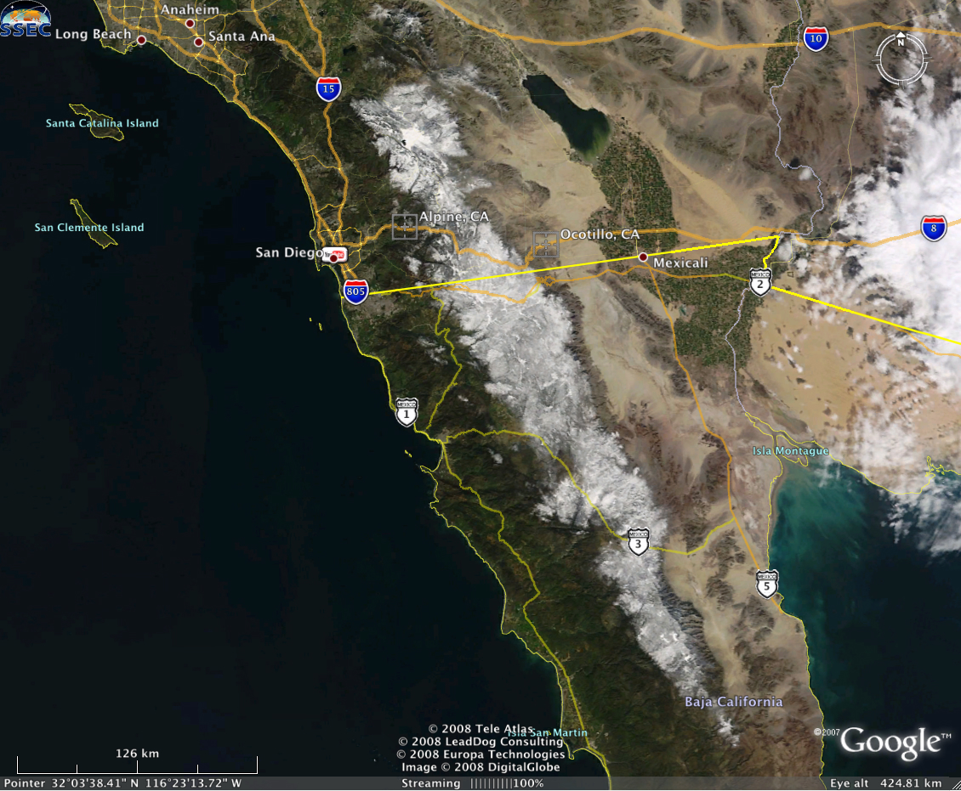
MODIS True Color

Slide 47
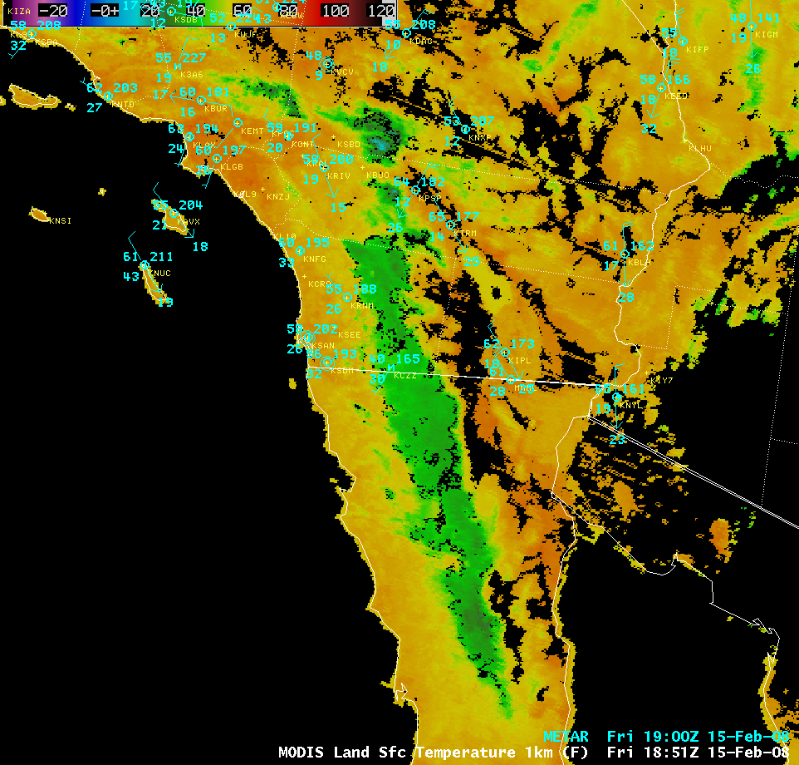
MODIS Land Surface Temperature

Slide 48
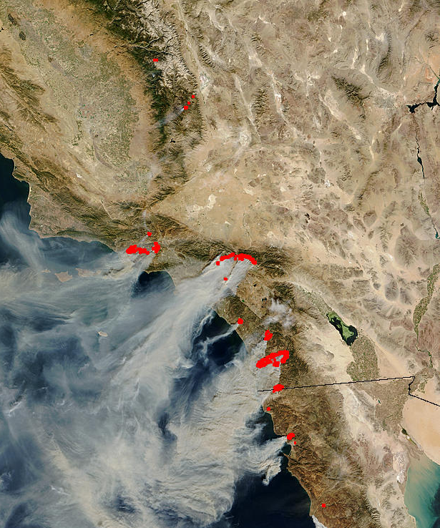
MODIS Active Fire Detection
The algorithm considers the spectral signature (in middle and thermal infrared) of each pixel and compares it to the non-burning surrounding pixels
The natural variability of the surrounding background is taken into account
Fewer false detections than traditional threshold-based algorithms
Sensitive enough to detect small fires
California – 10/26/03

Slide 49
MODIS Atmosphere Applications

Slide 50
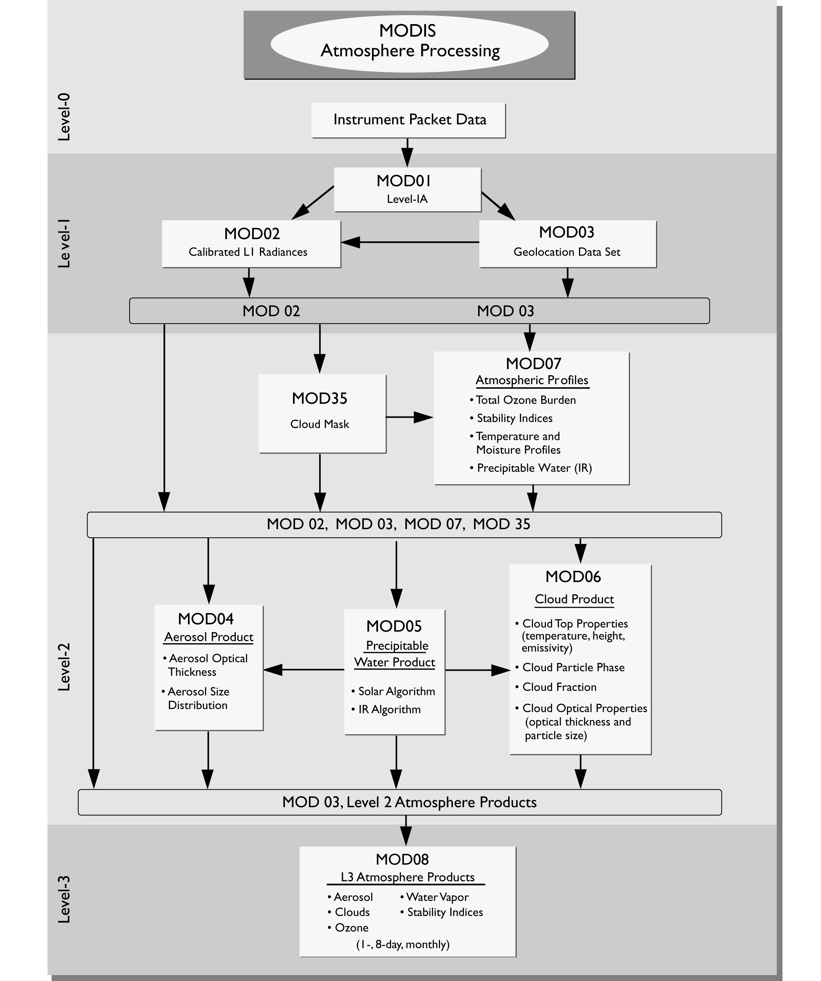
MODIS Atmosphere Product Flowchart
Notes:
This flowchart shows the relationships between the MODIS atmosphere products. Note that all of the products depend on the MODIS cloud mask.

Slide 51
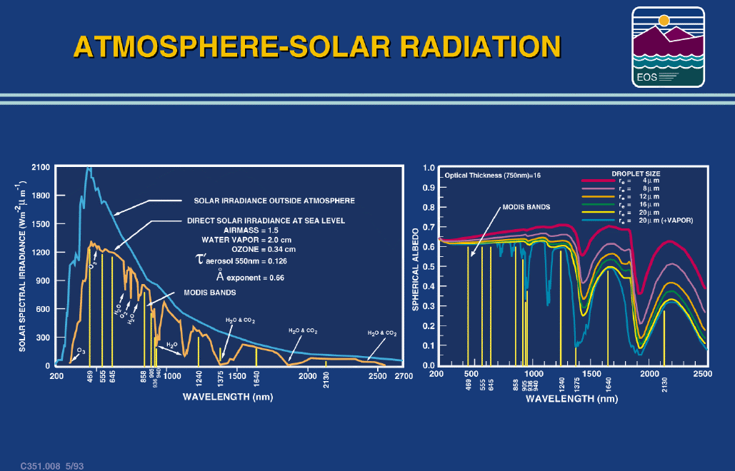
Notes:
For atmospheric applications, MODIS reflective bands can indicate particle size in clouds. Notice how the spectrum opens with increasing wavelength so that measurements at 2.1 and 0.75 um can be used to discriminate 5 to 30 um particles. Again this is a multispectral application of the MODIS data to reveal cloud and clear sky properties.

Slide 52
MODIS Cloud Mask
1 km spatial resolution day & night, (250 m day)
  19 spectral bands (0.55-13.93 µm, incl. 1.38 µm)
  11 individual spectral tests (function of 5 processing paths) combined for initial pixel confidence of clear
  temporal consistency test over ocean, desert (nighttime); spatial variability test over ocean
48 bits per pixel including individual test results and processing path
Result classes are
Confident Clear, Probably Clear, Uncertain, Cloudy
Notes:
The MODIS Cloud Mask detects the presence of cloud in each field of view (pixel). Reflected solar (daytime) and thermal emissive bands (day/night) are used in combination, depending on the surface type, to indicate the likelihood of cloud. Note that there are four result classes, not just a binary clear/cloudy decision.

Slide 53
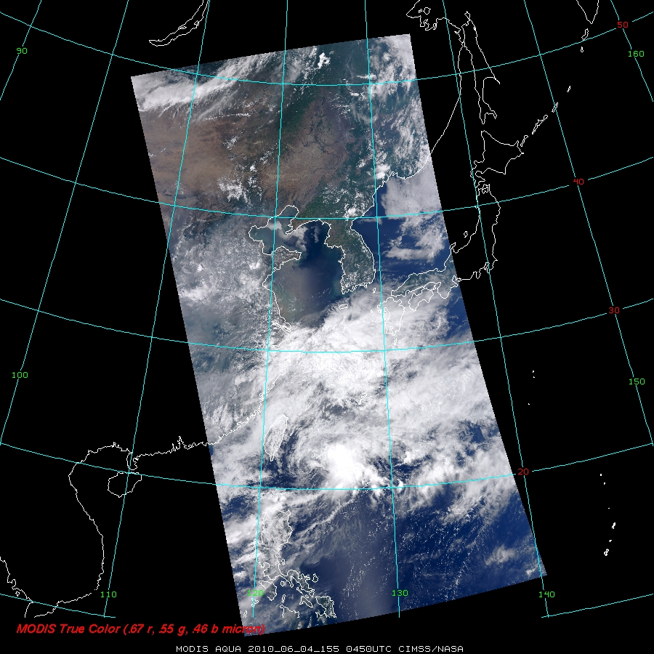
Notes:
This is

Slide 54


Slide 55

MODIS Cloud Optical Properties
MODIS observations at 0.66, 0.86, 1.6, 2.1, and 3.7 microns contain information about the cloud droplet size and optical properties.
Liquid water cloud
ocean surface
2.1 µm absorption increases with particle size, little effect at 0.86 µm
2.1 µm reflectance reaches limiting values with optical thickness
S. Platnick, ISSAOS ‘02
Notes:
In this example, a liquid water cloud over and ocean surface is simulated, and the reflectance at 1.6 microns vs. the reflectance at 0.86 microns is plotted for a range of cloud droplet sizes (effective radius). It can be seen that for small droplets, there is good sensitivity at 2.1 microns for a range of optical depths. However as the cloud droplet size increases, there is less sensitivity to changes in optical depth.

Slide 56

Monthly Mean Cloud Optical Thickness

Slide 57

Monthly Mean Cloud Effective Radius

Slide 58
MODIS Aerosol Product
Separate aerosol retrieval algorithms for land and water
Algorithm matches observed reflectances to a lookup table of precomputed reflectances for a wide variety of aerosol conditions
Over land, atmospheric and land surface reflectance are separated by estimating the surface contribution from the measured reflectance at 2.13 microns for dark targets
Final land products include aerosol optical thickness at 0.47, 0.56, and 0.65 microns at 10-km spatial resolution, and the fine mode (radius 0.6 micron) fraction of the aerosol optical thickness at 0.56 microns
Over ocean the surface contribution to the total reflectance is small and can be calculated
Retrieved aerosol products are represented by the best fits between observed reflectance and the lookup table
Ocean products include aerosol optical thickness at 0.47, 0.56, 0.65, 0.86, 1.24, 1.64, and 2.13 microns at 10-km spatial resolution, effective radius of the particle population, and fine mode fraction

Slide 59
Notes:
This is

Slide 60

Notes:
Aqua MODIS Aerosol Optical Depth from ECNU DB station on June 4, 2010

Slide 61

Monthly Mean Aerosol Optical Thickness

Slide 62

MODIS IDEA-I Product for 2010/06/04

Slide 63

Notes:
The brightness temperatures of the outgoing radiance observed by an airborne interferometer are shown along with the MODIS infrared spectral bands. The brightness temperatures generally decrease as the center of an absorption band is approached. This decrease is associated with the decrease of tropospheric temperature with altitude. Near about 690 cm⁻¹, the temperature shows a minimum which is related to the colder tropopause. On the basis of the sounding principle already discussed, the MODIS team selected a set of sounding wave numbers such that a temperature layers in the troposphere can be described. The arrows indicate the selection. The associated weighting functions are also shown revealing that the radiation is coming from broad overlapping layers, helping to confound the inversion problem from multispectral radiance measurements to temperature profile.

Slide 64


Four Panel Zoom of Cloud-Free Orographic Waves
revealed in Water Vapor Imagery
Notes:
These events (mountain waves and gravity waves were detected in clear skies.

Slide 65
Aqua MODIS True Color Image: 2010/06/04
Note land, ocean, and sunglint surfaces, and mix of high clouds, low clouds, and fog.
Notes:
The MODIS Cloud Top Pressure product is generated by a physical algorithm based on ratios of radiance observations in the longwave infrared, where the atmosphere becomes more opaque at longer wavelengths due to CO2 absorption.

Slide 66
MODIS Cloud Mask Product (MOD35)
Clear and Cloudy Sky (everywhere)
Day/Night
1 km resolution
Fuzzy logic spectral tests
Notes:
The MODIS Cloud Top Pressure product is generated by a physical algorithm based on ratios of radiance observations in the longwave infrared, where the atmosphere becomes more opaque at longer wavelengths due to CO2 absorption.

Slide 67

MODIS Cloud Top Pressure Product (MOD06)
Cloudy Sky Only
Day/Night
5 x 5 km resolution
CO₂ slicing algorithm
Notes:
The MODIS Cloud Top Pressure product is generated by a physical algorithm based on ratios of radiance observations in the longwave infrared, where the atmosphere becomes more opaque at longer wavelengths due to CO2 absorption.

Slide 68

MODIS Cloud Phase Product (MOD06)
Cloudy Sky Only
Day/Night
5 x 5 km resolution
Threshold Algorithm
Notes:
The MODIS Cloud Phase product is generated by a threshold algorithm based on modeled effects of cloud phase on 8.5, 11, and 12 micron brightness temperatures, where the change in refractive index of ice vs. water creates larger brightness temperature differences.

Slide 69

MODIS Water Vapor Product (MOD07)
Clear Sky Only
Day/Night
5 x 5 km resolution
Statistical Algorithm
Notes:
The MODIS infrared total water vapor retrieval is done by a statistical algorithm that has been trained by a global database of quality controlled radiosondes.

Slide 70





MODIS Cloud Top Properties Level 3 Products March 2004
Notes:
Global statistics of MODIS cloud properties help to reveal information about the presence of optically thick high and low clouds, and also the presence of optically thin high clouds, both of which may be important indicators of climate change. The scientific community is still debating whether there are long term changes in cloudiness.

Slide 71
End of Part One

