Slide 1


Using water vapor measurements from hyperspectral advanced IR sounder (AIRS) for tropical cyclone forecast
Jun Li@, Hui Liu#, Jinlong Li@, and Tim Schmit&
UW-Madison

Slide 2
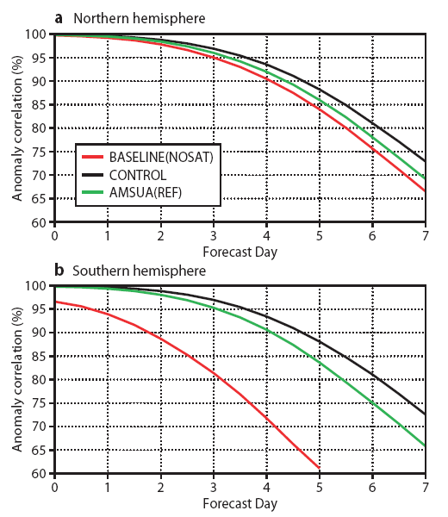
Impact of Satellite Data
2007 ECMWF Numerical Weather forecasting system
Currently most important
NWP instruments at ECMWF
- Advanced infrared sounders
- Microwave sounders/imagers
- GPS transmitters/receivers
- GEO IR imagers/sounders
- Scatterometers
- UV/VIS/IR spectrometers
3/4 day
3 days
from Peter Bauer, ECMWF, 9/2009
2
Notes:
500 hPa geopotential height anomaly correlation

Slide 3

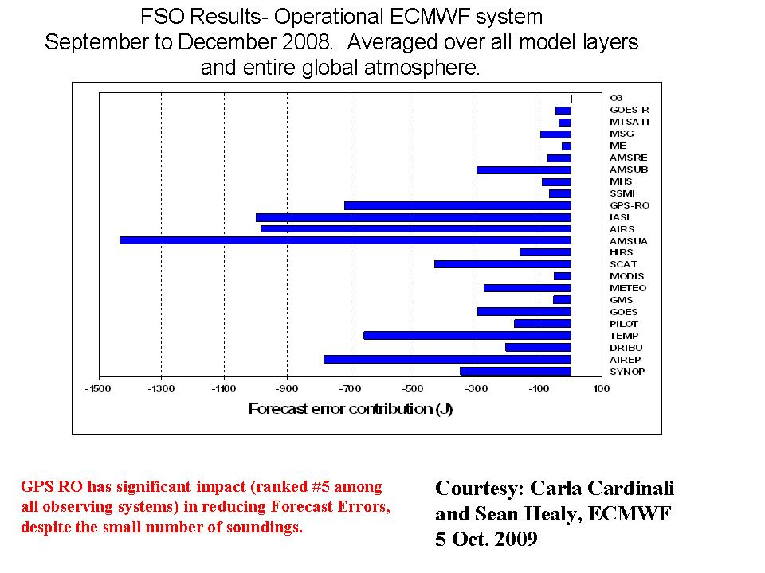
AIRS+IASI contribute to 23.8% error reduction
4 AMSU-A contribute to 17.2% error reduction
RAOBs contribute to 7.9% error reduction
The order of the top five and their contribution to error reduction is:
AMSU-A (4 satellites) 17.2%
IASI (one satellite) 12.0%
AIRS (one satellite) 11.8%
AIRREP (aircraft temperature and winds) 9.3%
GPSRO (bending angles) 8.5%
TEMP (radiosonde winds, humidity, and temperatures) 7.9%
QuikSCAT (scatterometer surface winds over the oceans) 5.2%
3
3

Slide 4
Pre-convection environment for Zhou Qu storm
The Zhou Qu storm (7 – 8 August 2010) caused 1435 death, and 435 missing according report of Xinhua News.
Weather briefing：From 10 UTC on 07 August to 00 UTC on 08 August 2010, severe storm brought heavy local precipitation to Zhou Qu county, Gansu Province in China，the maximum rain rate is 77.3 mm.

Slide 5
AIRS full spatial resolution for Zhou Qu storm
AIRS full spatial resolution soundings are derived with CIMSS hyperspectral IR sounding retrieval (CHISR) algorithm
AIRS (SFOV soundings) detected atmospheric instability for storm development 5.5 hours before the storm development for Zhou Qu case
Atmospheric lifted index (LI) is used to indicate the atmospheric instability

Slide 6
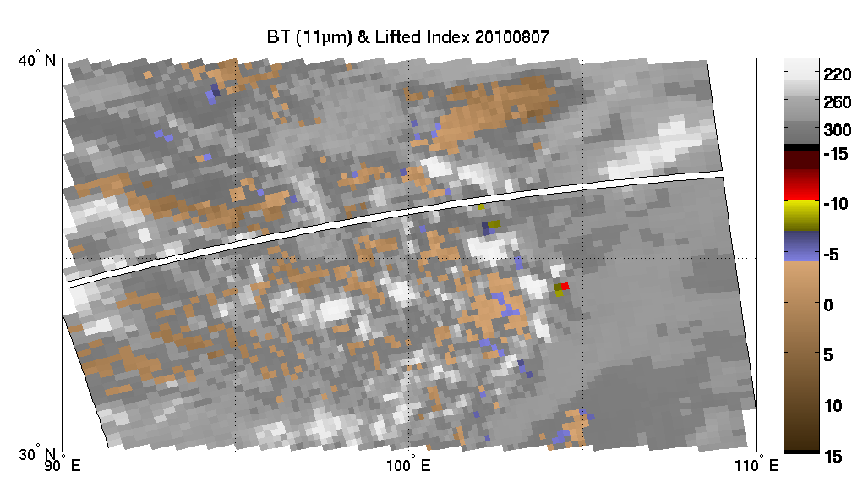
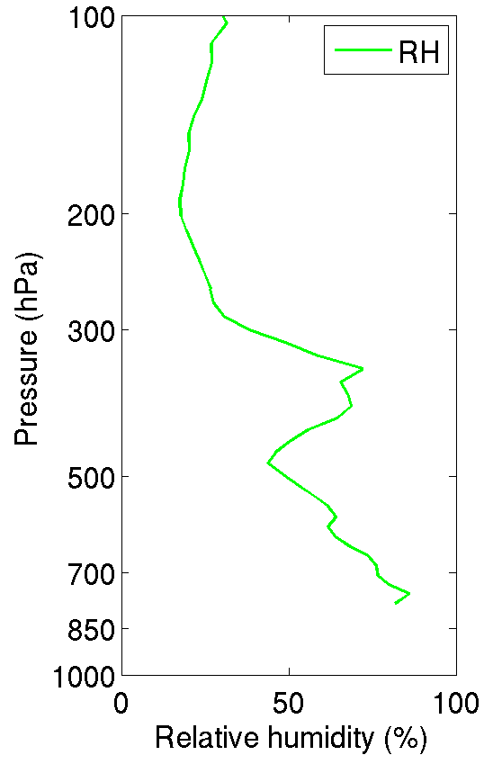
LI = T500 – Taa
  0< LI → stable
  -3< LI <0 → marginally unstable
  -6< LI <-3 → moderately unstable
  -9< LI <-6 → very unstable
  LI <-9 → extreme instability
AIRS (SFOV soundings) detected atmospheric instability for Zhou Qu storm 5.5 hours pre-convection
Lat=34.19; Lon=104.41
0635UTC on 07 August 2010 (storm starts 12 UTC on 07 August 2010)

Slide 7
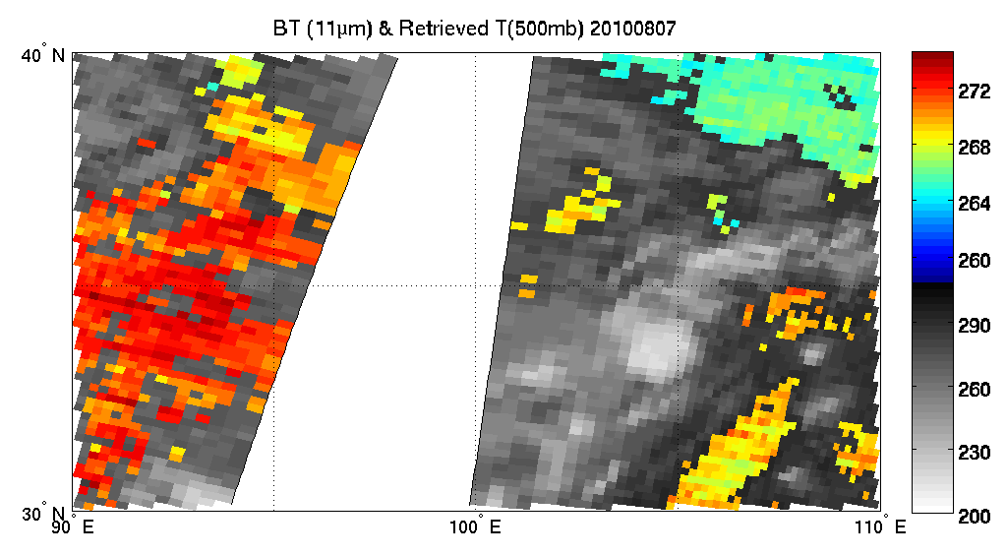
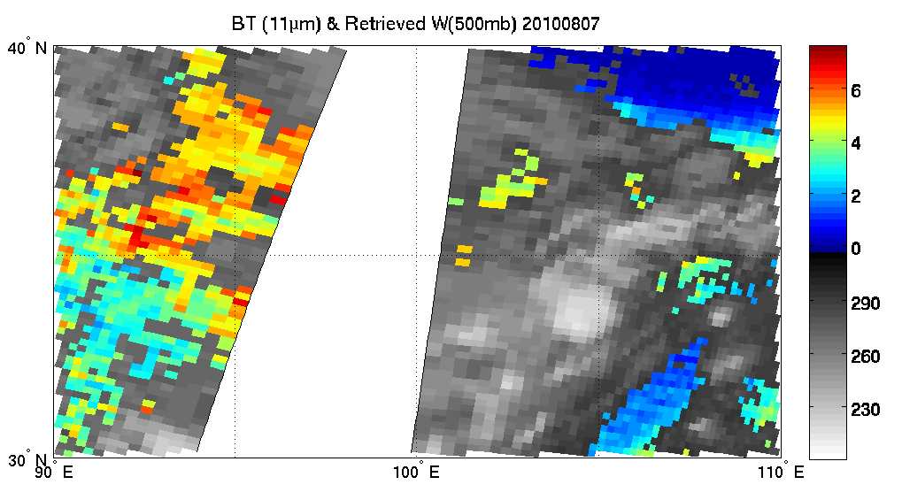
(K)
Cold and dry air
Zhou Qu storm
Warm and moist air
AIRS SFOV 500 hPa temperature (K)
1840 UTC
07 August
2010
2015 UTC
07 August
2010
(g/kg)
AIRS SFOV 500 hPa water vapor mixing ratio (g/kg)
(K)

Slide 8
Using full spatial resolution hyperspectral IR water vapor profiles for tropical cyclone forecast
Better use of water vapor measurements in global NWP satellites remains challenge (ΔR is always favorable for ΔT, not Δq)
Full spatial resolution water vapor profiles in environmental region is critical for tropical cyclone forecast with a high resolution regional NWP model
CIMSS Hyperspectral IR Sounding Retrieval (CHISR) algorithm has been develop for full spatial resolution temperature and moisture soundings from AIRS and IASI
Forecast of various hurricanes and typhoons using advanced full spatial resolution IR soundings is studied with NCAR WRF/DART system

Slide 9
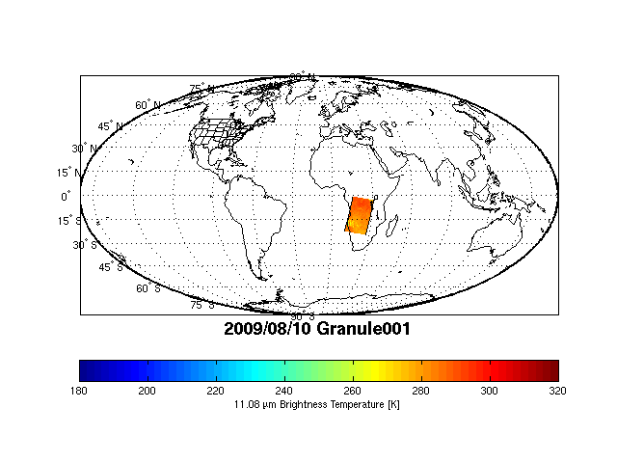
Atmospheric InfraRed Sounder (AIRS) spatial coverage

Slide 10
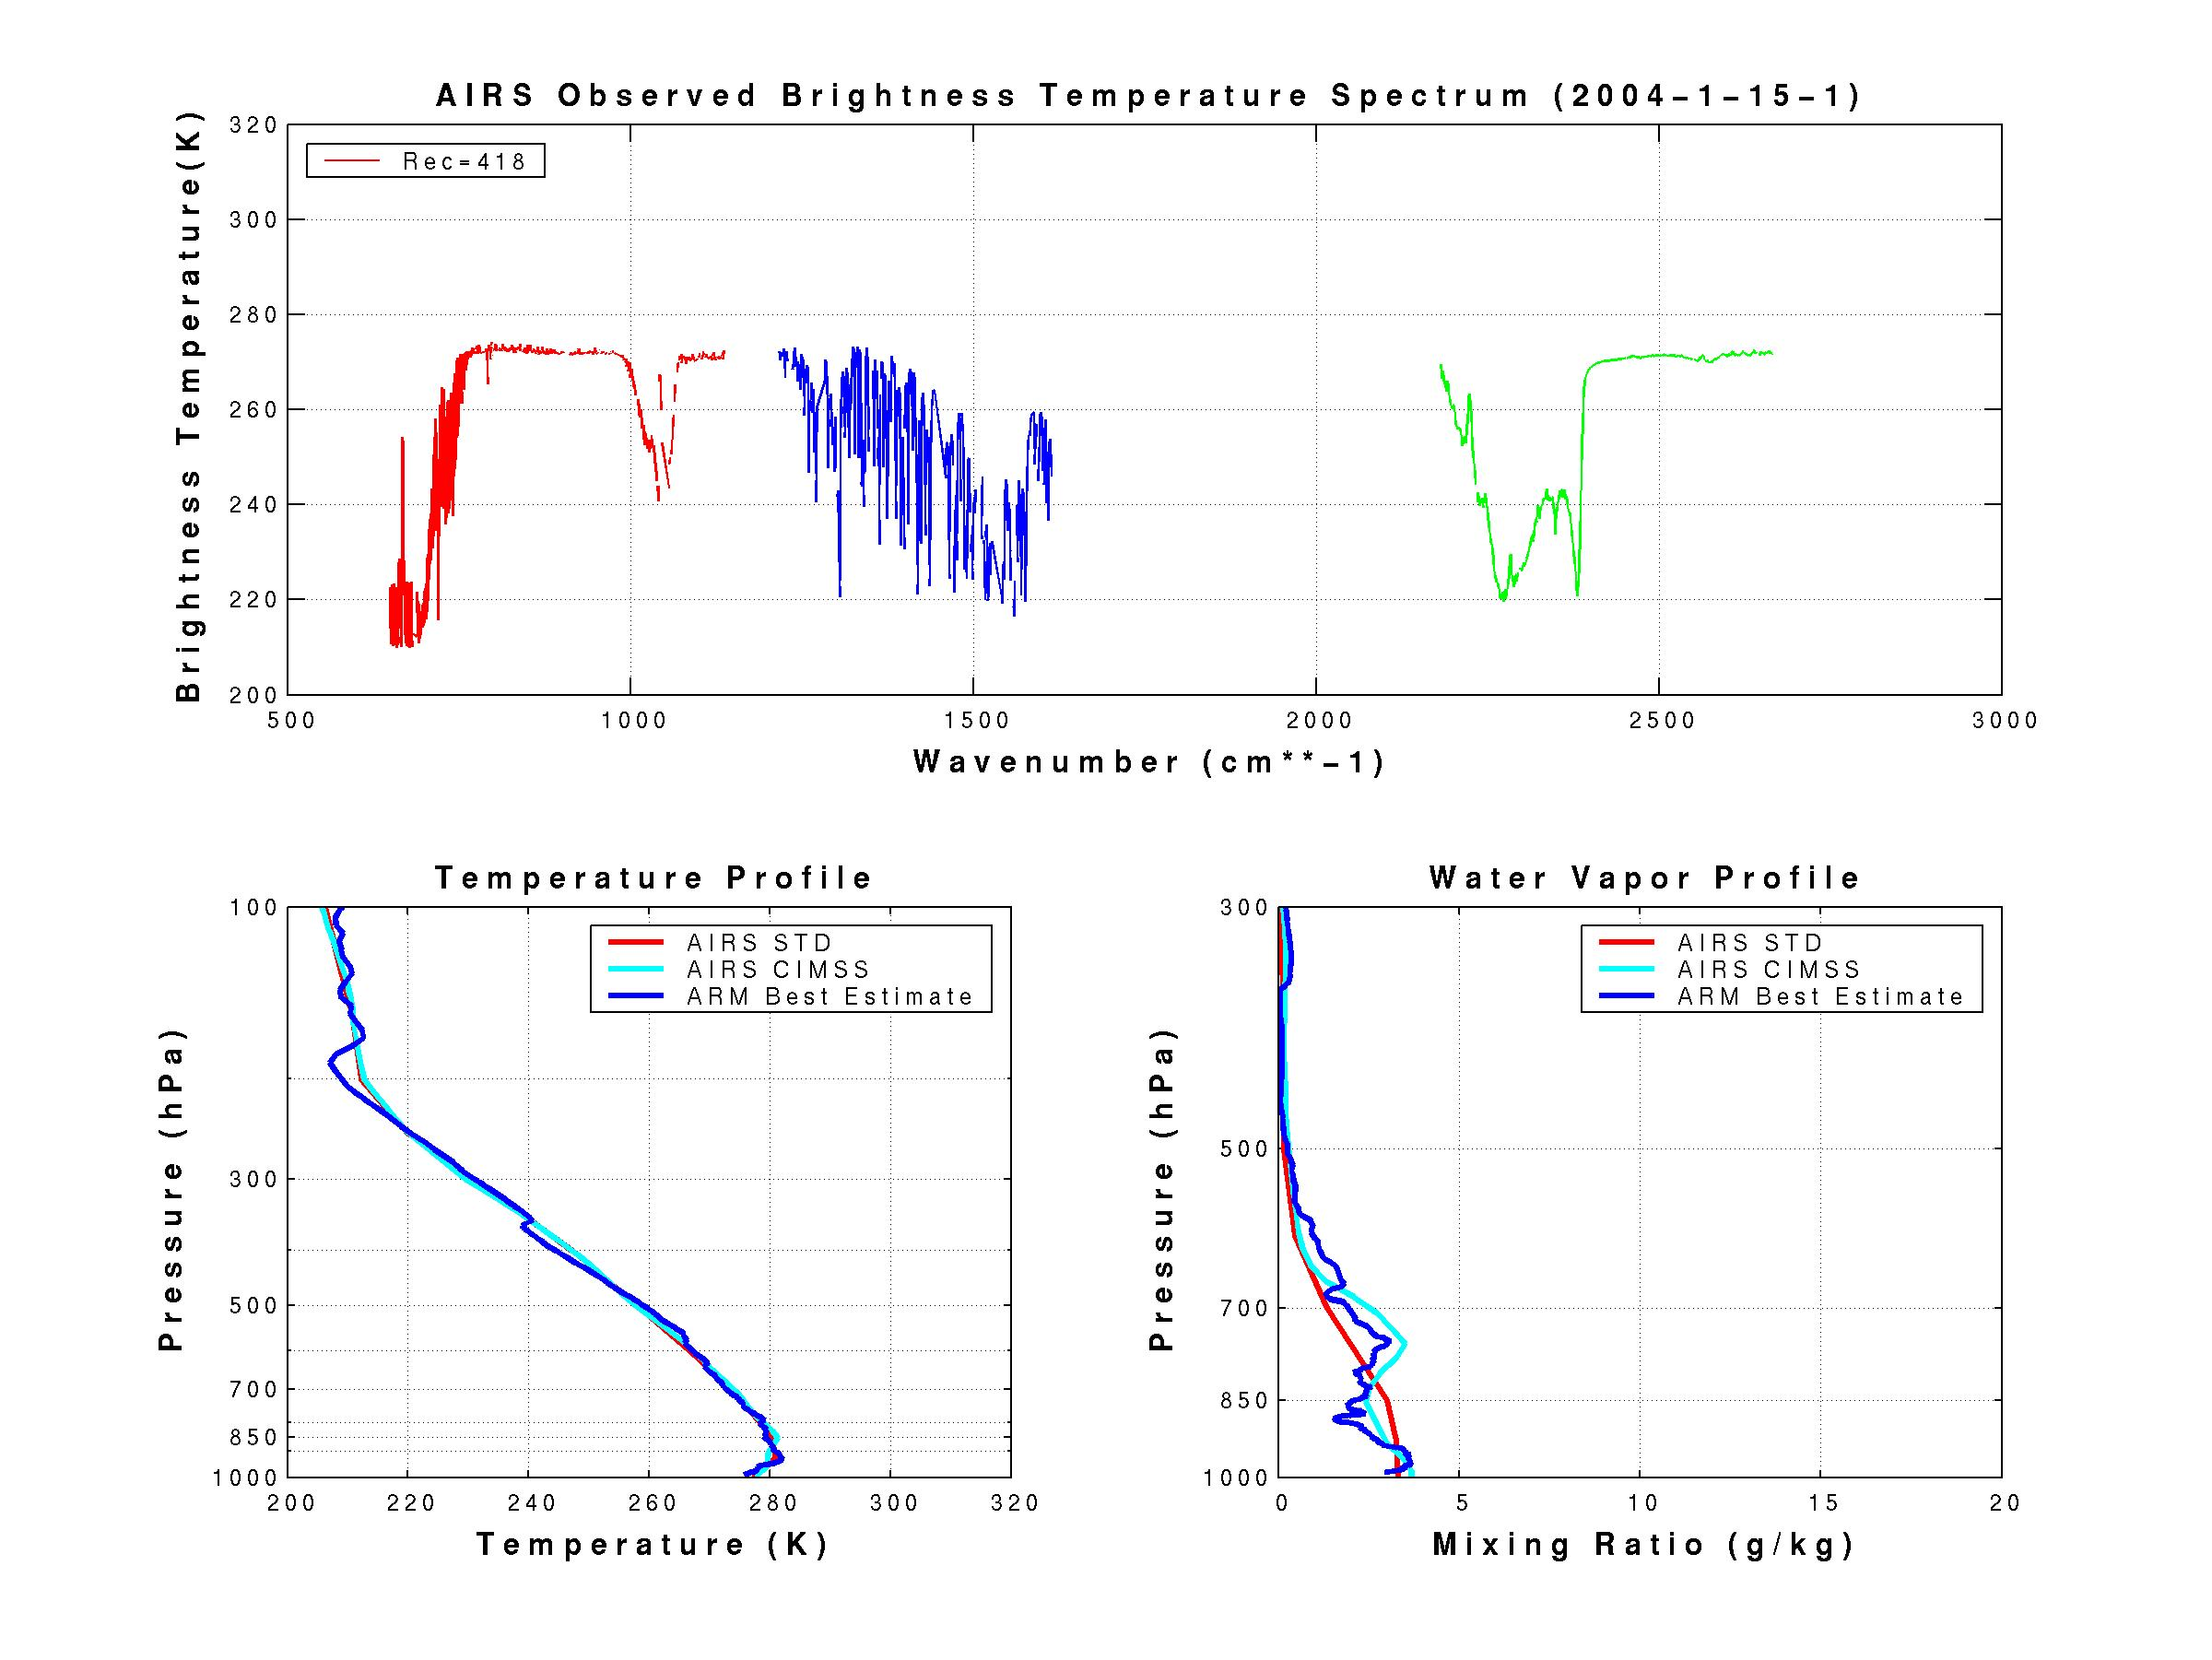
AIRS proofs hyperspectral sounding capability
AIRS resolves absorption features in atmospheric windows enabling detection of temperature inversions – warming with height evident from spikes up
Guess
CIMSS Physical
Guess
CIMSS Physical
Inversion
Li et al, 2006
Notes:
Monitoring capping inversion and cell top height critical for estimating storm development and likely storm intensity – if cell top is higher and drier uncapped moisture can rise rapidly without a low ceiling (e.g. stratosphere is stable area

Slide 11
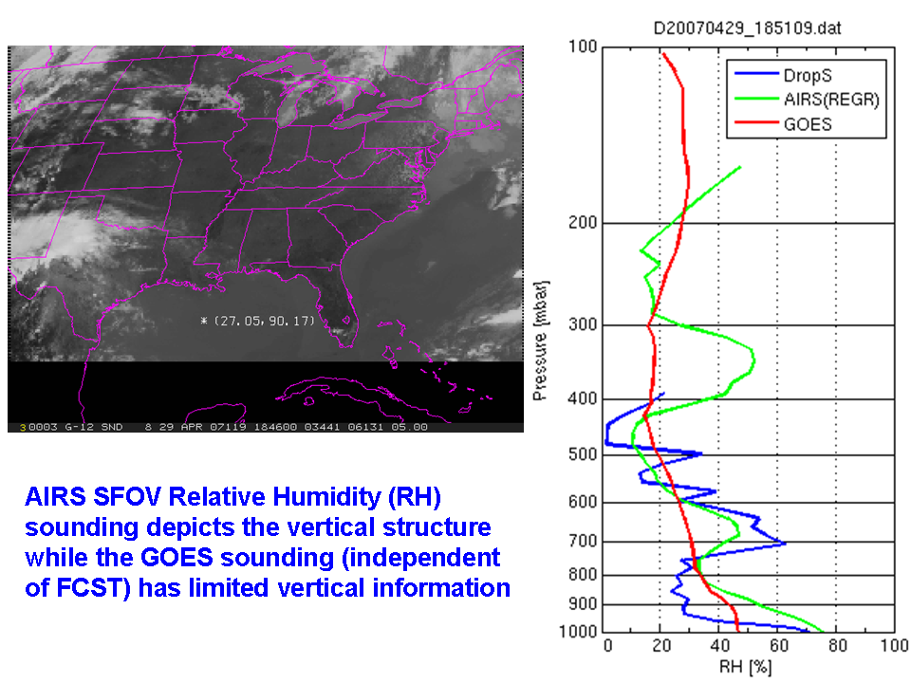

Slide 12
AIRS full spatial resolution soundings used for hurricane and typhoon forecast
~10 AIRS granules over the regional WRF domain
Full spatial resolution AIRS soundings (13.5 km at nadir) are derived using CHISR algorithm
Clear sky only soundings are used
Ensemble assimilation of AIRS soundings followed by ensemble forecast (36 km resolution)
  CTL run: Assimilate radiosonde, satellite cloud winds, QuikSCAT winds, aircraft data, COSMIC GPS refractivity, ship, and land surface data.
  Assimilation run: Same as CTL run plus AIRS full spatial resolution T and Q soundings

Slide 13
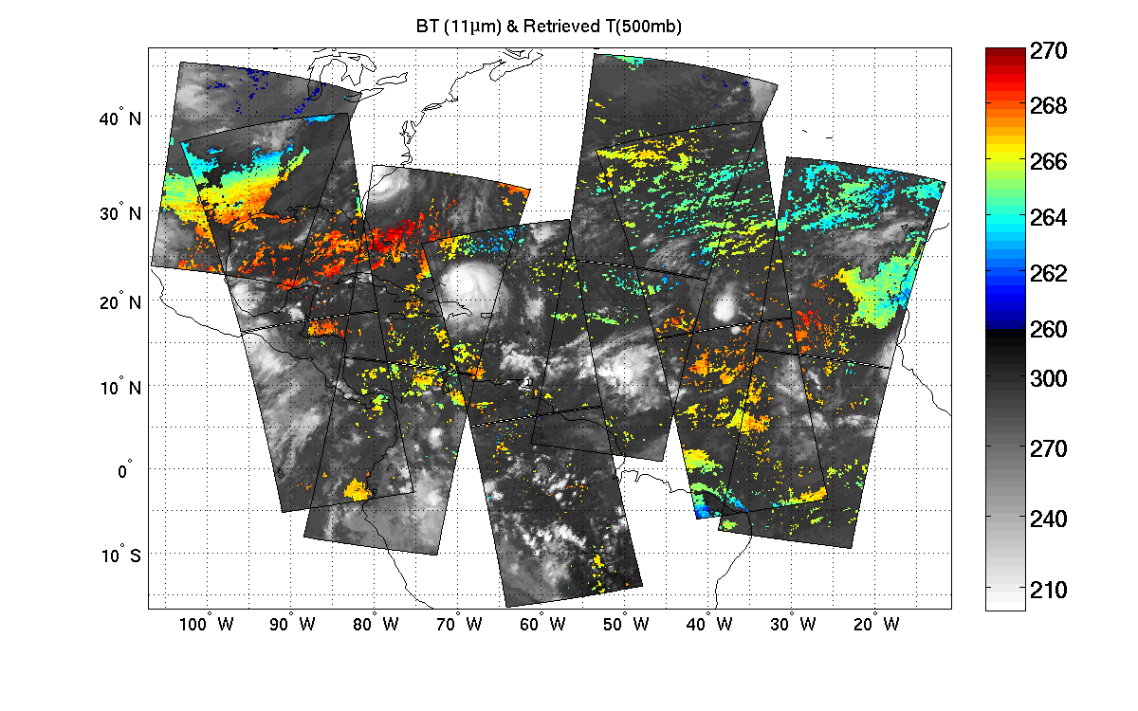
Hurricane Ike (2008) case: Retrieved 500mb temperature 2008.09.06 – Used in assimilation)
(K)
CIMSS/UW
Clear sky AIRS SFOV temperature retrievals at 500 hPa on 06 September 2008, each pixel provides vertical temperature and moisture soundings.

Slide 14
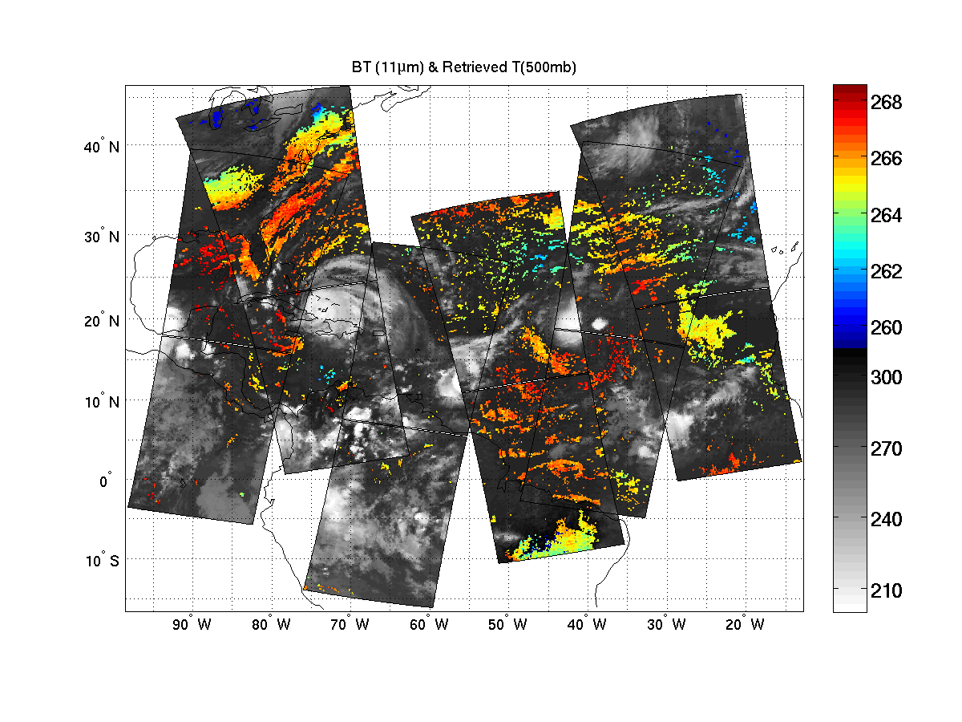
Retrieved 500mb temperature
(2008.09.07 - Used in assimilation)
(K)
(K)
CIMSS/UW
Clear sky AIRS SFOV temperature retrievals at 500 hPa on 07 September 2008, each pixel provides vertical temperature and moisture soundings.

Slide 15
Statistics for Ike (2008) case
Comparisons with ECMWF analysis

Slide 16
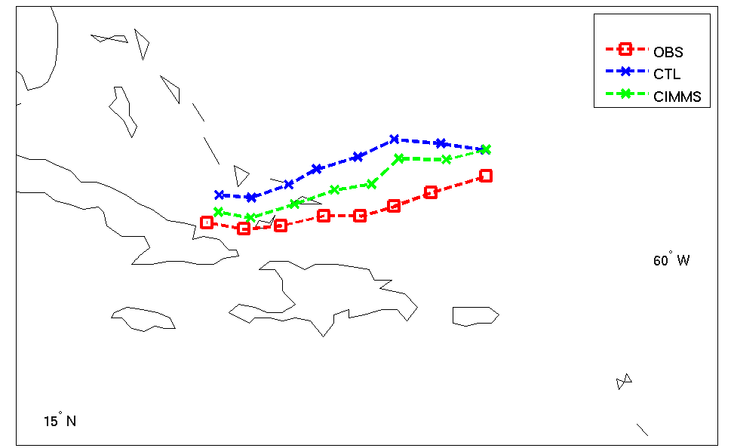
Tracks of ensemble mean analysis on Hurricane IKE
CTL run: Assimilate radiosonde, satellite cloud winds, aircraft data, and surface data.
AIRS
Li and Liu 2009 (GRL)
Analysis from 06 UTC 6 to 00UTC 8 September 2008

Slide 17
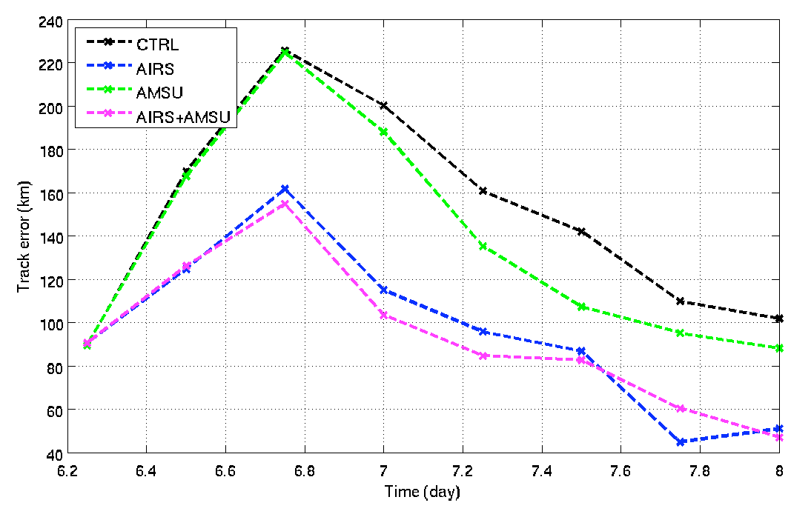
Track errors of on Hurricane IKE
Li and Liu 2009 (GRL)
Analysis from 06 UTC 6 to 00UTC 8 September 2008

Slide 18
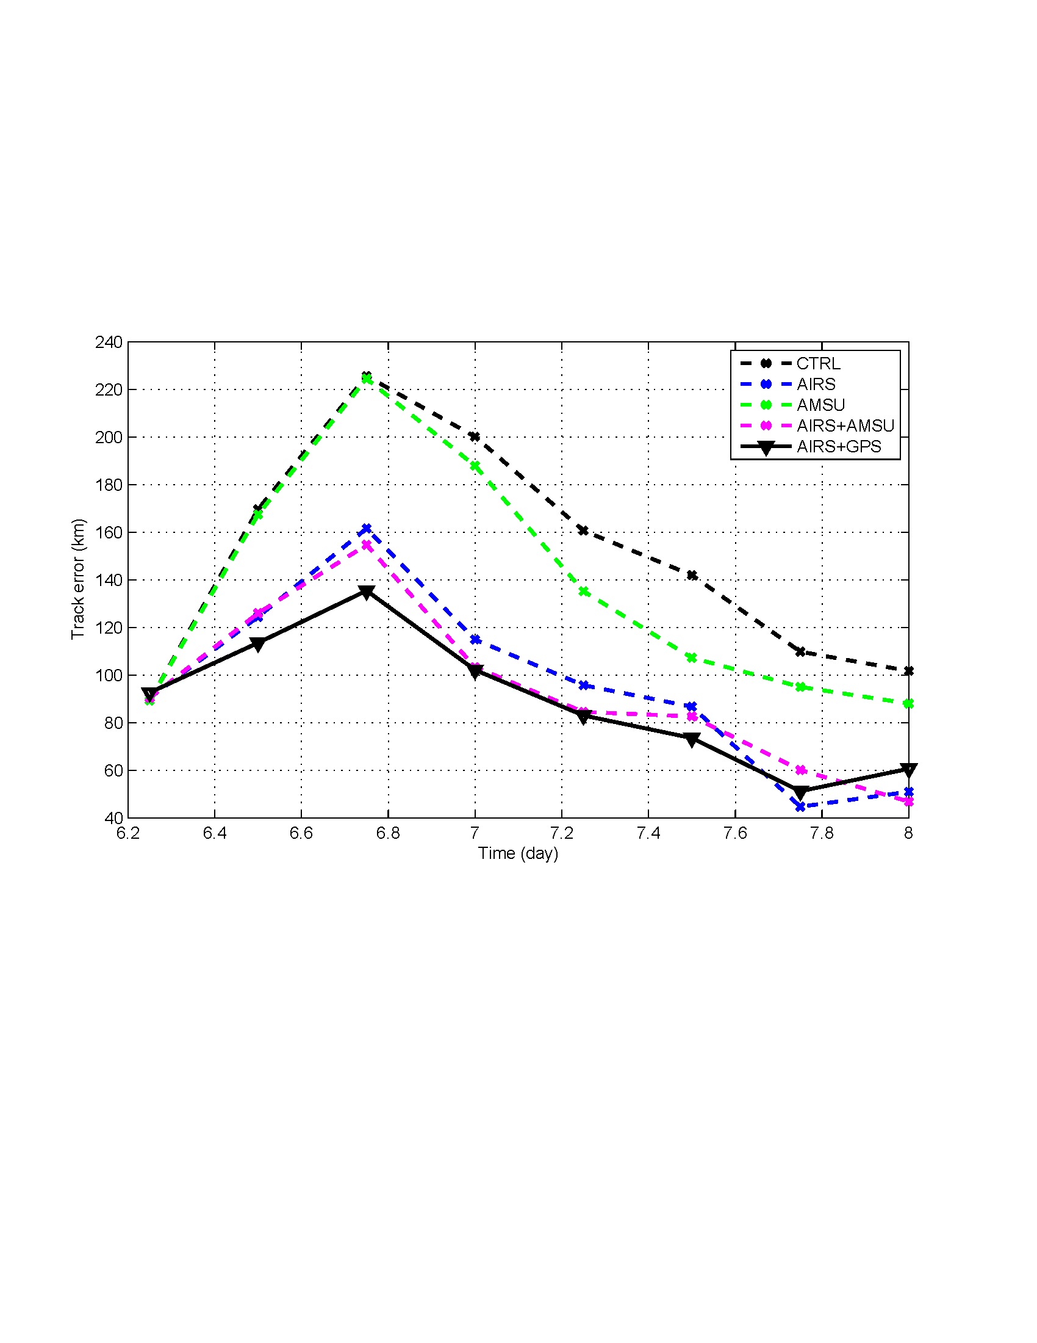

Slide 19
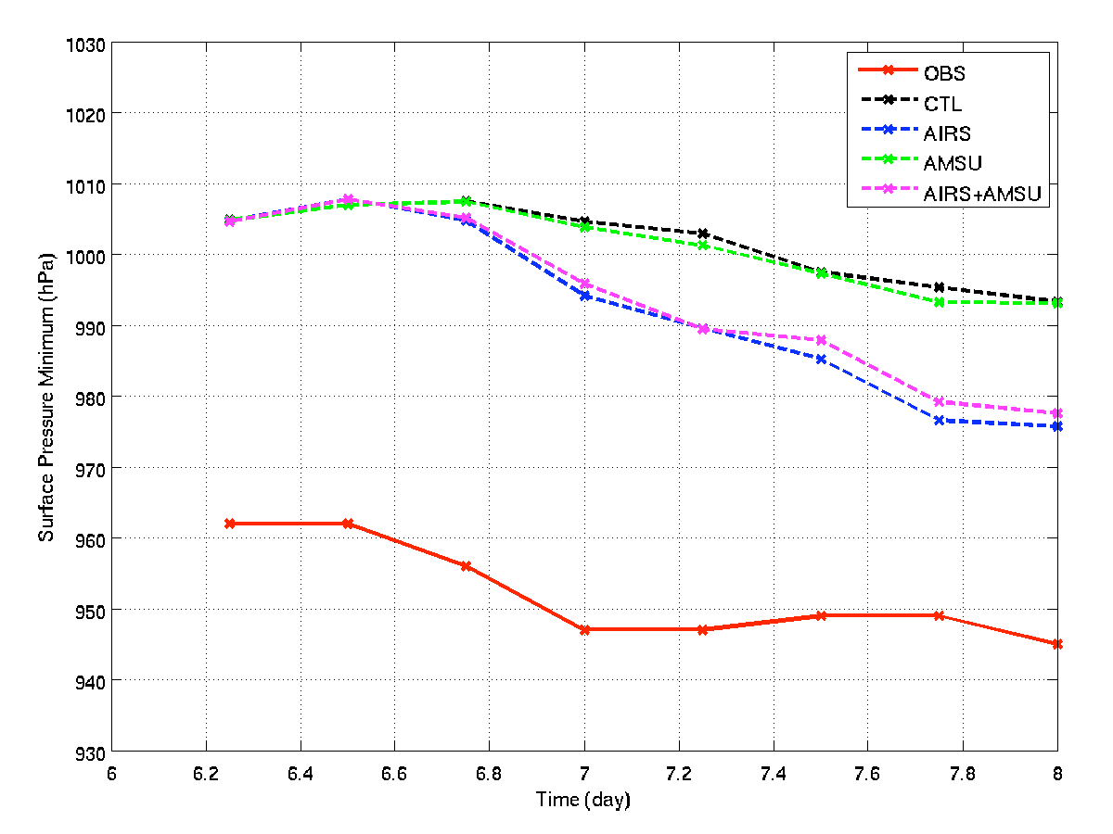
SLP Intensity on Hurricane IKE
Li and Liu 2009 (GRL)
Analysis from 06 UTC 6 to 00UTC 8 September 2008

Slide 20
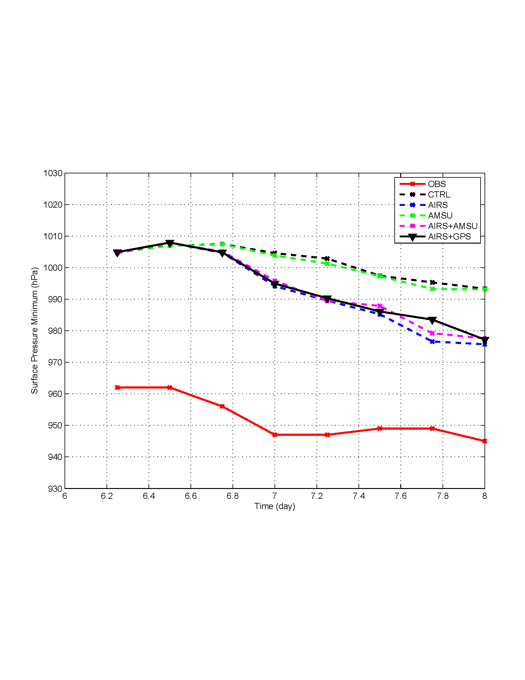

Slide 21
Forecast Experiments on Ike (2008)
4-day ensemble forecasts (16 members) from the analyses on 00UTC 8 September 2008.
Track trajectory and hurricane surface central pressure are compared (every 6-hourly in the plots).

Slide 22
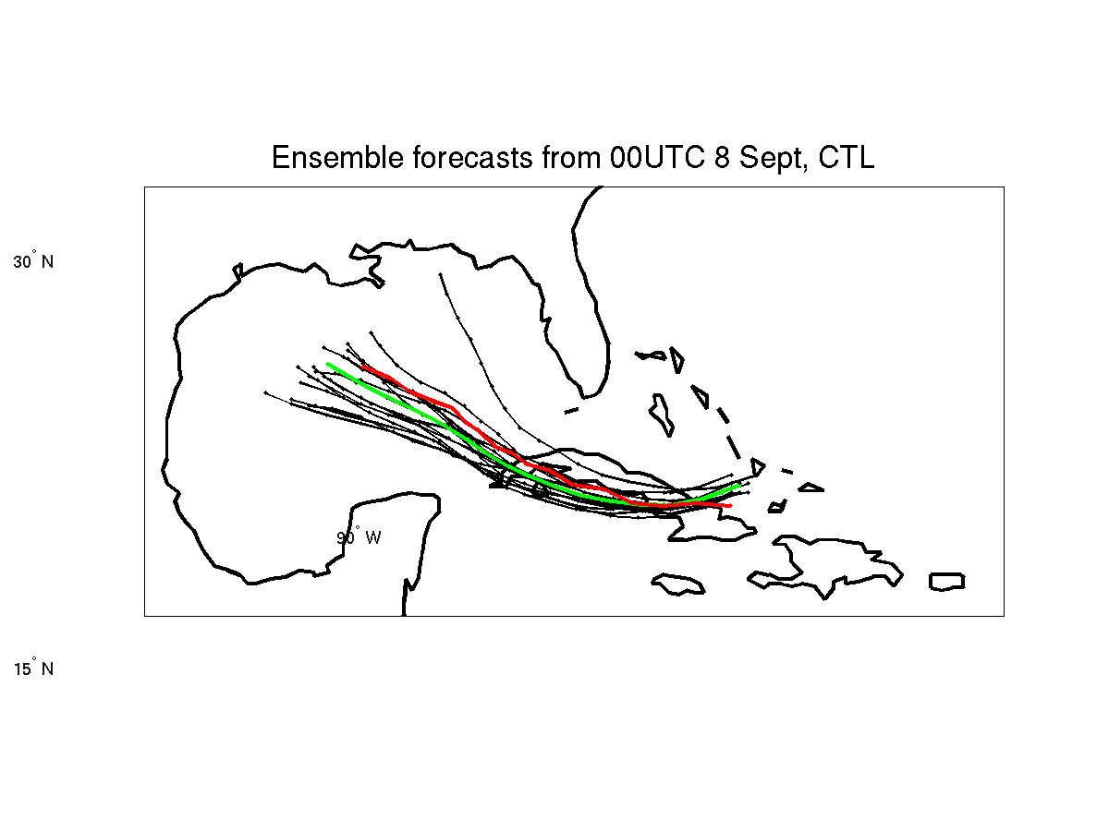
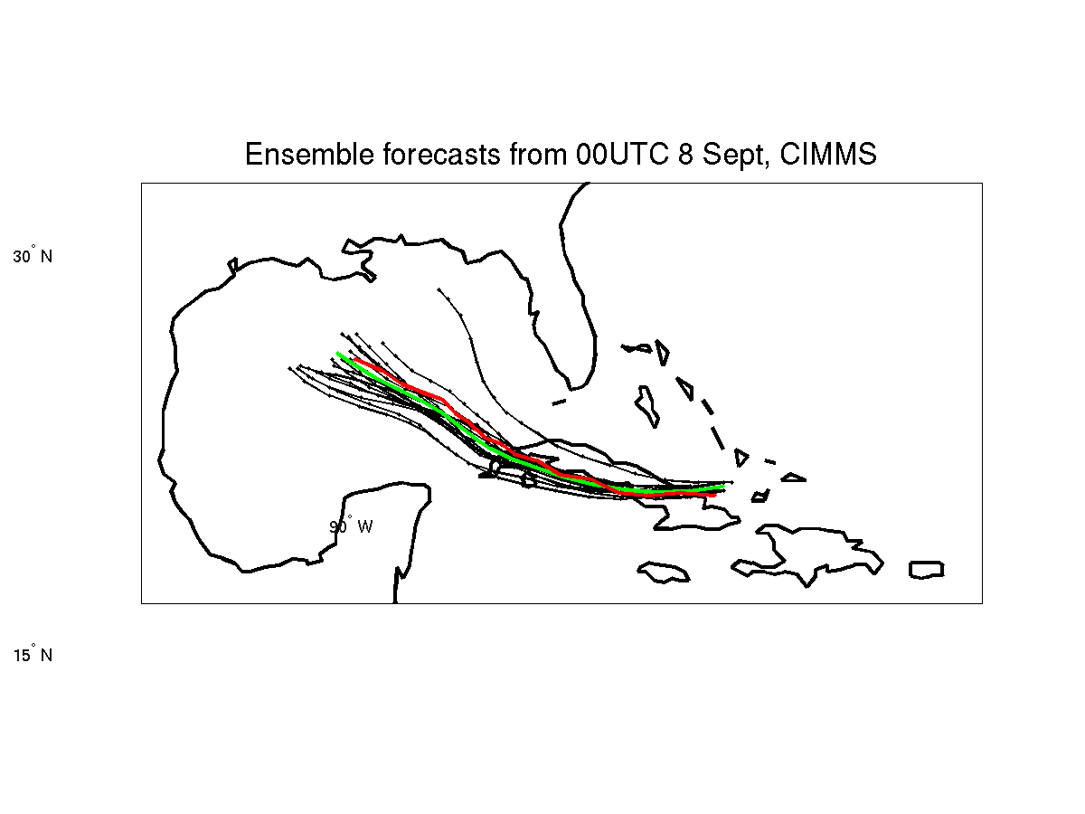
Tracks of 96h forecasts on Hurricane IKE
AIRS
CTRL run: Assimilate radiosonde, satellite cloud winds, aircraft data, and surface data.
No AIRS
With AIRS
Red is observation, green is forecast
Forecasts start at 00 UTC 8 September 2008

Slide 23
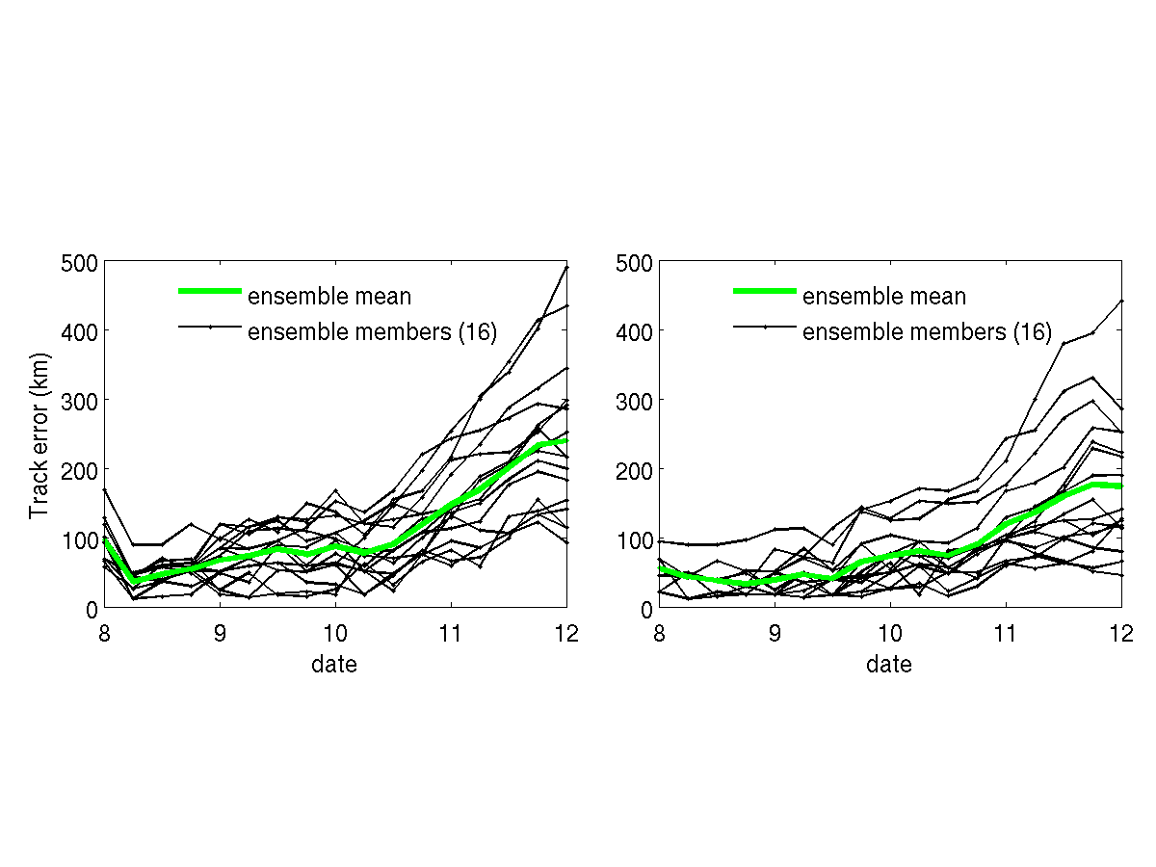
Track errors of 96 h forecasts
Without AIRS
With AIRS
Li and Liu 2009 (GRL)
Forecasts start at 00 UTC 8 September 2008

Slide 24
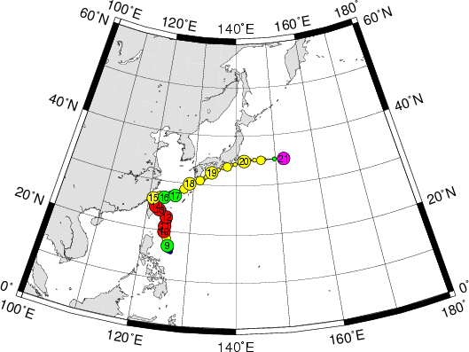
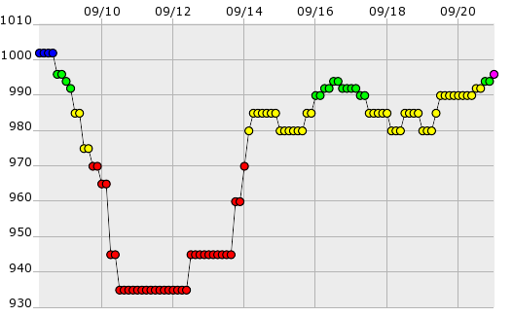
Typhoon Sinlaku (2008) Fact
Sinlaku Path
Sinlaku rapid intensification observed

Slide 25
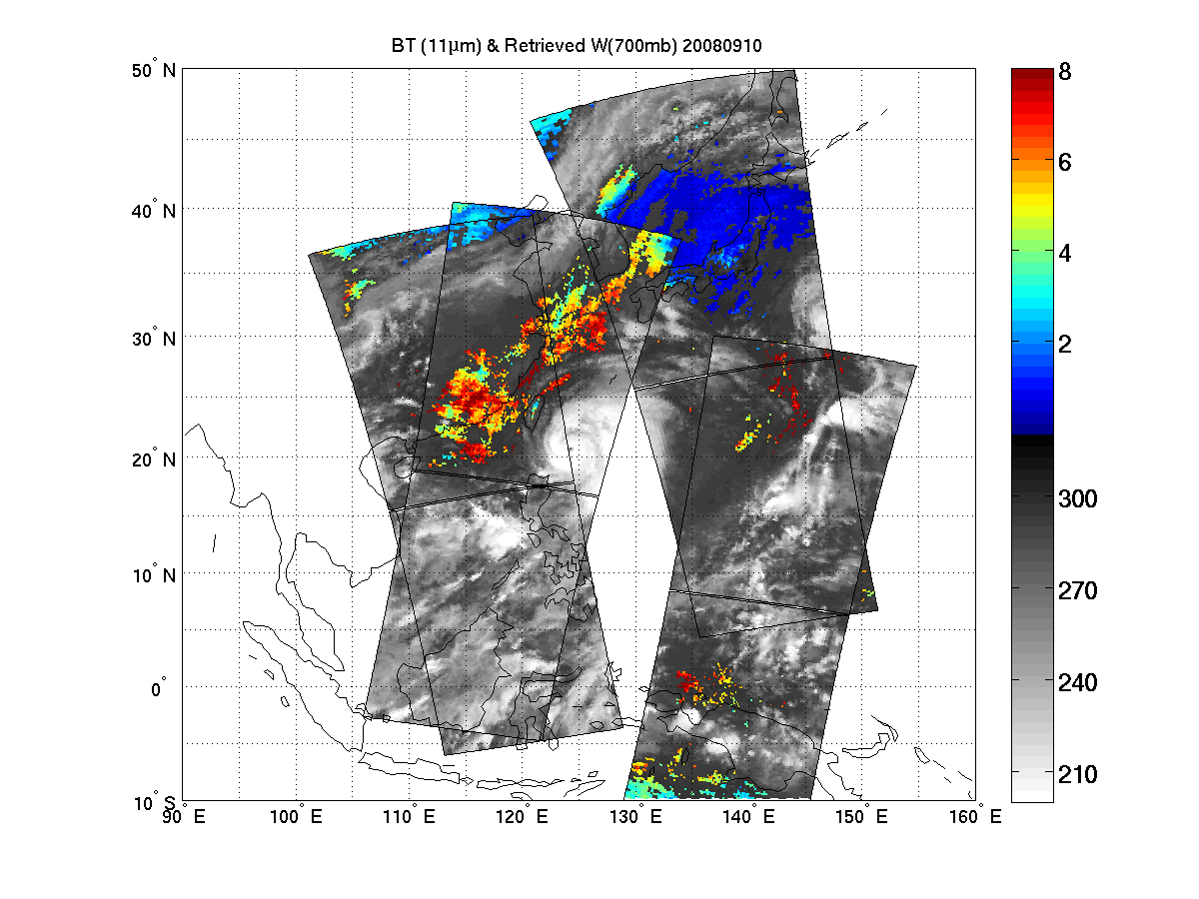
(g/kg)
(K)
700 hPa water vapor mixing ratio (g/kg) (Sinlaku – 10 September 2008)
GEO advanced IR sounder can provide more clear sky soundings in south environment through frequent observations !

Slide 26
Forecast Experiments on Sinlaku
2-day ensemble forecasts (16 members) from the analyses on 12UTC 9 September 2008.
Track trajectory and hurricane surface central pressure are compared (every 6-hourly in the plots).

Slide 27
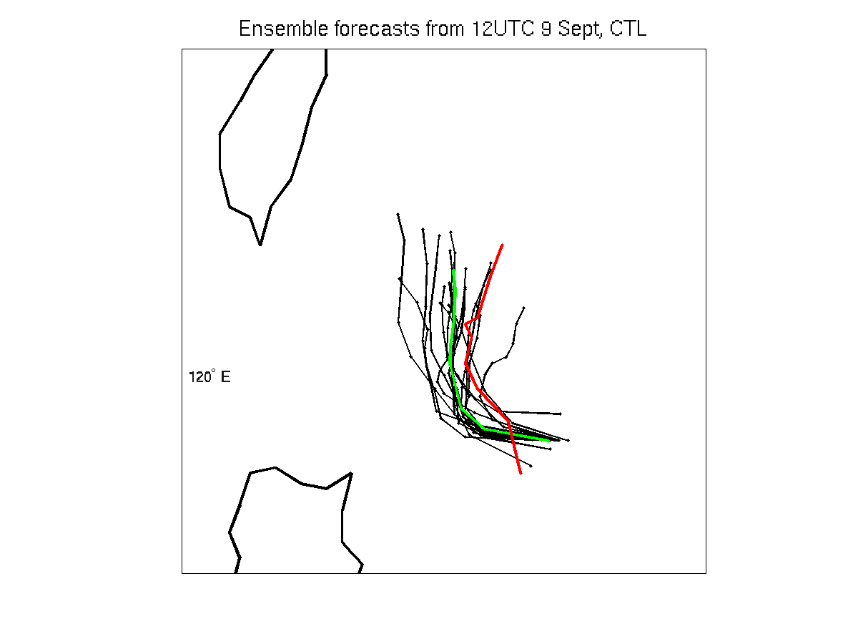
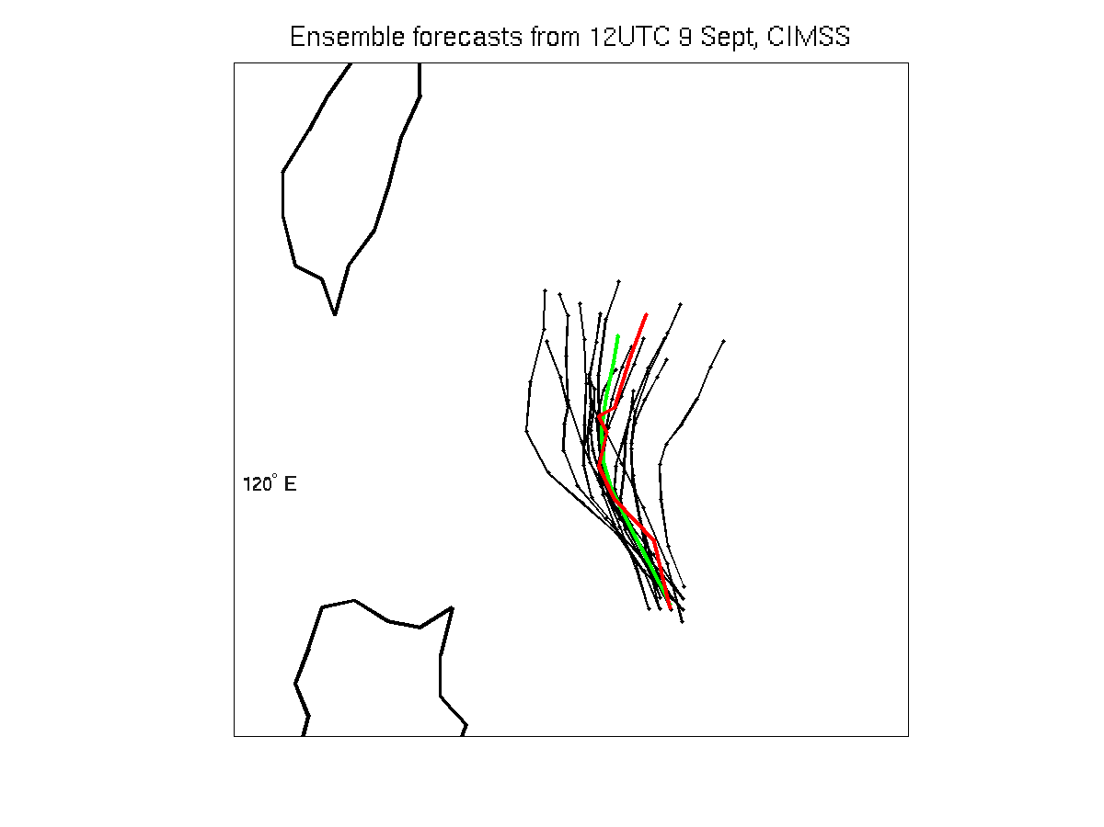
Tracks of 48h forecasts on Sinlaku
CTRL run: Assimilate radiosonde, satellite cloud winds, aircraft data, and surface data.
CTRL
CIMSS
Without AIRS
With AIRS
Red: observations
Green: forecast
Liu and Li 2010 (JAMC)
Hui Liu (NCAR) and Jun Li (CIMSS)
Forecasts start at 12 UTC 9 September 2008

Slide 28
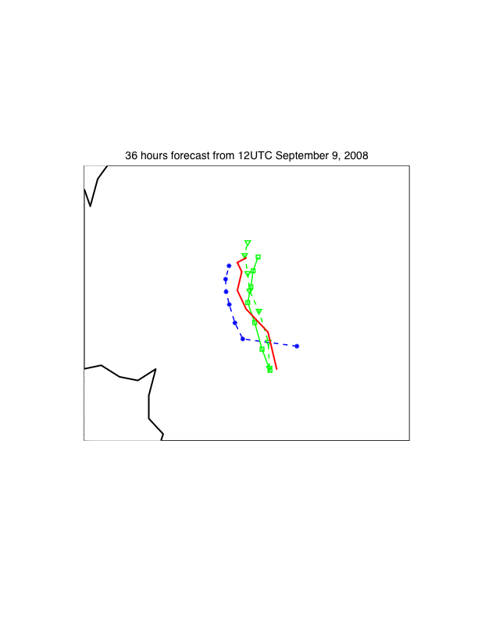
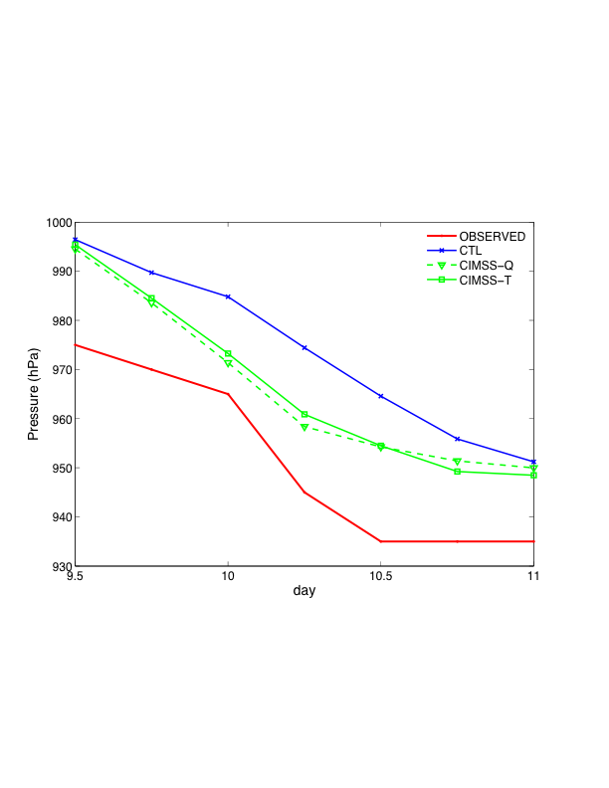
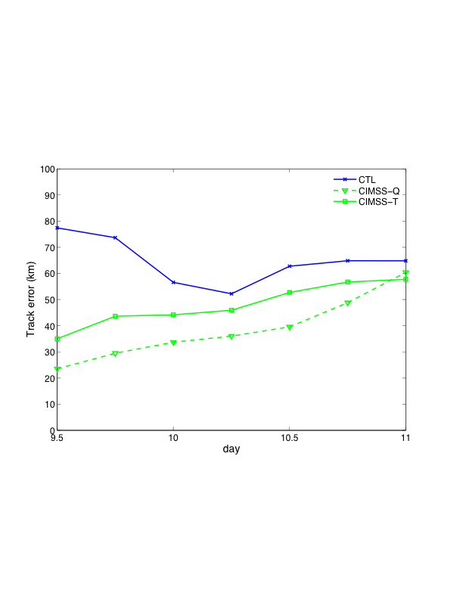
Impact of AIRS on Typhoon Sinlaku (2008) track forecast with full spatial resolution temperature soundings and moisture soundings, respectively.
Typhoon Sinlaku (2008) track forecast error with AIRS full spatial resolution temperature soundings and moisture soundings, respectively.

Slide 29
References
Li, J., H. Liu, 2009: Improved hurricane track and intensity forecast using single field-of-view advanced IR sounding measurements, Geophysical Research Letters, 36, L11813, doi:10.1029/2009GL038285.
Liu, H., and J. Li, 2010: An improvement in forecast of rapid intensification of typhoon Sinlaku (2008) using clear sky full spatial resolution advanced IR soundings, Journal of Applied Meteorology and Climate (in press)

Slide 30
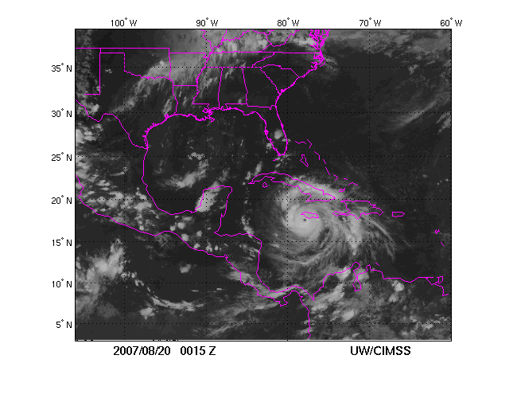
AIRS measurements overlay on GOES IR image (Hurricane Dean)
LEO data have limitation on monitoring weather due to orbital gap and low temporal resolution.
High temporal resolution is unique aspect of GEO measurements
GEO can provide data anytime for weather event, not LEO !

Slide 31

