Slide 1
2017 Apr 06 Severe Weather - why did severe weather occur where it did?
By: geselle coleman and mike dutter
Date: 2017 june 9

Slide 2
Severe weather report between 15Z and 18Z on April 6th, 2017 and SPC Severe Weather forecast
Much of the severe weather occurred in Northern VA rather than in the eastern part where they suspected most of the weather would occur.
Question: Why was the weather more concentrated in northern Va than the east?

Slide 3
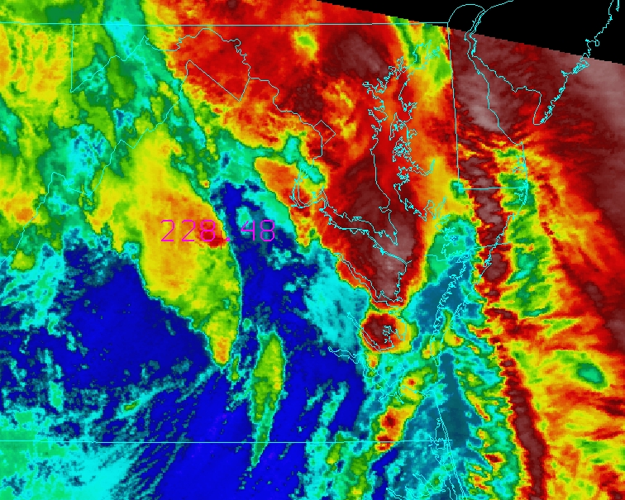
1000m Cappi image from AKQ (left) 11 micron modis data both valid 1615 UTC
Why did this cloud rapidly cool and get stronger over the next 2 to 3 hours?
This is the area where the severe weather occurred for the next 2/3 hours.

Slide 4
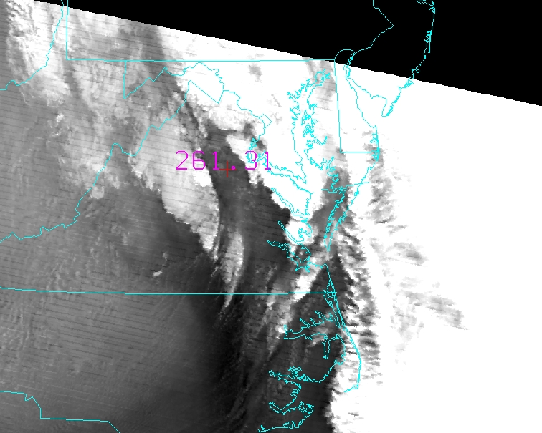
1615 utc MODIS
Warm/Moist air ahead of the frontal zone
Dry slot in the mid levels allowing for
Reduced stability aloft
B27 : 6.7 µm (mid-level water vapor)
B28: 7.3 µm (low-level water vapor)

Slide 5
1 Hour Rap forecast sounding for iad Valid 16UTC 4/6/20127
Note the destabilization associated within the dry and cool air within the lower levels and the warm moist airs within the upper levels.

Slide 6
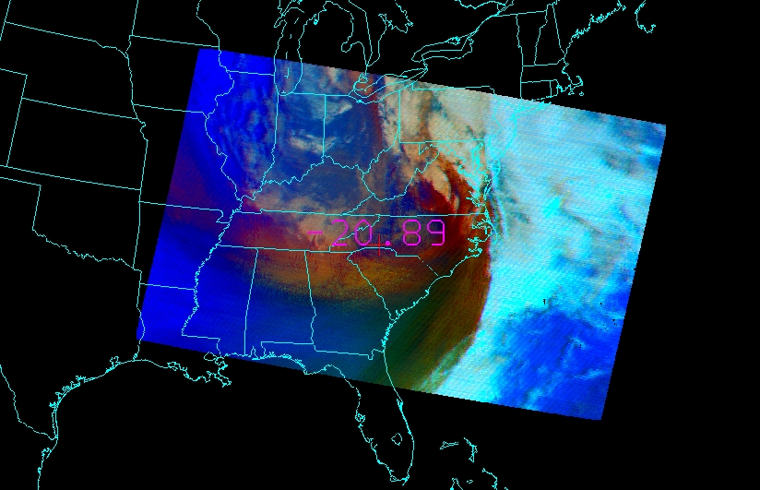
AIRMASS RGB Product – 1615UTC 4/6/2016
Cool air aloft also
Helping destabilize
Warm/hot ar near the surface
Dry airmass
air causing destabiliaztion

Slide 7
Conclusions
Severe convection across northern va was underforecast due to the lack of understanding of reduced stability ahead of the surface front/upper short wave
Modis data from 1615 utc showed an area of increased instability due to the juxtaposition of the upper level drying/cooling, and the increased moisture in the lower levels from the strong s-se flow.

