Slide 1
Severe Weather/DC Metro
Haiden Mersiovsky (FSU/NASA LaRC)
William B. Moore (HU)
6/9/2017
Hampton University DBS Workshop

Slide 2
Correlating Visible Structure with Severe Weather
Actively convecting systems display distinct visible textures and features (i.e. overshooting tops, gravity waves, cirrus plumes)
These features have been correlated with severe weather impacts to aviation and on the ground
We investigated Terra-MODIS visible and IR data as well as RAOS profiles for 4/6/17 in the NoVA/DC area.
We found strong correlation between highly textured visible cloud tops w/severe weather impacts on the ground (incl. EF0 tornadoes)

Slide 3
Severe Weather 4/6/17

Slide 4
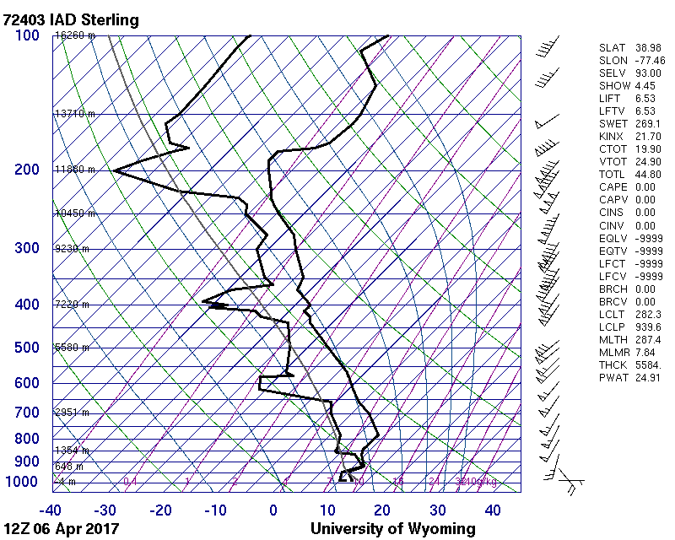

Slide 7
IR Band 26 (1.38micron)

Slide 8
Cloud Top Pressure (hPa)

Slide 9
Visible and IR Band 26 with Storm Reports

Slide 10
Visible and Cloud Top Pressure with Storm Reports

Slide 11
Conclusions
There are visual texture image properties associated with strongly convective storms
Provides an automatic detection of these storms using a combination of Visible and IR
Future work to determine an algorithm for detection

